Slide 1
CPD Autumn 2019-20
Non-examination Assessment
Language and Identity

Slide 2
Overview
At a basic level, the investigation should include:
a brief introduction to the area of study under scrutiny
a brief introduction to the hypothesis to be tested
a brief explanation of the methodology
the main body of the investigation as an analysis into the sense of identity, including:
o selection and use of knowledge to argue a case
o interrogation of data to support the argument
a conclusion about the ways in which language is used to create and communicate a sense of identity.

Slide 3
Developing a Title:
Use of 'investigate and analyse' and 'using relevant data‘?
Link between language and identity, and the chosen language area?
Include a strong hypothesis to help candidates develop a line of argument?
The focus of the investigation may alter slightly as the learner explores the issues/concepts and data in greater depth.

Slide 4
Activity 1: Read the three extracts taken from NEA investigations: Candidate A, Candidate B and Candidate C.
With your partner rank order the candidates from best to worst as to which offers the best understanding of contextual factors linked to language choices and the construction of meaning?
Explain the features that make each one better or worse than the others.
Notes:
A, C and B

Slide 5
Candidate A: Activity 1
The use of the interrogative ‘WHY ARE YOU STILL TALKING?’ in the first transcript in an example of the bald on record as the participant is being direct and doing nothing to avoid face. The speaker is also flouting Leech’s agreement maxim as they are not maximising agreement between self and other, due to the combative premise. Therefore, the prosody of women can be very aggressive. However, the women don’t always use Fact Threatening Acts towards each other as you can in the first transcript even though there are three women involved in the conversation there is only two of them arguing and the other is trying to save face by using the declarative ‘let’s stay calm’. Women also try to save face with the use of the adjective ‘sorry.’ In the case of apologizing, it may be impossible for others to know how sincere the speaker is, especially within this competitive context. Therefore, there is no assurance that the apologetic attitude will last. ‘I would like to bring back Sarah Sorry’ is also an example of negative politeness as the speaker has recognised that she is imposing on Sarah so uses the polite interjection ‘sorry’ to minimise the imposition. This can also be applied to men’s use of the language as in the fourth transcript Tom says, ‘Jasmine please, can you just.’ This is because Jasmin is trying to dominate the situation and exert power which may be because she is in a minority and therefore feels her position on the show is vulnerable. The use of hedging used by the women is also way of avoiding conflict with their negative face. In these transcripts. There are no examples of the contestants using positive politeness due to the purpose of the show being entertaining and if everyone on the show got along with each other the show would be highly unentertaining. It is a show that involves the contestants being independent and therefore they concentrate on praising themselves, rather than other. The use of the declarative sentence ‘I was left to pick up the pieces’ supports this.
Notes:
A, C and B

Slide 6
Candidate B: Activity 1
For the conversation with my dad, I can immediately tell a difference in my own use of punctuation. I use less punctuation in this conversation, but this may also be since I did not need to necessarily use too much. For instance, I asked my dad if I could borrow money off him, “cheers, and can I tax like 20 quid cos it’s a meal” which includes the comma after the initial cheers. Also, I should have used a question mark at the end of the message, as it is more of a statement in this form than a question. Another example is the use of apostrophes, as I did not use apostrophes in my chat with Kian, whereas I have done in my conversation with my dad. For example, I say “I’m getting the bus home with Sam and Conor”, which is more formal than saying it without the apostrophe and the capitalisation of my friend’s names. In this conversation, I feel my sentence structures are partly better and are also more fluid, as I was rarely using one-word sentences, and I was construction longer messages also.
Notes:
A, C and B

Slide 7
Candidate C: Activity 1
Throughout the transcript of Tangled the semantic field of plants was evident. Mother Gothel, the antagonist of the story, often uses common concrete nouns such as ‘flower’, ‘petal’ and ‘sapling’ when addressing her daughter. The fact that Gothel has been so delicate in her phrasing shows the audience that she should hold a low opinion of Rapunzel, and this is highlighted through the lack of using her given name. It suggests the stereotypical characteristic of vulnerability that most female characters can be seen to possess. The connotations of the floral names she uses imply that Rapunzel is weak and frail, and perhaps her only purpose is to look pretty, reinforced by John Berger’s claim that “Men look, women appear” (1972, Ways Of Seeing). Flowers are often valued for their aesthetics, and not much else, so this could represent how Gothel views Rapunzel. This seems like a common theme for Gothel, as she also uses the noun ‘darling’ frequently in a patronising tone. This indicates that Gothel has a lot of power over her daughter, and is very dominant in these terms. It is apparent from simply a few names used that Gothel is the superior character, which sets the tone for the film. This is interesting, as Gothel is also a female character; so immediately it could be assumed that both characters would be treated in such a way. Gothel, however, holds the conventional factors of her character archetype, and, as the antagonist of this story, she uses her language in such a way that she becomes the more dominant female. Despite the fact that she is turning eighteen years old in the film, her mother still does not accept that Rapunzel wants to become more independent, and stray from the elegant characteristics she seemingly possesses.
Notes:
A, C and B

Slide 8
Activity 2: Read the three extracts taken from NEA investigations: Candidate A, Candidate B and Candidate C.
Rank order the candidates from best to worst as to which offers the most focused overview of an element of their investigation.
Explain the features that make each one better or worse than the others.
Notes:
C, B and A.

Slide 9
Candidate A: Activity 2
To briefly summarise my findings from my investigation, I will start by saying that my initial question/hypothesis has been supported by my data, as I personally feel that there were clear differences in my own lexis and grammar between both conversations. As expected, there were multiple contractions and abbreviated words being used, in both conversations. Shortening words is what we may call the norm relative to more recent time, as people use these shortened terms to cut time and inevitably shorten sentences. Looking back now at my idiolect within both conversations, I understand that I change the way I speak to suit my addressee and the situation, as texting is much different to physical conversation. As I have addressed, my language and grammar is very casual and basic when talking to Kian and includes more abbreviated terms.
Notes:
C, B and A.

Slide 10
Candidate B: Activity 2
It is important to consider how Rapunzel talks to herself, the first being “When will my life begin?” This rhetorical question, which is also the title of her song, is very poignant to an audience. It suggests that Rapunzel feels as though she hasn’t had a life, and won’t until she leaves her tower, which creates sadness for the audience. It further implies Gothel’s dominance, which links the Rapunzel’s other declarative statement; “Mother might just let me go.” The emotive language used here isn’t as shocking as some of Gothel’s statements, but it is prolonging the pain that Rapunzel feels and is expressing to the audience. She clearly isn’t asking for much, and the imperative ‘let me’ has connotations of pleading and desperation. It is clear that Gothel is still in control. Finally, Rapunzel is referred to as “Their lost princess.” The possessive determiner ‘their’ is heavily indicating that Rapunzel is not her own being; she belongs to other people. This may form a basis for the argument that Rapunzel lacks her own identity; this was also touched upon when analysing the semantic fields of informal nouns used towards her. The pre-modifying adjective ‘lost’ also links back to the implications that Rapunzel is too weak to make her own decisions and defend herself.
Notes:
C, B and A.

Slide 11
Candidate C: Activity 2
The aim of my investigation was to test whether the linguistic theories of Lakoff, Tannen and Brown & Levinson are accurate with reference to gender conversations and single gendered female conversations taking place in the Apprentice. After viewing a limited number of clips, most of the characteristics of the women on The Apprentice are not those predicted by the theories. The differences between the language of men and women are not as easy to identify as the Theorists are proposing the language adopted by the women features a more ‘manlier’ trait than proposed by the women and they are not afraid to threaten face. This may be because these women are highly self-motivated and confident and do not see themselves as being inferior to men. Do this year’s contestants have linguistic traits due to watching competitors on previous series? Also, with the circumstances, and the genre being a game show it is a highly competitive, the women are willing to do whatever they need to adjust their language in order to win the competition. It may also be the case that linguistic norms within society have changed over the decades since the theories were produced. However, if I looked at an average conversation between a man and woman on the street based on my personal experience, I think that findings may be very different. As a final thought it may be worth considering whether Television shows like the Apprentice are creating linguistic changes in society? Do some viewers think these are the linguistic traits you should have in everyday life and are therefore seen as the ‘norm’?
Notes:
C, B and A.

Slide 12
Characteristics of successful responses:
a clear focus on language and identity
a range of sustained apt terminology
a well organised study with topic sentences used throughout
well-embedded linguistic theory used to inform the investigation
an understanding of how contextual factors are associated with the construction of meaning
a familiarity with the assessment objectives and their descriptors.
How can you prepare students to demonstrate these skills/knowledge in their NEA investigations?

Slide 13
Areas for improvement:
a knowledge of genre
a clearly defined hypothesis closely linked to language and identity
the selection of concepts and issues relevant to the investigation
analysis of data rather than description
the use of data that provides enough breadth and depth for an A level investigation.
How can you support students in addressing some/all of these areas of weakness?

Slide 14
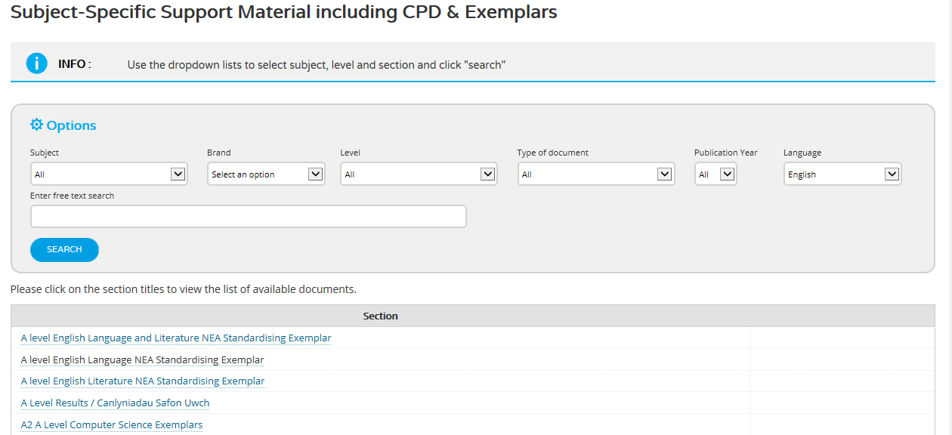
Standardising material
A series of short training videos are available on the WJEC secure website for teachers, which cover a range of different levels of response to the NEA investigation for A level English Language.

