Slide 1
Unit 3: Shakespeare
Overview
Written examination (closed book): 2 hours (120 marks)
20% of qualification
Section A: One extract-based question based on the reading of one Shakespeare play from the prescribed list for this unit
Section B: One essay question based on the reading of one Shakespeare play from the prescribed list for this unit

Slide 2
For this unit, candidates will need to demonstrate that they can:
use integrated linguistic and literary approaches
analyse how meanings are shaped in their set text
show knowledge and understanding of relevant language levels
use accurately a range of linguistic and literary terminology
demonstrate an understanding of the significance and influence of the
contexts in which texts are produced and received
organise responses in a clear and effective academic style and register with
coherent written expression.

Slide 3
Candidates are required to study one Shakespeare play selected from the list below:
Antony and Cleopatra
King Lear
Much Ado About Nothing
Othello
The Tempest
N.B. For the purpose of the examination, the Collins Alexander Complete Works of William Shakespeare will be used for extract-based questions.

Slide 4
Candidates are required to complete two questions – one from Section A and one from Section B.
Mark Allocation
Section A - one compulsory extract-based task (40 marks)
Section B - one extended essay from a choice of two (80 marks).
Time management in the exam
Section A – it is advisable to spend 45 minutes on the extract-based question
Section B - it is advisable spend 1 hour 15 minutes

Slide 5
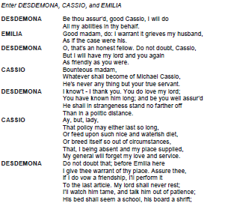
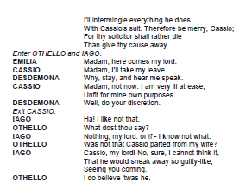
The Extract Question

Slide 6
Assessment Objectives
AO1 (25 marks)
Apply concepts and methods from integrated linguistic and literary study as appropriate, using associated terminology and coherent written expression
AO2 (15 marks)
Analyse ways in which meanings are shaped in texts

Slide 7
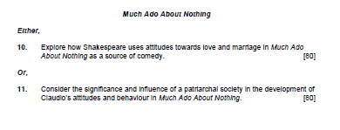
The Essay Question
The essay will require candidates to demonstrate knowledge of the wider play and to select appropriate supporting evidence in their response.
There will be a choice of question on the studied text e.g.

Slide 8
Assessment Objectives
AO1 (35 marks)
Apply concepts and methods from integrated linguistic and literary study as appropriate, using associated terminology and coherent written expression
AO2 (15 marks)
Analyse ways in which meanings are shaped in texts
AO3 (30 marks)
Demonstrate the significance and influence of the contexts in which texts are produced and received

