Slide 1
WJEC GCE English Language and Literature
Unit 3

Slide 2
Overview
Written examination (closed book): 2 hours (120 marks)
20% of qualification
Section A: One extract-based question based on the reading of one Shakespeare play from the prescribed list for this unit
Section B: One essay question based on the reading of one Shakespeare play from the prescribed list for this unit

Slide 3
For this unit, candidates need to
use integrated linguistic and literary approaches
analyse how meanings are shaped in their set text
show knowledge and understanding of relevant language levels
use accurately a range of linguistic and literary terminology
demonstrate an understanding of the significance and influence of the
use contexts in which texts are produced and received
organise responses in a clear and effective academic style and register with
use coherent written expression.

Slide 4
Candidates are required to study one Shakespeare play selected from the list below:
Antony and Cleopatra
King Lear
Much Ado About Nothing
Othello
The Tempest
N.B. For the purpose of the examination, the Collins Alexander Complete Works of William Shakespeare will be used for extract-based questions.

Slide 5
Candidates are required to complete two questions – one from Section A and one from Section B.
Mark Allocation
Section A - one compulsory extract-based task (40 marks)
Section B - one extended essay from a choice of two (80 marks).
Time management in the exam
Section A – it is advisable to spend 45 minutes on the extract-based question
Section B - it is advisable spend 1 hour 15 minutes on the essay

Slide 6
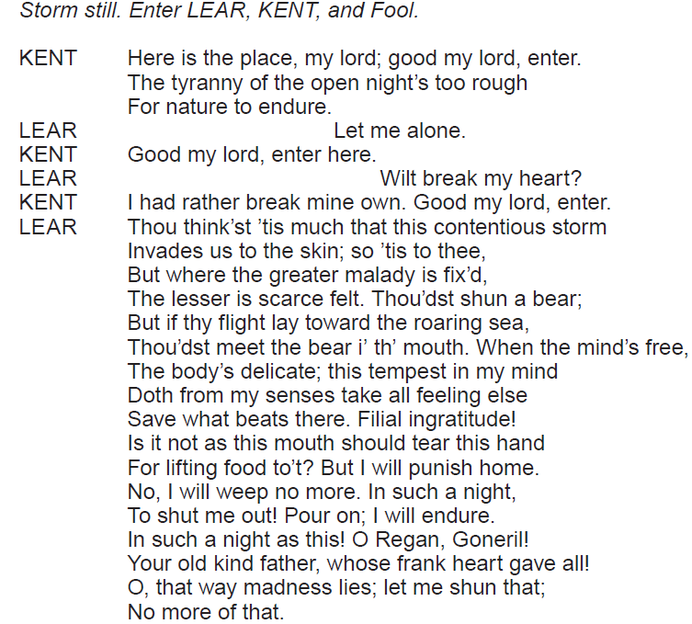
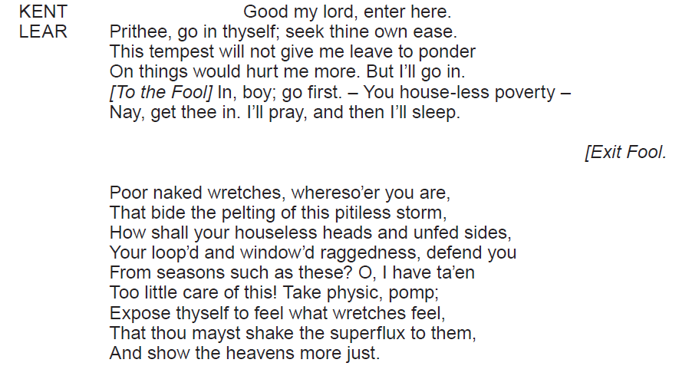
The Extract Question
King Lear
By focusing closely on the literary and linguistic techniques used, explore how Shakespeare presents Lear’s state of mind in this extract from Act 3, Scene 4.
[40]

Slide 7
Assessment Objectives
AO1 (25 marks)
Apply concepts and methods from integrated linguistic and literary study as appropriate, using associated terminology and coherent written expression
AO2 (15 marks)
Analyse ways in which meanings are shaped in texts

Slide 8
The Essay Question
The essay will require candidates to demonstrate knowledge of the wider play and to select appropriate supporting evidence in their response.
There will be a choice of question on the studied text e.g.

Slide 9
Assessment Objectives
AO1 (35 marks)
Apply concepts and methods from integrated linguistic and literary study as appropriate, using associated terminology and coherent written expression
AO2 (15 marks)
Analyse ways in which meanings are shaped in texts
AO3 (30 marks)
Demonstrate the significance and influence of the contexts in which texts are produced and received

Slide 10
Unit 3 Examiner’s Report – Key Messages
What went well…
As a closed text examination, this paper is challenging for candidates and it was encouraging to note that many centres had thoroughly prepared candidates for this examination
Many candidates engaged with the set texts and examiners read many insightful and perceptive responses to the set questions
The best responses evaluated literary and linguistic features (AO1), confidently linking language and meaning (AO2)
For Section B candidates also had to provide relevant contextual detail (AO3) and link it meaningfully to the set text they had studied - the best responses saw this context being applied to the Shakespeare text

Slide 11
Unit 3 Examiner’s Report – Key Messages
The extract question…
Spend 45 minutes responding to Section A
Candidates need to read, think and write at speed
Candidates are free to select detail from within the extract to focus on but they are expected to provide coverage of the whole extract. (e.g. some candidates only referred to the first half of the extract and completely ignored the ending)
Sustained analysis of the extract, covering a range of points and exploring language/meaning in detail, is needed
Brief responses are self-penalising (e.g. responses that were a side to a side and half rarely scored well)

Slide 12
Unit 3 Examiner’s Report – Key Messages
The extract question…
Include a brief introductory sentence placing the extract in the context of the play – 1-2 sentences are sufficient here
Candidates need to focus on discussing the specified extract rather than other parts of the play
Candidates are expected to respond to the extract with knowledge and insight - the extract should not be treated as an unseen text

Slide 13
Unit 3 Examiner’s Report – Key Messages
The extract question…
Candidates need to be specific in identifying terminology - too many candidates quoted whole sentences or phrases, generally labelling them with the ‘verb’/’modal verb’/’noun’ etc., without identifying which word they were attempting to analyse
Candidates should refer to at least one term per cited example – this term should be specifically supported by the example
Terms need to be purposefully applied – this is not a feature spotting exercise

Slide 14
Unit 3 Examiner’s Report – Key Messages
The extract question…
Context (AO3) is not explicitly assessed in Section A – avoid irrelevant contextual detail
It is possible to credit contextual information if a candidate has used relevant detail to inform their reading (AO2) of the extract
However, a number of candidates included irrelevant contextual detail at the expense of close focused literary and linguistic analysis (AO1) when discussing meaning (AO2)
Candidates need to be reminded of the importance of reading the set question and shaping their response to address the requirements of the question asked

Slide 15
Unit 3 Examiner’s Report – Key Messages
The essay question…
Spend 1 hour and 15 minutes responding to Section B
Candidates need to produce one essay from a choice of two on the same text that they use for Section A
Candidates are expected to show wider knowledge of the text as a whole
Candidates may refer to a selection of key episodes in detail as long as they place them within the context of the whole text and they are relevant to the actual response
The selection of examples to support their argument also addresses AO1, as this Assessment Objective considers their line of argument and the organisation of their response
It is not advisable for candidates to refer only to the first act of the play (e.g. Cordelia)

Slide 16
Unit 3 Examiner’s Report – Key Messages
The essay question…
Encourage candidates to plan their response carefully
Responses need to be shaped and coherent arguments clearly constructed
Essays need to be sustained – work that is too brief is self-penalising
Essays that are overly long (some were in excess of 12 sides) can also be self-penalising as the focus sometimes drifts
Answer the set question – some students had pre-prepared responses they were determined to write down regardless of the question (e.g. an essay on women in King Lear rather than focusing specifically on Cordelia or women in Othello loosely linked to the set question on male power)

Slide 17
Unit 3 Examiner’s Report – Key Messages
The essay question…
Given the fact that this is a closed text examination, in order to fully access AO1 candidates need to have prepared thoroughly and learned a sufficient number of relevant quotations
They need to apply a range of literary and linguistic terms to access the marks available
As with Section A, candidates need to be far more specific in identifying language (e.g. The use of the conjunction ‘By land and sea’….’)
Candidates need to be reminded of the importance of quoting accurately from the play – there were several instances of made up quotations
Avoid description/narration – candidates should be encouraged to adopt the SEA approach

Slide 18
Unit 3 Examiner’s Report – Key Messages
The essay question…
Context (AO3) is clearly important in Section B - relevant context should be used to illuminate the candidate’s argument
Avoid generalised context which has little relevance to the set task (e.g. context being addressed through irrelevant biographical information relating to the author)
Avoid the ‘history’ essay – some candidates provided limited discussion of the actual play itself
Responses should always lead with the play itself and embed relevant contextual detail
Candidates need to put the text at the centre of their response and apply relevant context (rather than vice-versa)

Slide 19
Unit 3 Examiner’s Report – Key Messages
The essay question…
The best responses applied context to their reading of the text and provided thoughtful interpretations of the play
Candidates who wrote mini-biographies, random historical detail or who included context as a ‘bolt-on’ at the end of a paragraph performed less successfully than those who meaningfully embedded contextual detail into their responses

Slide 20
Unit 3 Examiner’s Report – Key Messages
The essay question…
Prepare candidates with a wide and broad understanding of the social, political, historical and cultural context of their chosen text and how to apply that context to the Shakespeare text
Encourage candidates to consider how their chosen texts can be interpreted in contemporary and modern societies

Slide 21
Unit 3 Examiner’s Report – Key Messages
In terms of organisation, students need to be reminded of the importance of paragraphing and coherent written expression
The correct spelling of Shakespeare and character names must also be stressed

Slide 22
Unit 3 - Focus Areas
Exploding the question
Context

Slide 23
Exploding The Question
For both Section A and Section B of the Shakespeare paper, candidates need to be reminded of the importance of reading the set question and shaping their response to address the requirements of the question asked

Slide 24
Exploding The Extract Question
Example 1
Much Ado About Nothing
3. By focusing closely on the linguistic and literary techniques used, explore how Shakespeare conveys Leonato’s thoughts and feelings in this extract from Act 5, Scene 1. [40]
Several candidates ignored this question and focused on the presentation of a Leonato

Slide 25
Exploding The Extract Question
Example 2
Othello
4. By focusing closely on the linguistic and literary techniques used, explore Shakespeare’s presentation of Iago and his attitudes towards Desdemona in this extract from Act 2, Scene 1. [40]
Some candidates ignored the second part of this question entirely

Slide 26
Exploding The Extract Question
Example 3
The Tempest
5. By focusing closely on the linguistic and literary techniques used, explore how Shakespeare creates dramatic tension in this extract from Act 2, Scene 1. [40]
Several candidates ignored this question and focused on the presentation the characters, making no attempt to link back to the question

Slide 27
How does the playwright create dramatic tension/comedy/ mood and atmosphere?
Some approaches candidates could use…
What is actually happening on stage – the action itself
Staging/Props
Setting
Characterisation
Character interaction
Conflict – external or internal
Turn-taking
Use of dialogue
Dramatic irony
Language
In order to answer a dramatic tension/comedy/mood and atmosphere question, candidates need a clear overview of what is going on in the extract.
Candidates need to use clear topic sentences. E.g. Shakespeare creates dramatic tension through the way Ariel manipulates the action…
Weaker responses in the examination tended to lead on language techniques.
E.g. Shakespeare creates dramatic tension through the use of the superlative.

Slide 28
Exploding The Essay Question
Example 1
Antony and Cleopatra
7. “O hard, when love and duty clash.” Explore the presentation of different attitudes towards duty in Antony and Cleopatra.
[80]
Some candidates wrote about love - they read the opening quotation and not the whole question

Slide 29
Exploding The Essay Question
Example 2
King Lear
8. “A compassionate but flawed heroine.” Discuss Shakespeare’s presentation of Cordelia in the light of this statement.
[80]
Several candidates ignored the quotation and wrote general character essays
Some candidates based their entire essay on Act 1 Scene 1

Slide 30
Exploding The Essay Question
Example 3
Othello
12. Examine the different ways in which Shakespeare presents male power in Othello.
[80]
Using women under the umbrella of this task is a valid approach if the question is addressed
Several candidates had, however, prepared an essay on women and ignored the set question
Those candidates who used time in the examination to plan the essay prior to writing it and thought sensibly about how they could utilise women in a male power response tended to provide more relevant responses

Slide 31
Context
Candidates need to put the text at the centre of their response and apply relevant context (rather than vice-versa).
Context must be meaningfully applied.
Some approaches that candidates could adopt include:
Social, political, historical and cultural context
Biographical – use with caution
Audience reaction - contemporary and modern
Genre
Critical viewpoints
Productions

Slide 32
Activity
Applying context to the examination question:
In groups, consider one of the questions from last year’s examination.
Select key events from the play that could be used to address the question.
Create a list of relevant contextual points that can be applied to each section of the play you have selected.

Slide 33
‘Human suffering has entirely human origins.’ Examine the different ways in which suffering is presented in King Lear.
Section of the play | Relevant contextual detail
1. Lear’s decision to divide his Kingdom in Act 1 Scene 1 | Abuse of patriarchal power Subversion of the Great Chain of Being Divine Right of Kings Reaction of Jacobean audience James 1
2.
3.
4.
5. Deaths of Lear and Cordelia | Concept of the tragic hero Wheel of Fortune Divine Justice

Slide 34
Activity
Assessing context within the essay response:
Look at the following paragraphs taken from essays produced by students in the Summer 2017 session in response to the question:
‘Human suffering has entirely human origins.’ Examine the different ways in which suffering is presented in King Lear.
Consider how relevant the context supplied actually is.
Assess the paragraphs for AO1, AO2 and AO3.

Slide 35
Example 1
Poverty was a prominent issue in the Elizabethan era, as the population grew from 3 to 4 million during Elizabeth 1’s reign alone. As the death rate increased and fertility increased, there became more and more people to feed and more heads to house. The devastating effects of the poor harvests, resulting in starvation led Queen Elizabeth to introduce the ‘Poor Acts’ passing the poor over to society; each person had to pay tax in order to help the poor. This differs hugely from King Lear as he never does anything to help the poor when he is in power. He realises later after meeting ‘Poor Tom’, ‘The thing itself’ that he has ‘ta’en too little care of this’. Shakespeare issued a stark warning to James 1 during the performance of King Lear through the quote ‘Thou wert better off in a grave than endure the extremities of the skies.’ The noun ‘grave’ really emphasizes how stark this warning was to James 1. James 1 was greedy and spent a lot of money on himself. Poverty was still an issue in James’s reign, even after Elizabeth passed the ‘poor acts’ and something had to be done.
Context is generalised rather than specific
Limited range of terms in the paragraph
Limited use of reference to the actual text itself
Limited focus on the question itself – points not being shaped into an argument

Slide 36
Example 2
At the beginning of the play we are shown how Cordelia’s emotional suffering causes the severance of her filial bond with Lear as she refuses to flatter his ego at court illustrated through her blunt declarative utterance ‘I cannot heave my heart into my mouth.’ Cordelia’s use of the contrasting nouns ‘heart’ and ‘mouth’ indicate her feelings that true filial love can only be shown through emotional actions and not by empty flattery. Her words suggest that her emotions towards her father are completely separate from her ability to vocalise them in a public arena and this is emphasized through the dynamic verb ‘heave’. The verb suggests the great burden of love for her father is too large or too precious to use to simply consolidate her hold on her part of the inheritance, unlike her sisters Goneril and Regan who were all too happy to conform to societal and parental expectation. Cordelia’s refusal to give into the whims of the patriarch of court would have shocked Jacobean audiences who would have expected her complete obedience to the monarch. Shakespeare, however, portrays Cordelia as a rebellious heroine who denies seventeenth century conformity. She purposefully removes her only power at court – the language of flattery as she recognises that it does not offer female empowerment but empty filial gain. Cordelia becomes an example of the prototypical Shakespearean heroine, and through her chosen silence feminist critics argue she is defying male authority. However, it can be argued that by offending Lear through this self-imposed silence, Cordelia initiates her own suffering which subsequently results in her tragic death.
Response leads with the text and focuses on the question
Relevant use of supporting quotations and terminology
Mature reading of text
Context is used to illuminate the argument

Slide 37
Cwestiynau? | Any Questions?
Cysylltwch â’n Swyddogion Pwnc arbenigol a thîm cefnogaeth weinyddol eich pwnc os oes gennych unrhyw gwestiynau.
gceenglish@wjec.co.uk
@wjec_cbac
@cbac_wjec
cbac.co.uk
wjec.co.uk
Contact our specialist Subject Officers and administrative support team for your subject with any queries.

