Slide 1
GCE ENGLISH LANGUAGE AND LITERATURE
UNIT 3

Slide 2
Unit 3
Overview
Written examination (closed book): 2 hours (120 marks)
20% of qualification
Section A:
One extract-based question based on the reading of one Shakespeare play from the prescribed list for this unit
Section B: One essay question based on the reading of one Shakespeare play from the prescribed list for this unit

Slide 3
Unit 3
For this unit, candidates will need to demonstrate that they can:
use integrated linguistic and literary approaches
analyse how meanings are shaped in their set text
show knowledge and understanding of relevant language levels
use accurately a range of linguistic and literary terminology
demonstrate an understanding of the significance and influence of the contexts in which texts are produced and received
organise responses in a clear and effective academic style and register with coherent written expression.

Slide 4
Unit 3
Candidates are required to study one Shakespeare play selected from the list below:
Antony and Cleopatra
King Lear
Much Ado About Nothing
Othello
The Tempest
For the purpose of the examination, the Collins Alexander Complete Works of William Shakespeare will be used for extract-based questions.

Slide 5
Unit 3
Candidates are required to complete two questions – one from Section A and one from Section B.
Mark allocation
Section A - one compulsory extract-based task (40 marks)
Section B - one extended essay from a choice of two (80 marks).
Time management in the exam
Section A – it is advisable to spend 45 minutes on the extract-based question
Section B - it is advisable spend 1 hour 15 minutes on the essay

Slide 6
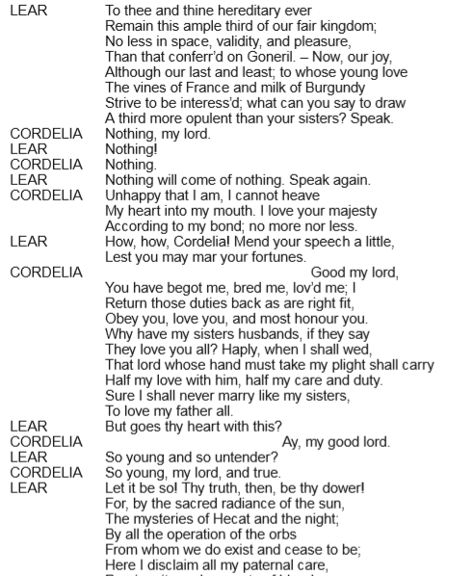
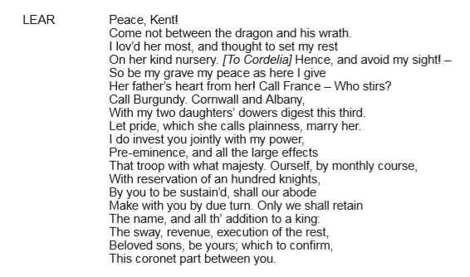
Unit 3
The Extract Question
King Lear
By focusing closely on the linguistic and literary techniques used, explore how Shakespeare creates dramatic tension in this extract from Act 1, Scene 1.
[40]

Slide 7
Unit 3
ASSESSMENT OBJECTIVES
AO1 (25 marks)
Apply concepts and methods from integrated linguistic and literary study as appropriate, using associated terminology and coherent written expression
AO2 (15 marks)
Analyse ways in which meanings are shaped in texts

Slide 8
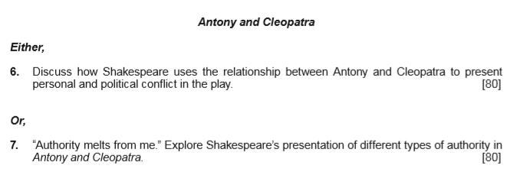
Unit 3
The Essay Question
The essay will require candidates to demonstrate knowledge of the wider play and to select appropriate supporting evidence in their response.
There will be a choice of question on the studied text e.g.

Slide 9
Unit 3
Assessment Objectives:
AO1 (35 marks)
Apply concepts and methods from integrated linguistic and literary study as appropriate, using associated terminology and coherent written expression
AO2 (15 marks)
Analyse ways in which meanings are shaped in texts
AO3 (30 marks)
Demonstrate the significance and influence of the contexts in which texts are produced and received

Slide 10
UNIT 3
EXAMINER’S REPORT – KEY MESSAGES
The extract question:
Spend 45 minutes responding to Section A
Include a brief introductory sentence placing the extract in the context of the play
Candidates are expected to provide coverage of the whole extract.
Focus on discussing the specified extract rather than other parts of the play
Candidates are expected to respond to the extract with knowledge and insight - the extract should not be treated as an unseen text
Candidates need to be specific in identifying terminology and terms need to be purposefully applied
Candidates need to be reminded of the importance of reading the set question and shaping their response to address the requirements of the question asked

Slide 11
UNIT 3
EXAMINER’S REPORT – KEY MESSAGES
The essay question:
Spend 1 hour and 15 minutes responding to Section B
Candidates need to produce one essay from a choice of two on the same text that they use for Section A
Candidates are expected to show wider knowledge of the text as a whole
Candidates may refer to a selection of key episodes in detail as long as they place them within the context of the whole text and they are relevant to the actual response - avoid using the extract set for Section A
Encourage candidates to plan their response carefully - responses need to be shaped and coherent arguments clearly constructed
Avoid description/narration – candidates should be encouraged to analyse how meaning is created and draw conclusions from their points

Slide 12
UNIT 3
EXAMINER’S REPORT – KEY MESSAGES
The essay question:
Terminology needs to be wide-ranging and applied accurately
Candidates need to learn a range of quotations from the play and cite them accurately
Centres should prepare their candidates with a wide and broad understanding of the social, political, historical and cultural context of their chosen text
However, responses should always lead with the play itself and embed relevant contextual detail meaningfully

Slide 13
Unit 3
Answering the extract question:
How does the writer create dramatic tension/comedy?

Slide 14
Unit 3
Exploding the question
For Section A (and Section B) of the Shakespeare paper, candidates need to be reminded of the importance of reading the set question and shaping their response to address the requirements of the question asked.

Slide 15
Unit 3
Exploding the extract question
King Lear
2. By focusing closely on the linguistic and literary techniques used, explore how Shakespeare creates dramatic tension in this extract from Act 1, Scene 1. [40]
Many candidates ignored this question and focused on the presentation the characters, making no attempt to link back to the question

Slide 16
Unit 3
Activity: tackling dramatic tension/comedy in the extract question
In groups, look at the extract you have been given.
Consider which techniques and areas of content candidates could explore in order to address how dramatic tension/comedy is created.

Slide 17
Unit 3
How does the playwright create dramatic tension/comedy?
In order to answer a dramatic tension/comedy question, candidates need a clear overview of what is going on in the extract.
Key Questions:
What is actually happening at that moment in the play?
What are the sources of tension/comedy?

Slide 18
Unit 3
How does the playwright create dramatic tension/comedy?
Candidates need to use clear topic sentences that focus on the question e.g.
Shakespeare creates dramatic tension through the way Lear’s action disrupts the Chain of Being.

Slide 19
Unit 3
How does the playwright create dramatic tension/comedy?
Some approaches candidates could use…
What is actually happening on stage – the action itself
Staging/Props
Setting
Characterisation
Character interaction
Conflict – external or internal
Turn-taking
Use of dialogue
Dramatic irony
Language
In addition, candidates answering on comedy may find it useful to consider, where appropriate…
Use of word play
Verbal comedy
Physical comedy
Slapstick
Situational comedy
Caricature
Misunderstanding
Mistaken identity/deception/disguise

Slide 20
Unit 3
Activity: assessing how dramatic tension/comedy is created within an extract response
Look at the following paragraphs taken from extract responses produced by students in the summer 2019 exam.
Consider how far each response addresses the actual question
Assess the paragraphs for AO1 and AO2

Slide 21
Unit 3
Structuring a response: improving analysis skills
What advice would you give to the writers of Example 1 and Example 2 on how to improve their analysis?

Slide 22
Unit 3
Example 1
King Lear
Shakespeare presents Lear in an uncontrollable temper. The use of plosive alliteration in the declarative ‘Here I disclaim all my paternal care, propinquity and property of blood’ suggests Lear has completely lost it and is no longer rational. He breaks his paternal bond with Cordelia because she has publicly humiliated him by failing to pander to his ego.

Slide 23
Unit 3
Example 1
King Lear
Shakespeare presents Lear in an uncontrollable temper. The use of plosive alliteration in the declarative ‘Here I disclaim all my paternal care, propinquity and property of blood’ suggests Lear has completely lost it and is no longer rational. He breaks his paternal bond with Cordelia because she has publicly humiliated him by failing to pander to his ego.
Shows clear understanding of Lear’s character – makes some pertinent points
Some high order analysis evident – this candidate has clear potential
However…
Ignores the set question – basically focuses on Lear
No real focus on HOW dramatic tension is created
Terminology needs to be more precise for Band 5

Slide 24
Unit 3
Example 2
Much Ado About Nothing
‘Write down Prince John a villain’, the use of the imperative tone used by Dogberry could illustrate that he thinks of himself of someone of great importance/superior. The theme of comedy arises often when it involves Dogberry trying to make himself look more important to impress the Sexton.

Slide 25
Unit 3
Example 2
Much Ado About Nothing
‘Write down Prince John a villain’, the use of the imperative tone used by Dogberry could illustrate that he thinks of himself of someone of great importance/superior. The theme of comedy arises often when it involves Dogberry trying to make himself look more important to impress the Sexton.
Struggles to say anything really meaningful
Basic attempt to link the point back to comedy – no real exploration of meaning
Basic use of terminology
Poor sentence construction
Failure to introduce quotations
Needs to analyse HOW the language creates comedy

Slide 26
Unit 3
Resources for use…
Antony and Cleopatra
June 2018
By focusing closely on the linguistic and literary techniques used, explore how Shakespeare creates dramatic tension in this extract from Act 2, Scene 5. [40]
Task 1 – Groupwork
Look at the following paragraphs.
Key Question – How effective is each example at addressing how dramatic tension is created?
Identify the strengths/weaknesses in each example
Mark each example against AO1 and AO2
Decide which band you would place the response in – remember you will need to be able to justify your decision in whole class feedback
Example 1
Firstly, Shakespeare creates dramatic tension through the introduction of the messenger in which the sentence ‘Madam, he’s married to Octavia’ with the use of the bilabial alliteration in the vocative ‘madam’ and the stative verb ‘married’ suggesting the explosive reaction from Cleopatra.

Slide 27
Unit 3
Example 1
Firstly, Shakespeare creates dramatic tension through the introduction of the messenger in which the sentence ‘Madam, he’s married to Octavia’ with the use of the bilabial alliteration in the vocative ‘madam’ and the stative verb ‘married’ suggesting the explosive reaction from Cleopatra.
Example 2
Shakespeare creates dramatic tension through the juxtaposing stage directions ‘strikes him down’ and the pre-modifier ‘good’ in which the dynamic verb ‘strikes’ appears to have contradictory connotations to the messenger’s meaning.
Example 3
Cleopatra is presented as superficial. This is shown through the guttural alliteration in ‘Give to a gracious message.’ The harshness of her command is contrasted with her false attempt at flattery through the adjective ‘gracious’.
Task 2 – Individual
Re-write one of the examples aiming to make it a Band 5 response. Make sure you address the set question and establish how dramatic tension is created.

