Slide 1
Component 3
Unseen Prose and Poetry

Slide 2
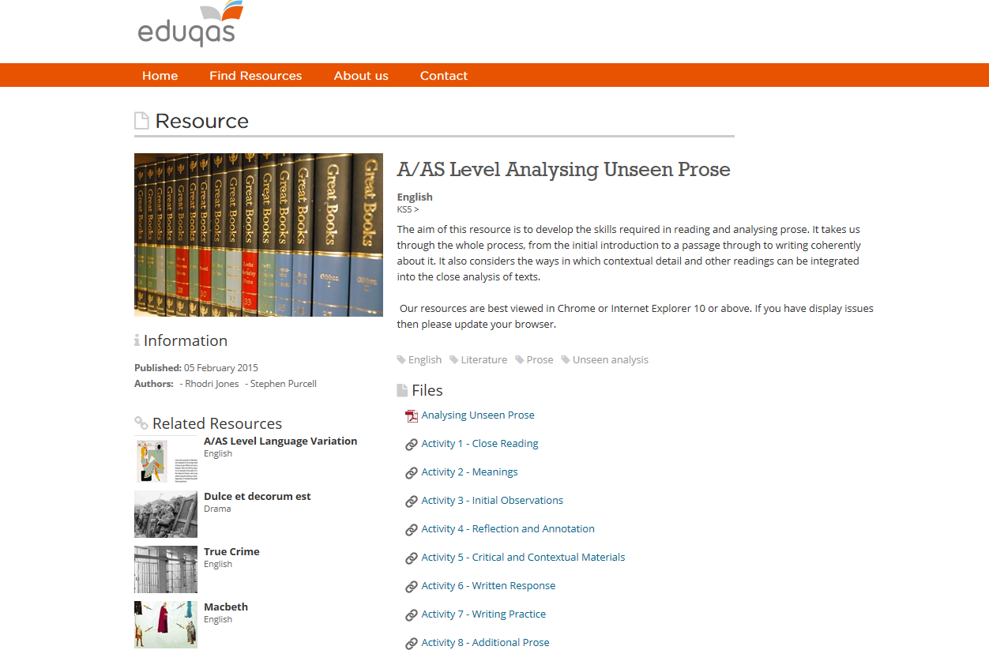
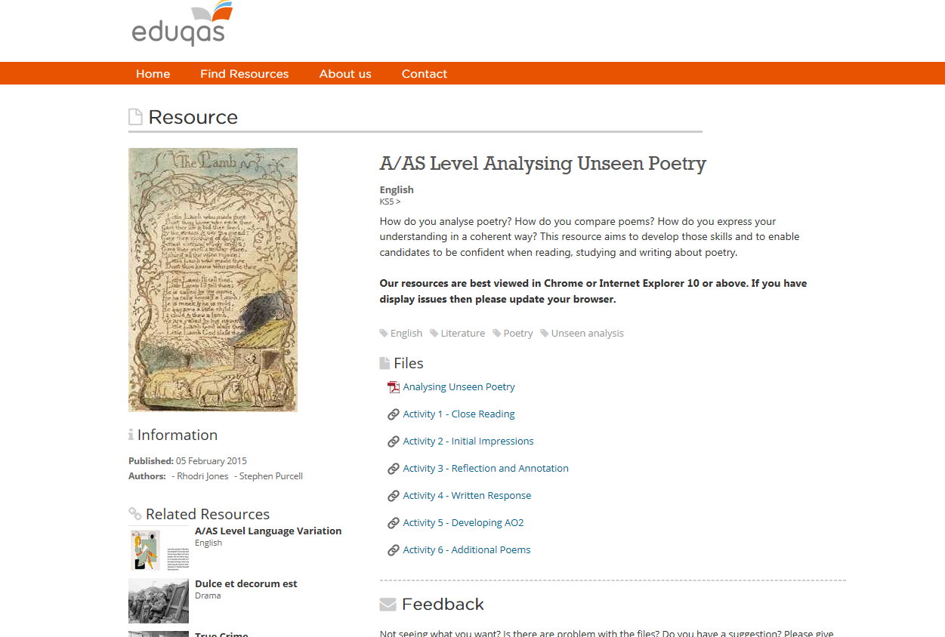
Online Resources
^{Unseen Prose}
^{Unseen Poetry}

Slide 3
Introductions
After close reading, annotation and planning the introduction sets the trajectory of the response
AO1 and AO2 are the most heavily weighted elements in this section
However, there is a requirement to make use of the published resource material
Paper rubric encourages wider contextual reference to the period studied
As always: contextual reference (AO3) must be a function of textual analysis
Reference to other readings (especially the published materials) (AO5) should be the stimulus to further discussion
Notes:
There are issues of balance here demonstrated in all the samples which follow. Candidates must be careful not to overload context – avoid the temptation to unpack everything they have learned – be highly selective. Pre-learned critical quotations pose the same problems but there is encouragement in the rubric for candidates to make use of their study as well as the published extracts. Techniques need to be practised frequently if candidates are to avoid under-cooking the AO2 work in their responses.

Slide 4
Candidate 1
Admirable attempt at economy of expression
Clear signpost that context is under consideration
Vocabulary (AO1) a little off key
Paragraph concludes with an unsupported assertion
How could the candidate add a brief critical/evaluative slant even at this early stage?
Write the next paragraph.

Slide 5
Candidate 2
A succinct overview of the passage but essentially descriptive
Without making the paragraph significantly longer, how could the candidate insert some critical/evaluative material which would target AO2?
How and where would brief quotation help to raise the quality and focus of the writing?

Slide 6
Candidate 3
Very confident writing
Informed contextual references
3rd sentence? A little scrambled perhaps
Confident integration of another reading
Consider how vocabulary such as “obsessive”; “trivial”; “eagerly”; “sanctity” demonstrate the candidate’s perceptive/creative engagement with the text.

Slide 7
Candidate 4
Leaning heavily towards context (AO3)
Potentially worrying start – seems to be an attempt to pack in contextual material at the expense of AO2
Essay might need to “recover” in subsequent paragraphs
As in Candidate 1, the paragraph concludes with a fairly broad assertion
Once again, a good exercise would be to write the next paragraph.

Slide 8
Whole Response to Prose Passage
Consider the impact of language such as “scandal”; “status”; “integrity”; “frivolity” on the quality of the essay
Compare the slightly under-developed points in paragraph 2 about irrelevance and superficiality; the observation about an “apparently meaningless discussion” in paragraph 3 and the comments on “regency lacquer” in paragraph 4, with the neatly made and supported point about moral disintegration in the penultimate paragraph.
The last sentence in paragraph 4 is a good example of the need for just a few more words to show how the “disapproving tone” is achieved.
Notes:
Please inform the audience that the commentary on this passage and some guidance on assessment is available on the CD/online. Please emphasise that this is an early attempt: the emphasis is still upon learning and suggesting ways to refine the approach.

Slide 9
Response to Unseen Poem
By way of an introduction, the candidate has chosen to deal with the form and structure of the poem. In the original there is a footnote after “effort” in line 31 and the rest of the paragraph is added in the margin – possibly as an afterthought.
Notes:
Certainly worth asking for a response to this before moving on to the next slide. Please also remind about online resources at this point.

Slide 10
Response to Unseen Poem
Are the analysis and evaluation of structure and form convincing? In the interests of effective organisation, should this material have been handled differently?
Consider paragraph 3. Has the candidate “drilled-down” sufficiently through language and images to demonstrate a perceptive analysis? What advice would you give?
Are there moments in this paragraph or elsewhere where the writing falls short of analysis and becomes commentary?
Consider lines 55-69. In what ways does the work here differ from the rest of the essay?
Does the conclusion add anything to the response?

Slide 11
Resources for Teachers
Supporting teaching and learning
Visit our website to access qualification information and download key documents.
eduqas.co.uk/qualifications/English literature
Free Eduqas digital resources to support the teaching and learning of a broad range of subjects.
resources.eduqas.co.uk

Slide 12
Any Questions?
gceenglish@eduqas.co.uk
Rhodri Jones: Subject Officer
029 20 265188
Mike Williams: Subject Support Officer
029 20 265129
@eduqas
eduqas.co.uk

