Slide 1

Portal
Finding what you need - Music

Slide 2
Access
Portal (formerly the secure website) is found at
Portal.wjec.co.uk
You need a username and password from your exams officer to access the site. The exams officer can determine your level of access so ask them if you cannot see the items you need.
The website covers Eduqas and WJEC, so be careful to select the correct materials.

Slide 3
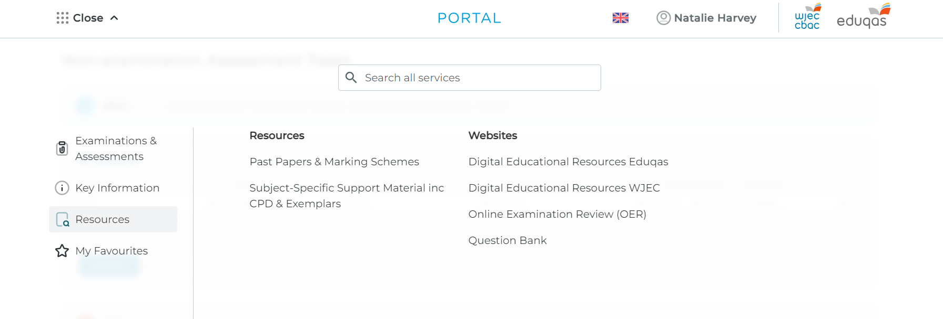
Finding Past Papers
Log in > Centre Number > All Services > Resources > Past papers and marking schemes
Your Name

Slide 4
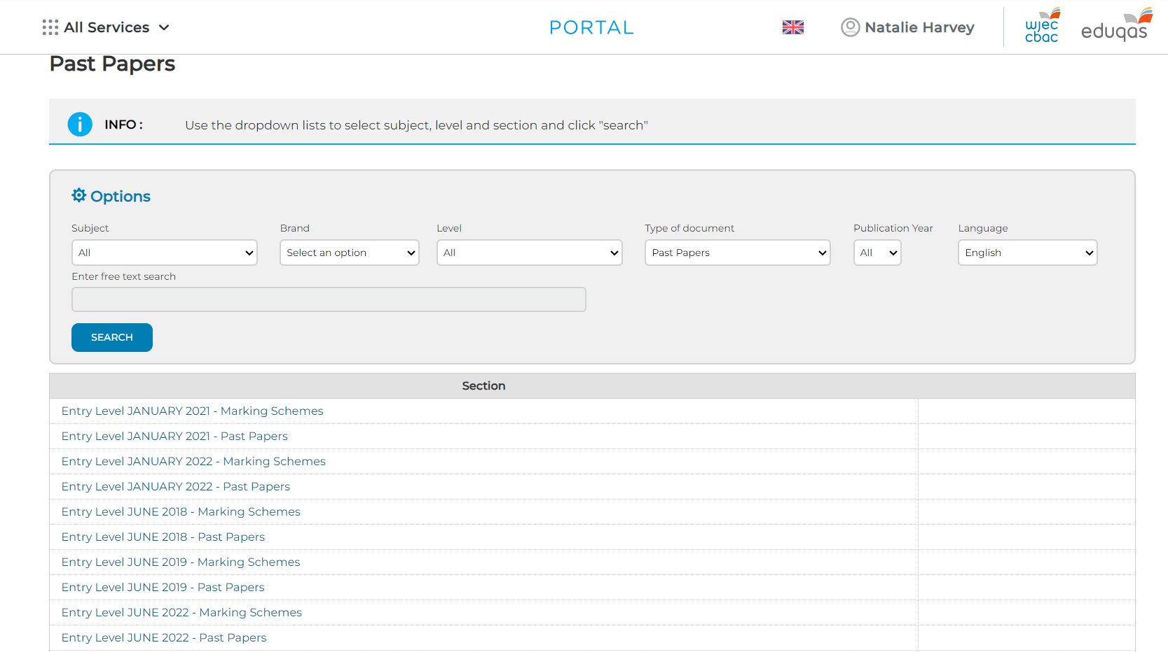
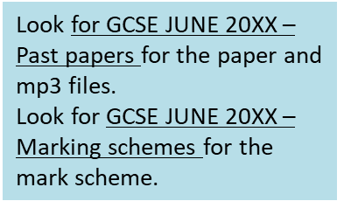
Finding Past Papers
Ignore the search filters and scroll to find the folder for the year you want. Open the folder.

Slide 5
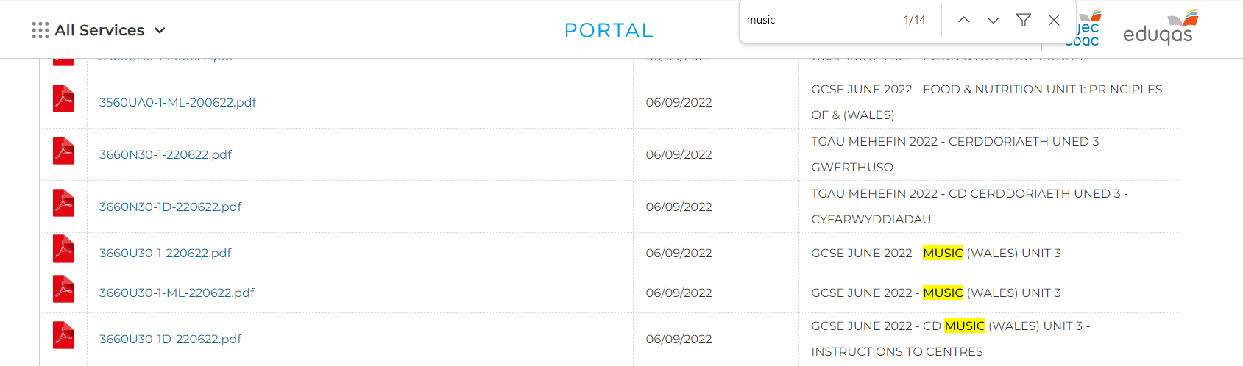
Finding Past Papers
When the folder is open press Ctrl + F and type Music to highlight all Music items.

Slide 6
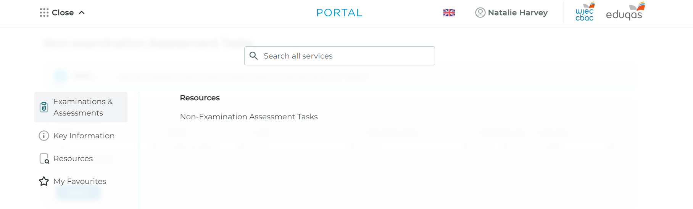
Finding Composing Briefs
Log in > Centre Number > All Services > Resources > Non-Examination Assessment Tasks
Your Name

Slide 7
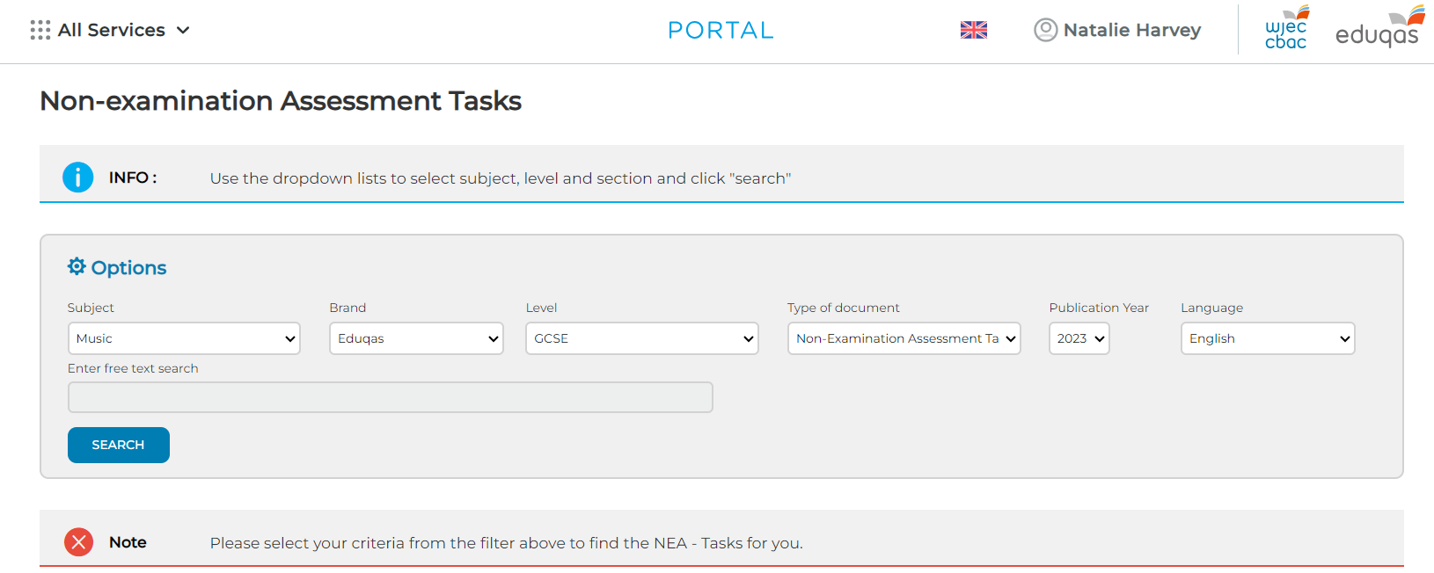
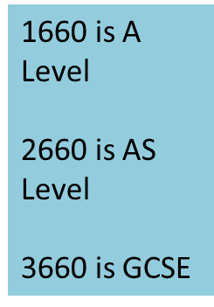
Finding Composing Briefs
Complete Subject, Brand, Type of Document, Publication Year, Language.
Your Name

Slide 8
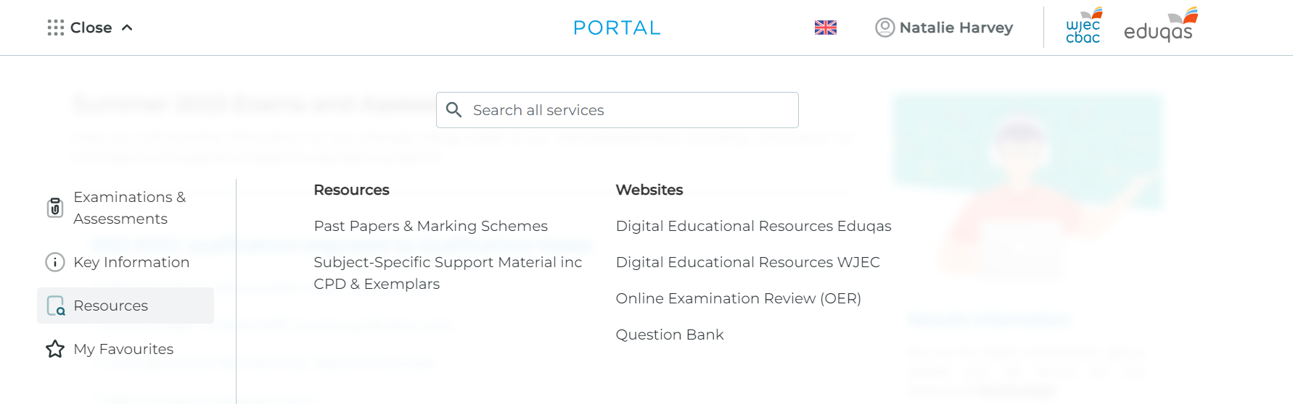
Finding CPD and Exemplar Materials
Log in > Centre Number > All Services > Resources > Subject Specific Support Materials inc CPD & Exemplars
Your Name

Slide 9
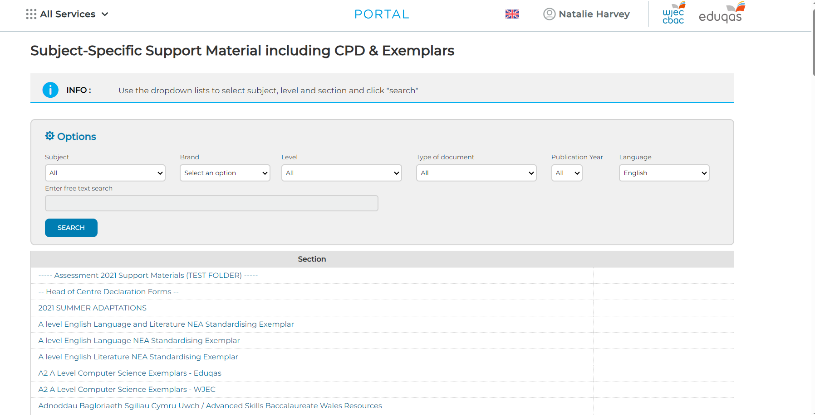
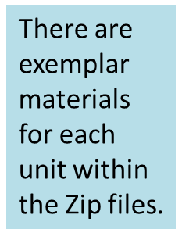
Finding CPD and Exemplar Materials
Complete Subject, Brand, Type of Document, Publication year.
Your Name

Slide 10
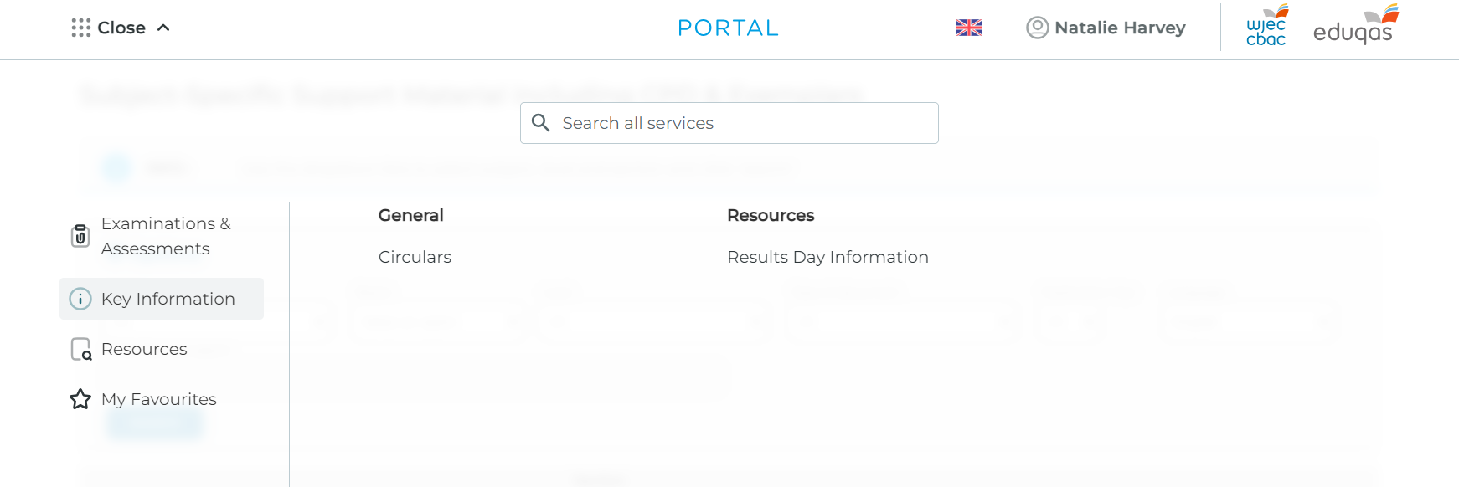
Finding Circulars
Your Name

Slide 11
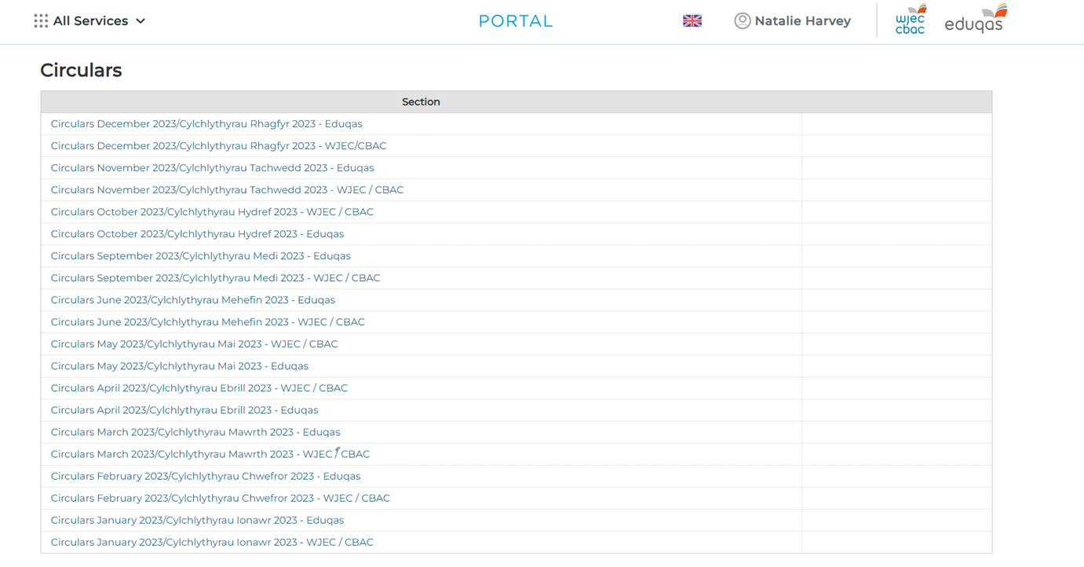
Finding Circulars
Click to open the folder for the latest month. Check regularly!!
Your Name

Slide 12
Any questions?
Contact our specialist Subject Officers and administrative support team for your subject with any queries.
music@wjec.co.uk

