Slide 1


GeogShots
CC BY-NC-ND 4.0

Slide 2

GeogShot.
A 10-minute solution focused “shot” of geography to help guide your learners to more successful responses in the exam.
They are designed so you can fit these resources into your existing lesson plan or adapt as you want.
Each builds on identified actions from examiners reports.
They could be part of your intervention strategy to support and challenge your learners in class.
They are designed to allow you to insert a relevant question to work on from any aspect within the specification.

Slide 3

Where candidates are asked to evaluate/say to what extent they agree and then to decide and justify. In these questions there must be some element of discussion to access the higher bands. For example, if a candidate is asked to choose a factor, candidates need to consider all factors and then reason why they chose the one they have.
https://creativecommons.org/licenses/by-sa/3.0/
How can this be included in your lesson?

Slide 4
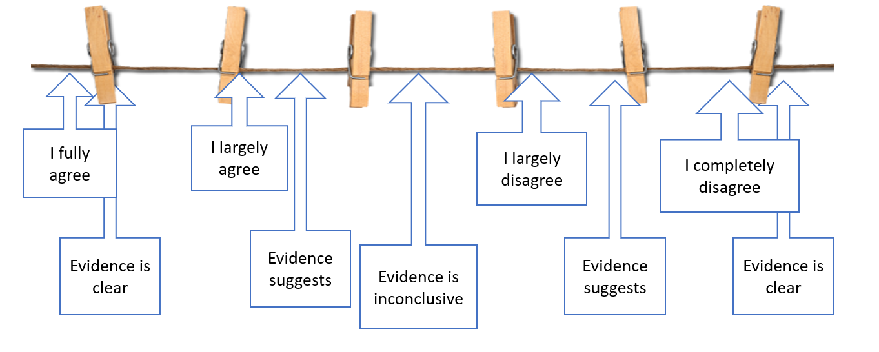
You must state whether you agree or disagree with the statement or not. It is possible that you only partially agree. The examiner is not looking for a particular yes or no. It’s the way you use the evidence to support your decision that is important.
These types of connectives can help you develop your reasons for your decision.
Therefore Yet
Alternatively
However Significantly
Importantly
Concluding
Overall Although Whereas
Similarly
Or you can use the washing line to help you state your decision

Slide 5
Often questions will start with a statement and follow with this type of instruction….How far do you agree with this statement, give specific information to support your answer?
An argument this paragraph will use evidence that supports the view.
Here you may argue that there are significant advantages make multiple points. Use evidence to support your points use the resources and add examples from your own studies.
Structuring your answer.
A counter argument, you may argue that other considerations can also be relevant. Use multiple points to support your point here. Use evidence to support your points use the resources and add examples from your own studies.
A decision, here you weigh up the evidence and reach a decision ... The evidence suggests that in the short term the ……..is a major benefit to.. However…. The long term benefits will out weigh…
Use the scale/washing line to measure your judgement.
Ensure your final judgement is clear.

Slide 6
Starters, choose from these prompts to help you extend your point, give evidence and develop your reasons.
Point | Evidence | Explanation | Link
It has been suggested that…. | Figure X clearly shows… | The trend in Figure X goes up because… | With this in mind, it is evident that….
It is believed that… | This is supported by… | This shows us that …. | Therefore, it is evident that…
Some people argue that… | This is demonstrated by… | It is clear from this that… | All this evidence demonstrates…
Many people believe that…. | Figure X tells us that.. | This evidence explains that.. | This also links to the idea that..
One argument that… | Figure X suggests that… | This means that.. | This is what I expected because….
One school of thought is that… | The evidence provided from figure X suggests…. | This supports my argument because…. | It is clear that…..
One of the main causes/advantages….. | The pattern on Figure X suggests…. | This demonstrates that… | Therefore, I can conclude that…

Slide 7
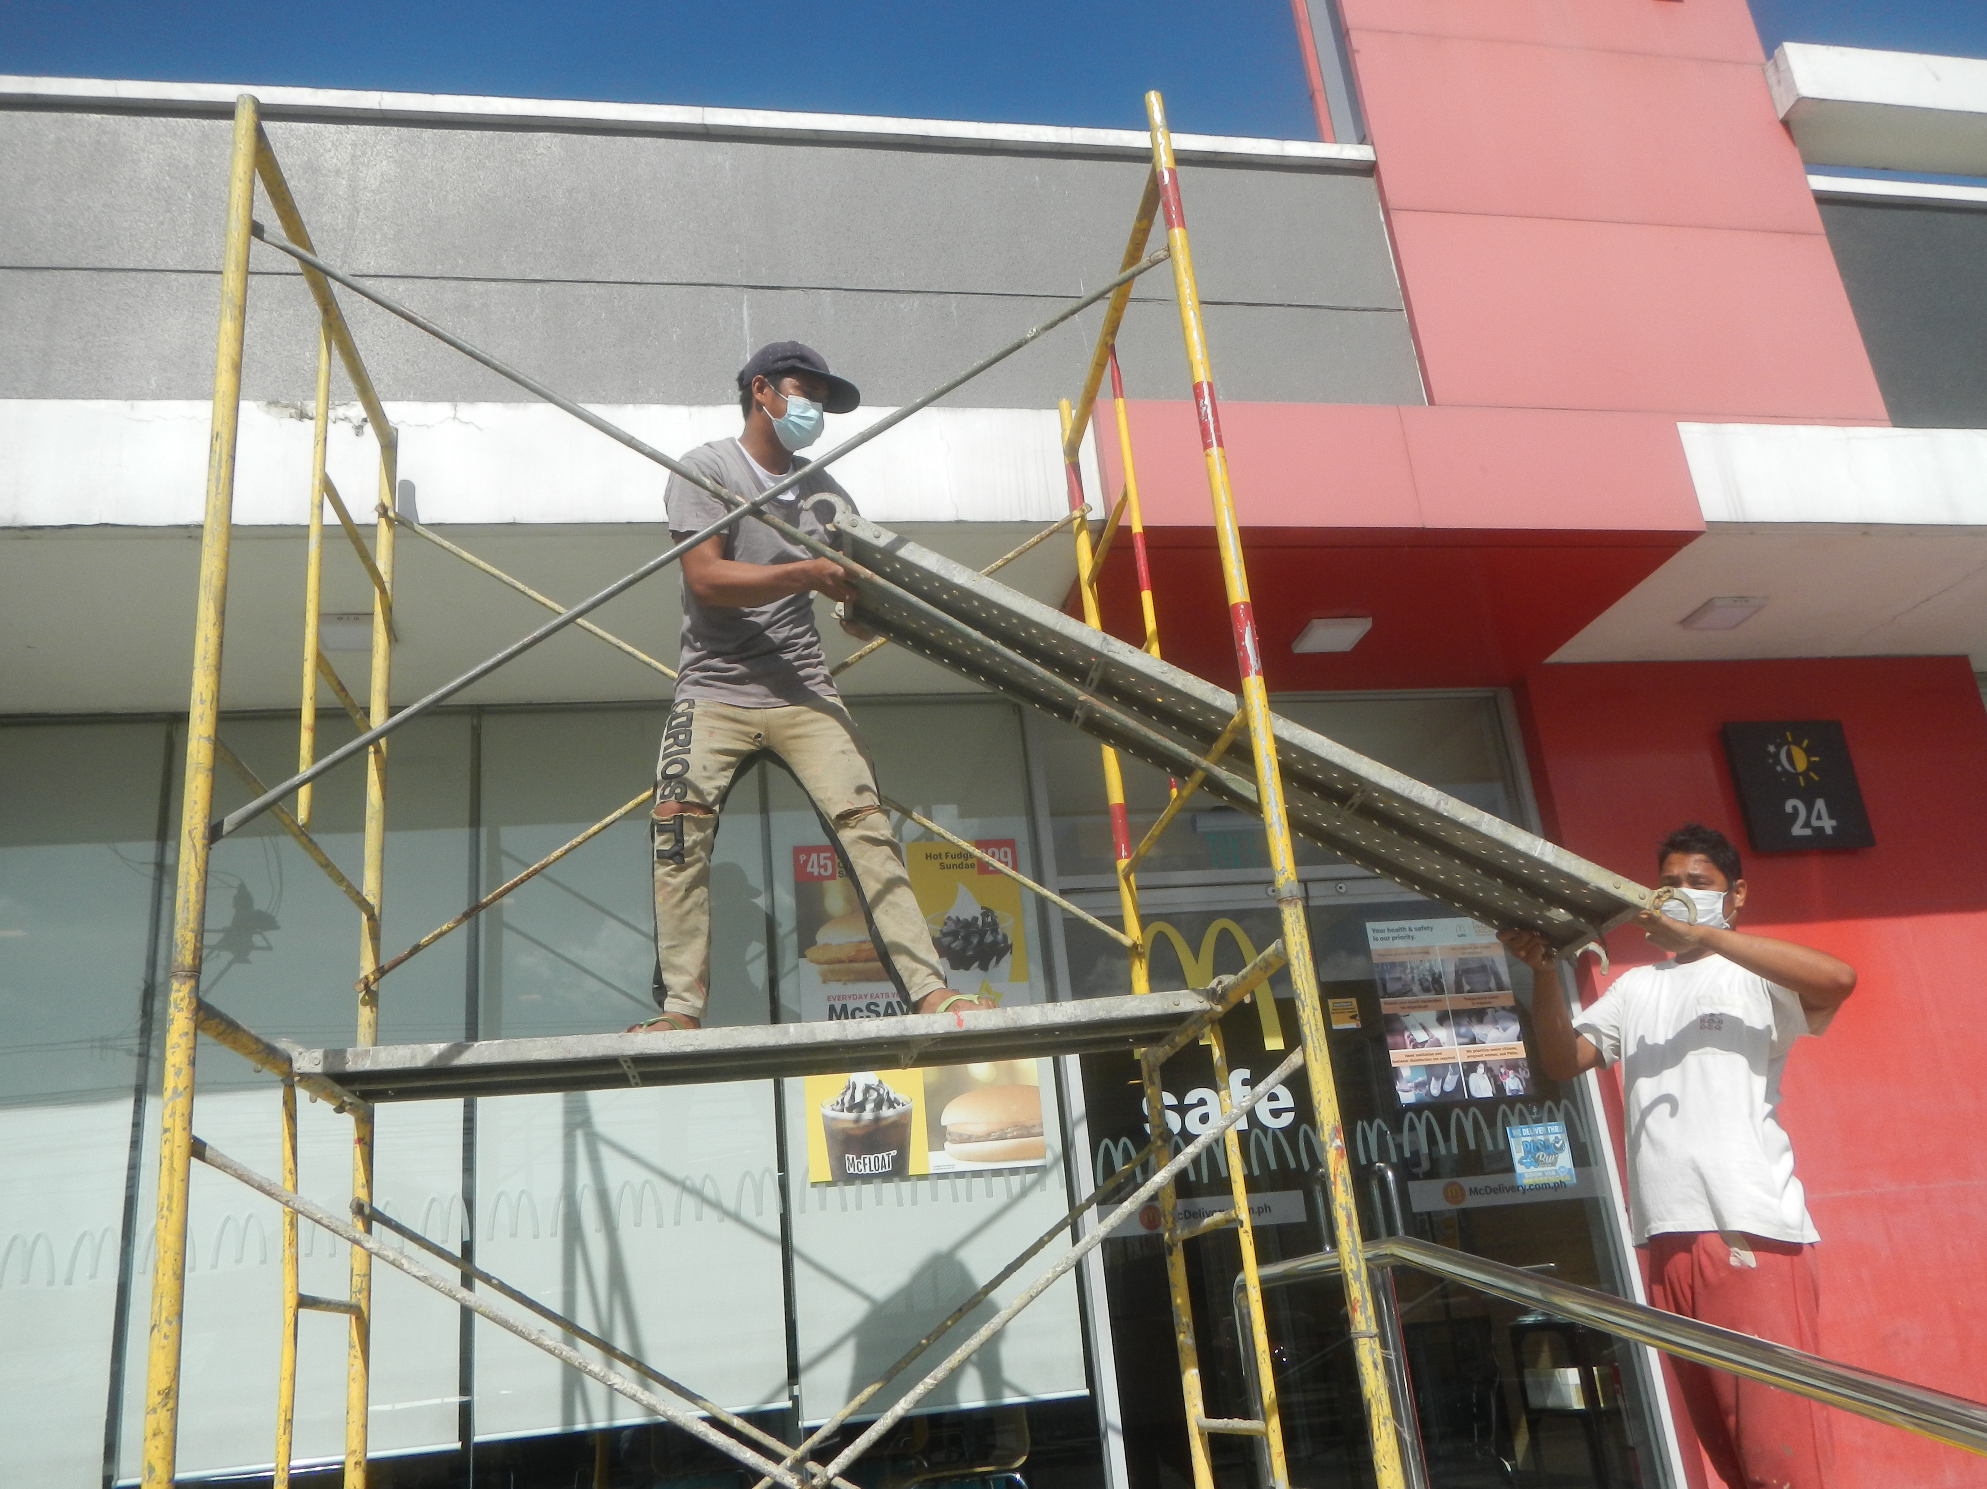
Remember, scaffolding is a temporary structure designed to be removed. Too much scaffolding will halt you developing independence, as needed in the exam hall. You will have a lot of support at the start of the scaffolding process. Then, it will be removed in stages.
CC0 1.0 DEED

Slide 8

Now using a minute, a mark try this question.
*****************
De bug the question and consider the scaffolds you have been using in class to help you structure your answer.
Your time starts now…..
Notes:
This slide can be customized and used for a question of your choice in the classroom.

Slide 9
Worked example
Here is how you could use a question and then introduce various scaffolds to support how to approach this application of knowledge and understanding.

Slide 10
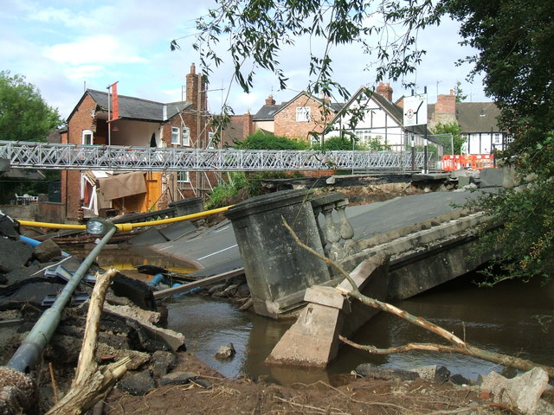
Suggest, means you need to propose a possible answer based on what you can see. Think about how this flood will have economic effects on businesses, shoppers, the emergency services or local builders.
Use evidence from the photo:
Debris on the river bank.
Road damage
Utility lines broken
https://creativecommons.org/licenses/by-sa/2.0/
Suggest how this river flood affected the economy. Use evidence from the photograph. (8)

Slide 11
Make a point
Provide some evidence
Make an inference
Significant debris has washed up along with the flood water.
The flood has provided work for local builders who are making repairs.
Flood water has damaged the bridge

Slide 12
Infrastructure
Damage
Use the photograph to identify the possible impacts a flood could have on the economy on an area suggested from the photograph.
Impact on Tourism
Property Damage and Insurance Costs:
Job Losses and Unemployment
Disruption of Business Operations
Long-Term Economic Consequences

Slide 13

Suggest how this river flood affected the economy. Use evidence from the photograph.
The economic impact of a river flood in the UK can be significant and wide-ranging. Here are several ways in which such an event could affect the economy:
Floods can cause damage to critical infrastructure such as roads, bridges, and utilities. This can disrupt transportation and communication networks, hindering the movement of goods and people. The photo does show that a bridge has been destroyed. This will mean difficult and often lengthy detours for delivery, commuters and tourist traffic which can have a cost to the economy over a significant time while repairs are being carried out.
Flooding can lead to extensive damage to homes and businesses. This results in the need for repairs and replacements, and the associated costs are often covered by insurance. Increased insurance claims can strain insurance companies and potentially lead to higher premiums for affected areas.
It can, however, create work for local business who may get contracts for repair and supply replacement goods. This will in short term help economic recovery of the area.
The economic impact of a river flood can extend beyond the immediate impact. Persistent challenges in recovery, decreased investor confidence, and changes in population distribution may have long-term economic consequences for the affected region. The impacts could be both positive and negative. Flood controls could mean greater confidence to invest in the area such as the St Austell Bay area in Cornwall where more than £10 million has been awarded to communities.
Overall, the economic impact of a river flood in the UK is complex, affecting various sectors and aspects of the economy. The severity and duration of these impacts will depend on factors such as the scale of the flood, the effectiveness of response and recovery efforts, and the resilience of the affected communities
Use the mark scheme below to assess the example answer.
Identify connective words used.
Underline the counterarguments used.
Band 4 (7-8) Excellent use of own knowledge and clear understanding of the impact on the economy. Photograph is used and other examples used to illustrate the point.
Band 3 (5–6 marks): Detailed knowledge of how flooding impacts the economy. The impact ideas are taken from the photograph. Gives possible reasons
Band 2 (3–4 marks): Some knowledge of how flooding impacts the economy. Full explanation will not be given
Band 1 (1–2 marks): Basic knowledge of how flooding impacts the economy. . Lacks named processes
No band (0 marks): Award 0 marks if wholly irrelevant
Candidates will be expected to talk about the cost of clear up safe disposal of toxic floodwater and damaged possessions.
The use of evidence from the photograph together with some examples from own studies.
It is expected that there will be mention of domestic and business costs to council and insurance companies and increased insurance and how this can be an extra cost to small businesses that will mean they may go out of business and loss of local jobs and services…..

