Slide 1

Assessing WJEC Geography
Units 1 and 2

Slide 2
Assessing evidence
Assessment Purpose
In their study of the two units, learners should have developed their:
knowledge and understanding of the content set out in the key ideas, enquiry questions and depth of study.
understanding of a number of the key overarching geographical concepts outlined in the specification.
Independent thinking by applying knowledge and understanding to real world contexts.
a range of mathematical and statistical skills.

Slide 3
Assessing evidence
Assessment Criteria
Guidance on how to mark the GCSE Geography assessments is available on the subsequent slides.
The guidance focuses on
how examination papers are constructed around the four different assessment objectives (AOs)
the different types of mark scheme needed for the AOs and types of questions
supporting understanding of the requirements of the types of marking style.
The guidance is organised by AO so that the marking principles can be applied to all assessments, including those teachers may have produced themselves.

Slide 4

Instructions for applying the marking scheme
Mark schemes enable you to award marks that are fair and consistent to all candidates
Specification and exam papers are constructed around the four ASSESSMENT OBJECTIVES.
Different assessment objectives require different types of mark scheme
Make sure you understand the requirements of each marking style
Notes:
Mark schemes are essential in any assessment process using examination papers as they enable you to award marks that are fair and consistent to all candidates, both within and between different schools and centres.
The WJEC GCSE specification, and therefore the examination papers are constructed around the four assessment objectives. It is worth reminding yourself and your teams who will be marking candidates responses how the assessment objectives are intrinsic to the way in which marks are awarded. Each individual sub-question, or item is designed to assess one of the assessment objectives only. Different types of examination question require subtle differences in the style of mark scheme used and, therefore in the way in which you award marks. It will really help if you are familiar with these differences and the aim of this presentation is to help you understand and apply the mark schemes fairly to your candidates responses.

Slide 5
Assessment Objectives create a rationale for the construction of the papers
AO | Requirement | weighting
AO1.1 | Demonstrate knowledge of locations, places, processes, environments and different scales. | 15%
AO1.2 | Demonstrate geographical understanding of: concepts and how they are used in relation to places, environments and processes; the inter-relationships between places, environments and processes. | 25%
AO2 | Apply knowledge and understanding to interpret, analyse and evaluate geographical information and issues and to make judgements. | 35%
AO3 | Select, adapt and use a variety of skills and techniques to investigate questions and issues and communicate findings. | 25%
Higher weighting
Greater demand
Notes:
Note that the assessment objectives have different weightings across the exam paper. For example, the application of knowledge and understanding (AO2) carries a higher weighting than basic knowledge, or recall of information itself (AO1.1).

Slide 6
AO1.1 (15%)
Knowledge of aspects of subject content
Candidates will be asked to recall knowledge of:
Locations
Processes
Places
Environments
Generally low mark tariffs. Maximum of 4 marks.
Notes:
AO1.1 assesses knowledge where candidates are required to recall information in relation to places, processes and environments. These questions usually carry a fairly low mark tariff, a maximum of 4 marks and are nearly always point, or tick marked.

Slide 7
AO1.2 (25%)
Understanding of aspects of subject content. Candidates will be asked to demonstrate understanding of:
Places
Environments
Concepts
Interrelationships
Some questions carry low mark tariff, ie. 2-4 marks, but others require extended writing, with a tariff of 6-8 marks
Notes:
AO1.2 assesses candidates’ understanding and will require them to make linkages and provide explanations for aspects of the subject content. Command words will include ‘explain’ and ‘give reasons for’.

Slide 8
AO2 (35%)
Will provide greatest challenge for candidates and assessing their responses
Generally higher tariff – always banded mark schemes
AO2 will provide most discrimination in a non-tiered paper
Facts and case studies might contribute to the quality of an answer but should not receive credit in their own right
Please keep referring to mark scheme and exemplars from conference to maintain a standard
Notes:
AO2 assesses candidates' ability to apply their knowledge and understanding to different scenarios and contexts. They often, but not always carry higher mark tariffs and are marks using levels rather than point-based mark schemes. Candidates can introduce additional material from their wider work to support their answers and give depth and breadth the response but no marks are awarded specifically for knowledge.

Slide 9
Elements of AO2 (35%)
Applying knowledge and understanding to interpret a novel situation. For example, finding meaning in a photo
Applying knowledge and understanding to make a decision and justify it.
decision making
inference
evaluation
analysis
Applying knowledge and understanding to make sense of data and explain connections. For example, making sense of a table of data
Applying knowledge and understanding to weigh up strengths and limitations. For example, evaluating a strategy
Notes:
AO2 requires candidates to either draw inference from a resource such as a photo, analyse information from a range of sources such as maps and datasets, evaluate and make decisions based on evidence. AO2 questions will always be based on one or more resources to stimulate candidates' thinking.

Slide 10
Key elements of a sophisticated response in AO2 – what to look for
Be BALANCED Weigh up advantages and disadvantages – e.g. costs / benefits, good / bad, positive / negative impacts | Use EVIDENCE Give extended and detailed evidence to support a decision. Use hard and soft evidence but do not use vague assertions. | COUNTER-ARGUMENT Be able to explain why some proposals or ideas have been rejected
Be SYNOPTIC Use knowledge and understanding from other topics in Geography, from the news, or from other subjects | Think about FUTURES Consider the impacts of your decision in the short term and longer term. Is it sustainable? | Reach a JUDGEMENT DECIDE! Be able to put together a logical case that is linked to evidence
10
Notes:
This grid will help to guide you in what to look for from candidates' responses in AO2 questions. These criteria will feature in the content of mark schemes for specific questions.

Slide 11
AO3 (25%)
Skills and techniques in the investigation of questions and issues
Candidates will be asked to:
Select
Adapt
Use
Communicate findings
Note: increased level of challenge in use of mathematical/statistical skills and techniques in a range of geographical contexts
Notes:
AO3 assesses candidates' geographical and mathematical skills in a range of contexts.

Slide 12
Instructions for applying the marking scheme
This box contains the sub-question.
The columns to the right indicate the assessment objective(s) targeted by the question and mark tariff.
3 (a) (i) Describe the location of the island of Lefkada. |  | AO1.1 | AO1.2 | AO2 | AO3 | Accuracy | Total
 |  |  |  |  | 2 |  | 2
Credit up to two valid statements based on map evidence. Credit accurate use of compass points max 1. Credit accurate use of scale line max 1. | In western Greece (1) In Ionian Sea (1) north of Cephalonia (1) 275km (+/-10) from Athens (1) 280km (+/-10) from Thesaloniki (1)
This box contains the candidates’ expected responses for point-based marking. For some sub-questions, those with a closed question, this box will indicate the only response that is acceptable.
For more open ended sub-questions this box will illustrate a number of likely responses that are credit worthy.
For banded mark schemes this box contains indicative content.
This box contains the rationale i.e. it explains the principles that must be applied when marking each sub-question. The examiner must apply this rationale when applying the marking scheme to the response.
Notes:
WJEC geography mark schemes follow a standard format and you should be familiar with this structure before assessing candidates' work. The sub-question is printed in the top left and you should note first that the top right of each mark scheme informs you of the assessment objective relevant to each sub-question. The bottom left box contains the rationale for marking the item and can contain instructions for applying the mark scheme. The fourth box contains the content from a response that can be awarded marks. In this example, it is for a point-based mark scheme where effectively, each valid point earns a mark but note that for levels based mark schemes, this could contain a range of indicative content that is neither exhaustive nor prescriptive but simply and indication of the type of material that might be relevant to the answer.

Slide 13
Instructions for applying the marking scheme
Tick marking
Most low tariff questions will be marked using a points-based system. Each credit worthy part of the response should be ticked. The number of ticks must equal the mark awarded for the sub-question.
The mark scheme should be applied precisely using the expected outcomes box as a guide to the responses that are acceptable.
Notes:
Point based mark schemes will be used in most cases for questions with a tariff of 4 marks and below. The number of relevant points from the mark scheme made by the candidate will determine the number of marks to be awarded.

Slide 14
Instructions for applying the marking scheme
Banded mark schemes
Banded mark schemes are divided so that each band has a relevant descriptor. The descriptor for the band provides a description of the performance level for that band. Each band contains a range of marks. Start by reading and annotating, using comments linked to the bands, a response to pick out the evidence that is being assessed in that question. Try not to use ticks on the band mark questions as this can confuse the learner when they review their marked work.
Once the annotation is complete, the mark scheme can be applied.
Notes:
Banded mark schemes are used where responses are likely to be more sophisticated or lengthy and in all cases where the tariff is greater than 4 marks. In all cases, banded schemes are used for AO2 questions because there is rarely a definitive response for such questions and there is often not a 'right' or 'wrong' answer. The aim is to look at an answer holistically and find a 'best-fit' to the criteria for a given band. It is often good practice not to use ticks when using banded mark schemes because they can mislead you. It is usually better to underline or circle phrases which are creditworthy before deciding on the band to fit the answer into.

Slide 15
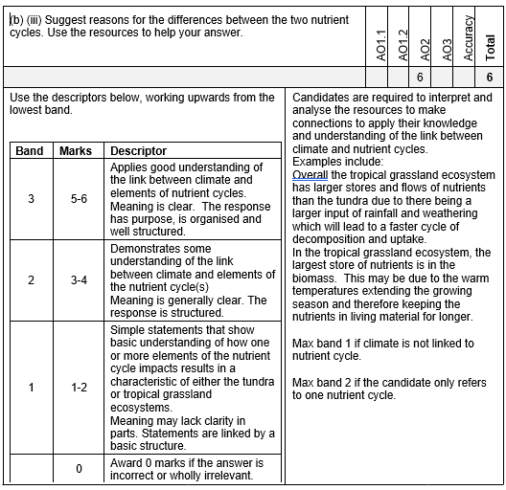
Instructions for applying the marking scheme
Stage 1 – Deciding on the band
View the response holistically
Use a ‘best fit’ approach
Indicative content
This is not exhaustive
Other valid and relevant points must be credited
Stage 2 – Deciding on the mark
Where in the band does the response sit?
Compare to examples if available
Assessing Writing
Communicating and organising
Meaning
Purpose
Structure
Notes:
Banded mark schemes can take some getting used to and it’s worth going through a number of stages in applying them.
The first stage is to fit a response into the correct band.
When deciding on a band, the answer should be viewed holistically. Beginning at the lowest band, you should look at the learner’s answer and check whether it matches the descriptor for that band. If the descriptor at the lowest band is satisfied, move up to the next band and repeat this process for each band until the descriptor matches the answer.
Often, an answer will cover different aspects of different bands within the mark scheme, and when this happens a ‘best fit’ approach should be adopted to decide on the band and then the learner’s response will be used to decide on the mark to be awarded within the band. For instance, if a response is mainly in band 2 but with a limited amount of band 3 content, the answer would be placed in band 2, but the mark awarded would be close to the top of band 2 as a result of the band 3 content.
You should not seek to mark candidates down as a result of small omissions in minor areas of an answer.
The second Stage is to decide on the mark to award.
Once the band has been decided, examiners can then assign a mark within that band. Essentially, you are awarding a mark out of a possible two or three within the band. There may be some examples in the OER resources on the WJEC website to help with this.
Indicative content is also provided for banded mark schemes. Indicative content is neither prescriptive nor exhaustive, and any other valid points should be credited. In order to reach the highest bands of the mark scheme a learner need not cover all of the points mentioned in the indicative content but must meet the requirements of the highest mark band. Where a response is not creditworthy, that is contains nothing of any significance to the mark scheme, or where no response has been provided, no marks should be awarded.
Assessing Writing
The quality of writing is also assessed through two separate strands (for all banded questions of 6 marks and above):
(i) Communicating and organising is assessed in items that have a tariff of 6, 8 or 10. These responses should also be viewed holistically when deciding on a mark band (see stage 1 above). The following definitions clarify what is meant by the terminology in these descriptors.
Meaning: to have clarity the text must be legible. The meaning of statements should be clear and not require re-reading to make sense.
Purpose: the response should take into account what is required by the question. For example, evaluation requires consideration of pros/cons or the justification of a decision may be assisted by arguments.
Structure: well-planned responses have an overall structure with use of paragraphs to indicate portions of the response such as introduction, main arguments and conclusion. Chains of reasoning provide a logical structure within paragraphs.
In addition, for one question in Question 2, writing accuracy must also be assessed for 3 additional marks, We will go through this later in the resource.

Slide 16
Marking AO1.1 (knowledge) questions

Slide 17
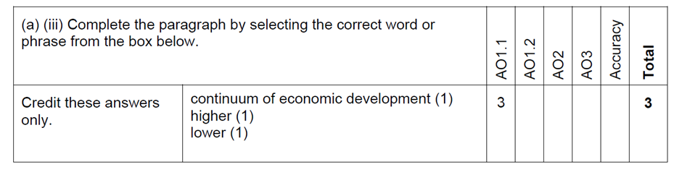
Marking AO1.1 (knowledge) questions
A fixed answer question. Credit these answers only.
Unit 2 example 1 – 2018 paper

Slide 18
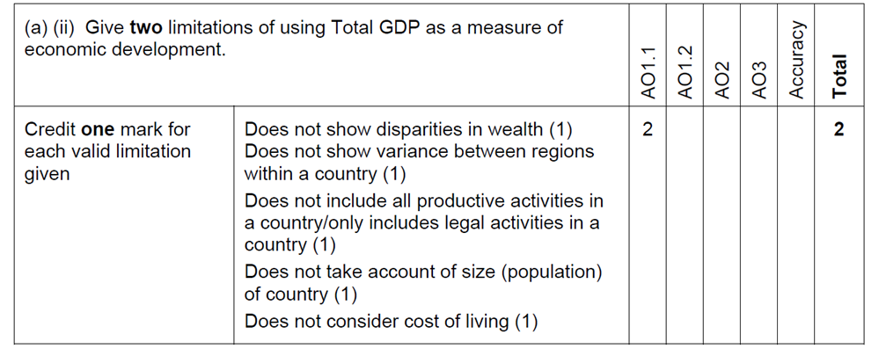
Marking AO1.1 (knowledge) questions
Credit two separate points – do not credit elaboration
Unit 2 example 2 – 2018 paper

Slide 19
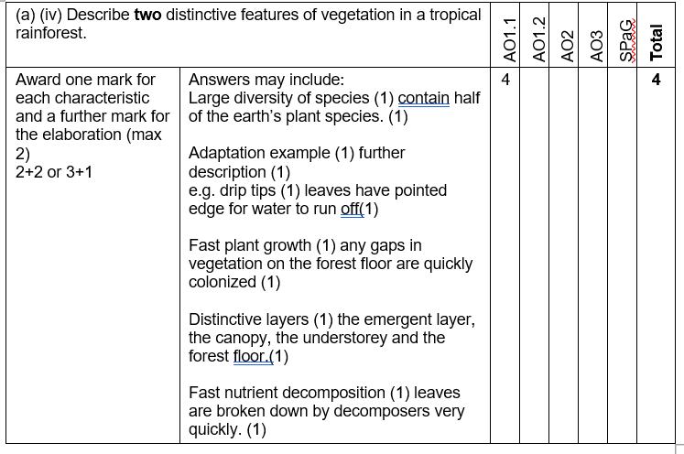
Marking AO1.1 (knowledge) questions
Example of a two mark answer for one feature
There are two marks awarded fore the features and two marks for the elaboration. You can award 1 elaboration mark per feature, or two marks for more detailed elaboration of one feature.
Example of the maximum 3 marks for one feature
Unit 2 example 3 – 2019 paper

Slide 20
Marking AO1.2 (understanding) questions

Slide 21
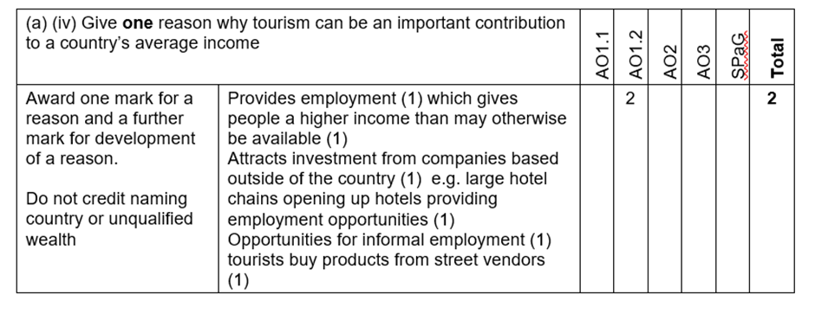
Marking AO1.2 (understanding) questions
Here the expected outcomes box is only a guide to the types of answers you may see.
Do no accept single word reasons, they need to be qualified e.g. more employment
Unit 2 example 4 – 2019 paper

Slide 22
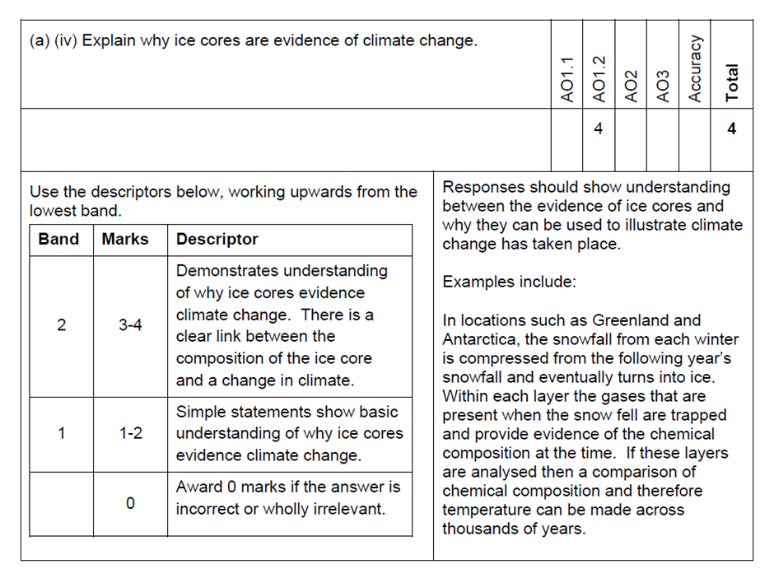
Marking AO1.2 (understanding) questions
To get into band 2 the link must be explicit.
Unit 2 example 5 – 2018 paper

Slide 23
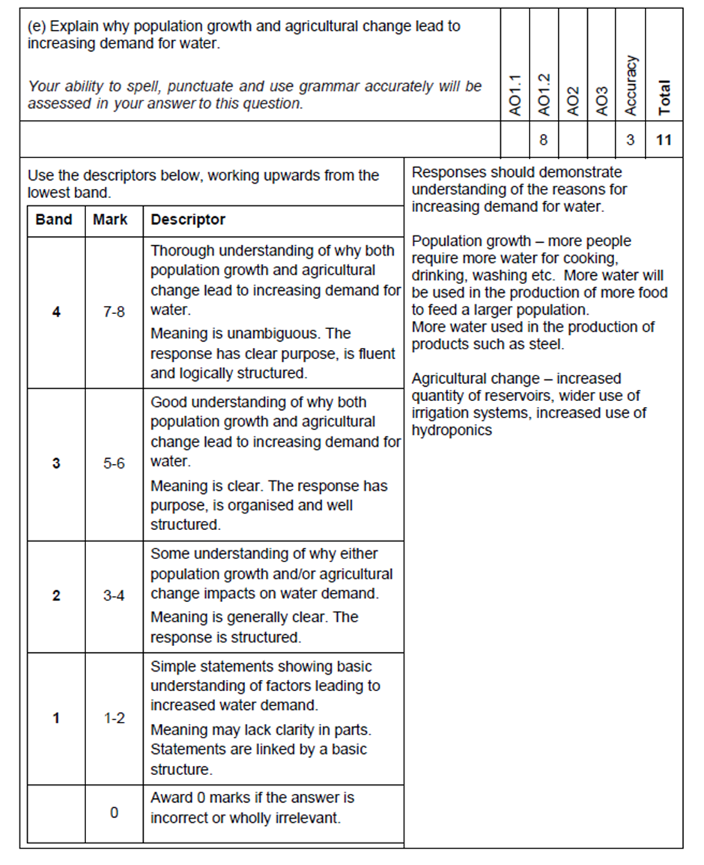
Marking AO1.2 (understanding) questions
Thorough explanation for both factors
Both factors must be present for band 3 and the candidate shows good understanding.
Award the mark for the geography and then reread and award the mark for accuracy
Answers would explain one or both factors briefly
Unit 2 example 6 – 2018 paper

Slide 24
Marking AO2 (application) questions

Slide 25
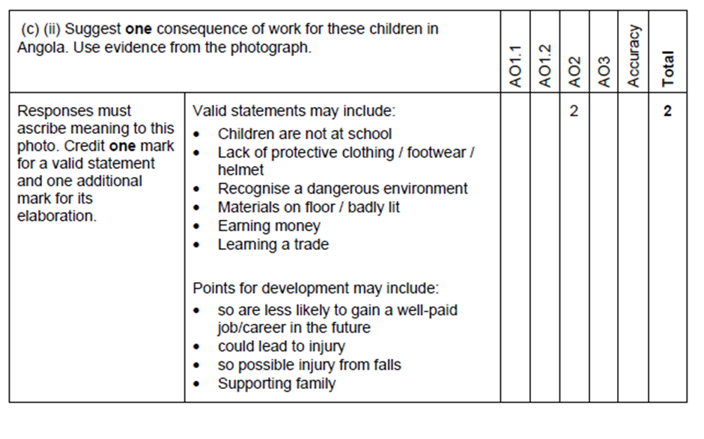
Marking AO2 (application of knowledge and understanding) questions
The response must be in relation to the photo
Suggested but not limited to these answers and elaboration.
Unit 2 example 7 – 2018 paper

Slide 26
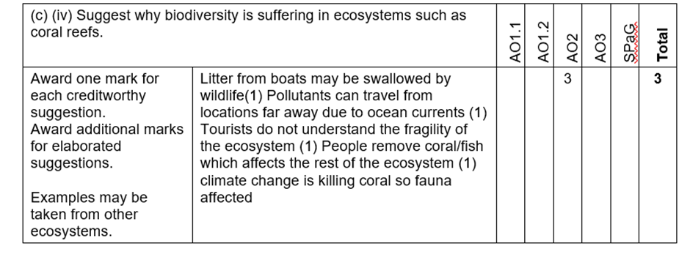

Marking AO2 (application of knowledge and understanding) questions
Candidates can choose an ecosystem
An example of q question where candidates can gain full marks from 3 different points, or from 1 elaborated point.
Unit 2 example 8 -2019 paper

Slide 27
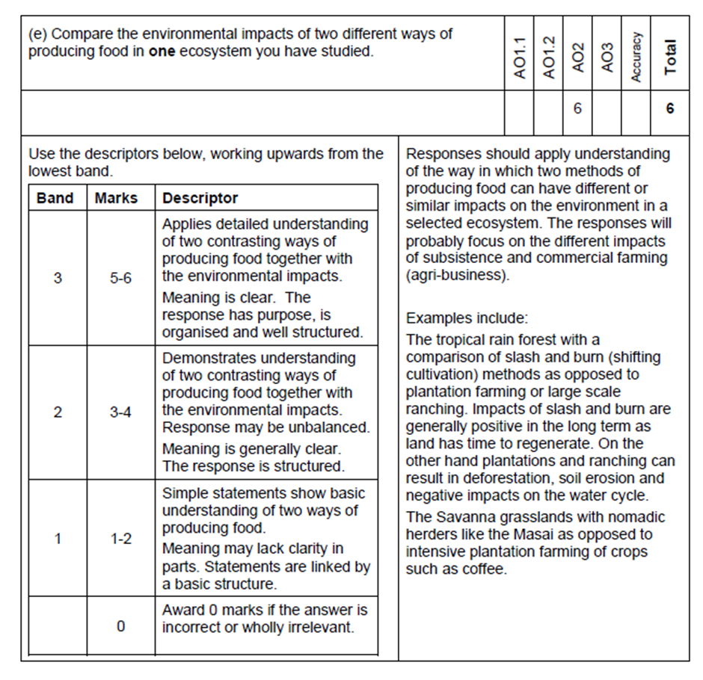
Marking AO2 (application of knowledge and understanding) questions
Candidates can choose the food production methods
Comparative language must be used, detailed understanding for both methods & clear links to environmental impacts.
Two methods must be given with brief links to environmental impacts. There may not be a balance between the two methods
Unit 2 example 9 –
2018 paper

Slide 28
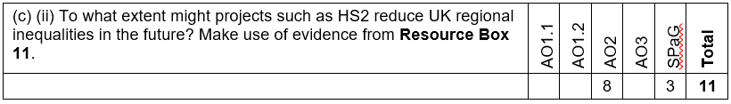
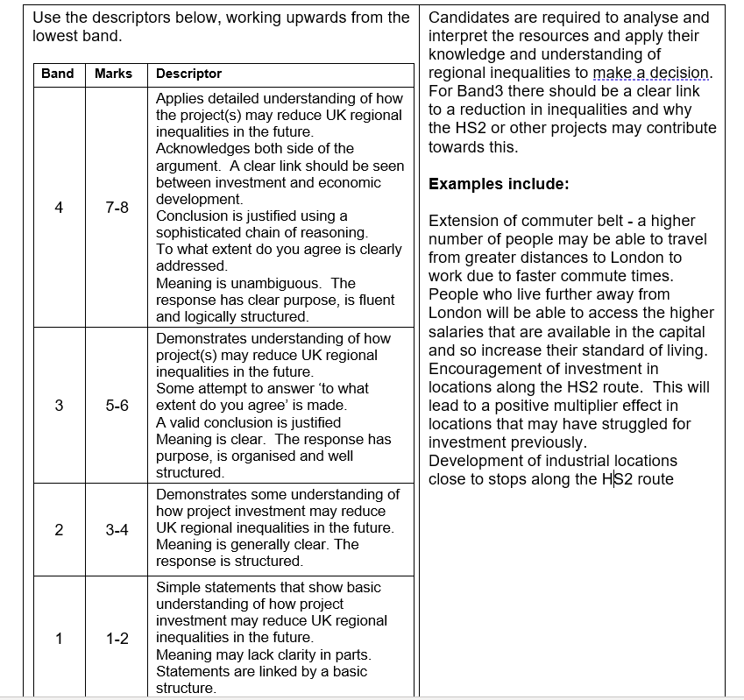
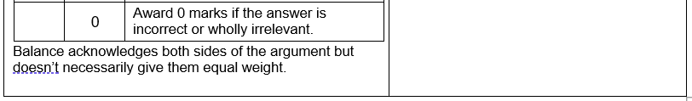
Marking AO2 (application of knowledge and
understanding) questions
Detailed understanding in a future context, clear link, conclusion and ‘to what extent’ must all be present.
It is optional to use HS2 as a context
Candidates discussion must have future context. A conclusion & ‘to what extent’ must be present
Lacks depth, may not use an example.
Unit 2 example 10 – 2019 paper

Slide 29
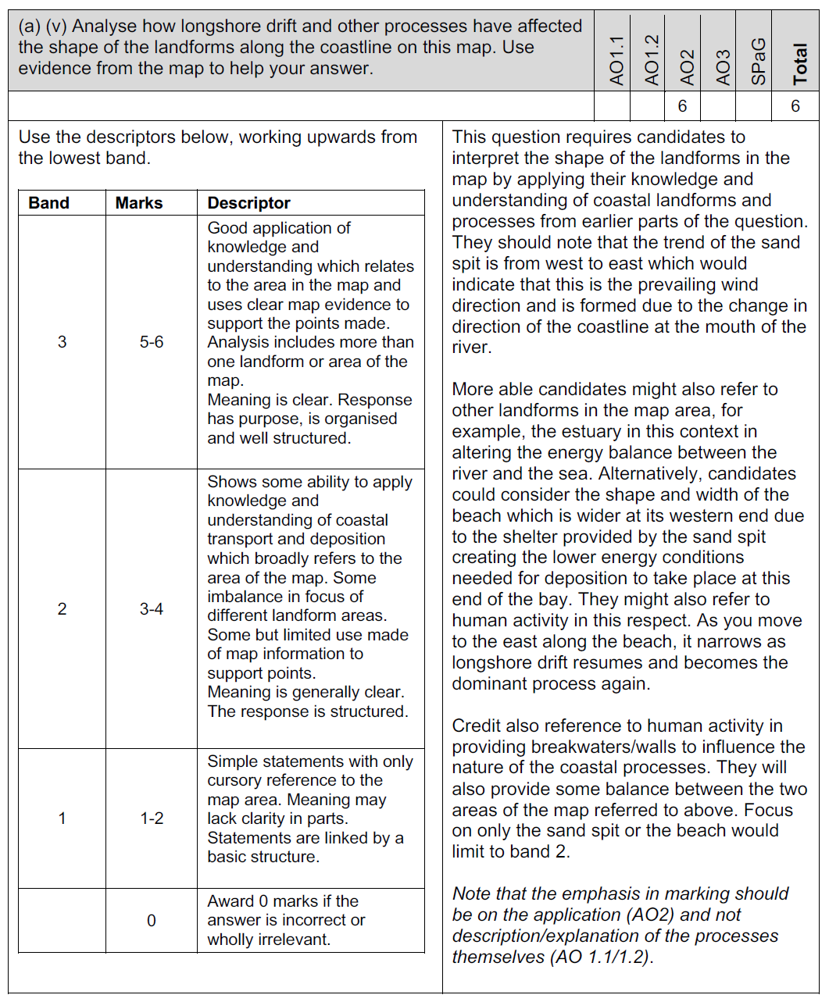
Marking AO2 (application of knowledge and understanding) questions
Candidates need to look at the shape of the beach and the direction of the sand spit to try to work out how longshore drift as affected this coastline.
In this question candidates are being asked to ANALYSE the map by identifying landforms and associated coastal processes.
Unit 1 example 1
– 2019 paper
Notes:
When marking AO2 questions, remember that there are different types of application being assessed. In this example, candidates are being asked to apply their knowledge and understanding of coastal processes and landforms to ANALYSE in formation in the ordnance survey map. The marks are awarded for working out that longshore drift from the south-west, for example has dictated the shape and trend of the spit and width of the beach as you move further to the east and away from the shelter of the beach. Map evidence can be provided in the form of distances, directions, place names, grid references or anything which indicates that the candidate is applying their knowledge and understanding to this particular context and not just writing in general terms about coastal landforms per se. Such a response is unlikely to move beyond band 1 of the mark scheme.

Slide 30
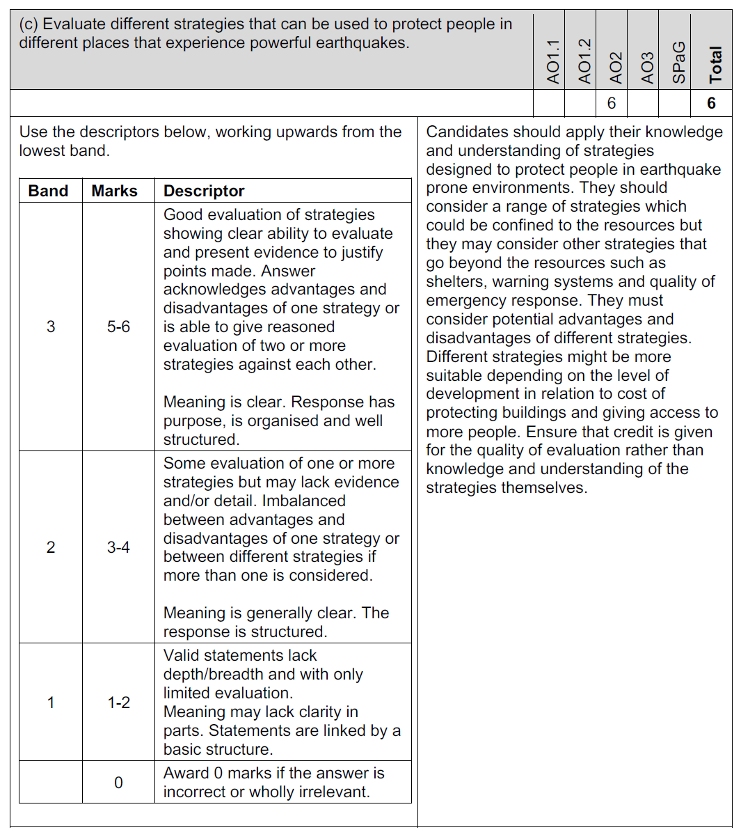
Marking AO2 (application of knowledge and understanding) questions
Award marks here for the ability to evaluate rather than for the knowledge of strategies themselves.
Can the candidate write about advantages and disadvantages or compare the effectiveness of different strategies?
Unit 1 example 2
– 2019 paper
Notes:
In this example of an AO2 question, the candidate is being asked to evaluate. The marks should be awarded for the quality of the evaluation rather than the geographical knowledge shown in the answer. This is why the candidate has been provided with a resource to show different strategies but they can, if they wish, ignore the resource and evaluate different strategies they have studied. However, although they will need the knowledge of case study material to do this, they must not be awarded marks for this, rather the answer must be assessed on the evaluative skills in showing the advantages and disadvantages of strategies or comparing one or more with each other.

Slide 31
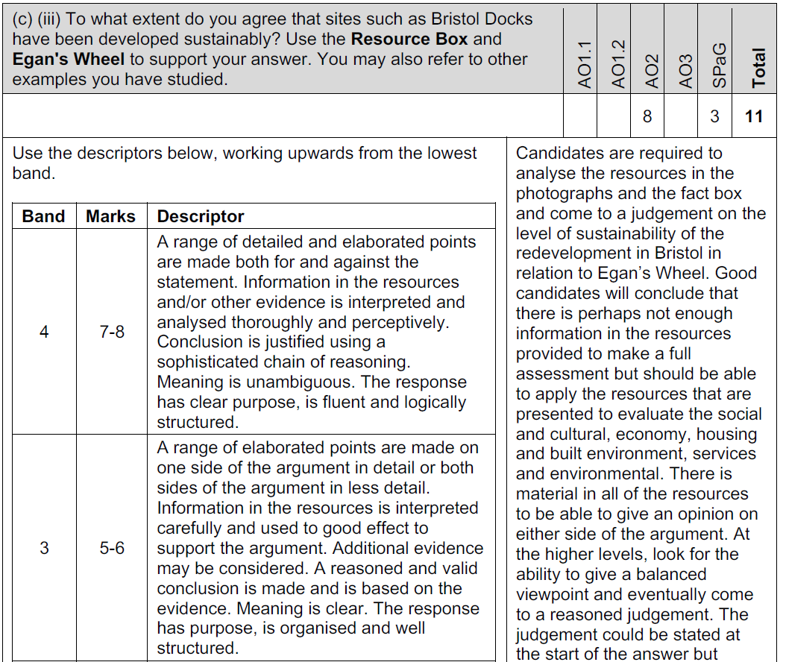
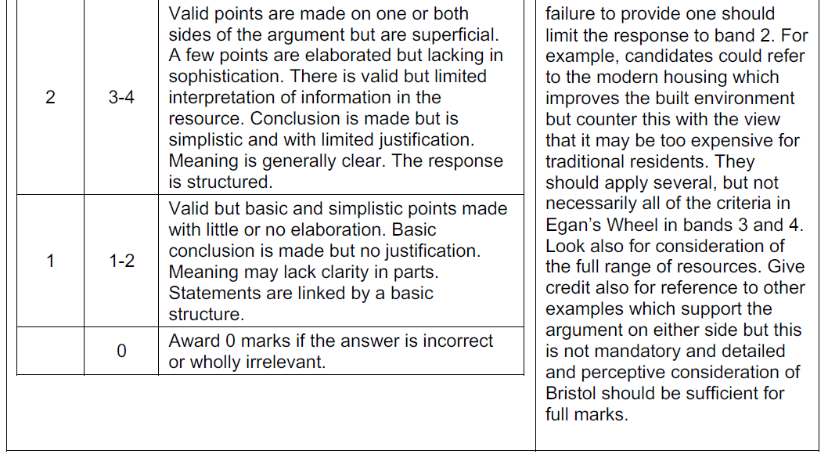
Marking AO2 (application of knowledge and understanding) questions
They can refer to other case study material to emphasise a point but take care not to credit knowledge unless it is helping the argument or providing balance to the answer.
Candidates need to make a decision. Credit the quality of their thought process in arriving at that conclusion.
Unit 1 example 3– 2019 paper
Notes:
This type of AO2 question requires candidates to make a decision. It is important for them to look carefully at the resources and provide a balanced assessment of them to arrive at a conclusion stating whether or not they agree with the statement. It does not matter whether they do or not, the marks are to be a warded for for their thought process and how they articulate their journey to that conclusion. In this example, they are also being given Egan's Wheel to help them identify what features to look out for in deciding whether Bristol Docks has been developed sustainably so they should stick to Egan's definitions and APPLY them to the resources. Note also that they could refer to other examples they have studied, such as Cardiff Docks and this could help their answer, particularly if aspects of Egan's Wheel are missing from the evidence shown for Bristol. If candidates fail to provide a reasoned conclusion, supported by evidence from the resources or other examples they have studies, they are unlikely to progress beyond band 2.

Slide 32
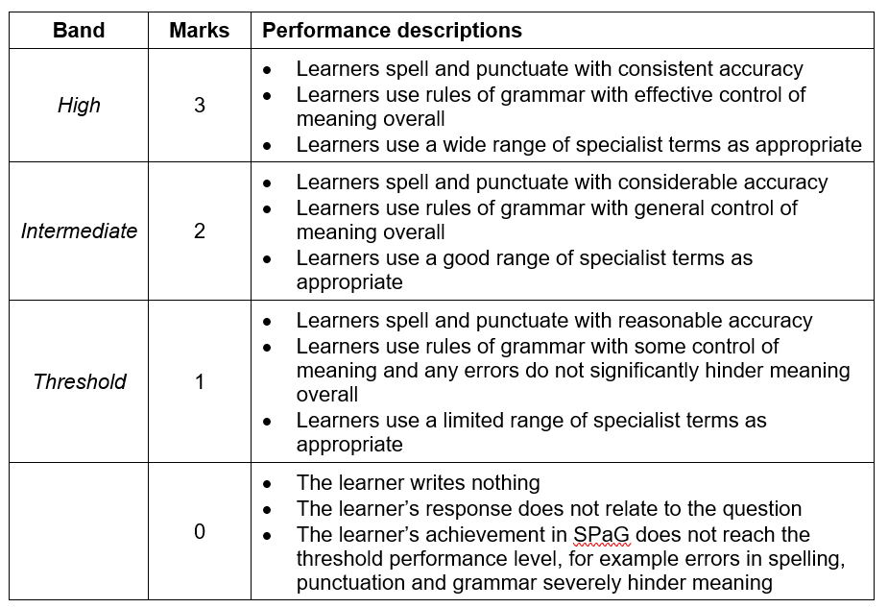
Marking Writing Accurately
After awarding a level and mark for the geographical response, apply the performance descriptors for writing accurately that follow. Having decided on a band, award a second mark (out of 3).
In applying these indicators, learners may only receive marks for responses that are in the context of the demands of the question; that is, where learners have made a genuine attempt to answer the question.
Notes:
Writing accurately takes into account the candidate’s use of specialist language. It also takes into account the accuracy of the candidate's spelling, punctuation and grammar. This assessment is restricted to specific items (one item in each unit) and will usually apply to the highest tariff question in the paper. You should award up to three marks for this answer regardless of the quality of their writing in other parts of the paper. The descriptors for writing accurately are printed in the mark scheme for each relevant item. In applying these descriptors learners may only receive marks for responses that are in the context of the demands of the question; that is, where learners have made a genuine attempt to answer the question. An answer that has failed to score any marks for the geography, cannot be awarded any marks for writing accurately.

Slide 33
Marking AO3 (skills) questions

Slide 34
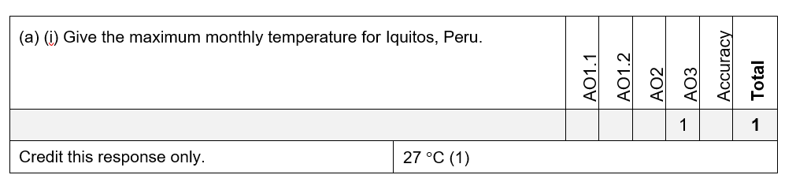
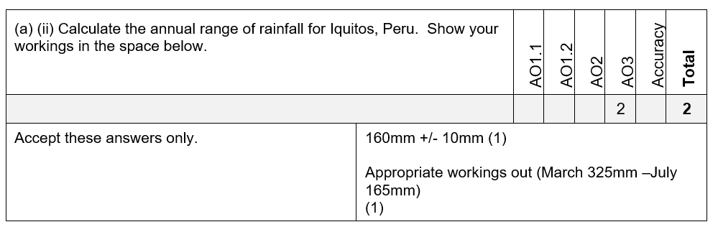
Marking AO3 (skills) questions
Unit 2 example 11 – 2019 paper
Notes:
AO3 questions are usually point based mark schemes. Often, as in the first example here there is only one acceptable response because it requires candidates to accurately read from a graph. Sometimes the mark scheme will give you an acceptable range from which to credit the answer if the data is less clear. In the second example here, the question is asking the candidate to perform a calculation. One mark is for the correct answer however it has been worked out but you must reserve a second mark for the candidate's working out. You may be able to award a mark for logical working out which has produced an incorrect answer, in which case the candidate would score only 1.

Slide 35
Assessing evidence
Rubric infringements
WJEC has a consistent way of addressing rubric infringements across all our qualifications. Below is a list of the possible infringements which sometimes occur for this qualification.
Type of infringement | Action
Answering more than the stipulated number of questions | Mark all optional questions that the learner has attempted. Determine which of the attempted routes through the rubric elicits the highest mark. Award highest mark.
Ticking/indicating more than the stipulated number of answers (MCQs) | Mark all responses offered by the learner. Total the number of marks. Deduct one mark for every additional response circled over the number stipulated in the question.

Slide 36
Assessing evidence
Rubric infringements
Type of infringement | Action
Answering with the wrong symbol, e.g. ticking instead of crossing, adding a word instead of the symbol provided | Mark wrong symbol as though it were the correct symbol if it is used consistently throughout the question. If the learner puts a mixture of symbols, and the intention is clear, award marks accordingly. If the intention is ambiguous, mark only the correct symbol, as per the question. If a word (from the choices provided with letters) is used instead of the letter, mark as for the letter associated with the word.

Slide 37
Assessing evidence
Rubric infringements
Type of infringement | Action
Where the question requires a set number of responses and the learner has provided more (open ended knowledge and understanding questions) | Mark all responses offered. Total the correct responses and award marks up to the maximum mark.
Writing answers in the wrong place (constrained papers) | If it is obvious to which question the response relates, award marks as per the marking scheme.

Slide 38
Any Questions?
If you have any questions, contact our specialist subject officers and administrative support team for your subject with any queries.
GCSEGeography@wjec.co.uk

