Slide 1

WJEC GCE Design & Technology
Unit 2 and Unit 4 NEA 2023
Feedback and Guidance
WJEC GCE Principal Moderator: Emyr James

Slide 2
WJEC GCE Design & Technology Principal Moderator Report (combined)
Unit 2 and Unit 4 Non-exam assessment
Summer 2023
Principal Moderator: Emyr James
It was a pleasure once again to be able to witness student creativity and innovation being encouraged at many centres. Summer 2023 saw NEA with no adaptations and generally most centres returned smoothly to delivering the full specification requirements but there were some issues. Many of the issues at AS were replicated at A2. In general, the majority of centres applied the assessment criteria consistently and fairly, but close scrutiny is required to the mark bands if high or full marks are to be awarded. Several of the shortcomings highlighted in the 2022 report were once again still evident at some centres despite WJEC releasing a range of NEAs for standardising purposes. All teachers at the centres need to be encouraged to use the WJEC resources available to them and to act on any recommendations. This report needs to be used in conjunction with your centre report to move the subject forward.

Slide 3
Identifying and investigating design possibilities
The assessment criteria clearly demands that candidates identify a broad range of problems/opportunities to clearly inform the development of possible design briefs. This was not the case in all centres. There are still some centres directing candidates in certain briefs or contexts. The candidates need to be allowed to choose and develop their own briefs and it is not expected that whole samples show the same contexts. Care is needed to ensure that access to the higher mark bands is possible, because with only limited very focused research, access to the higher bands is not possible. Candidates also need to be encouraged to use a variety of different design strategies during this section.
Developing a design brief and specification
Not enough evidence was witnessed to suggest that some centres had acted upon the recommendations of the report from last year. Many centres assessed this section too generously. Several centres produced design specifications with sufficient details required, but not all. This must be addressed if higher marks are to be awarded. The design specification needs to be specific and detailed and include a range of objective and measurable criteria. The design specification needs to direct and inform the designer whilst developing the design. A quality, measurable, in-depth design specification will help greatly when evaluating the product. It must be remembered that specifications are working documents and should be referred to throughout the iterative process.

Slide 4
Generating and developing design ideas
Some candidates had fully embraced the iterative design approach with some high-quality work being produced. This is where thorough use of relevant modelling and testing of ideas, driven by the design specification can support decision making and move the project forward on the journey. Those candidates who had done this extensively gained valuable information and feedback prior to making their final prototype. Research of different findings and possibilities can also be included here, to aid once again with the iterative design process. Centres need to continue to encourage candidates to develop this iterative process as much as possible and to always remember to record their findings in some way. Models, tests and concepts could take on the form of a physical model from any material or a 3D CAD model. Sketchbooks must also continue to be developed and used as the iterative working tool that they should be. With thorough testing and modelling, the candidates gain a real understanding of their project and for a method of gaining valuable development feedback from the target users or clients.
Manufacturing a prototype
Evidence of a logical sequence and achievable timeline for the stages of production is required in this section if higher mark band marks are to be awarded. Does the evidence communicate enough information to enable a 3rd party to manufacture the product? Excellent making skills were witnessed in many centres, but the standards of manufacture varied greatly, as did the application of the assessment criteria. Some of the products developed and manufactured were not really suitable for the course and a more innovative approach needed to be encouraged at the centre. Several prototypes manufactured were lacking in accuracy and skills, yet high band marks had been awarded. Last year the principal moderator’s report stated, “if top mark band marks are to be awarded the product needs to be a high-quality functioning prototype, displaying very good attention to detail with a quality finish”. Recommendations like these need to be acted upon. It must be remembered that marks cannot be awarded for models and test pieces in this section, these are rewarded in ‘generating and developing design ideas. Assessment of this section was generous overall and very generous in some centres and is an area to focus on next year.

Slide 5
Analysing and evaluating design decisions and prototypes
The depth and quality of evaluations did vary significantly across centres. A consideration of the time allocated to this section should be revised by many centres when considering the marks available to them. More end user trialling and testing needs to be encouraged and then to communicate the further developments required to better meet the functional and/or aesthetic needs of the product. There were some good examples in several centres of using video evidence for end user testing and there were some good examples of the consideration of how the product better meets the needs of the user. Modifications should be fully realised in annotated sketches or CAD presentations. A quality design specification with good measurable qualitative and quantitative criteria enabled the candidates to produce a much more meaningful final summative evaluation. Many of the summative evaluations were well written, and considered the design brief and specification, and considered views of users and referenced end testing. As mentioned, with the marks available for this section, after the manufacture of the prototype, the students must be encouraged not to rush and to produce a quality evaluation covering all the assessment criteria.
Centre Moderator’s Report
Valuable information for your centre work is available from the secure site from results day.

Slide 6
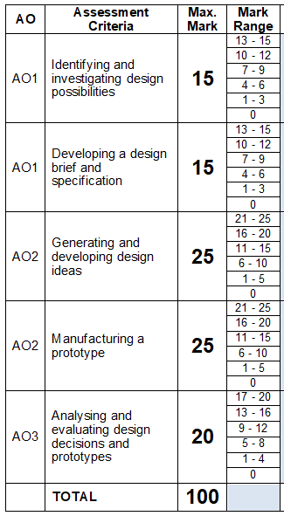
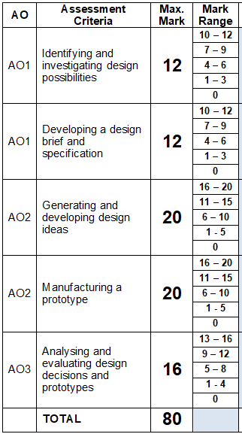
GCE AS Level
WJEC Unit 2
Design and make task
50% of qualification
Approximately 40 hours
80 marks WJEC
GCE A2 Level
WJEC Unit 4
Design and make project
50% of the A2 units and 30% of the overall qualification
Approximately 60 hours
100 marks WJEC
Internal standardisation is essential (across focus areas)

Slide 7
NEA requirements:
  A final design brief developed by the learner following a thorough analysis/research into a range of problems that have arisen from needs identified.
  A design portfolio including informal sketchbook that includes evidence of a personal iterative design journey
  A final quality prototype (or prototypes) based on the design brief. Expectation is that the final outcome will be a quality functioning prototype.
  Ongoing and summative final product evaluation with end user testing and modifications suggested.
  All additional evidence (tests pieces, trials, mock-ups, toiles) to support the iterative process

Slide 8
Teacher Assessment Good Practice
Interpreting the marking scheme
Consider the key words
When marking work of your students consider the following key words initially before placing the work in a particular band and before awarding a particular mark
Band the work first of all before then deciding on the mark within that band.
e.g. for A2, does the student meet…..
Section a) Band 5 - highly effective, wide-ranging, clearly inform, fully considered.
Section b) Band 5 - comprehensive range, thorough and detailed, comprehensive and detailed analysis, detailed, relevant, objective and measurable criteria
Section c) Band 5 - comprehensive and diverse range, excellent use of modelling, detailed proposal, fully considered, sophisticated and highly effective
Section d) Band 5 - comprehensively communicated, appropriate materials, very high quality fully-functioning prototype, excellent understanding, used a range of specialist tools
*It is always important to consider a best fit approach, students may not meet every single criteria in a particular band*

Slide 9
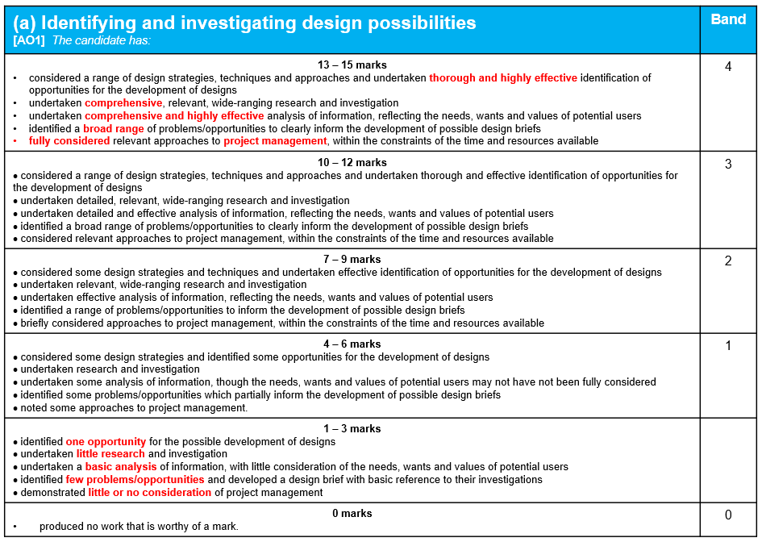
e.g.
(a) Identifying and investigating design possibilities UNIT 4 | WJEC 15 marks
5
4
3
2
1

Slide 10
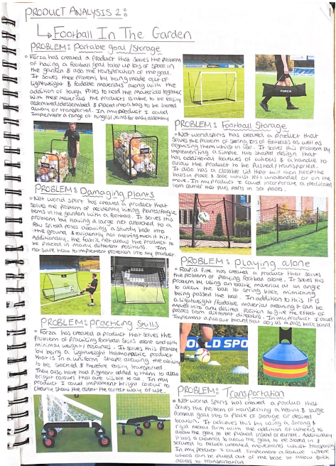
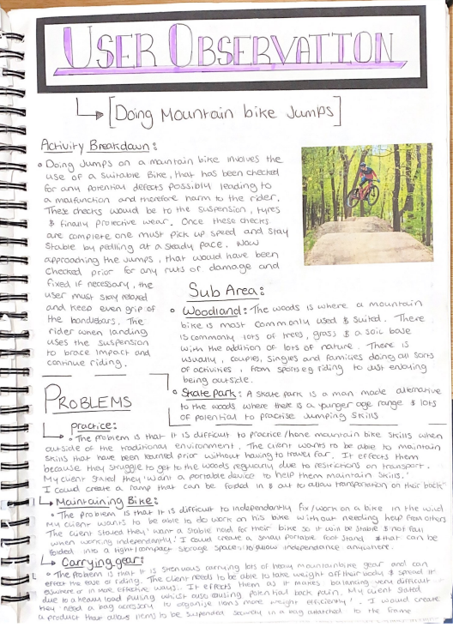
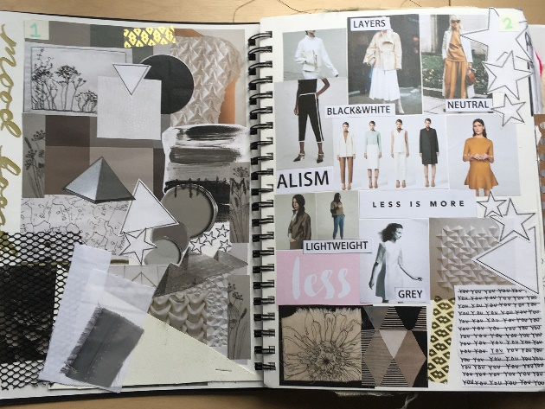
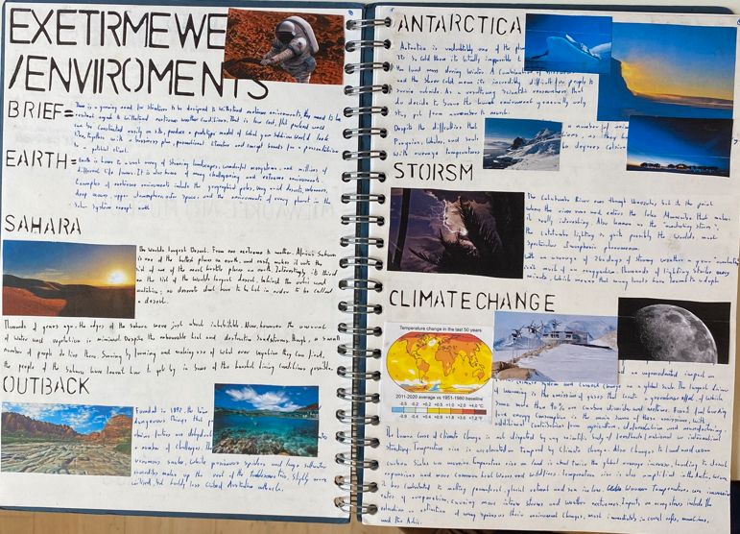
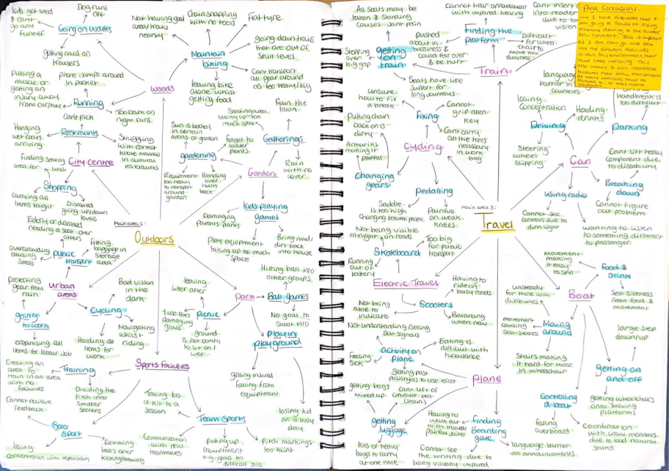
Where do candidates start ?
Identify a range of needs and analyse them
Focus on user/client requirements
Evaluate existing products
Research new materials, processes, techniques
Focus on the problem
Understanding the problem and target market linked to it.
Look at designers / other practitioners

Slide 11
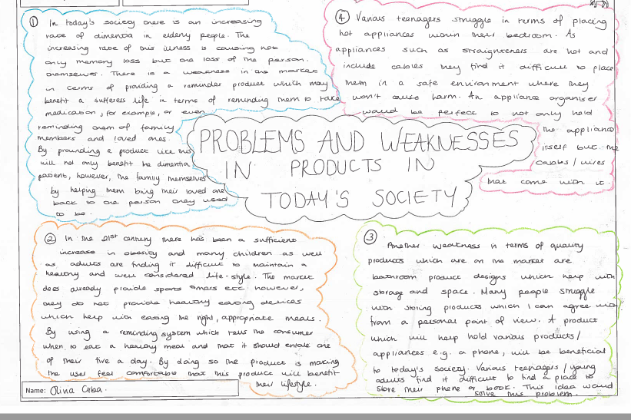
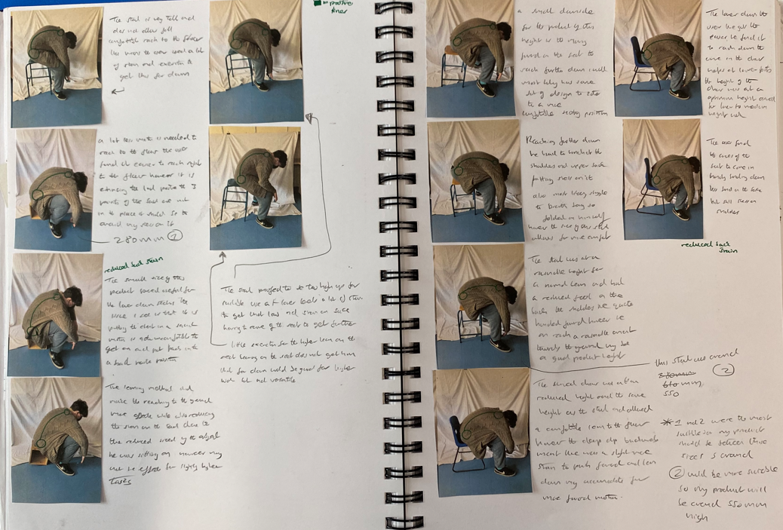
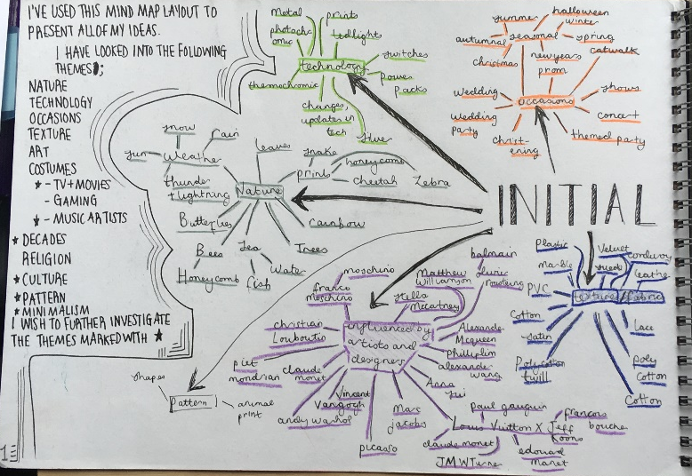
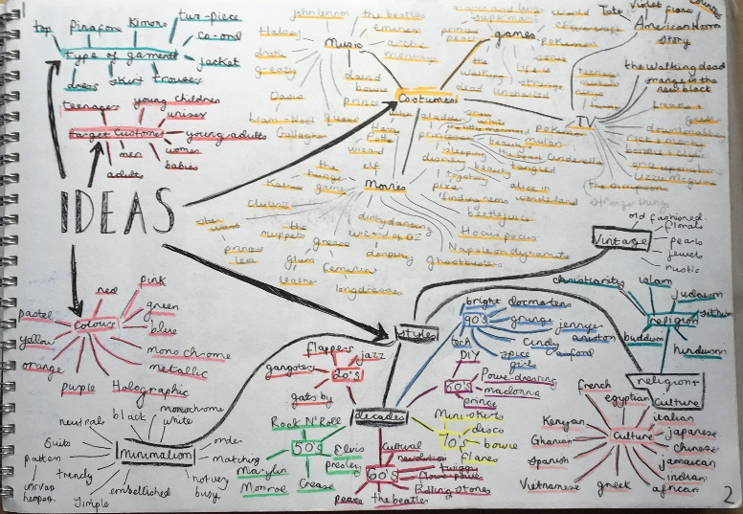
Full exploration of user needs with specific needs highlighted leads to a better understanding of the task. Superficial investigation with no real direction does not.
Focus on a broad range of opportunities to begin with. Candidate choice
Identifying a need
Specific needs identified.
Simple questions are being asked by the candidate - Who? Why? How?
Keeps an open approach
Conclusion about what their challenges are going to be and why they have chosen them
Analysis of information is needed
Focused relevant research follows

Slide 12
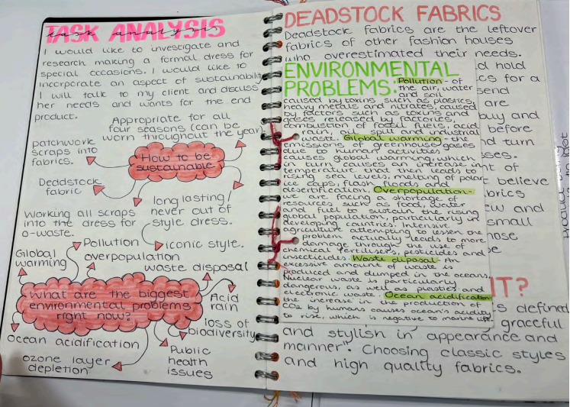
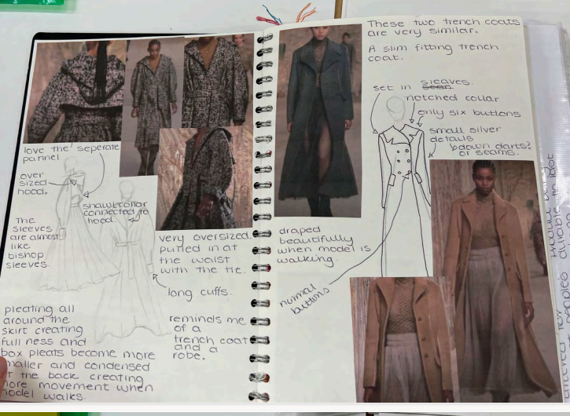
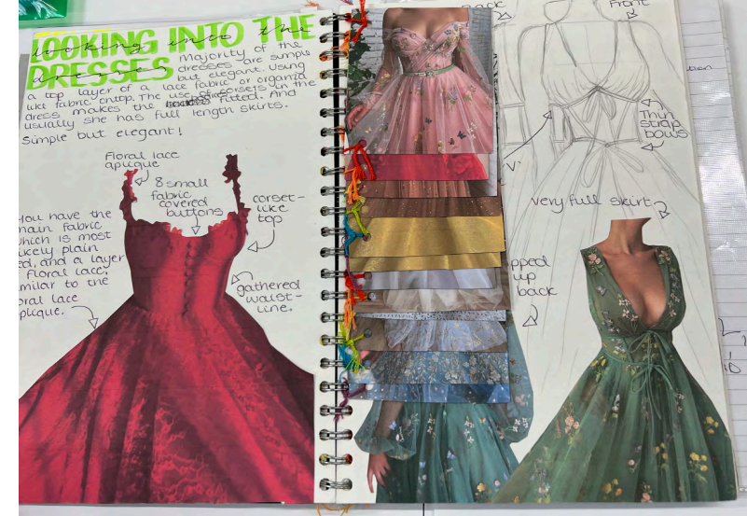
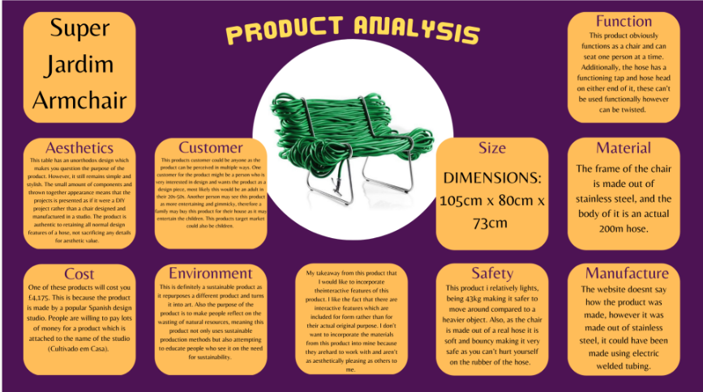

Slide 13
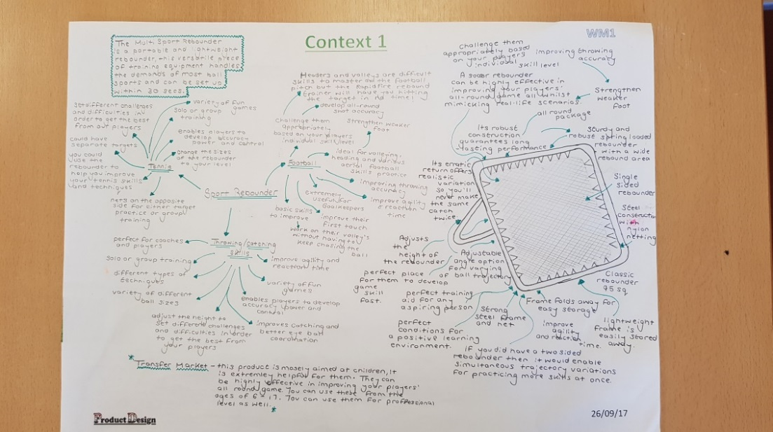
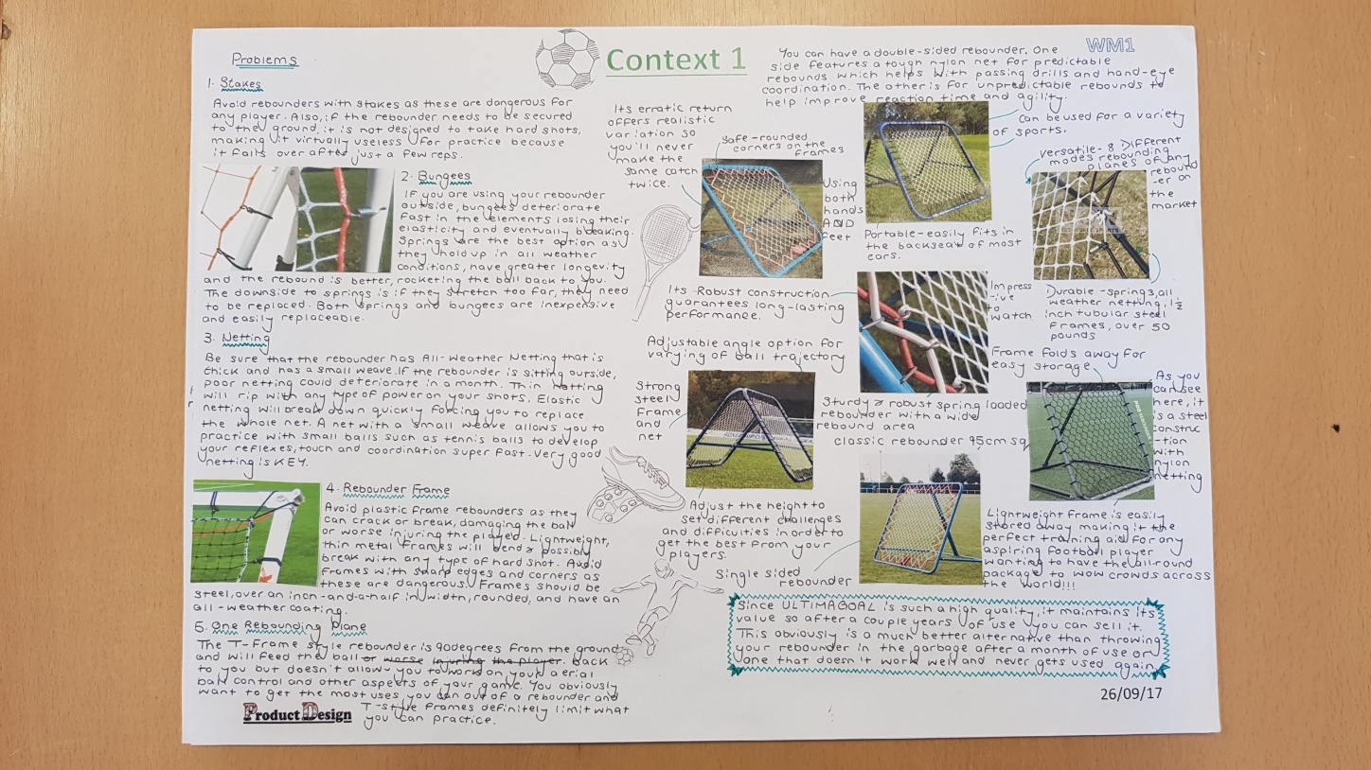
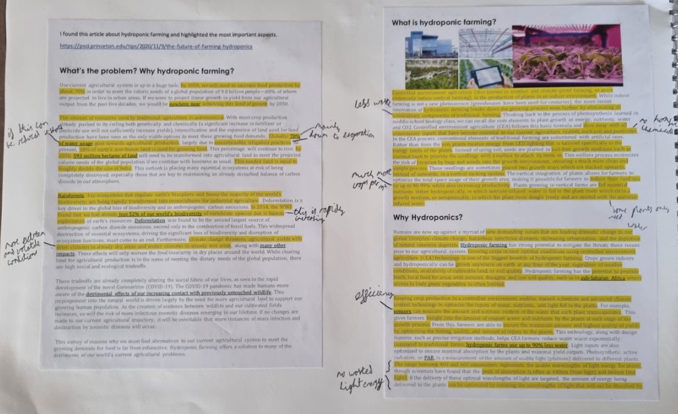
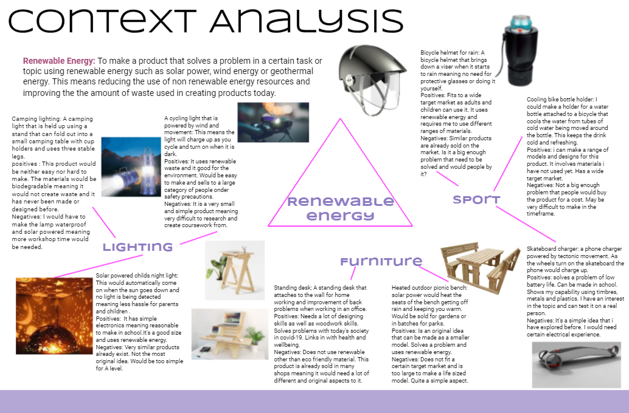
UNIT 4: more in depth
A range of contexts considered, analysed and conclusions drawn upon.

Slide 14
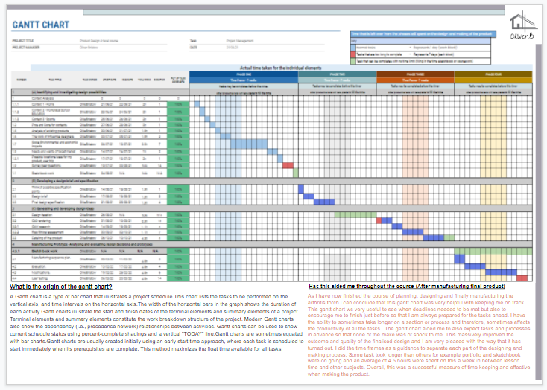
Considered approaches to project managementanningUNIT 4

Slide 15
Summary: Identifying and investigating design possibilities
Research and investigation must be relevant and linked to the context
The needs, wants and values of users is important
Reference to users is on-going throughout the task
Questionnaires (if necessary) should avoid superficial questions that do not provide any meaningful information
Strategies used to gather information should focus specifically on what the candidate needs to know to support the iterative process of design
Avoid ‘padding out’ the portfolio
Less work but far more focused!
A clear understanding of design problems must be evident.

Slide 16
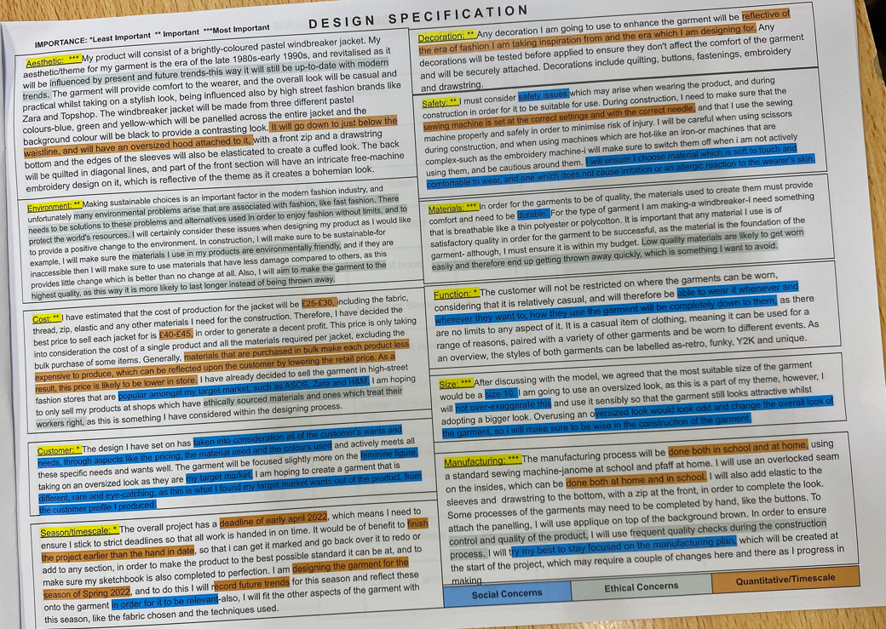
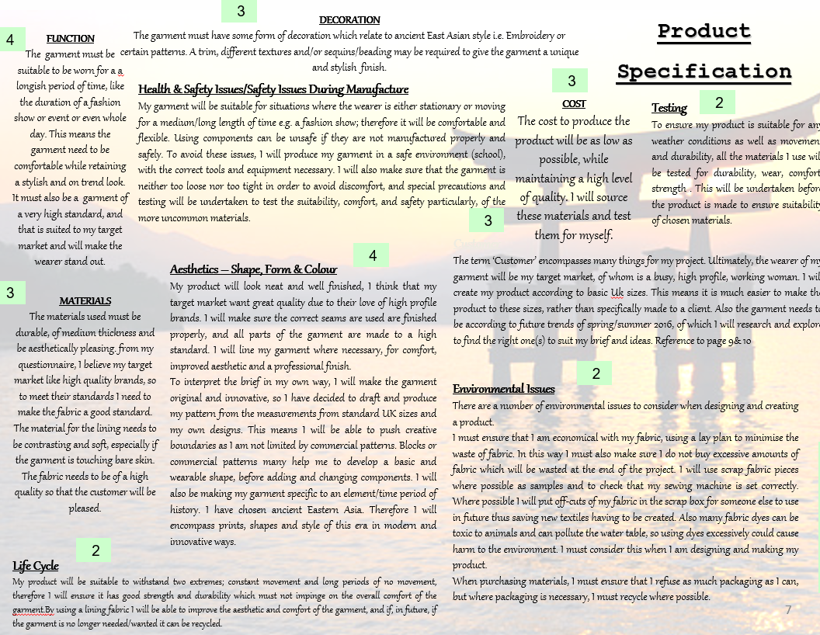
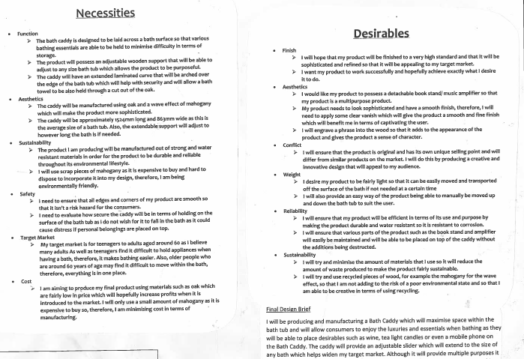
Final Design Brief and Specification

Slide 17
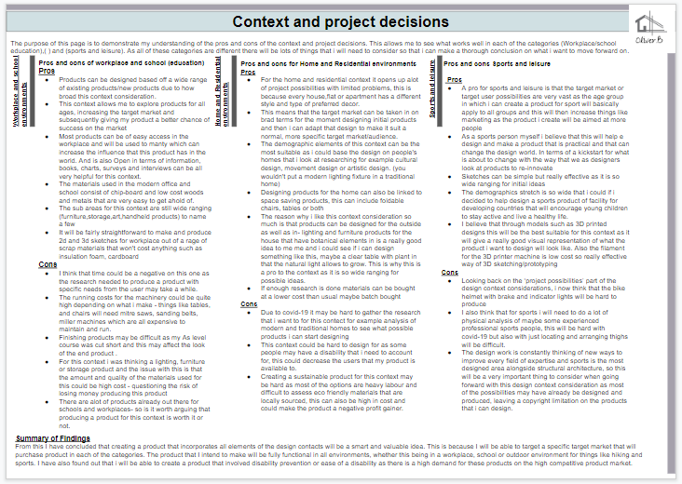
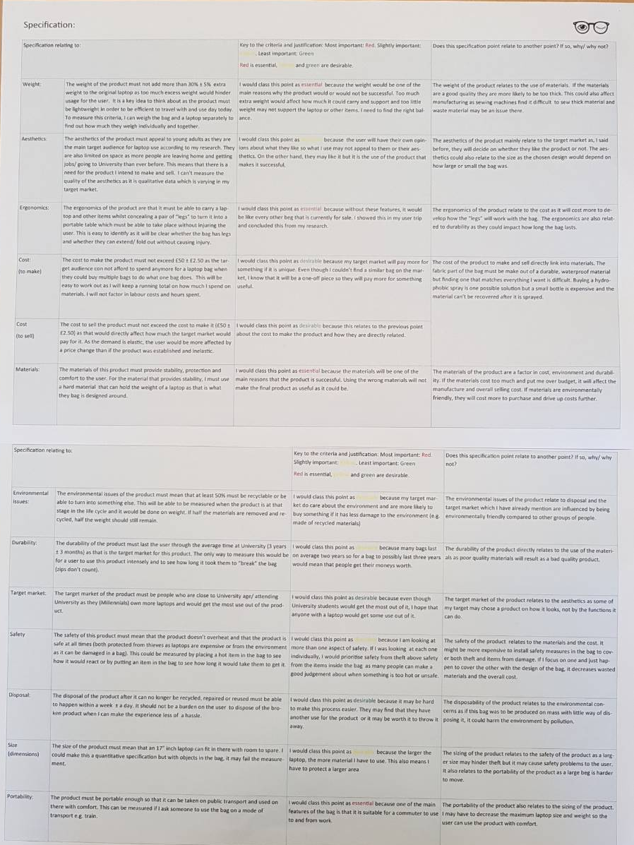
UNIT 4:
Thorough understanding.
A summary of research should then result in a design brief and detailed Specification

Slide 18
Summary: Developing a design brief and specification
Range of problems/opportunities considered before final Design Brief.
Analysis of research to direct need identification.
A clear and detailed Design Brief based on a thorough understanding of the task ahead
Specification with objective and measurable criteria
User needs and wants identified and understood
Specific relevant factors critical to success.
Identifies key aspects including Form, Function, Materials, Sizes, Safety, Ergonomics, Cost etc.
Should be used to direct design decisions and manufacturing

Slide 19
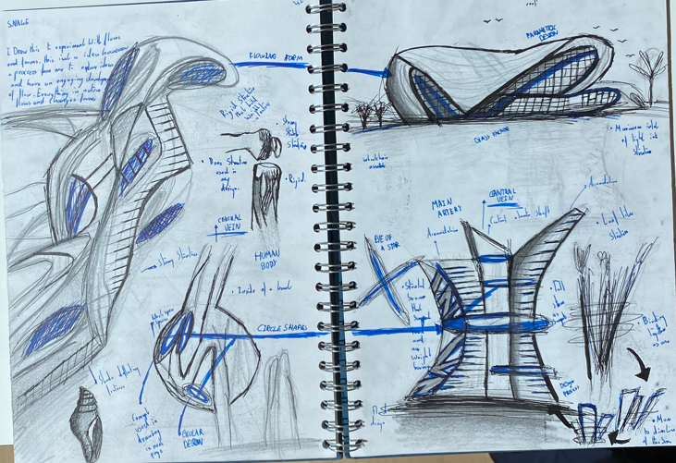
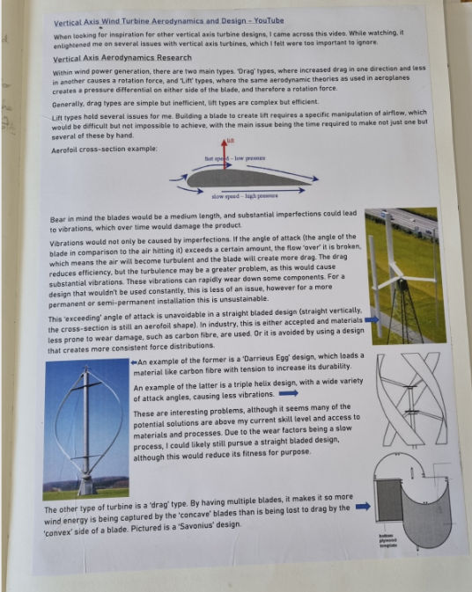
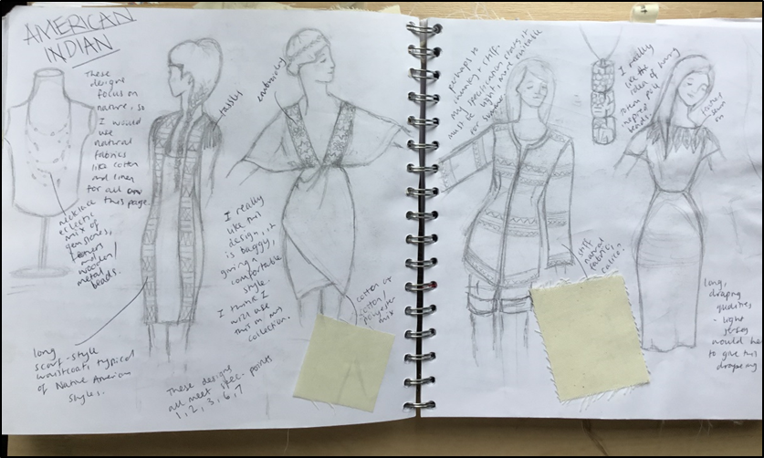
Generating and developing design ideas
Initial ideas
Good concepts
A sound starting point
Specific named material
Shape / form / aesthetics
INFORMAL Sketchpad
Annotation provides details
On-going analysis/ evaluation
Some ideas will be rejected
Possible additional research to support ideas.

Slide 20
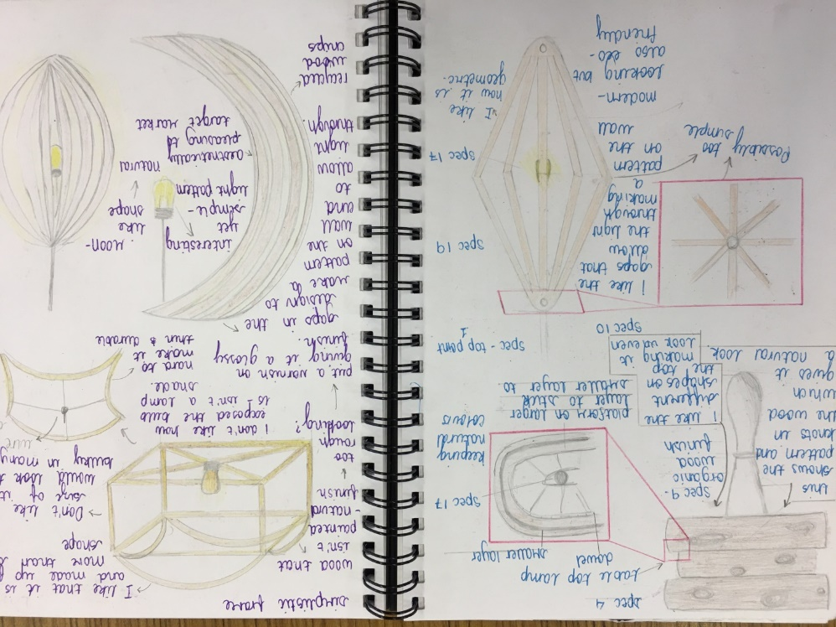
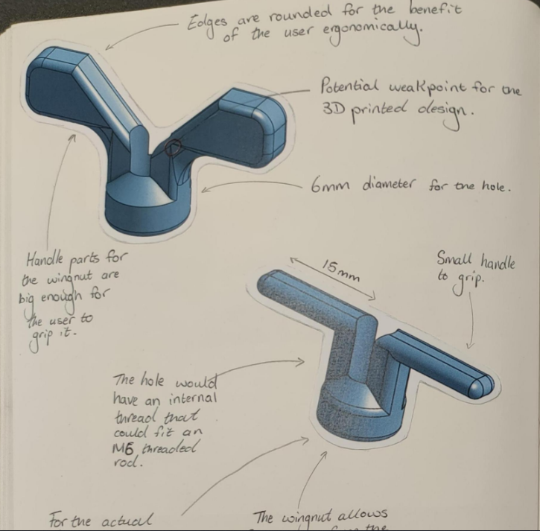
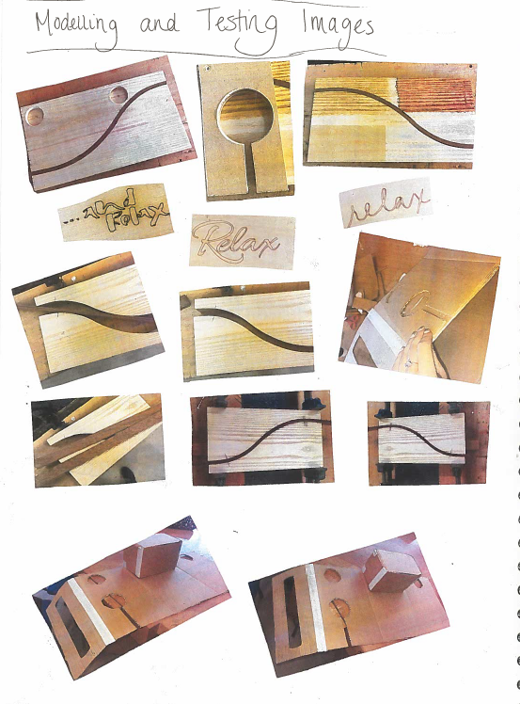
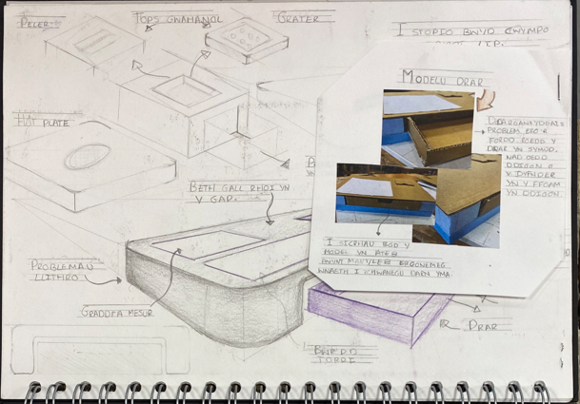
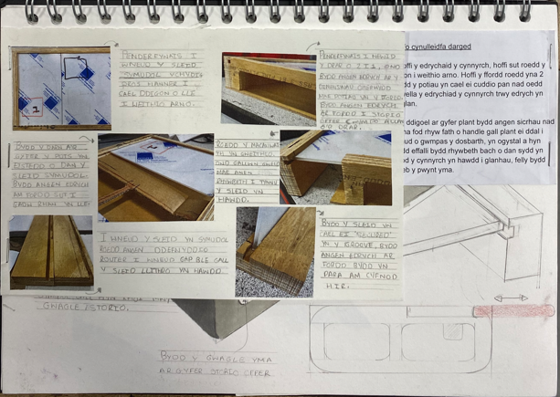
INFORMAL Sketchpad
First iteration
Form / style considered
Some detailed annotation, the student is going through iterative changes clearly showing their design thinking
Idea is supported with practical testing of concepts
Trial materials and construction
Test finishes.
THEN ANALYSE – how to move forward

Slide 21
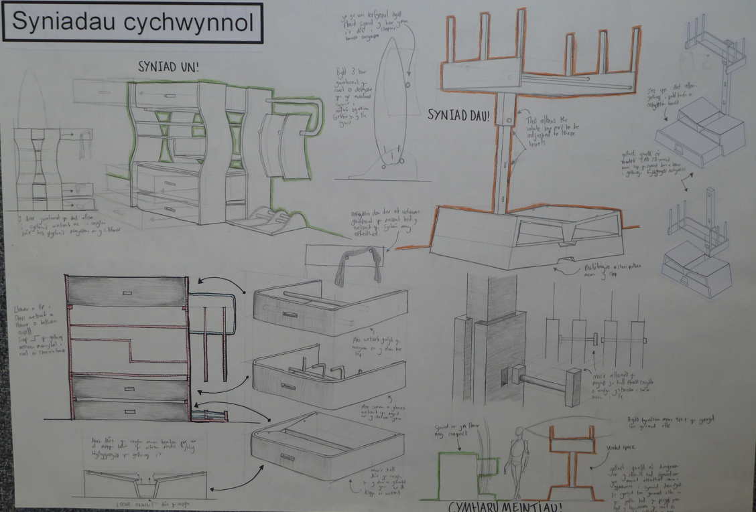
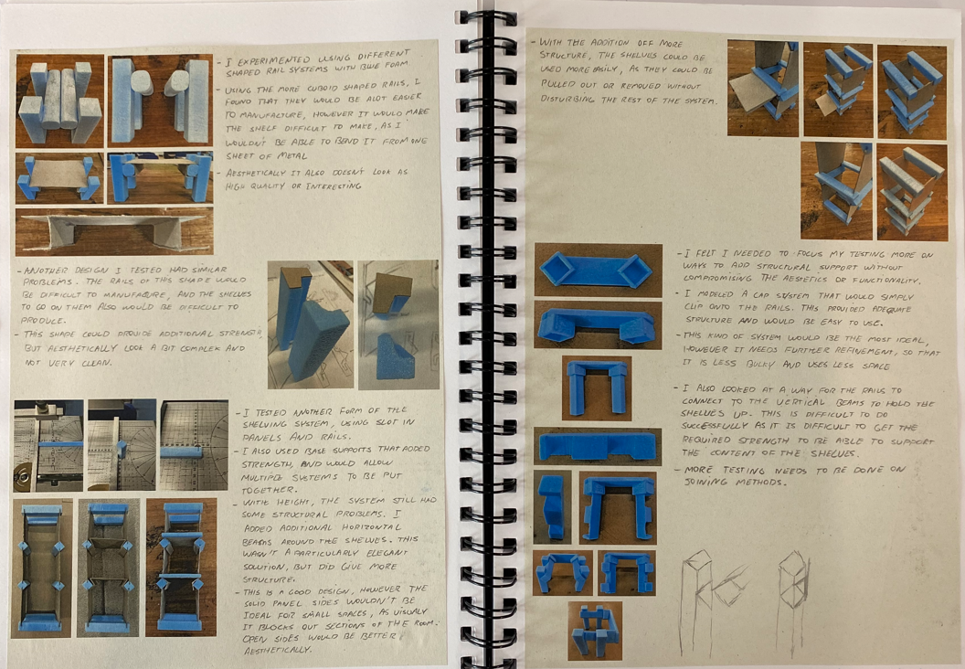
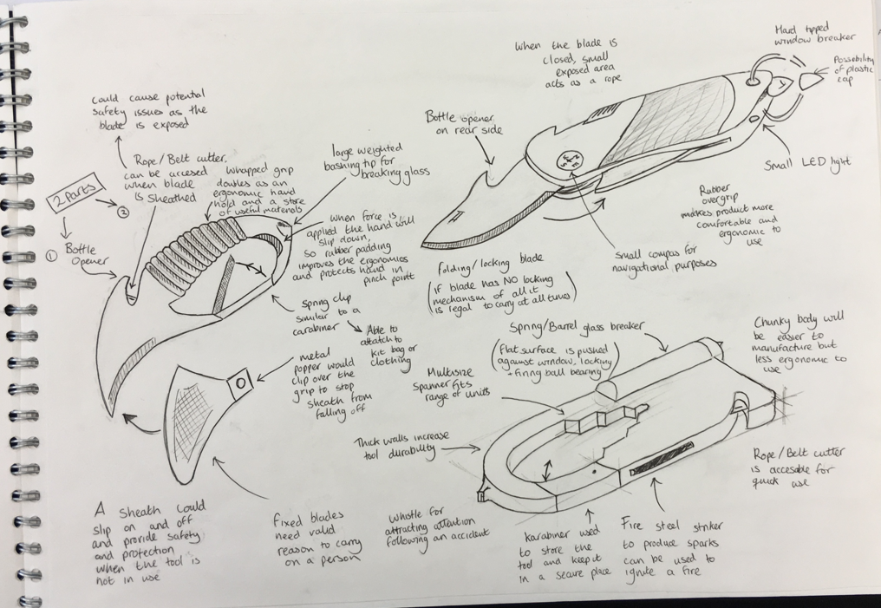
Initial ideas
Good evidence of modelling
Testing v Spec.
Analysis is perceptive
Clear decision making
A mix of practical activity, sketching, reflecting
Needs and wants of users considered
Lean design - adding value!

Slide 22
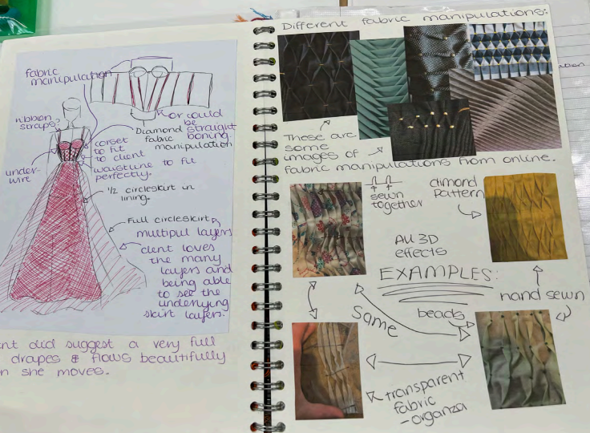
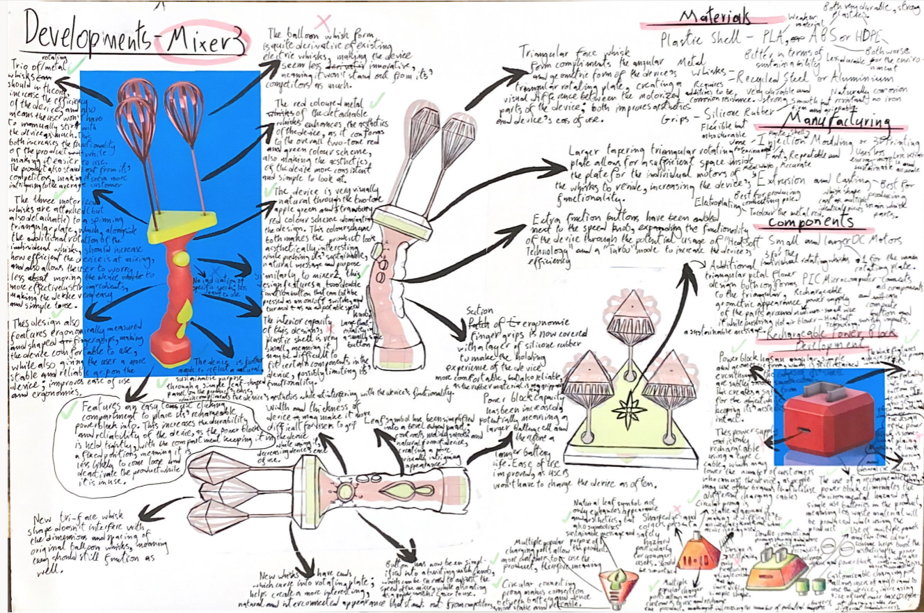
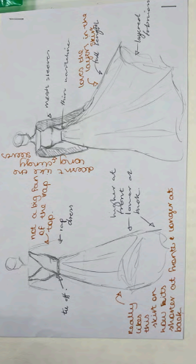
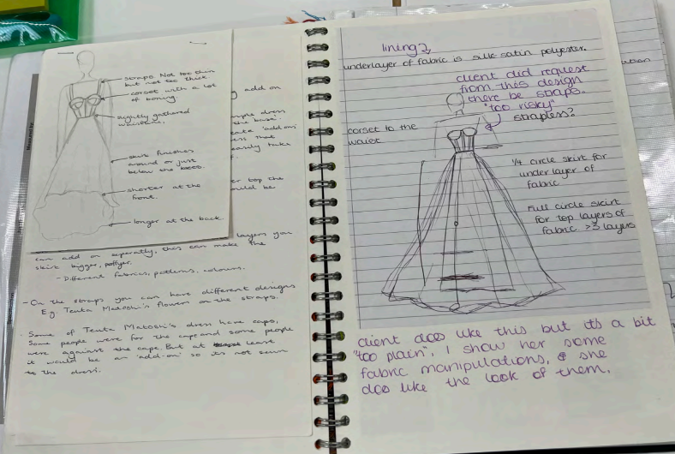
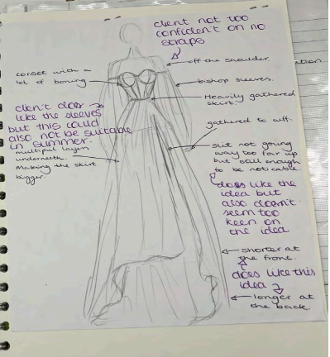

Slide 23
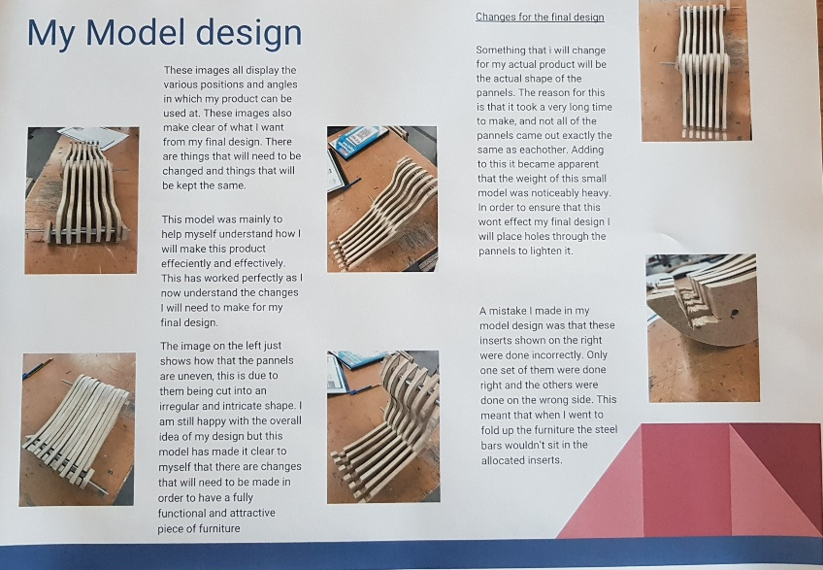
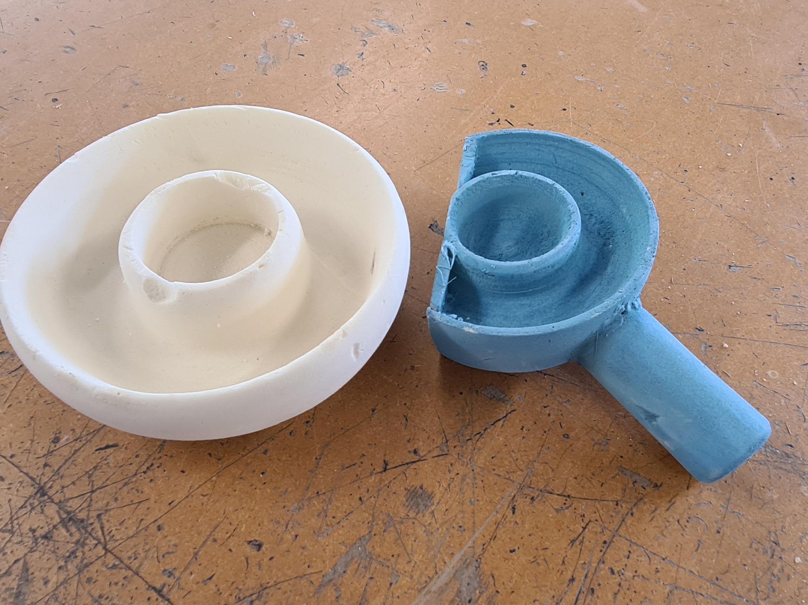
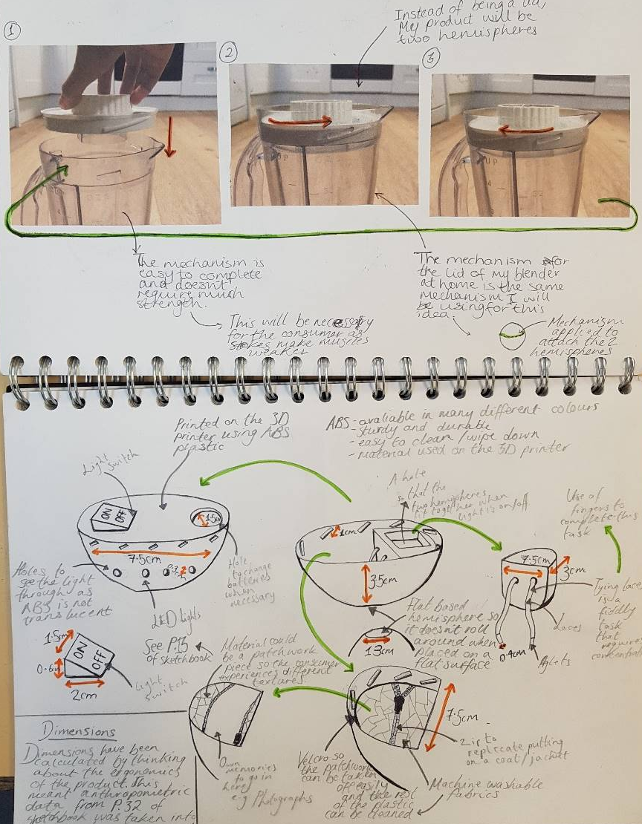
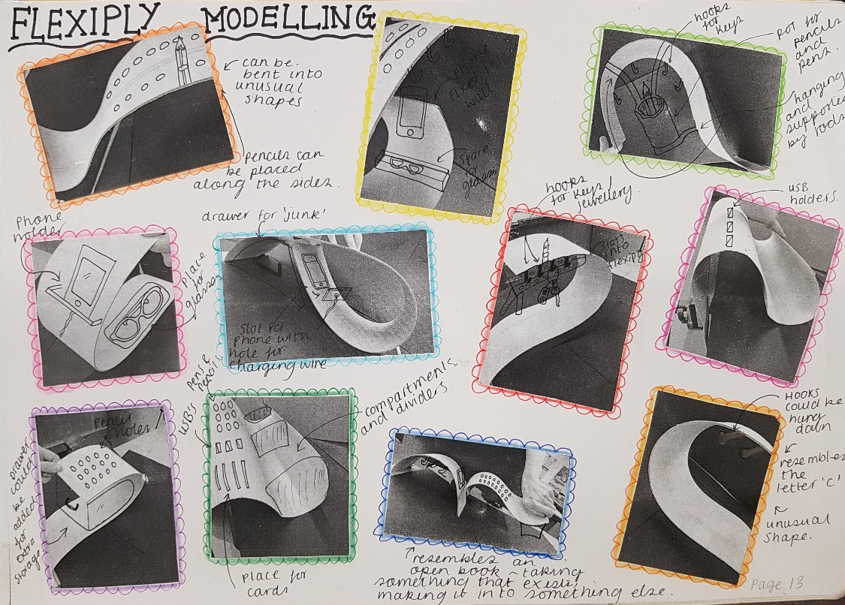
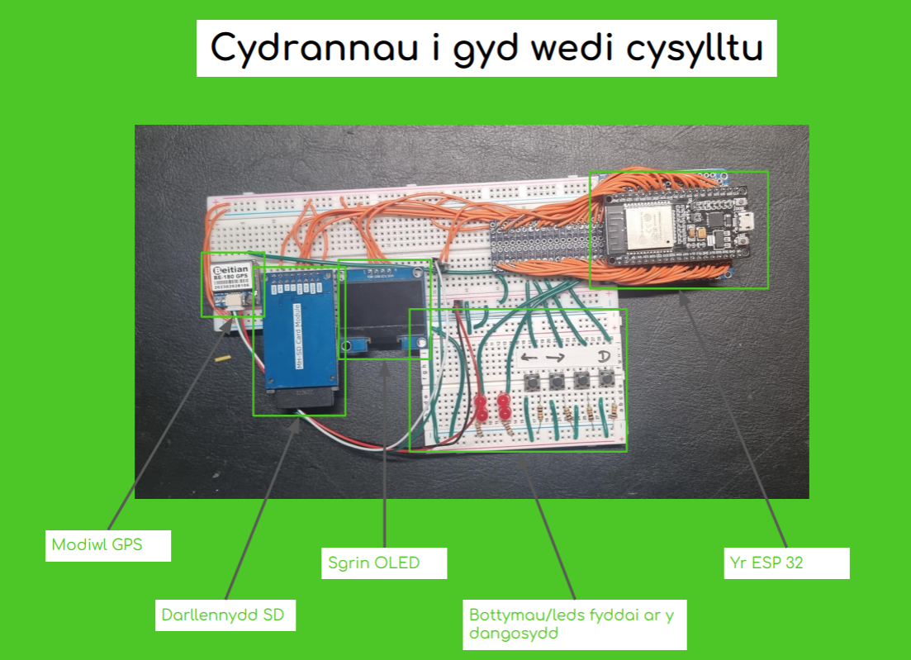

Slide 24
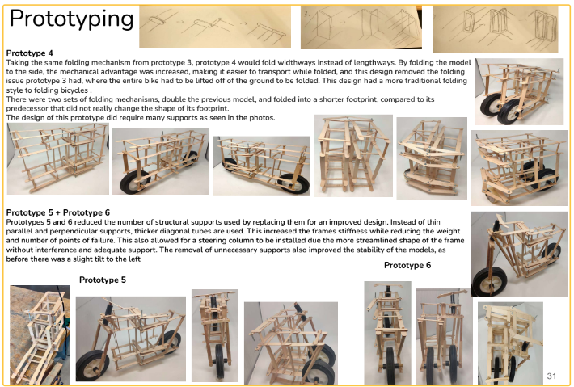
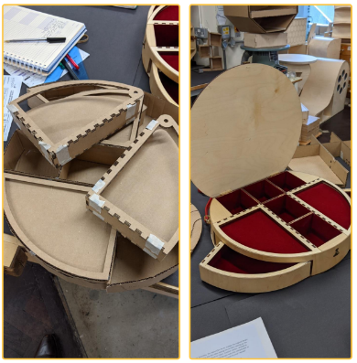

Slide 25
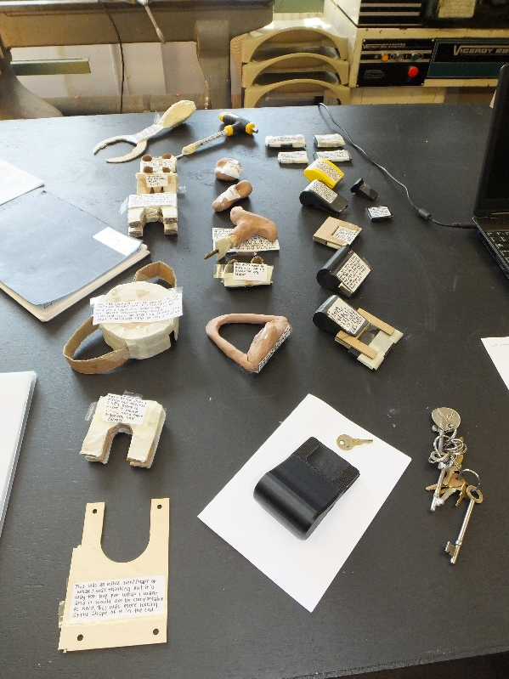





Slide 26




Evidence of an iterative process

Slide 27




INFORMAL Sketchpad
Another iteration -
CAD needs to be introduced at the right time to maximise benefit – not normally a starting point, but could be, for example form.
Communication of details to a third party
Relevant details of materials, dimensions, finishes and production techniques

Slide 28


Slide 29




Slide 30
Summary: Generating and developing design ideas
An iterative approach – good evidence of practical testing / ideas rejected /developed
A range of design strategies – including quick developmental sketching, annotation of details
On-going analysis / evaluation against the specification identifies further refinements
Decision making supports developmental iterations
A mix of practical activity, sketching, CAD…..
Use of modelling
Needs, wants of users considered
High level skills / techniques evident
Detailed proposal
Considered the manufacture of the prototype.

Slide 31



Manufacturing a prototype
FORMAL PRESENTATION FOLIO
Stages of manufacture
A logical sequence – is it clearly communicated with sufficient detail within each stage – could a third party follow the sequence?
Reference to tools, processes and techniques
Quality control
Realistic timeline for manufacture of prototype is needed

Slide 32



FORMAL PRESENTATION FOLIO
A logical sequence for manufacture ~ alternative method of presentation.
Achievable sequence
Could a 3rd party/ manufacturer follow this sequence to produce same?

Slide 33




Slide 34



Slide 35


Slide 36




Is there an iterative journey evident in the evidence provided?

Slide 37



Does it perform as intended?
End user testing.

Slide 38





Slide 39





Slide 40






Slide 41







Slide 42





Slide 43




Slide 44
Summary: Manufacturing a prototype
Stages of a production timeline
High quality fully functioning prototype
Highly appropriate making skills
Excellent understanding shown
Specialist processes and materials used skilfully
High levels of accuracy and finish achieved
A precise outcome that functions well
Meets the needs, wants and values of the user

Slide 45

Analysing and evaluating design decisions and prototypes
A critical and objective evaluation comparing the outcome to the final brief and design specification.
Views of users considered, including end user testing
Suggestions and communication for modifications following testing

Slide 46

More in depth for A2

Slide 47


Slide 48


Slide 49


Slide 50
Summary: Analysing and evaluating design decisions and prototypes
Critical, objective and articulate appraisal of the final prototype
Ongoing analysis/evaluative commentary whilst applying the iterative process of design and development
Final prototype testing; wearer/user trials
Opinions of users
Respond to feedback from users
Further development opportunities identified
Modifications offered

Slide 51
Unrhyw Gwestiynau?
Any questions?

Slide 52
WJEC GCE Design & Technology
Product Design Unit 1 and Unit 3 Exams 2023
Feedback and Guidance

Slide 53
GCE Product Design – Units 1 & 3 Exam Understanding the exam questions
Candidates need to read and consider the question carefully before attempting to answer, some candidates make notes around the question.
Command words give instructions – candidates need to know the differences.
Mark allocation is an indication of the depth of the response required.
Each question has key words that should be carefully considered.
Questions will make use of products and images to put the topic into context.
Notes:
General exam techniques need to be taught to the candidates – STRESS THE IMPORTANCE OF THE BASICS.

Slide 54




Understanding the command words
Give
State
Identify
These questions are designed to ease the learner into the question.
Low tariff questions that rely on recall. Will only be used in early questions at GCE.
There is a need for detail in the answer with clear sentences. Basic bullet points won’t get the higher marks. Sometimes the question will ask the learner to use notes and sketches; this means that a clearly labelled sketch or diagram will, of course, gain the marks.
Higher tariff questions, more challenging and meant to test knowledge and understanding.
Describe
Outline
Explain
Justify
Discuss
These high tariff questions are designed to test, stretch and challenge the more able learner. These questions require the learner to make a well-balanced argument involving both advantages and disadvantages.
A structured approach is needed with a number of paragraphs of extended writing required.
Evaluate
Analyse
Notes:
Discuss the importance to teach the candidates to read questions carefully and ensure they are answering the questions accordingly for the command words.
Higher tariff questions are evaluate and analyse that need the extended answers.
Encourage use of sketches to aid explanations and descriptions where asked.

Slide 55

Unit 1 - Item Level Data
Mean mark (average) typically less than half marks for each question
SD (Standard Deviation) and FF (Facility Factor) indicate accessibility of the paper
Notes:
Share unit 1 item level data with the 2 worst answered questions – Question 1 and 5.
Identify the better answered question 4.
Discuss the next steps to go through some examples for these questions and carry out some discussions.

Slide 56
Exemplar Responses
Unit 1
Discussions looking at example responses from 2023 paper

Slide 57

Question 1 – Worst answered question
General Comments
All candidates attempted this question. With 3.4 the average mark attained and a Facility Factor of 42.4 and a Standard Deviation of 1.6, this proved to be the most challenging question on the paper.
Basic analytical skills were not employed in relation to the question, many responses referred to the colour coding of the containers which has little relevance to the effective use of space.
Actual Mark – 5
Not enough discussion in part (a) to gain more than 2 marks. Candidate only talks about the stacking of the containers and could have mentioned about the impact of the lids also.
Marked agreed by Principal Examiner in the sampling process as seen by the green marks.
Notes:
Talk through the general comments for this question which was the worst answered question on the paper surprisingly. Main issue that the responses didn’t link to the effective use of space in part (a).

Slide 58


Question 6 (a) and (b) – Spot the difference
Not much difference from part (a) to part (b) responses. A lot of the information is the same and a redraw of part (a)
Part (b) needed to be a working drawing this was not the case for the majority of candidate responses and this part was poorly answered.
Notes:
Talk them through the main issue with question 6 – Part (a) and (b) very similar and lack of working drawings.

Slide 59
Question 6 (a) and (b) – The biggest issues
This question proved to be challenging with a wide variety of responses and marks. Many candidates did not link this question to the skills and knowledge that they would have developed through the NEA task and the information that they would have produced in the Generating and Developing Design Ideas (AO2) section of the NEA.
A surprising number of candidates did not respond to this question and many of the responses presented little information other than a simple sketch or a drawing.
In some instances, the response was a redraw of the information presented in question (a) and in this instance candidates were only credited with any new information that was provided.
Candidates who were able to produce a simple drawing/drawings together with critical details that were complied with BSI standards i.e. dimensions and tolerances were suitably credited and achieved high marks.
Notes:
Talk through the general comments for this question which saw the vast ranges in responses.

Slide 60



Question 6 (b) – Better examples
Better technical details shown with some attempt to draw an orthographic working drawing.
Key measurements identified which are suitable.
Reference to scale.
Parts labelled with materials and key features.
6/8 marks
8/8 marks
Notes:
Talk through the better responses for question 6b.

Slide 61

Unit 3 - Item Level Data
Mean mark (average) typically less than half marks for each question
SD and FF indicate accessibility of the paper
Notes:
Share item level data with the 3 worst answered questions – Question 4, 10 and 7.
Identify the 2 better answered questions 2 and 8.
Discuss the next steps to go through some examples for these questions and carry out some discussions.

Slide 62
Exemplar Responses
Unit 3
Discussions looking at example responses from 2023 paper

Slide 63

Question 4 (b)
General Comments
The facility factor for this question was 24.5 and a mean score of 2.9 from 12, proving to be the most challenging question to candidates. This question had two elements to it and part (a) was better that part (b).
The main concern with this question was that responses for part (b) did not address what was being asked from the question and the majority of responses explained the process of vacuum forming rather than explaining the features required to produce a successful industrial former.
This highlights the importance of reading the question carefully. Where the answer was answered well it was clear that candidates were able to identify draft angles, support ribs and the need for the former to be designed with a working hinge to make it one piece.
Discussion
Any thoughts?
Actual Mark – 0
Process of vacuum forming explained but this is not what the question was asking.
This was a common theme across the majority of candidate responses.
Notes:
Talk through the general comments for this part of question 4 which was the worst answered question on the paper.
Talk through main concern that candidates gave the process of vac forming instead of talking about the features of the former/mould.
Stress importance to read questions - BASICS

Slide 64


Question 4 (b) – Better examples
Reference to webbing
Ribs on the mould
Rounded edges
Draft angles
One piece mould requirement
Required finish of mould
Notes:
Talk through the better responses for question 4b.

Slide 65


Question 7
General Comments
This question proved difficult for many candidates, with a facility factor of 46.3 and a mean mark of 5.6 out of 12.
There were some good responses in which candidates identified a range of benefits and negatives of JIT, however many didn’t go onto evaluating the impact this could have on the manufacturer. As in previous years it is vital that candidates ensure they structure their response for the A03 evaluate questions.
Discussion
Mark scheme
Any thoughts?
Notes:
Talk through the general comments for question 7.
Show mark scheme and example answer and give a few minutes for discussions.
Reveal actual mark and discuss where the candidate was credited for their response.

Slide 66
Extended responses
Question 5 – Unit 1
Question 10 – Unit 3
Still issues regarding depth of answers for extended responses in both AS and A-Level papers.
The A03 ‘analyse’ and ‘evaluate’ questions particularly need to be an area of focus for centres as there are still a large number of candidates that lack the structured well written answers required to meet the higher band marks and it would be beneficial if centres could continue to allow candidates to practice answers in a structured approach; using introduction, main points followed by a conclusion.
The mean marks for extended response questions in unit 1 and unit 3 sees a drop from last year’s mean score for these longer analyse/evaluate questions.
Short introduction outlining overview of topic
Main paragraphs giving detailed evaluative or analysed details of benefits, negatives of topic
Concluding comments
Notes:
Talk through the same issues from previous years regarding the longer extended responses needed and the need for a more structured approach in both units.

Slide 67

Producing examination style questions for assessment in the classroom

Slide 68





Question banks
https://questionbank.wjec.co.uk/
Notes:
Direct to useful resources available on the question banks. Demonstrate how these can be used to build internal assessments.
Point out that the eduqas questions could be used also as long as the topics are on the WJEC spec so just need to check that.

Slide 69





Resources for teachers
Supporting teaching and learning
Free subject specific resources available for all to download from our website.
Free digital resources
To support the teaching and learning of a broad range of subjects.
Secure Website
It allows teachers to analyse item level data, assess sample and past papers, mark schemes, grade boundaries ^{and receive examiner feedback.}
Notes:
Direct to useful resources available on the WJEC website, including secure website for grade boundaries and item level data that could inform future planning for cohorts.
Links to relevant websites hyperlinked in presentation.

Slide 70
Resources for teachers
Supporting teaching and learning
A range of very useful resources already created for the candidates to revise and prepare for both unit 1 and 3 exam papers
Notes:
Demonstrate where to find the useful resources on the WJEC website and show some examples of the above resources which are very useful when delivering the content for unit 1 and 3. Very useful for revision and exam lessons.

Slide 71
Improving performance - Recap
Allow sufficient time to teach the contents of the specification and build skills
Regular testing and practice answering exam style questions
Link theory with practical work
Use the OER resources on the WJEC website – candidates can access this too
The papers allow plenty of time for a reason – avoid rushing through the paper
Questions demand that candidates think carefully about the context of the question – the images and products are there to support; use this information
Avoid repetition in answers
Read the questions carefully
Candidates should read through their answers – is the meaning clear?
Notes:
Recap main findings

Slide 72

Resources for teachers
Supporting teaching and learning
Free subject specific resources available for all to download from our website
https://resources.eduqas.co.uk/
Free digital resources
To support the teaching and learning of GCE Design and Technology
Free online exam review
It allows teachers to analyse item level data, critically assess sample question papers and receive examiner feedback.
www.wjecservices.co.uk
Key documents, past papers and mark schemes

Slide 73

Digital Resources
Blended Learning: interactive self-study to complement teaching and learning
Knowledge Organisers: To support learning of GCE Design and Technology
NEA walk through: aimed at learners; a practical approach in preparing for the NEA.

Slide 74
Become an examiner or moderator?
If you wish to:
Enhance your subject knowledge
Progression of your career
Network with other teachers and experienced professionals
Receive comprehensive training and support
Boost your income visit the WJEC website and follow the link to apply to become an Examiner.
“It is the best CPD available to you”

Slide 75
Unrhyw Gwestiynau?
Any questions?

Slide 76
Diolch
Tîm Dylunio a Thechnoleg
Jason Cates – Swyddog Pwnc
029 2240 4303 dylunioathechnoleg@cbac.co.uk
Thank you
Design & Technology team
Jason Cates – Subject Officer
029 2240 4303
designandtechnology@wjec.co.uk

