Slide 1


GeogShots
CC BY-NC-ND 4.0

Slide 2
GeogShot.
A 10-minute solution focused “shot” of geography to help guide your learners to more successful responses in the exam.
They are designed so you can fit these resources into your existing lesson plan or adapt as you want.
Each builds on identified actions from examiners reports.
They could be part of your intervention strategy to support and challenge your learners in class.
They are designed to allow you to insert a relevant question to work on from any aspect within the specification.

Slide 3

Candidates need to ensure that they use map evidence when this required for exemplification in the command for a question. When using map evidence, regardless of the type of map, candidates should aim to be as accurate as possible in their use of scale, direction, or information from the key, (examiners report 2023).
https://creativecommons.org/licenses/by-sa/3.0/
How can this be included in your lesson?

Slide 4
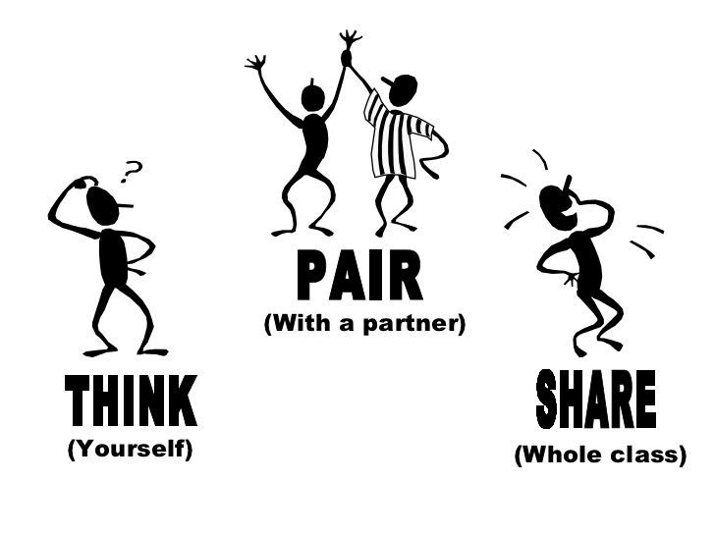
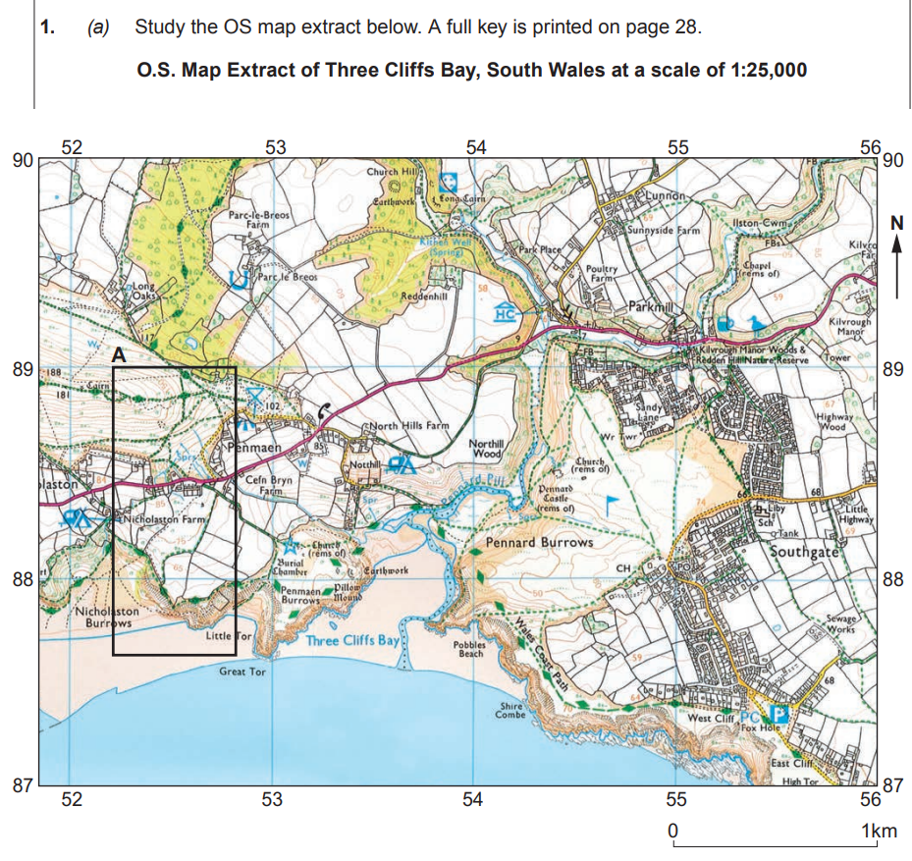
What should you always notice and use accurately in your answer using an OS map?
Read the title there are clues here.
Note there is a key on page 28 USE IT.
Often there is an outlined focus area.
Describe 3 main features.
Make sure you know how to interpret the scale. Use your ruler.
You need to be able to locate on the map using 4 and 6 figure co ordinates.
WJEC/CBAC 2019

Slide 5
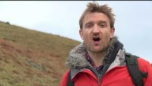
Watch this video to remember how to use OS map extract accurately.

Slide 6
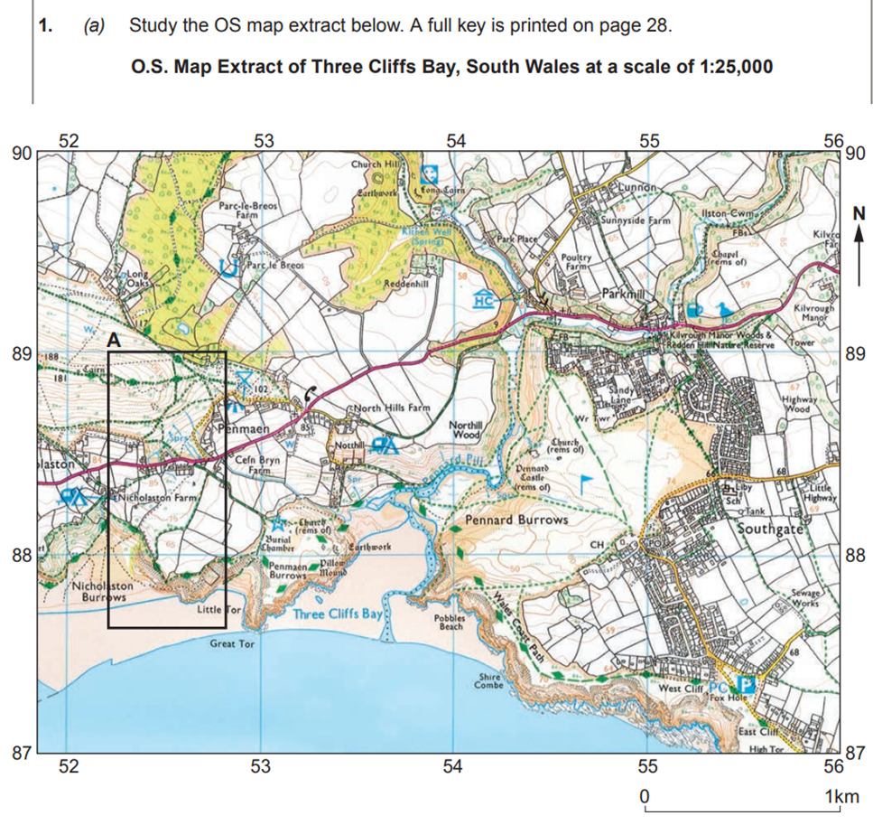
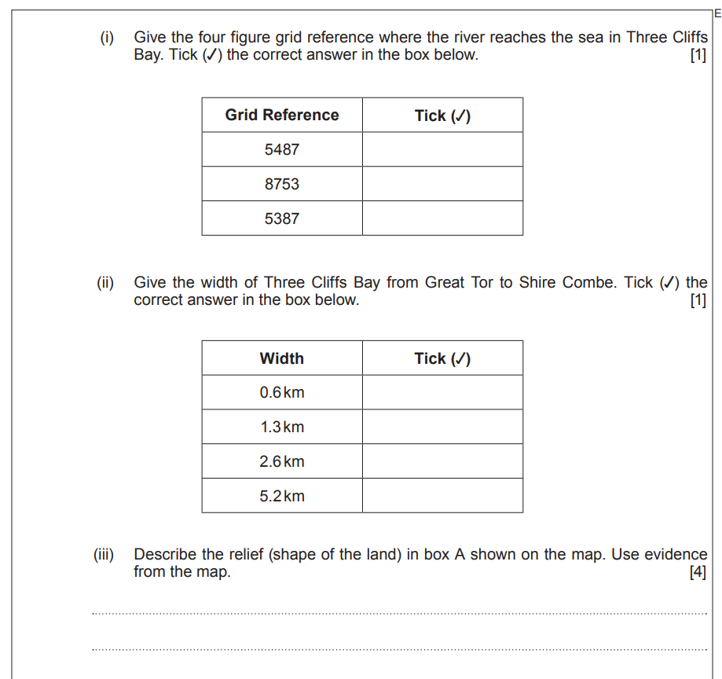
The skills you have been asked to demonstrate in these questions gives you 6 marks.

Slide 7
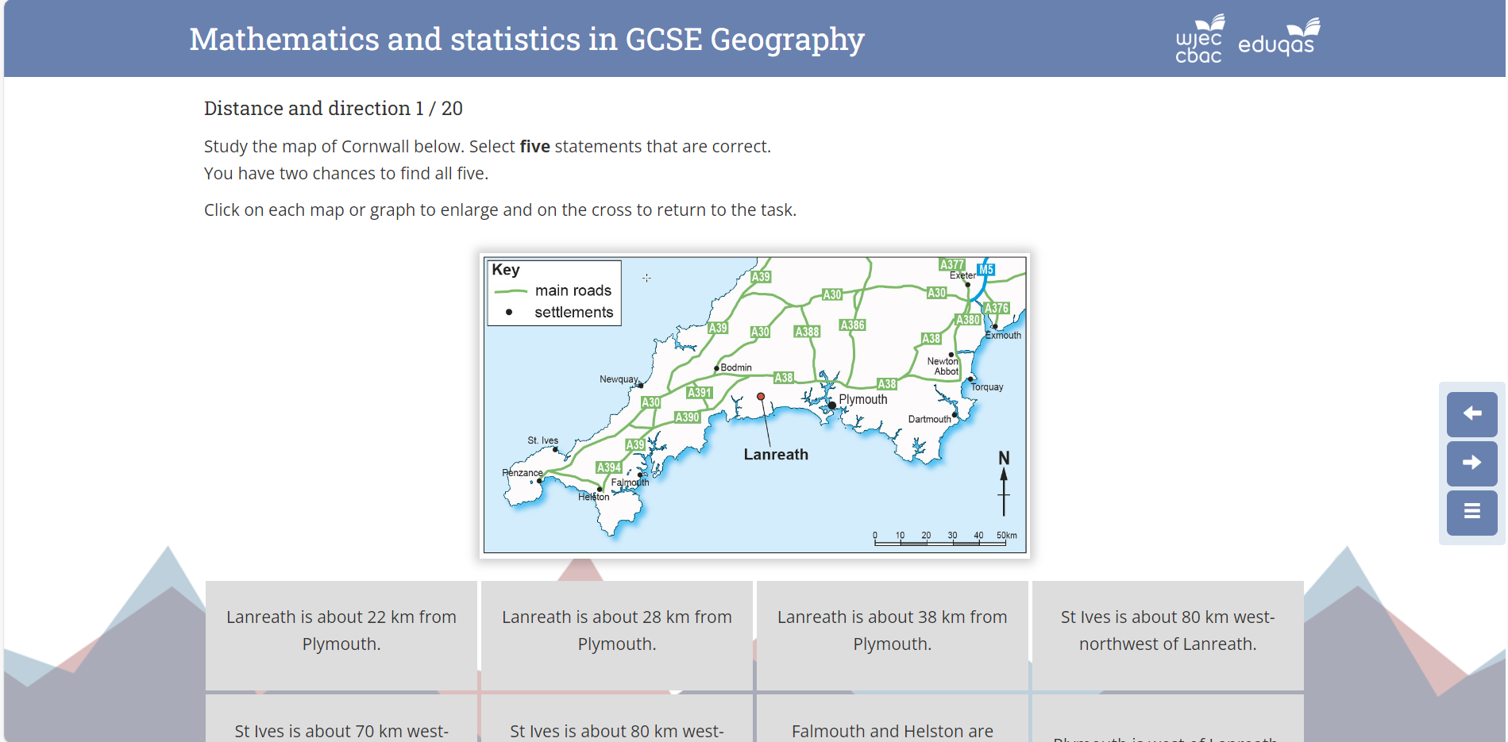
Use this resource to practice. These are often low tariff questions but straightforward where you can gain a good score to add to your overall grade.
You need to be accurate and use as directed the scale, key and direction in your answer.
Mathematics and statistics in GCSE Geography (wjec.co.uk)

