Slide 1
GCSE

Slide 2
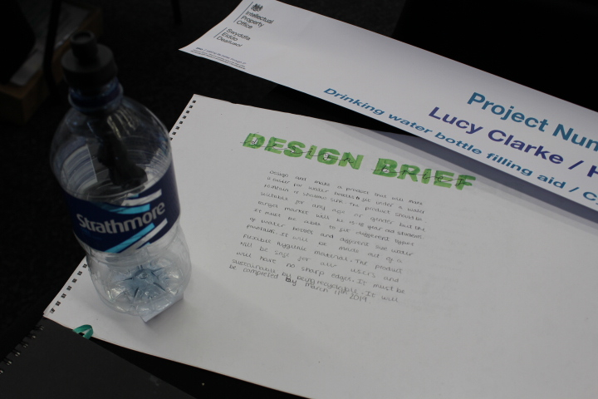
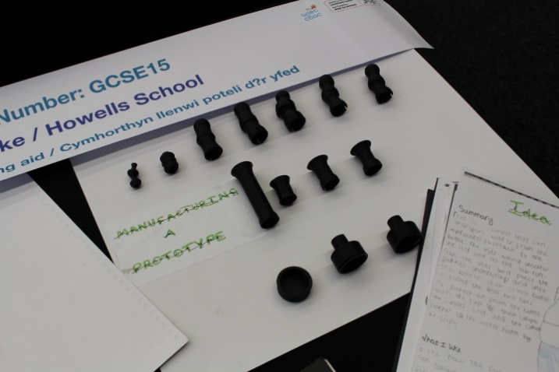
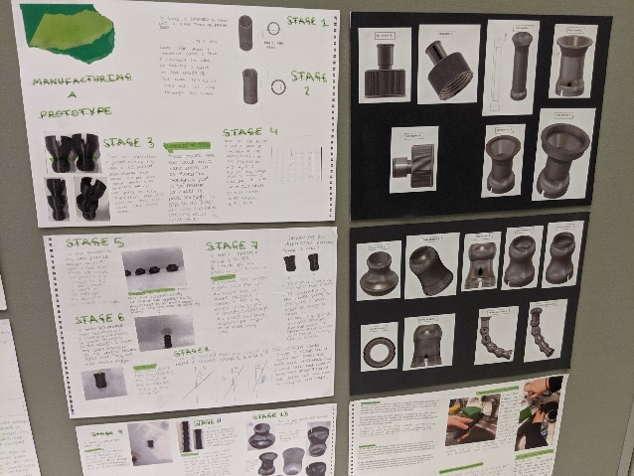
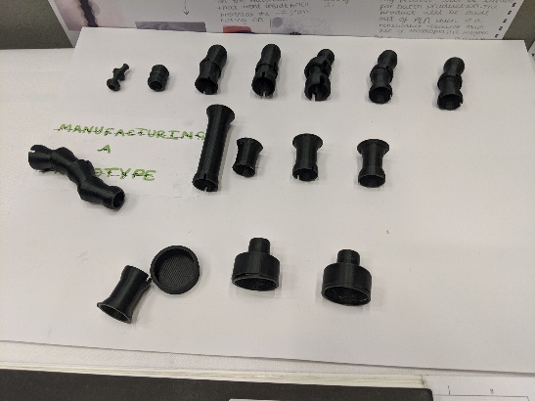
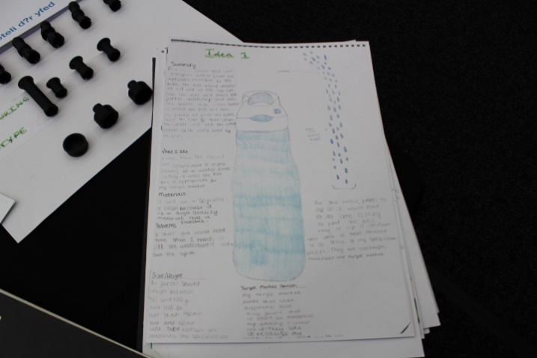
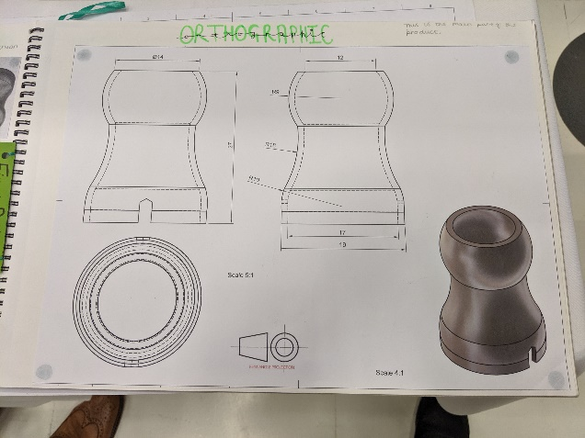
GCSE 15 Lucy Clarke Howells School Drinking Water Bottle Filling Aid
CAD/CAM WINNER
ENILLYDD CAD/CAM

Slide 3
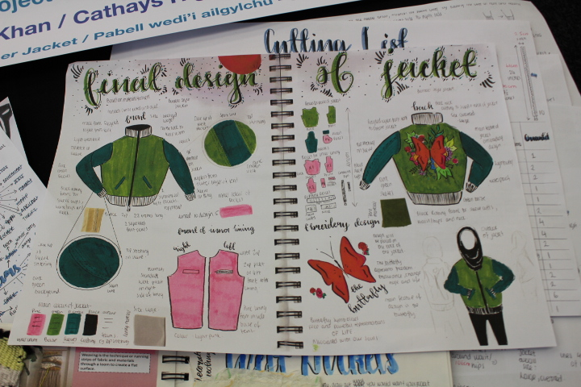
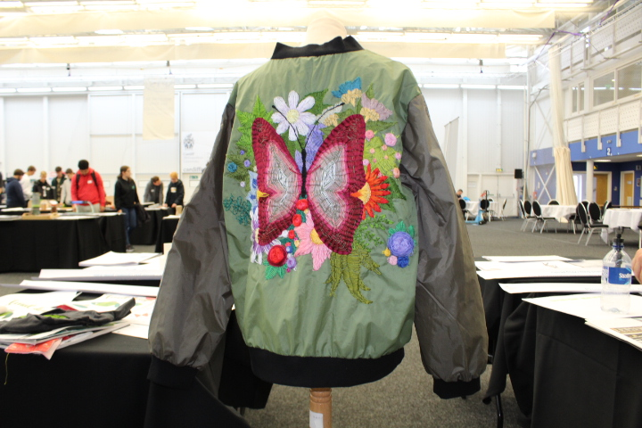
GCSE 19 Yusara Khan Cathays High School Recycled Tent – Bomber Jacket

Slide 4
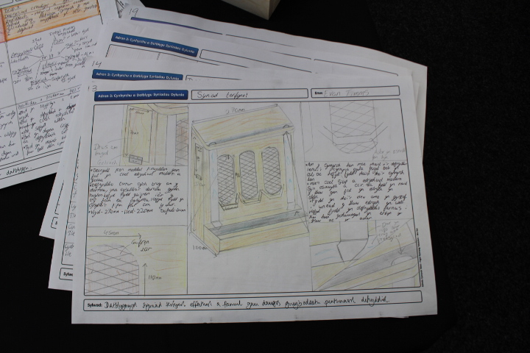
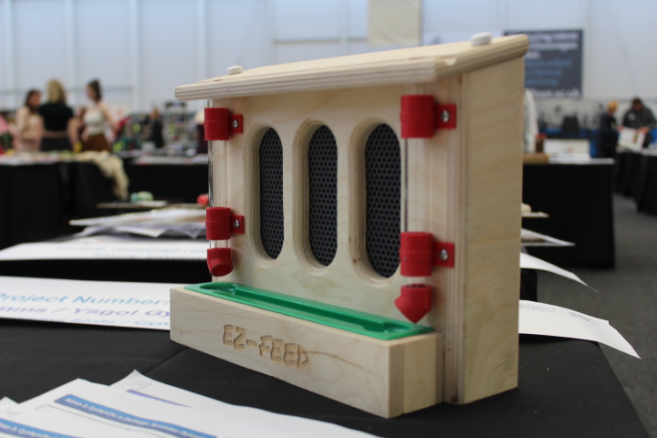
GCSE 17 Evan Paul Timms Ysgol Gymraeg Ystalyfera

Slide 5
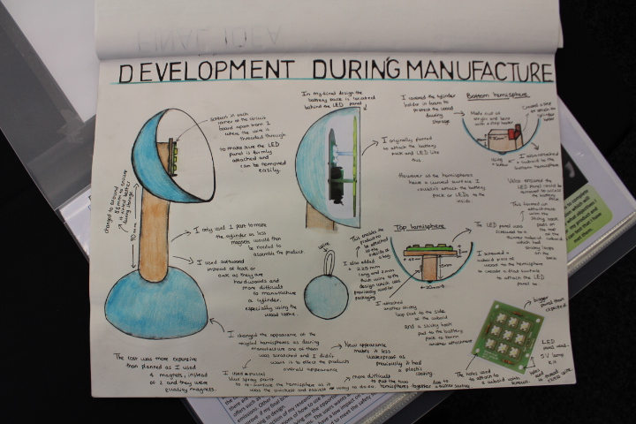
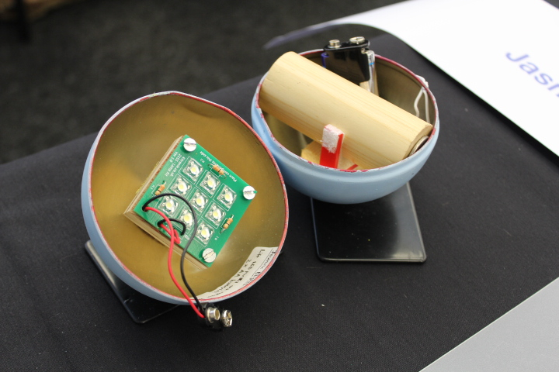
GCSE 11 Jasmine Blights Ysgol David Hughes Orbe Torch

Slide 6
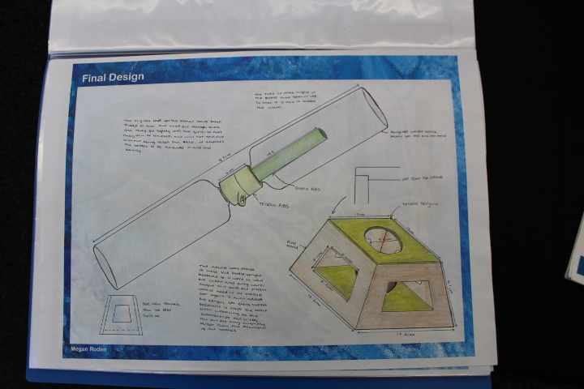
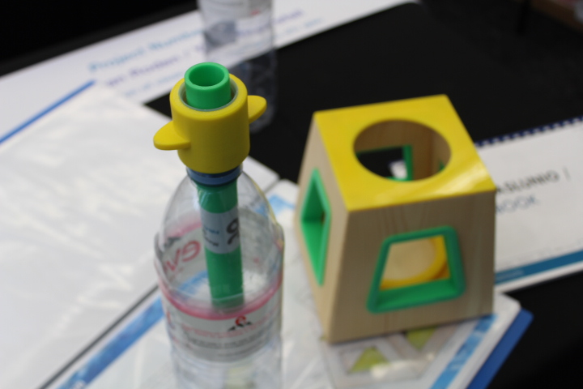
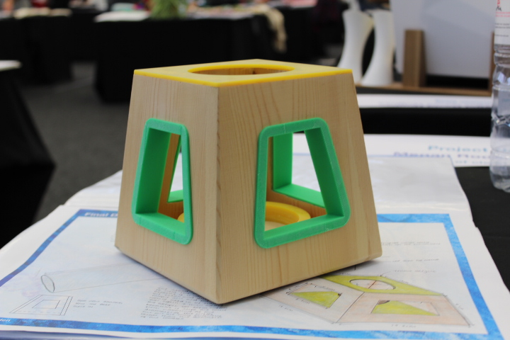
GCSE 2 Megan Roden Ysgol Brynrefail
Production of Clean
Water

Slide 7
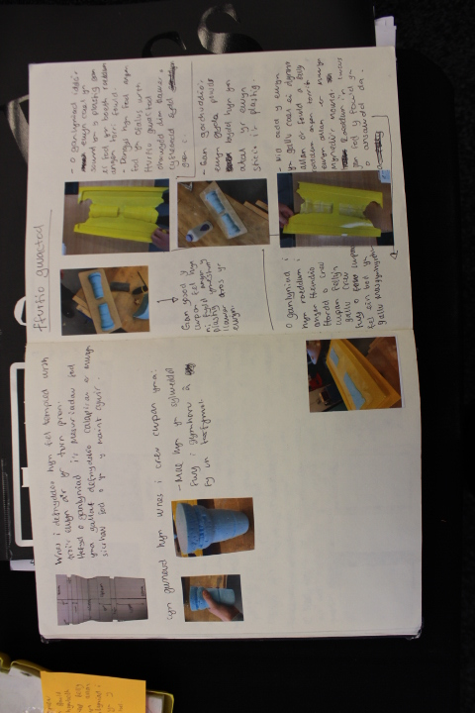
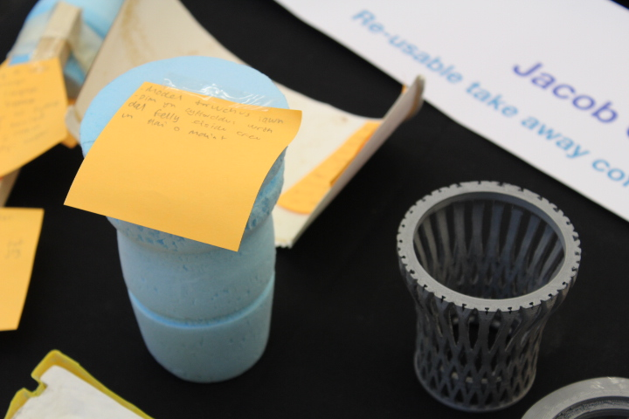
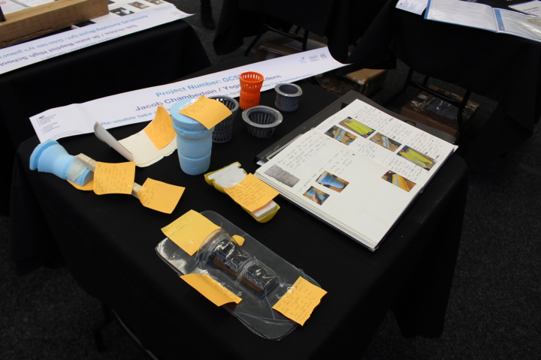
GCSE 18 Jacob Chamberlain Ysgol Bro Edern Re-usable Take Away Coffee Cup

Slide 8
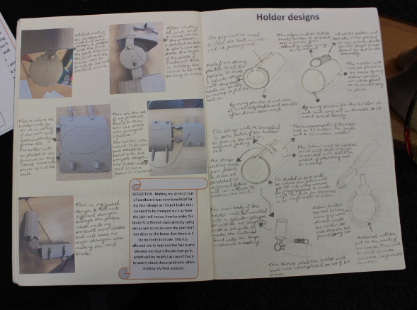
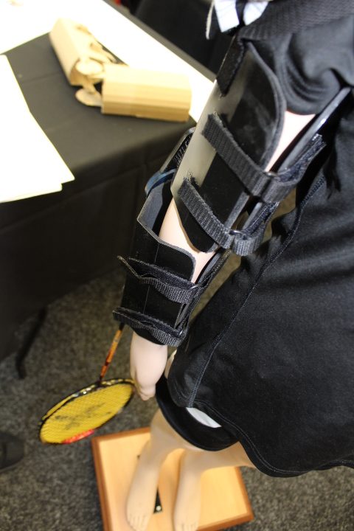
GCSE 10 Rhianna McCallion Pencoed Comprehensive School Disability Sports Aid

Slide 9
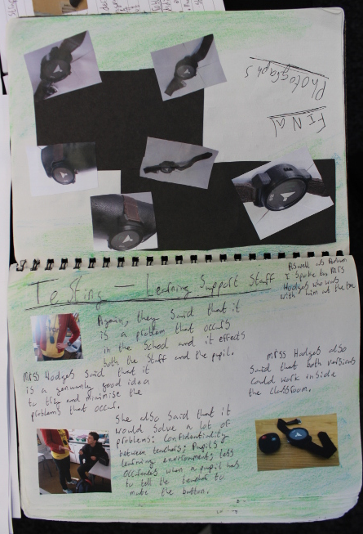
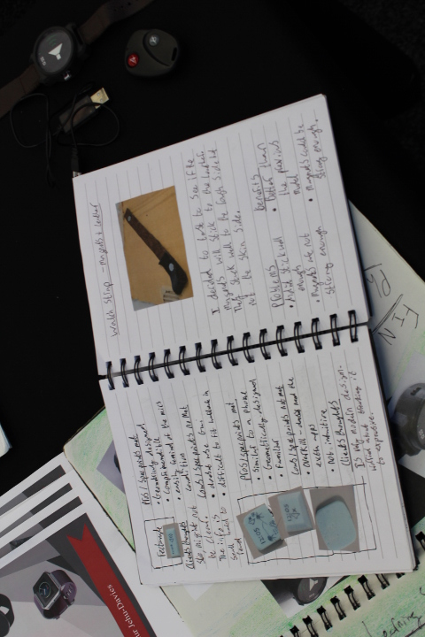
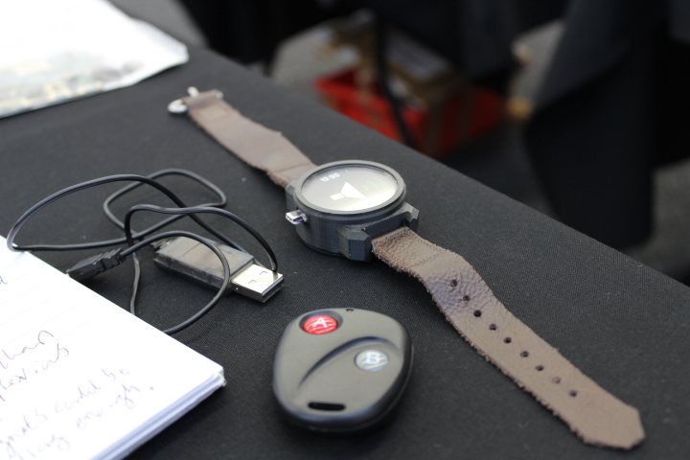
GCSE 5 Arthur Jehu-Davies Llanfyllin High School
Teacher Mic Alert System

Slide 10
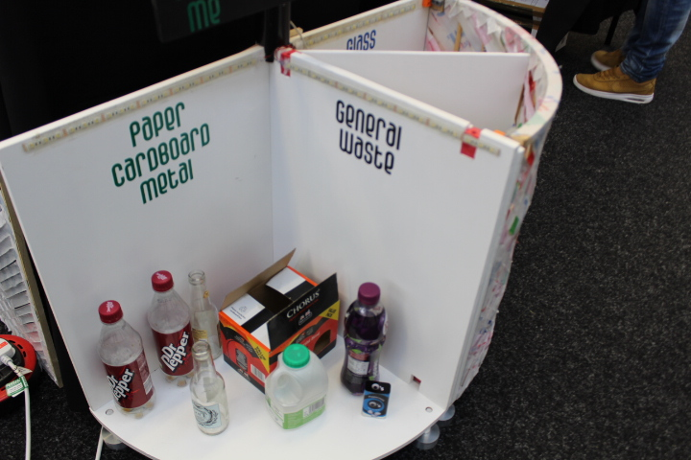
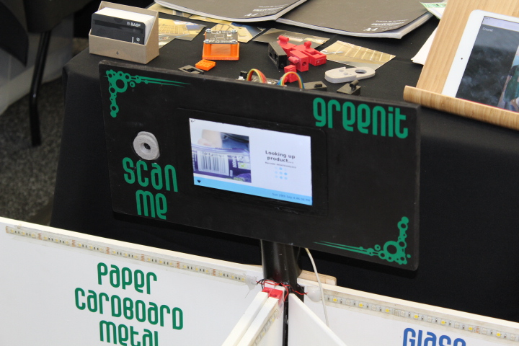
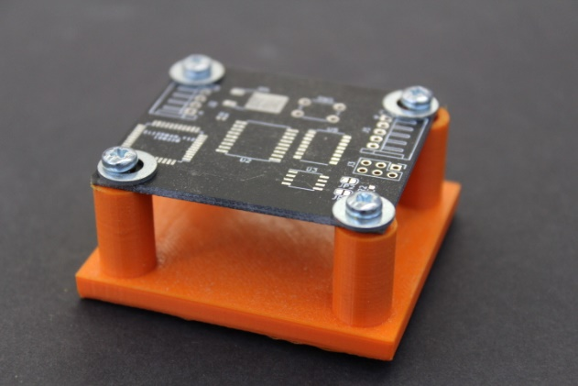
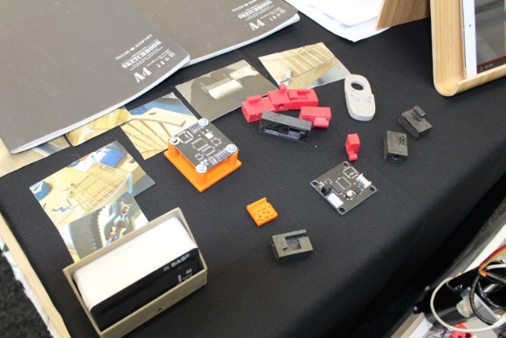
GCSE 14
Q Misell
Ysgol Bro Edern
Ingenious Recycling Bin
1st Prize/ Gwobr 1af (GCSE)

Slide 11
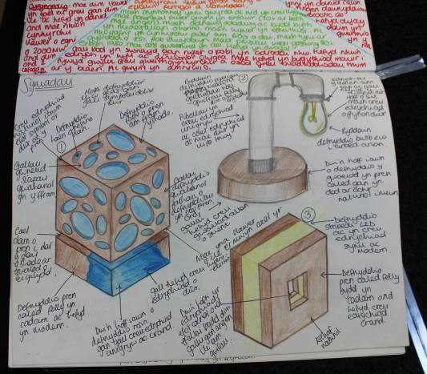
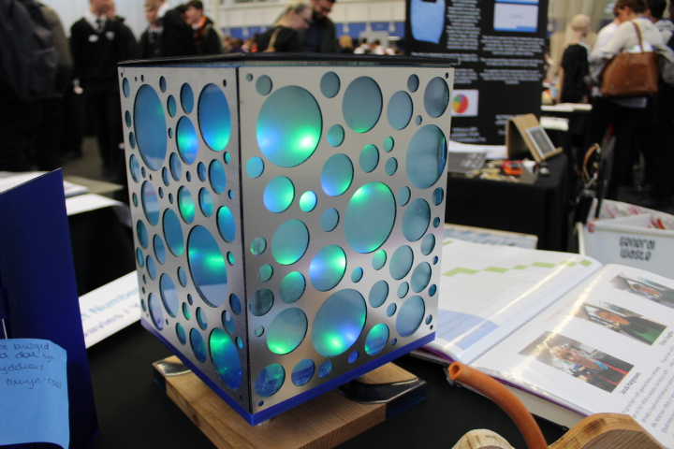
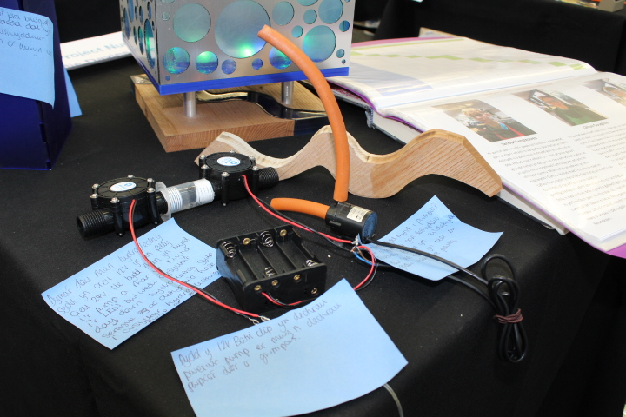
GCSE 8
Millie Davies
Ysgol Bro Edern
Hydro-electric Lamp

Slide 12
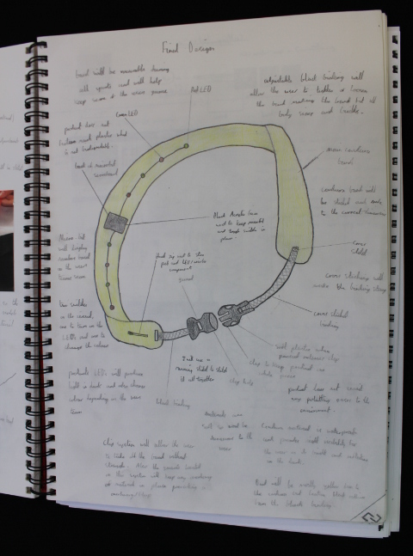
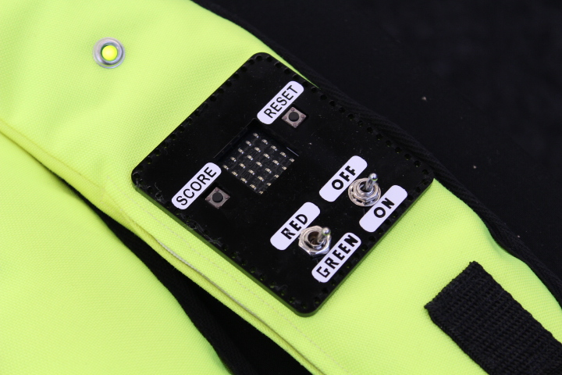
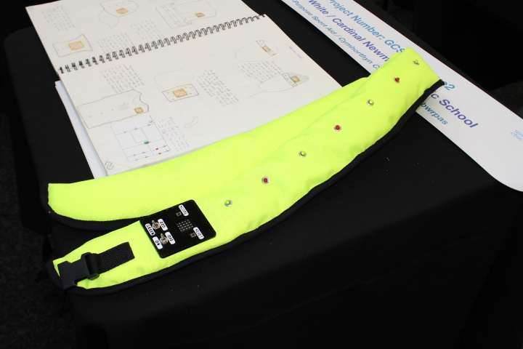
GCSE Reserve 2 Jaiden White Cardinal Newman School Multi-Purpose Sports Aid

Slide 13
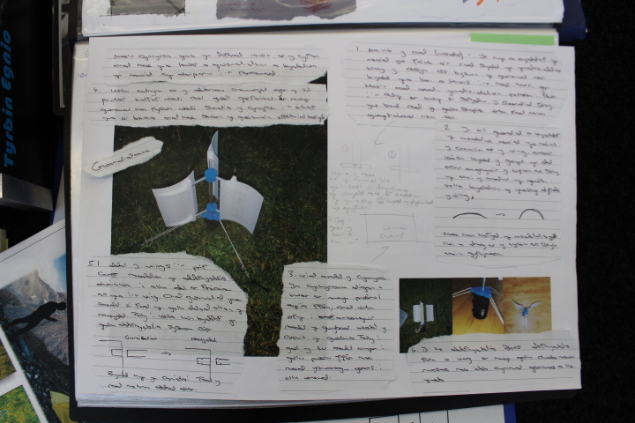
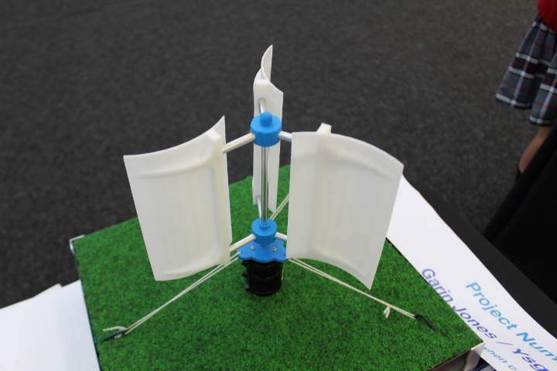
GCSE Reserve 4 Garin Jones Ysgol Maes Y Gwendraeth

Slide 14
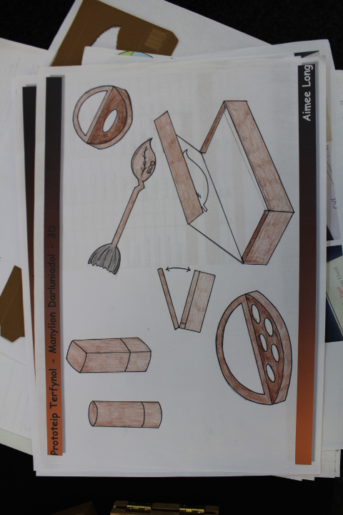
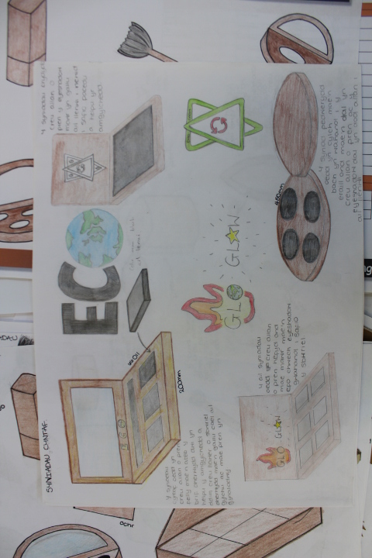
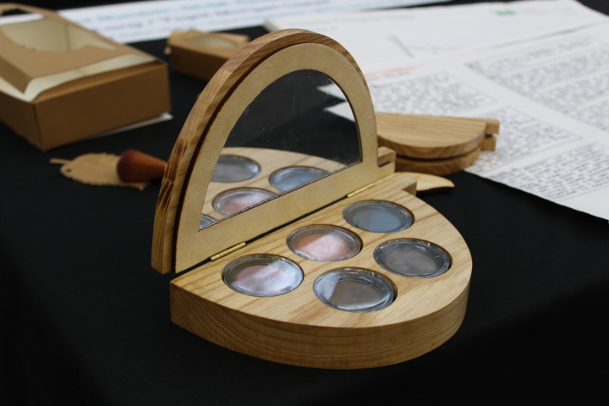
GCSE Reserve 3 Aimee Long Ysgol Morgan Llwyd
Eco Friendly Make Up Box

Slide 15
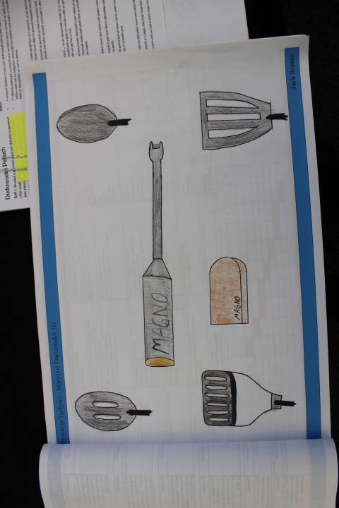
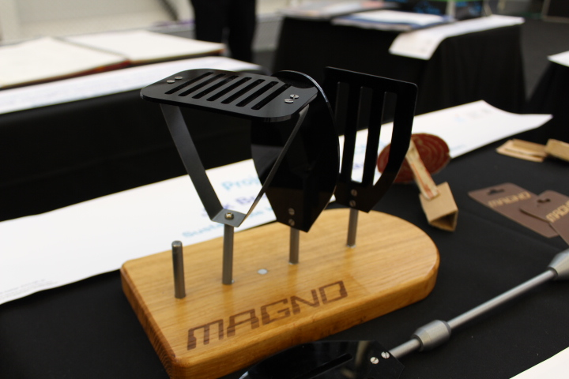
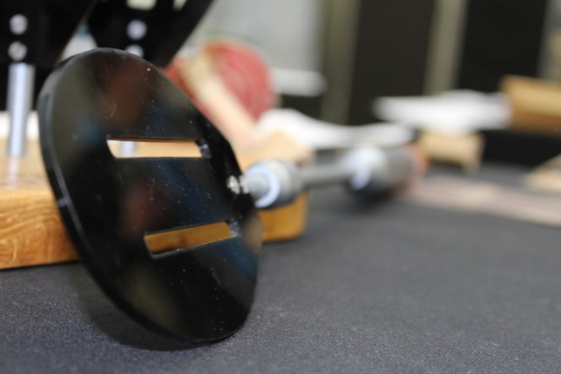
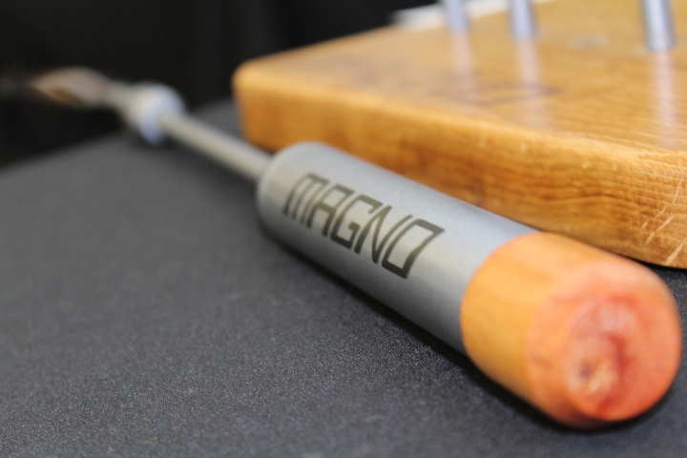
GCSE 3 Jak Breeze Ysgol Morgan Llwyd

Slide 16
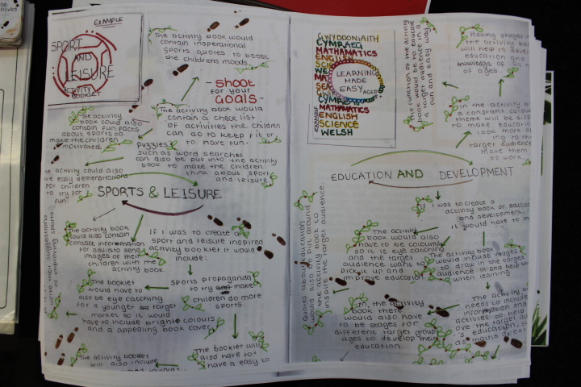
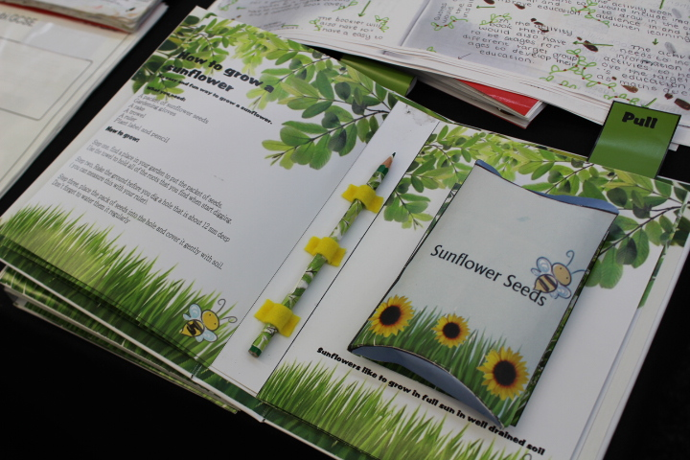
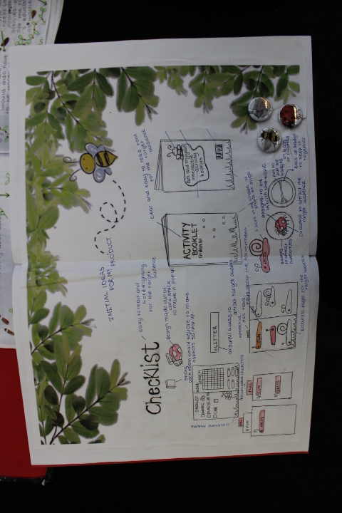
GCSE 4 Amy Owen Ysgol Uwchradd Caergybi Interactive Activity Book
CREATIVITY PRIZE WINNER/
ENNILLYDD GWOBR CREADIGRWYDD

Slide 17
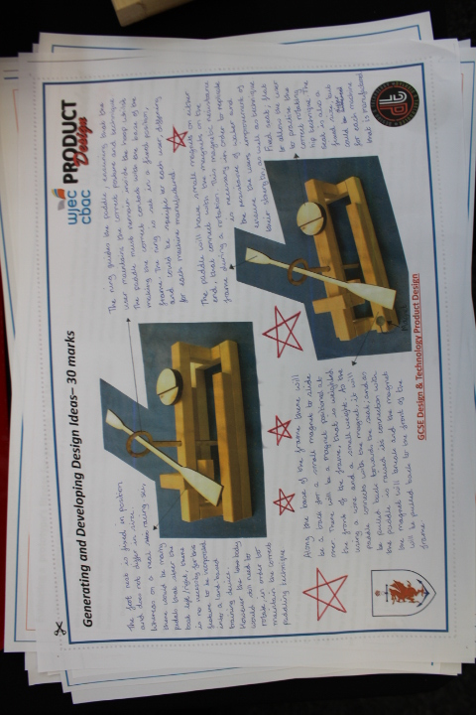
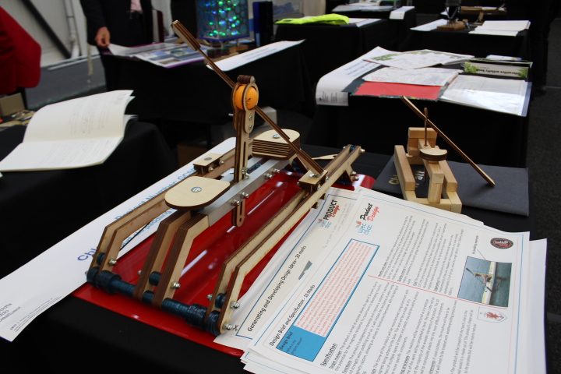
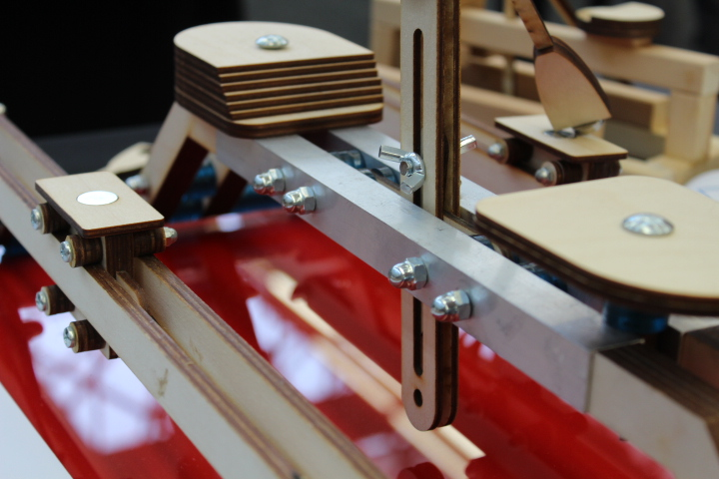
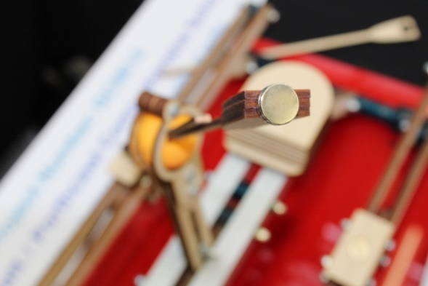
GCSE 13 Chloe Wyatt Porthcawl Comprehensive School
Surf Ski Paddling Trainer
2nd Prize/ 2il Wobr (GCSE)

Slide 18
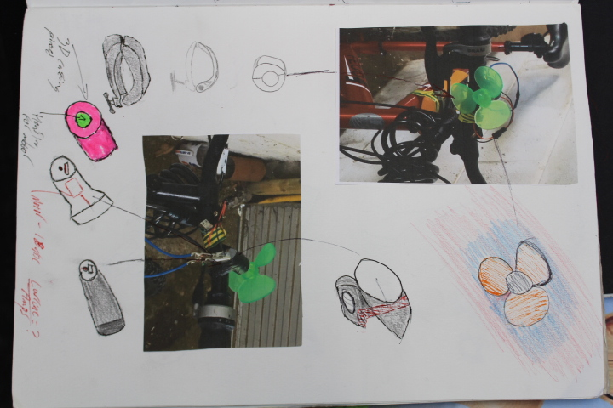
GCSE 7 Ceuron Jones Ysgol Uwchradd Bodedern Bicycle Mobile Phone Charger

Slide 19
GCSE 12 Owain Wigley Llanfyllin High School
Wigley Teet Sprayer
3rd Prize/ 3ydd Wobr GCSE

Slide 20
GCSE 1 Seb Hobbs St John Baptist High School Automatically Illuminating Bicycle Light

Slide 21
GCSE 6 Stephen Cowley Ysgol David Hughes
Desk Tidy

Slide 22
GCSE 20 Kyle Owen Ysgol Syr Thomas Jones
Pen Grip for Dyslixia Sufferers

Slide 23
GCSE 16 Victoria Ropelewska Newport High School
Child’s Interchangeable Gardening Tool

Slide 24
GSCE 9 Rhys Webb St John Baptist High School
Baby Bottle Warming Timer

Slide 25
GSCE Reserve 1 Sophie Larcombe Cwmtawe Community School
Pinafore Dress

Slide 26
AS LEVEL

Slide 27
AS3 Jamie Williams Brynteg Comprehensive School
Electric Can Opener

Slide 28
AS 5 Lowri Lloyd Coleg Meirion-Dwyfor

Slide 29
AS 24 Dominic O’Leary Whitchurch High School
Coffee Dispenser for Disabled

Slide 30
AS 14 Rhona Loxton Ysgol Brynrefail
Arthritis Disabled Aid

Slide 31
AS 8 Matt Small Ysgol Bro Pedr
Self Watering Plant Pot for Asthmatics

Slide 32
AS 2
Euan Griffiths
Ysgol Gyfun Gymraeg Bro Edern
Shopping Trolley Aid

Slide 33
AS 6
Lewis Bailey
Rougemont School
Plant Identification Devices

Slide 34
AS 22
Maddie Henson
Brynteg Comprehensive School
Exhibition Food and Drink Cooler

Slide 35
AS Reserve 1
Iestyn James
Ysgol Gyfun Gymraeg Llangynwyd

Slide 36
AS 20
Austeja Stasivleviciute
Rougemont School
Tamper Proof Drinks Lid for Festivals

Slide 37
IP PRIZE WINNER/
ENILLYDD WOBR IP
AS 9
Morgan Clewer-Evans
Ysgol y Preseli
Gate Safety Mechanism

Slide 38
AS 18
Rhys Davies
Ysgol Maes Y
Gwendreaeth
3rd Prize/ 3ydd Wobr (AS)

Slide 39
AS 15
Aimee Jones
Coleg Meirion Dwyfor
Reading Lamp for Children

Slide 40
AS 16
Ffion Hopkins
Ysgol Bro Pedr
Architectural Garment

Slide 41
AS 25
Jessica Jones
Stanwell School
Textile Product

Slide 42
AS 17
Thomas Jenkins
Ysgol Gyfun Rhdywaun
Overall Winner

Slide 43
AS 1
Mitzi Tilston
St Davids’s College
3D Scanning Attachment

Slide 44
AS 10
Eleanor Jayne Lomax
Ysgol David Hughes
3D Lighting

Slide 45
AS 23
Violet Niamh Moran
Ysgol Syr Thomas Jones
Revision Aid

Slide 46
AS 19
Harry Evans
Ysgol Uwchradd Llanfyllin
Tea Flask and Accessories

Slide 47
AS Reserve 2
Megan Morgan
Ysgol Maes Y Gwendraeth

Slide 48
AS 12
Moneeb Ayoubi
St Cyres School
Breakdown Waring Kit

Slide 49
AS 4
Seren Hopkins
Pontypridd High School
Inflatable Tent
2nd Prize/ 2il Wobr (AS)

Slide 50
AS 7
Ella Niman-Beard
Cowbridge Comprehensive School
EcoHouse

Slide 51
AS 13
Alex Hutchinson
Ysgol Dyffryn Aman
Medicine/ Pills Bottle

Slide 52
AS 11
William Gethin Jones
Ysgol Uwchradd Llanfyllin
A Helping Hand

Slide 53
A LEVEL

Slide 54
A 33
Brooklyn Hicks-Williams
Whitchurch High School
Rheumatool

Slide 55
A 3
Sam Bray
Ysgol David Hughes
Survival Kit

Slide 56
A 18
Sebastian Lindhe Branfield
Monmouth School for Boys
Egg Box Re-design
2nd Prize/ 2il Wobr (A Level/ Lefel A)

Slide 57
A 5
Ian Placket-Dash
Newport High School
Multi-Functioning Gardening Trowel

Slide 58
A 11
Dewi Evans
Ysgol Gyfun Rhydywaun
A Game that Entertains Children to Measure their Breath (Medical)

Slide 59
A 17
Holly Morgans
Stanwell School
High Fashion
Dressage Outfit

Slide 60
A 13
Patricia West
St Cyres School
Wearable Self
Defence Device

Slide 61
A 32
Rachel Williams
Ysgol Gyfun Rhydywaun
Surf Transporter

Slide 62
A 6
Emily Sullivan
Maes Y Gwendreath
Cape that Turns in to a Frock
3rd Prize/ 3ydd Wobr (A level/ lefel A)

Slide 63
A 2
Lilly O’Neill
Hawarden High School
Homeless Shelters

Slide 64
A 19
Jack Hughson
Ysgol Calon Cymru
Fencing Pro
1st Prize/ Gwobr 1af (A level/ Lefel A)

Slide 65
A 26
Benjamin Cook
St John’s College
Electricity Generator

Slide 66
A Reserve 2
Lois Owen
Coleg Meirion Dwyfor
Male Jewellery

Slide 67
A 34
Cai Evans
Ysgol Gyfun Gwyr

Slide 68
A 24
Ellena Jones
Stanwell School
Spill Proof Bowl

Slide 69
A 25
Millie Baxter
Rougemont School
Disabled Access Ramp

Slide 70
A Reserve 1
Sam Budd
Ysgol Gyfun Gwyr
Stand for Shoe Spraying

Slide 71
A 7
Rhys Vincent
Cardinal Newman Catholic School
Automatic Plant Carer

Slide 72
A 10
Non Rhys Howel
Coleg Meirion Dwyfor
Dimentia Therapy

Slide 73
A 21
Nia Thomas
Ysgol Bro Pedr
Architecture Inspired Dress

Slide 74
A 27
JamesEdwards
Rougemont School
Car Multitool

Slide 75
A 9
Rhydian Williams
Ysgol Caergybi
Aeroshell

Slide 76
A Reserve 3
Holly Preece
Rougemont School
Drinking Cup for the Elderly

Slide 77
A 29
Nathan Purchase
Ysgol Aberconwy
Egg Seperator

Slide 78
A 12
Reece Jones
Ysgol Uwchradd Aberteifi
Beehive Transportation Device

Slide 79
A 35
Iestyn Evans
Ysgol Bro Pedr
Cicular Economy Table

Slide 80
A 28
Amy Jordan
Stanwell School
Costume Production

Slide 81
A 1
Yamita Hayashi
St David’s College
HVD-Heads Up Display for Cars

Slide 82
A 30
Harry Jones
Castell Alun High School
Goat Milking Stand

Slide 83
A 4
Patrick Roobottom
St David’s College
Affordable Housing

Slide 84
A 23
Osian Griffiths
Maes Y Gwendreath
Quad Bike Fencing and Felling Equipmemt Holder

Slide 85
A 20
Harri Tulliver
Ysgol Brynrefail
Cable Management for Ladders

Slide 86
A 16
Alex Scott
Ysgol Uwchradd Llanfyllin
Propelled Water Life Saving Board

