Slide 1
GCSE Design and Technology TGAU Dylunio a Thecnolog
CPD Innovations 2023
Agenda:
Unit 1:Examination - Engineering Design, Fashion and Textiles, Product Design
Unit 2: Iterative Design and Innovation
Presenter: Mrs Jacqui Howells

Slide 2
Recordio’r Sain/Audio Recording
Mae'n ofynnol i'r cyflwynydd recordio'r sain yn y digwyddiad hwn. Dull rheoli yw hwn i sicrhau y gall CBAC ddangos ei fod yn cydymffurfio ag Amodau Cydnabyddiaeth y rheoleiddwyr; yn benodol yr Amodau hynny sy'n ymwneud â chyfrinachedd deunyddiau asesu.
Bydd y recordiad hwn ar gael i'r rheoleiddiwr cymwysterau os gofynnir amdano, ond ni chaiff ei rannu â thrydydd partïon eraill. Bydd CBAC yn cadw'r recordiad yn ddiogel am gyfnod o dair blynedd, ac yn ei ddinistrio'n barhaol wedi hynny.
Sylwer os gwelwch yn dda NAD OES HAWL gan gynrychiolwyr i recordio sain na ffilmio unrhyw agwedd ar y digwyddiad hwn.
The presenter is required to make an audio recording of this event. This is a control designed to ensure that WJEC is able to demonstrate compliance with regulatory Conditions of Recognition; specifically, Conditions relating to the confidentiality of assessment materials.
The recording will be made available to the qualifications regulator if required, but it will not be shared with any other third parties. The recording will be stored securely by WJEC for a period of three years and then permanently destroyed.
Please note that delegates are NOT PERMITTED to make an audio or video recording of any aspect of this event.

Slide 3
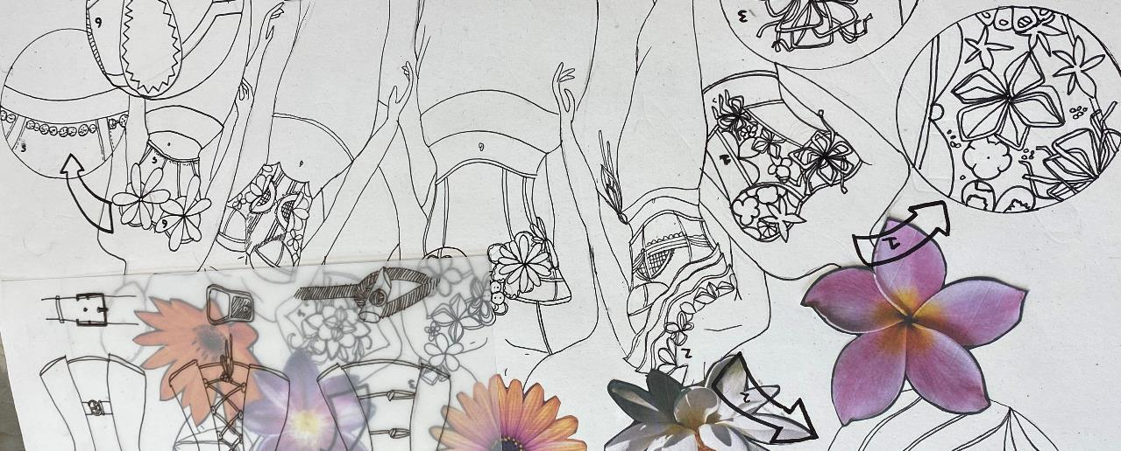
GCSE Exam performance - General comments
Failure to read and consider the whole question properly and thoughtfully
Repeating the stem of the question but failing to demonstrate a specific body of knowledge
Failure to ‘explain.’ An ‘explanation’ requires a fact and an elaboration of that fact
Not addressing the requirements of AO3 style questions – evaluate requires evidence of appraisal, analyse requires logical lines of reasoning
Subject specific technical knowledge is weak – across all three endorsed routes
A marked increase in the number of questions ‘not attempted’ or only ‘partially attempted’
Please refer to:
Principal examiners’ full reports on exam performance
All available on the main website:
Engineering Design
Fashion and Textiles
Product Design

Slide 4
GCSE Exam performance - General comments
A marked increase in the number of questions ‘not attempted’ or only ‘partially attempted’
Command words not considered properly – instructions indicating how to respond
Mark values eg. [4] are an indication of the level of response required – requires more thought
Increase in low level responses – lacking depth of knowledge and understanding
Writing with clarity and clear meaning; handwriting not legible
Failing to take advantage of the full two hours of examination time to consider and respond to the questions more thoughtfully
Significant increase in unnecessary doodling across papers
Advance information did not appear to have any impact of candidate performance

Slide 5
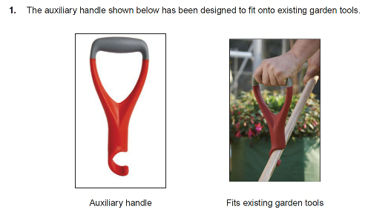
Question structure
Question stem – must be read and properly considered throughout the entire question.
The images support candidate responses throughout the entire question.
(a) ‘Describe’ is the command word – a straightforward description is required with some detail for 2 marks.
(b) ‘Explain’ is the command word – a fact with elaboration of that fact is required – one mark for the fact and one for elaboration of that fact – 2 marks. 2 marks for each explained fact.
(c) ‘Explain’ is the command word – but far more detail is required for 4 marks and both economic and social issues must be addressed.

Slide 6
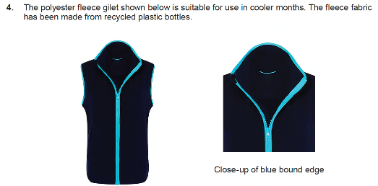
Question structure
Question stem – must be read and properly considered throughout the entire question.
The images support candidate responses throughout the entire question.
(c) ‘Evaluate’ is the command word – an extended response which demonstrates sound knowledge and understanding with evidence of appraisal is required.
Banded mark scheme.
(d) ‘Analyse’ is the command word – an extended response demonstrating sound knowledge and understanding with evidence of logical lines of reasoning is required.
QWC also assessed in this exemplar question.
Banded mark scheme.

Slide 7
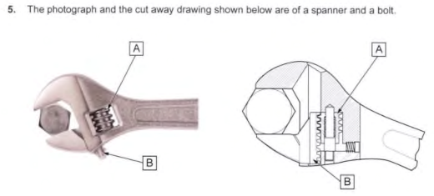
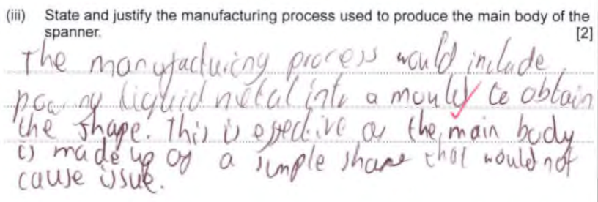
Engineering Design
0 mark
This part question was not attempted.
Correct answer: rack gear.
Low level questions relying on recall – always worth an attempt!
Correct answer: casting/drop forging
One mark awarded for the description of a process, but it has not been named. Some evidence of justification.
Overall, a weak response with little depth of understanding.
1 mark

Slide 8
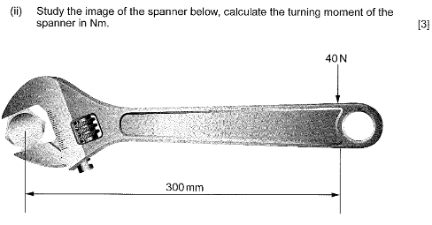
Engineering Design
Overall candidate ability regarding mathematical calculations/principles is considered weak.
A concern as it is a critical aspect of Engineering Design.
Exemplar answer 1
Exemplar answer 1:
The correct formula has been used
Numerical values are correct
Correct answer 3 marks
Exemplar answer 2:
The correct formula has been identified
Numeric values are incorrect (not converted from millimetres to metres) which impacts on the final answer 1 mark
3 marks
Exemplar answer 2
1 mark

Slide 9
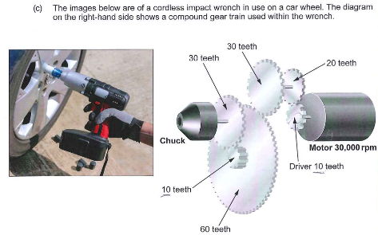
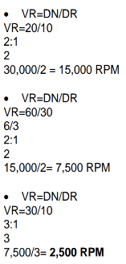
Engineering Design
3 marks
Few candidates accessed full marks for calculating the rotational speed of the chuck
Some gained marks for gear rotation calculations
Exemplar above – a basic attempt
Guesswork using information in question?
Not really applying any mathematical principles
0 mark
Acceptable answers include: no cable; ease of movement when in use; no obstruction in use; rechargeable; portable
Could apply to a number of products
Notes:
C(ii) This candidate multiplies the motor rotational velocity by the first spur gear – incorrect. 30,000x10 is wrong, unless they continue to calculate the rotational velocity of the compound gear train.
Method 1 – Rotational velocity over 3 ‘steps’
Step 1 – 30,000 x 10 = 20 x ?=15,000 (1 mark)
Step 2 – 15,000 x 30 = 60 x ? = 7,500 (1 mark)
Step 3 – 7,500 x 10 = 30 x ? = 2,500 rpm. (1 mark)
Method 2 = Velocity Ratio
2:1 x 2:1 x 3:1 = 12:1 (I mark)
30,000 / 12 (1 mark)
= 2,500 rpm (1 mark)
Candidates can do this either way, but the answer in the paper is a complete guess – the 30,000 x 10 needs to be divided by 20 to get the rotational velocity of the first gear train – they do the first ‘bit’ but not the second – insufficient understanding of this to access a mark. If they had not multiplied the 30,000 by 10 and then just divided by 2, then 2 and then 3 they would have got the correct answer, but this basic error shows they are not really applying any mathematical principles – they are ‘guessing’ by using some of the info in the question.

Slide 10
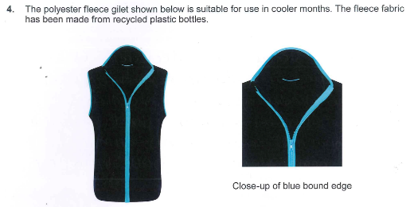
Fashion and Textiles
The context of the question is a fleece gilet; part questions test a broader range of different topics associated with the product.
2 marks
This answer relates to a knitted fabric which is what the question is asking. Good level of detail. 2 marks
This response refers to ‘fleece’ which is stated in the stem/question construct but not for this part question. Knitted fabric is comfortable to wear so one mark has been awarded but technically the answer is incorrect. 1 mark
1 mark

Slide 11
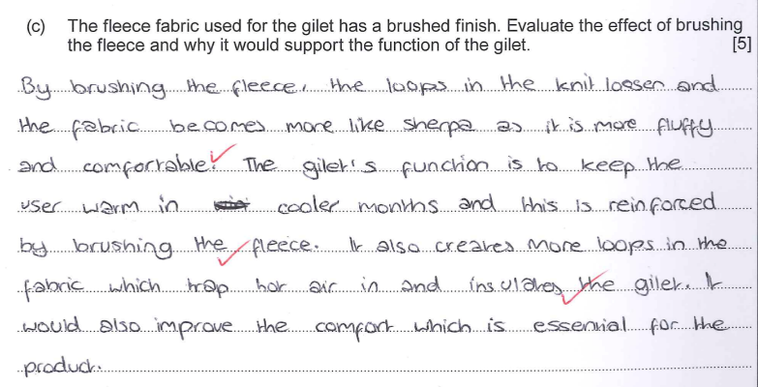
Fashion and Textiles
The next part question relates to the fleece fabric. The exemplar answer below is from the same candidate as in the second exemplar answer (1 mark) on previous slide.
The candidate has not considered that two different questions would not test the same body of knowledge.
There is some knowledge and understanding of brushing a fabric. Both parts of the question have been addressed but little evidence of appraisal. Some repetition of facts. Banded mark scheme range 3 - 4 marks. 3 marks
3 marks

Slide 12
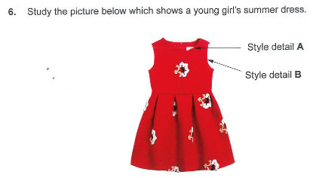
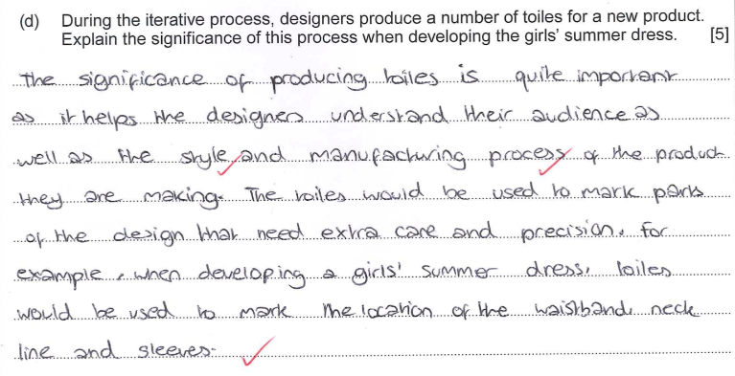
Fashion and Textiles
Iterative process is not fully understood
Some reasons included why many toiles are made which are worthy of some credit
Overall lacks detail relating to the iterative process – repetition and refining the product
Incremental changes?
Iterative process 3 marks
3 marks
Note: this question relates to the NEA/iterative process.
Overall, it was not answered well.
Think, model, test, reflect

Slide 13
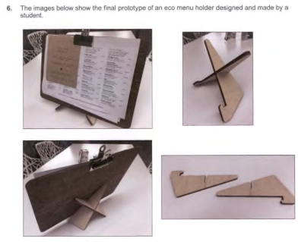
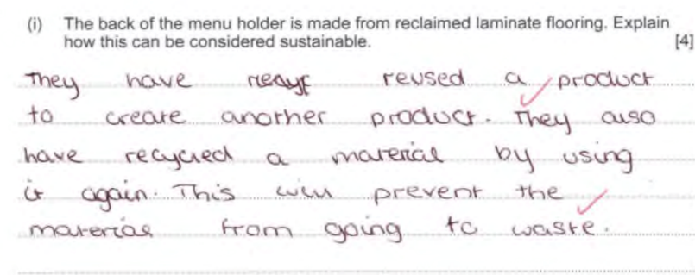
Product Design
The context of this question relates to producing a basic product in a school setting using tools and equipment that the vast majority of candidates should be familiar with.
2 marks
In both exemplar answers a fact is given and elaboration of that fact. Candidates could have expanded on the stated facts or explained a different one. Overall responses were weak.
2 marks
Notes:
Candidates struggle to show knowledge and understanding of processes that are commonplace in a school workshop

Slide 14
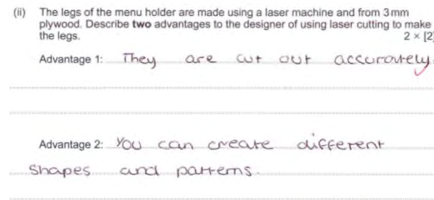
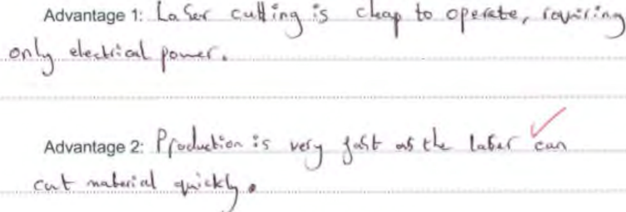
Product Design
The context of this question relates to the advantages of using the laser cutter to make a product – a process that most candidates should be familiar with.
1 mark
0 mark
0 mark
Typical under developed responses worth 1 mark
Several incorrect responses
A disappointing statistic - most candidates achieved a maximum of 2 marks for this question
1 mark

Slide 15
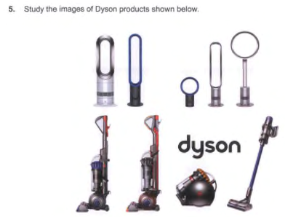
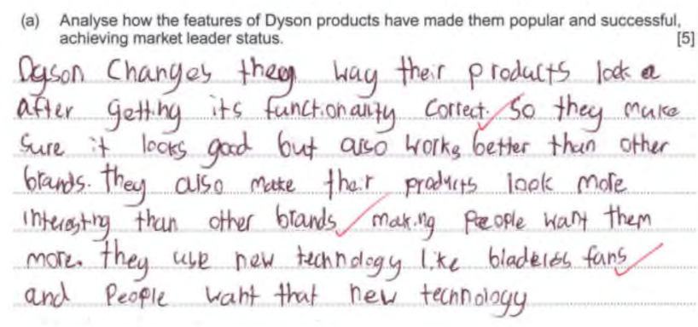
Product Design
Q5 Product Design had the lowest mean mark on paper
Analyse questions require evidence of reasoning in the response
Knowledge of Dyson products is critical
Understanding what is meant by market leader is critical – features that outperform other products
Some knowledge of Dyson products
Some evidence of reasoning (AO3)
Brief reference to market leaders
Lacks detailed understanding – many other features not discussed
Banded mark scheme – sits at lower end of the 3-4 range
3 marks

Slide 16
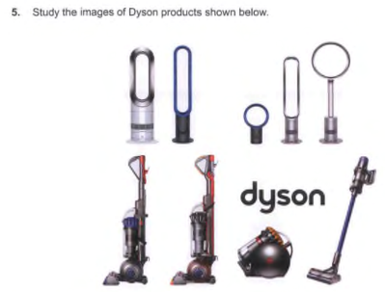
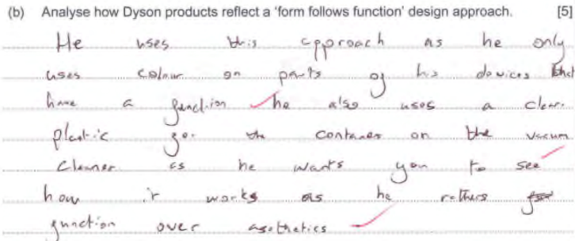
Product Design
3 marks
‘Analyse’ questions require evidence of reasoning in the response – some evidence of this skill in this response but it is descriptive rather than analytical
Understands that ‘function’ precedes ‘form’ for Dyson products
Focuses on vacuum cleaner rather than the broad range of products
Lacks detailed knowledge and understanding of Dyson products eg. innovative technological developments that improve function
Banded mark scheme – sits at the lower end of the 3 – 4 mark range
Notes:
Least accessible question on the paper

Slide 17
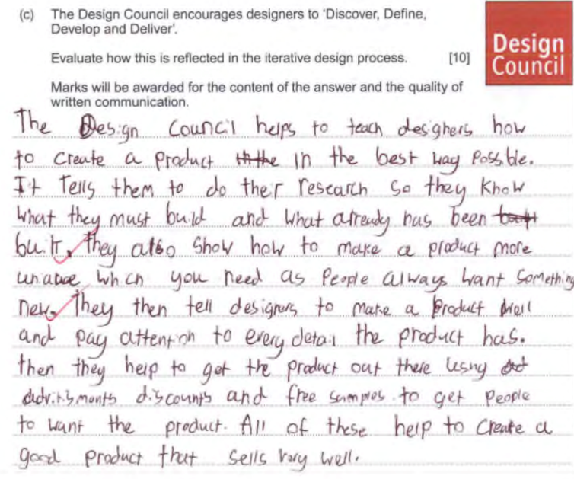
Product Design
‘Evaluate’ questions require evidence of appraisal in the response – this is descriptive rather than evaluative
QWC is mostly satisfactory
Candidate understands the iterative process but reference to the ‘Discover, Define, Develop and Deliver’ statement is weak
Lacks depth of knowledge and understanding
Banded mark scheme - sits at the lower edge of the 3 – 4 mark range
3 marks

Slide 18
Any questions?

Slide 19
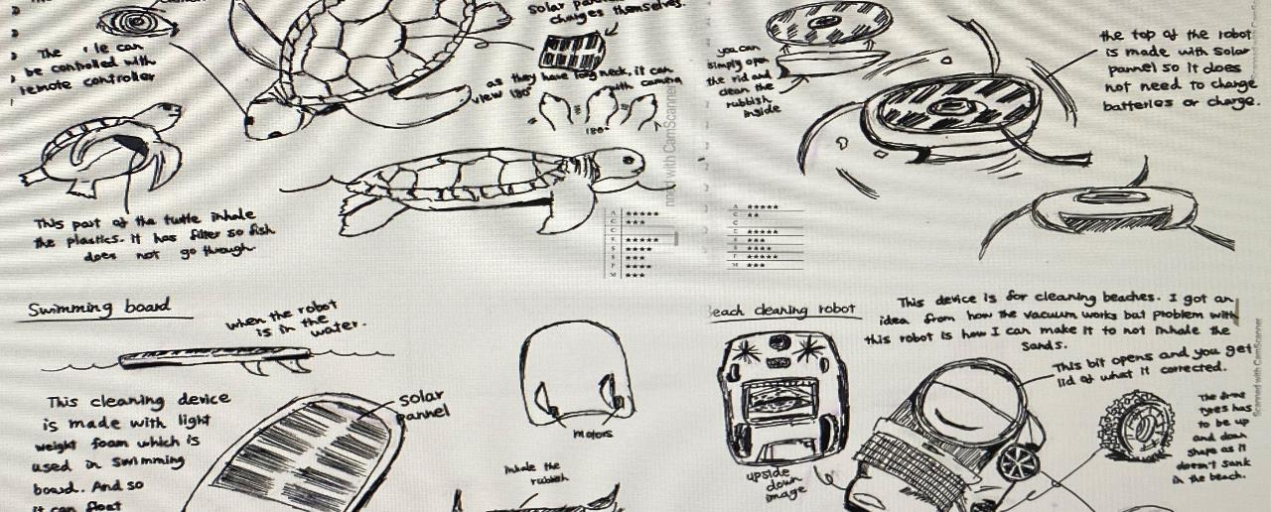
GCSE NEA - General comments
Accuracy of applying assessment criteria – overall fairly accurate
Some centres had an adjustment applied – brings all candidates into line with the national standard
Inconsistent application of the assessment criteria - marks awarded from the wrong band, sometimes 2 bands adrift
Internal standardisation - not taken place or was entirely ineffective
The WJEC provides exemplar NEA projects (on the secure website), with sole aim of supporting centres in securing greater accuracy in assessment
Increase in teacher led approaches/ formulaic
Some NEA submissions did not represent an iterative design process
Please refer to:
Principal Moderator’s full report for NEA -
available on the main website

Slide 20
Time management
Assessment criteria | Marks
Identifying design possibilities | 10
Developing a design brief and specification | 10
Generating and developing design ideas | 30
Making a prototype | 30
Evaluating a prototype’s fitness for purpose | 20
Proportion time for each assessment strand according to marks available

Slide 21
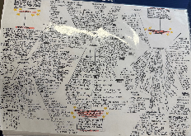
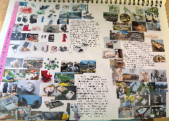
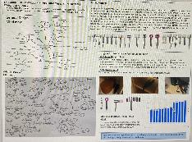
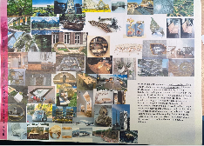
Identifying Design Possibilities [10 marks]
Thoughtful but critical analysis of the contextual challenges - all 3 or 2 or just 1 - access to all 3 - student choice
Opportunities for the development of designs - problems - identified in the early stages of the task - genuine/realistic problems?
Early investigation - focus on identified problem/s
Innovative design – more creative solutions to existing problems
User requirements - the needs and wants of users is critical throughout – user centred approach to design
Engaging with a ‘real’ client – interview; on-going dialogue and support with development
Focused relevant research
A range of possible design briefs

Slide 22
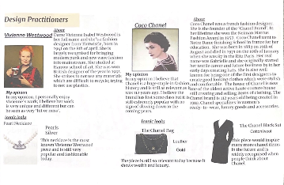
Points for consideration and further development
Limited exploration of opportunities
Limited identification of possible design briefs
Generic questionnaires to a broad audience – useful activity?
‘Users’ often inconsistent and/or unrealistic – celebrities?
Too much time spent on unhelpful activities that do not help inform ideas
Mood boards – how effective are these in supporting design?
Work of professionals – biographical information does not support design
‘Text book’ style table of materials – how useful is this activity?
Teacher led/formulaic approaches
No analysis, no commentary – are these activities useful?
Autobiographical information does not inspire design
Pictures of their work - fully analysed - could!
Note: Quality of work is important NOT quantity. A more focused approach is required.

Slide 23
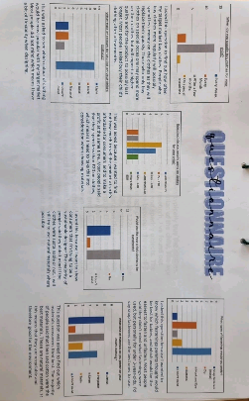
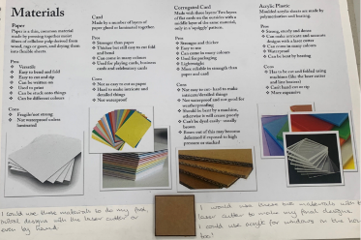
Points for consideration
User needs and wants are integral to the iterative process
A clear understanding/analysis of the needs of the user have been considered in this example – good practice
User centred approach is required – the identification of a real client is useful and can be more supportive
Make this activity relevant!
Are questionnaires effective research strategies?
An interview with a real client could be better – invite them to join an on-going discussion
A real client can test the final outcome – user experience/ provide feedback
User centred design approach
Make this activity relevant!
Do pages listing materials and components reflect an iterative process of design?
A better understanding of materials etc comes from handling/testing them – in a practical context
The identification of materials etc. will come from research/existing products
Make this activity relevant!

Slide 24
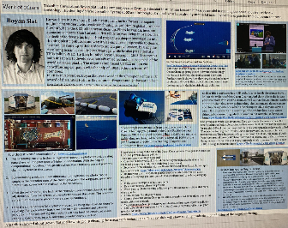
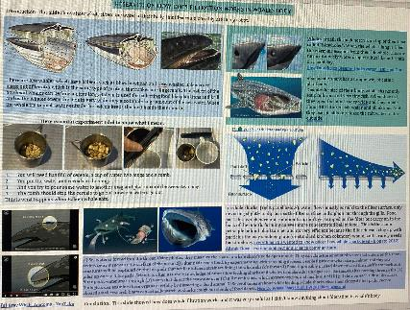
Relevant focused research
Product analysis: aesthetics/styling; function; materials/finishes; construction processes; measurements/dimensions; sustainability etc
Work of ANY designers/professionals – to inspire and support innovative and creative design
Mood boards: to focus initial ideas and inspire creativity
Identify constraints – eg. location of product in use
Materials, finishes and process best investigated in a practical context
This professional has a company that specialises in ocean clean-up campaigns. This research focuses on his work and the technology he uses.
The final prototype was a remote-controlled robotic filtration system to clean waterways – this research supports the candidate in solving a very realistic problem.
Key point: Evidence of analysis – draw conclusions, include reasons for all decisions

Slide 25
Developing a design brief and specification [10 marks]
A final design brief:
relevant to the context; based on analysis of research and investigation
Demonstrates understanding of the task ahead
Addresses the needs, wants and interests of potential users
Is a development from any of the ‘possible design briefs’
Some students might find fewer but more developed specification points easier to manage
and when using the specification as a design tool or for summative evaluation purposes
The design specification:
Critical points essential for success
Arrived at through careful analysis of research and investigation
Clearly sets out the needs, wants and interests of potential users – evidence of reasoning
Includes objective criteria – use of technical vocabulary
Includes measurable criteria – where do these values come from? How will they impact on development?
Used to direct and inform design decisions – used as a design tool

Slide 26
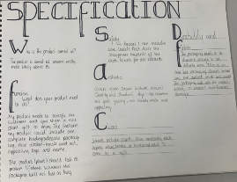
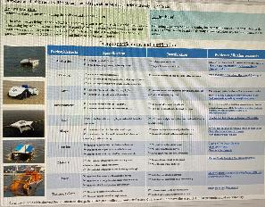
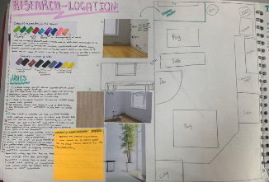
Points for consideration and further development
An under developed
specification
Other opportunities often not explored/preconceived ideas – inhibits design thinking
Final design brief and specification – superficial or no links to research and investigation
Final design brief ‘appears’
Many specification points simply ‘appear’
Measurable criteria – dimensions, weight, cost, etc where does this data come from? Little or no evidence
Needs of users is often vague – relates to choice of user
Not used as a design tool
If cost is stated, it should be referenced throughout development
If dimensions are critical, they need to be tested and analysed during development
A well developed specification based on research
The intended location of the proposal has been considered – size matters!

Slide 27
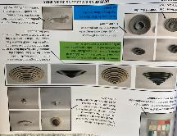
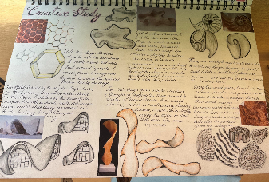
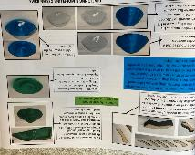
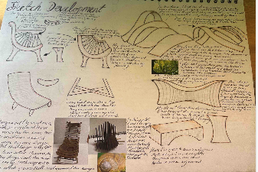
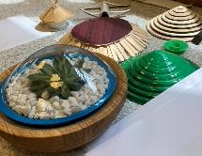
Generating and developing design ideas [30 marks]
Initial ideas and basic concepts
Quick developmental sketching supported by annotation
Consider shape / form / aesthetics
Iterative process: Think, model, test, reflect
Some ideas will be rejected – include reasons
Engage with users – consider their needs/wants
Ideas based on specification criteria
Decision making supports developmental iterations
Provide evidence of decision making - analysis
Evidence of testing including against the specification
Functional development/performance testing
Incremental development of prototype

Slide 28
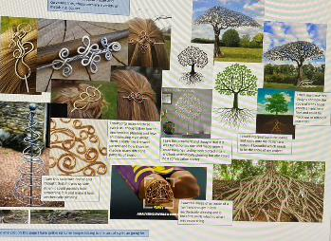
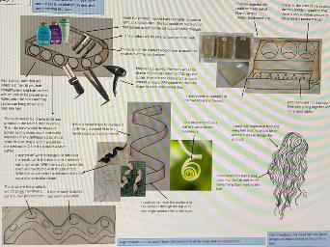
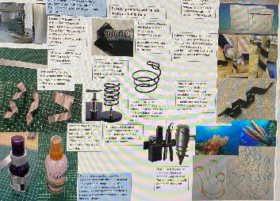
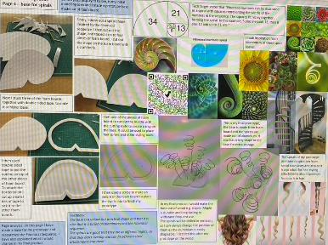
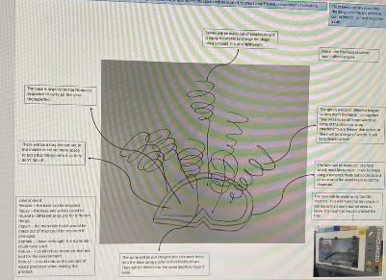
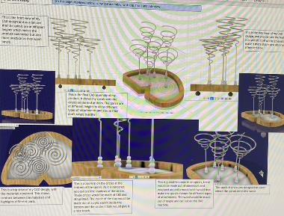
Generating and developing design ideas [30 marks]
Detailed evidence of an iterative design process – incremental development.

Slide 29
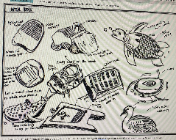
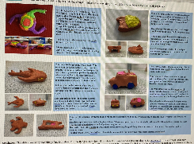
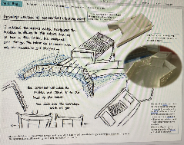
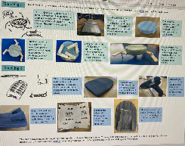
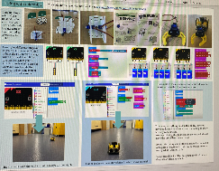
Points for consideration and further development
A few sketches, a card and/or CAD model does not represent the iterative process
Pre-conceived ideas/teacher led formulaic approaches impede design
Ineffective use of the specification as a design tool
Effective modelling and testing may highlight further areas to investigate
Little evidence of practical testing ie. construction processes/ finishes/techniques – images from the internet?
CAD modelling generally good - practical testing also required
Technical details often lacking
Candidates need to show how they arrived at the final prototype stage
Closer attention to the assessment descriptors when awarding marks – often generous in this strand
Examples of effective testing and modelling – incremental development – innovative design.

Slide 30
The Iterative Process - recap
Early modelling and testing of concepts - supports the development of ideas
Enables a better understanding of the problem/task ahead
Engage with users
Further research arising from testing/trialling ideas – materials, components, processes, decorative techniques, finishes
Incremental changes
A more refined/successful outcome
A cyclic process: Think – model - test - reflect

Slide 31
Technical details
A detailed high quality pictorial drawing of the final prototype – all appropriate views – annotation optional
Hand drawn or CAD
Manufacturing Specification:
All critical dimensions: dimensioned drawing - fashion flat - orthographic
Finishing techniques as appropriate
Details of tools, equipment and making
Details of specialist processes and materials
CNC/CAD CAM details of speeds and settings
Note: A fashion flat is a line drawing which indicates important style details and all critical measurements
Note: Could a 3rd party/manufacturer produce the prototype from the information provided?

Slide 32
Making a prototype [30 marks]
A logical sequence in pre-emptive text – a defined schedule
A suitable timeline, health & safety, constraints, reference to end testing
Appropriate materials and components
Appropriate making skills
A high-quality functioning prototype - accurate and precise
Skilful use of tools and equipment
Functions and is fit for purpose
Embracing new technology and innovation
Good mix of traditional and modern manufacturing processes – 3D printing

Slide 33
Points for consideration and further development
Not in pre-emptive format.
A pictorial diary of manufacture is not required
Manufacturing skills need refining – outcomes varied
Some evidence of inappropriate materials and process
Accuracy of assessment: high levels of accuracy and precision are required in all aspects of construction to award marks in top two bands
Closer attention to the assessment descriptors when awarding marks – often generous
A plan FOR making is required not ‘of’ making
Not a high skill technically demanding product to manufacture; issues with quality on applique – adequate.
A more complex product to manufacture however there are issues with accuracy and finish – good overall.

Slide 34
Evaluating a prototype’s fitness for purpose [20 marks]
Credit on-going analysis and evaluation in this assessment strand
Presented as a critical appraisal of the final prototype
A substantial document worth 20% on the total marks
End testing in situ/with users is critical
A robust specification better supports candidates
Quantifiable/measurable criteria is important
Response to feedback
Modifications in light of testing and feedback
Opportunity for further design and development

Slide 35
Points for consideration and further development
Summative evaluation against specification needs to be far more than a tick box exercise
Weak specifications are not helpful
End testing in situ not always evident/superficial – photographic evidence? Film?
User feedback – underdeveloped – appropriate choice of user?
Modifications and improvements – based on final testing and user feedback – not fully explored
Opportunities for further design – often superficial
Worth 20 marks - 20% of total marks – apportion time accordingly
Some generosity in awarding marks in this section
Improvements offered but not based on end testing – no evidence to support decisions.
A retrospective account of the whole process – not required.
Superficial reference to the design specification.
Mark band:
1 – 4 marks

Slide 36
Summary of key points
All assessment strands build on one another, with clear links throughout, one section informing the other
User needs and wants are critical throughout the iterative process, essential in user-centred design and to the eventual success of the prototype product
Understanding the problem is critical
Design specifications should include objective and realistic measurable criteria that can be used to drive design development
Modelling and testing of concepts, alongside on-going analysis and evaluation underpins the iterative process
Proportionate time needs to spent on each assessment strand - final evaluations often appeared rushed or incomplete - too much time spent elsewhere where activities were not relevant or focused
Greater accuracy in applying the assessment criteria
Banded assessment descriptors help determine the correct band where the most appropriate mark should be awarded and what the work deserves

Slide 37
Any questions?

Slide 38
Resources for teachers & learners Supporting teaching and learning
Free digital resources
Free subject specific resources available for all to download from the WJEC website
Supports learning of all GCSE Design and Technology courses: Engineering Design, Fashion and Textiles and Product Design

Slide 39
Digital Resources
Blended Learning: interactive self-study to complement teaching and learning
Knowledge Organisers: To support learning of GCSE Design and Technology
NEA walk through: aimed at learners; a practical approach in preparing for the NEA.
Exam walk through: aimed at learners; preparing for written examinations

Slide 40
NEA Walk Through

Slide 41
Diolch/Thank you

