Slide 1

High, Medium and Low Level Practical Skills
G.C.S.E Food & Nutrition

Slide 2
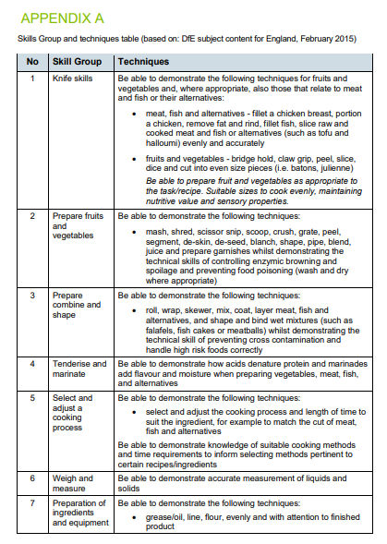
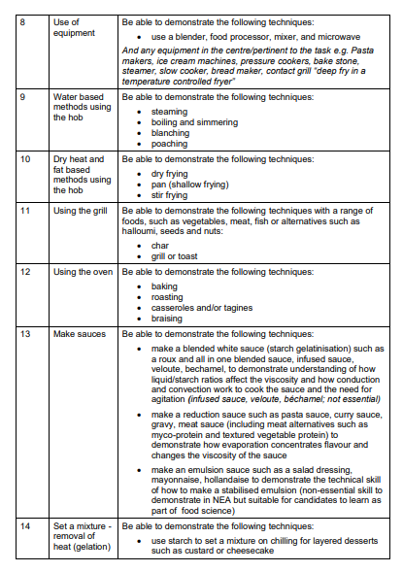
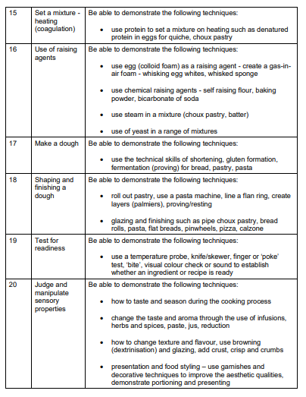
Skills and Technique table – Specification p24-26

Slide 3
Please note: In order for a dish to be considered HIGH SKILL, not only should the skills demonstrated reflect the high skill criteria, but the practical work should also be conducted in a HIGHLY SKILLED manner. The working practices of the learner should be exemplary, and the finished presentation and flavour balance of the finished dish/es should be done to a high standard.

Slide 4
Preparation techniques:
blending*
beating*
creaming**
crimping***
dehydrating**
folding**
Grating*
hydrating *
juicing*
kneading**
laminating (pastry )***
marinating*
mashing *
measuring**
melting*
melting using bain -marie***
mixing**
piping***
proving*
puréeing**
rub-in**
rolling **
shaping***
shredding*
sieving*
skinning**
tenderising *
toasting(nuts/seeds) **
unmoulding***
weighing**
whisking(aeration)***
zesting*
Knife techniques:
chopping*
bâton**
chiffonade**
brunoise***
dicing**
julienne***
mincing***
slicing**
deboning***
deseeding**
filleting***
peeling*
segmenting***
spatchcock**
trimming*
Cooking techniques:
basting*
baking**
baking blind***
blanching**
boiling*
braising**
caramelising***
chilling*
cooling*
deep fat frying***
deglazing**
dehydrating*
emulsifying***
freezing*
frying**
griddling**
grilling*
pickling**
poaching***
reduction**
roasting**
sautéing**
setting**
skimming*
steaming**
stir-frying**
tempering***
toasting*
water-bath (sous-vide) **
The preparation and cooking techniques are categorised as follows:
Low* Medium** High***
Ready-made/prepared components used in the preparation and cooking of dishes are all classed as basic.

Slide 5
Basic/Low: Making fishcakes with readymade produce: tinned fish/ready filleted fish, boiling and mashing potato, purchased breadcrumbs and salad with homemade vinaigrette.
Medium: Making fishcakes with homemade breadcrumbs, pre -filleted fish that needs skinning, boiling and mashing potato, shaping the fishcakes into different shapes and served with a homemade mayonnaise served with a salad demonstrating a range of knife skills
High/Complex: fish that requires filleting, homemade breadcrumbs, boiling and mashing potato, containing vegetables using a range of knife skills, hollandaise sauce or similar level served with stacked vegetables, demonstrating a range of knife and cooking techniques along with wedges/chips that are deep fat fried.

Slide 6
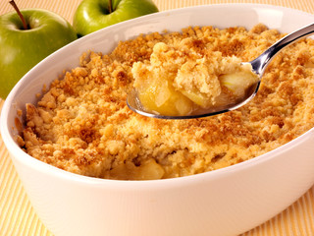
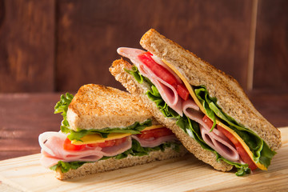
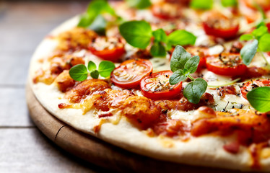
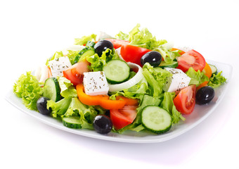
Examples of dishes that demonstrate low level skills:
• crumbles
• sandwiches
• pizza with ready-made bases
• simple salads.

Slide 7

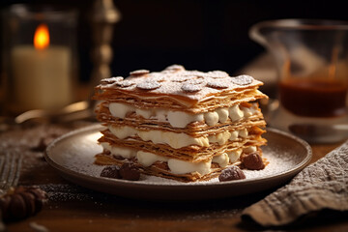
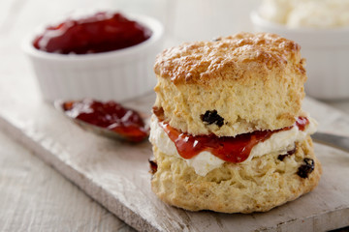
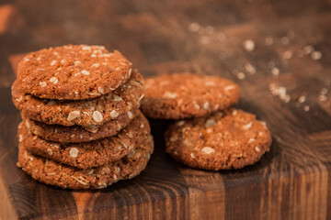
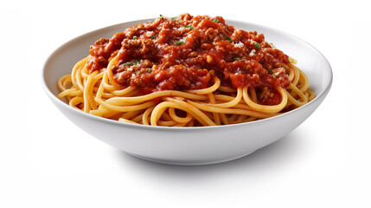
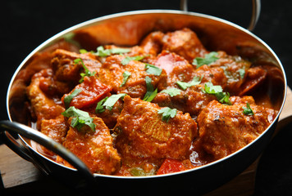
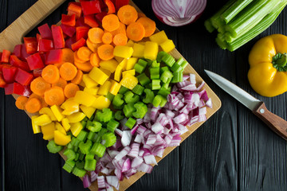
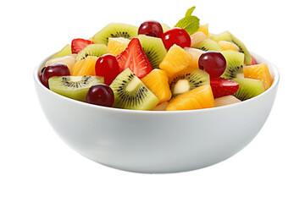
Examples of dishes that demonstrate low to medium level skills.
• readymade pastry items assembly e.g. mille feuilles
• fruit and vegetable dishes that require even sizes
• simple cakes, cookies, scones, undecorated
• pre-cut meat products or simple meat dishes such as curry, bolognaise with homemade sauce

Slide 8


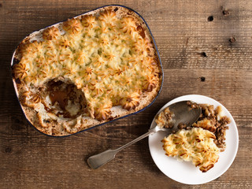

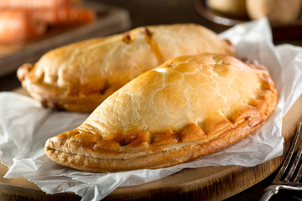
Examples of dishes that demonstrate medium level skills:
• cheesecakes, homemade ice cream
• simple sauces— e.g., red wine sauce
• decorated cakes and genoise sponge
• homemade short crust pastry products
• piped potato dishes, e.g., duchess, croquette, shepherd’s pie.

Slide 9

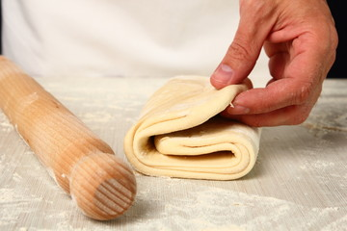
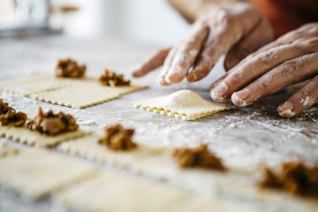
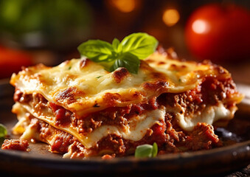
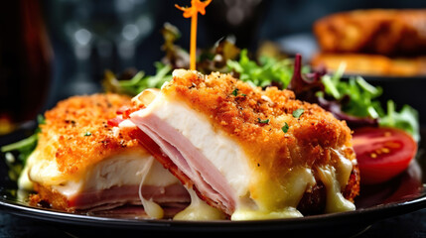
Examples of dishes that demonstrate medium to high level skills:
• cheesecakes—gelatine, baked panna cotta
• rich yeast doughs
• 1 or 2 complex accompaniments/garnishes
• choux buns, homemade puff pastry
• tiramisu with homemade sponge
• homemade pasta dishes
• roux based sauces
• lyonnaise, dauphinoise potatoes
• meat and fish dishes that require changing the shape of the meat e.g. chicken kiev.

Slide 10
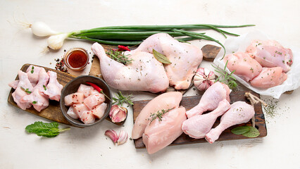
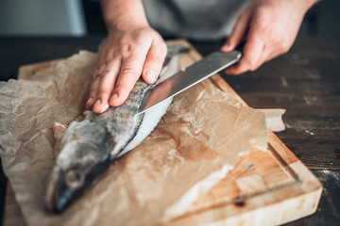
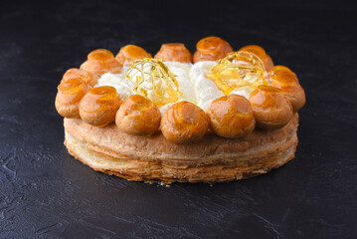
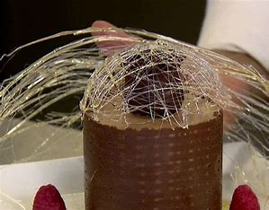
Examples of dishes that demonstrate high level skills:
• de-boning/ portioning chicken
• filleting fish
• 3 to 4 complex accompaniments/ garnish
• 2 or more high skills to make one product e.g. gateau St. Honore
• exemplary presentation of dishes —clean neat presentation
• chocolate run outs, spun sugar for decorated cakes. Accurate piping skills.

Slide 11
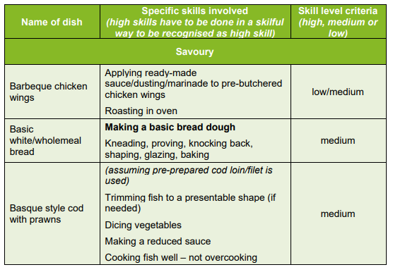
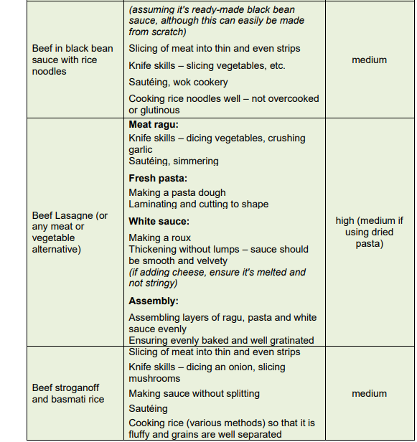

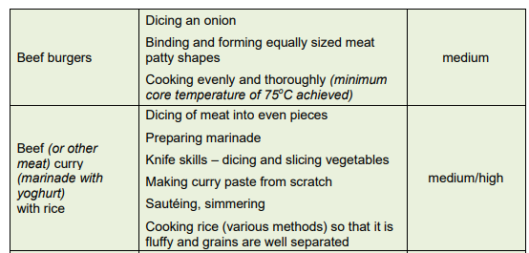
Teacher Handbook p57-73
This list gives you examples of dishes – it would be impossible to list every dish.
Our aim is to give you examples so that you can consider the skill level of dishes selected in your centre.

Slide 12
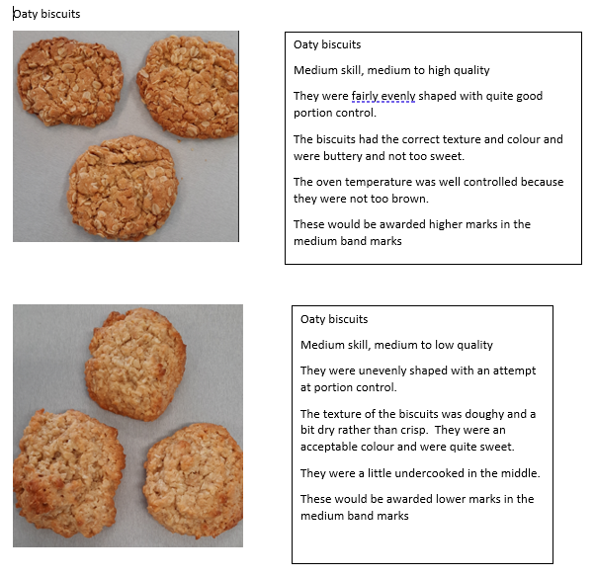
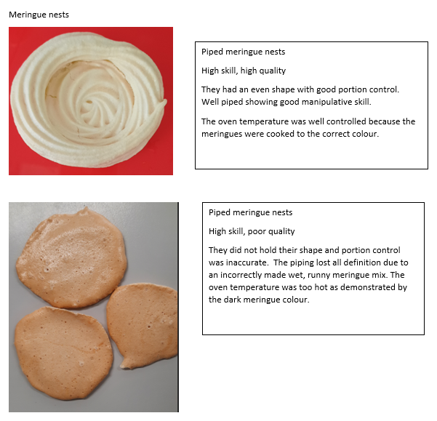
How to award those top band marks?......
Oaty Biscuits
Meringue Nests

Slide 13
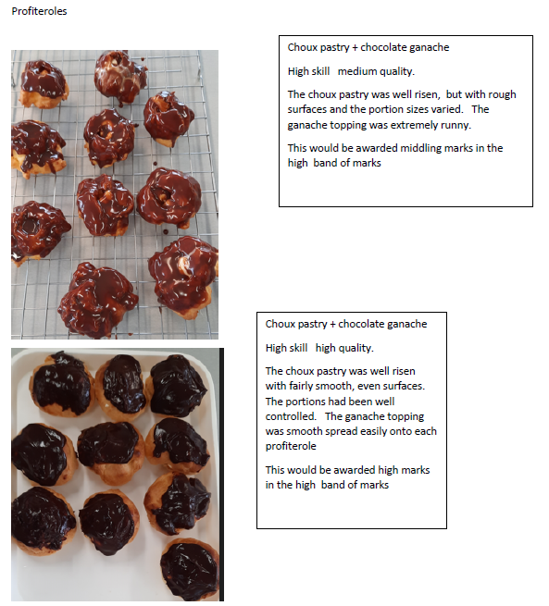
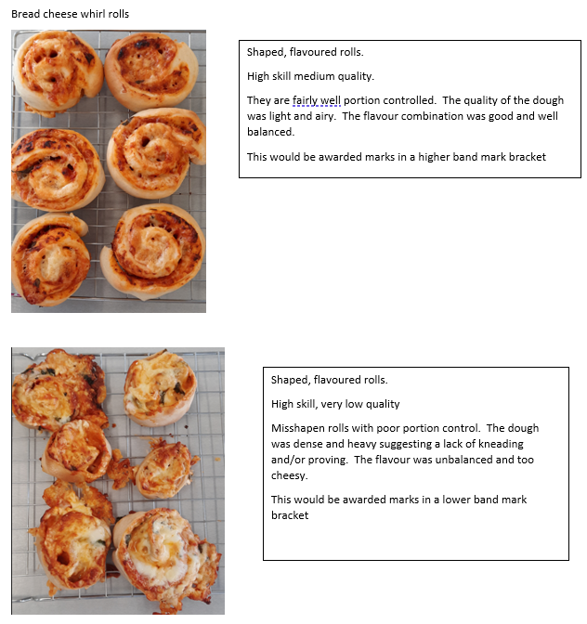
Profiteroles
Bread cheese whirls

Slide 14
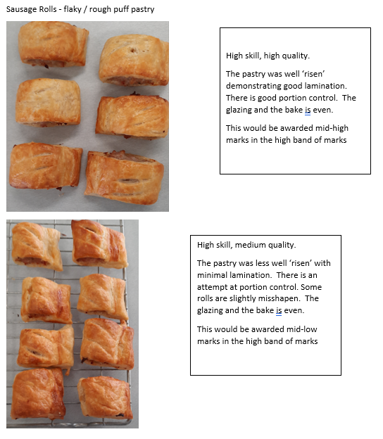
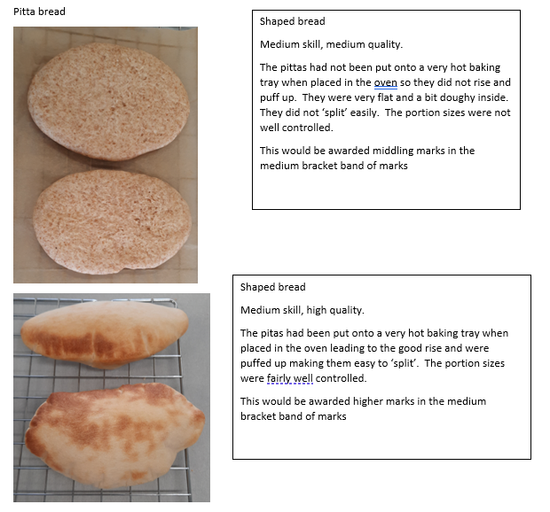
Sausage rolls Rough puff pastry
Pitta bread

Slide 15
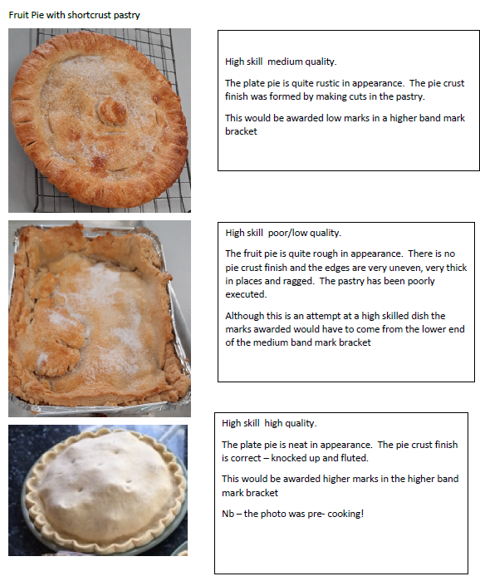
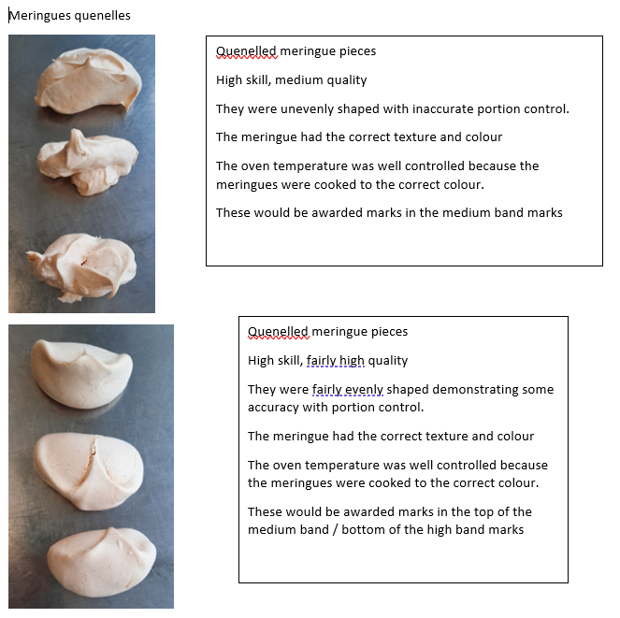
Fruit Pie with SC Pastry
Meringue quenelle

Slide 16
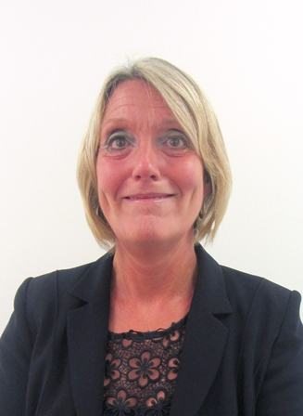

Thank you
CONTACTS:
Contact our specialist Subject Officer and administrative support team with any queries.
Allison Candy - Subject Officer
food@wjec.co.uk
Gemma Edwards - Subject Support Officer
food@wjec.co.uk
Sian Williams – Subject Adviser
food@wjec.co.uk

