Slide 1


GeogShots
CC BY-NC-ND 4.0

Slide 2

GeogShot.
A 10-minute solution focused “shot” of geography to help guide your learners to more successful responses in the exam.
They are designed so you can fit these resources into your existing lesson plan or adapt as you want.
Each builds on identified actions from examiners reports.
They could be part of your intervention strategy to support and challenge your learners in class.
They are designed to allow you to insert a relevant question to work on from any aspect within the specification.

Slide 3

It is important your learners can define with understanding geographical concepts.
How can this be included in your lesson?
CC BY-SA 3.0
Notes:
Ideas on how to use these slides in your lesson is included in the notes these are just suggestions and the idea is this is flexible for you to edit and use as you would want to.

Slide 4
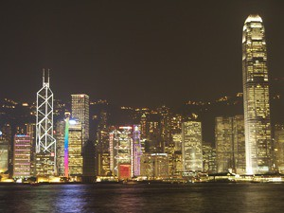
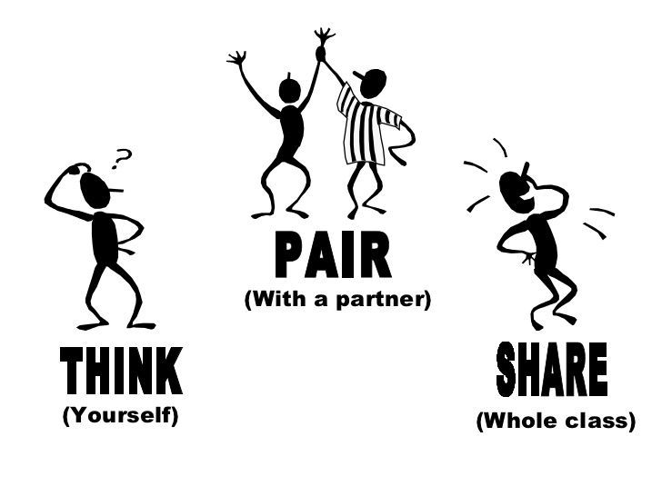

What is a global city?
Not just a large city area and big population, this would be described as a mega city.
What characteristics would make a city be classified as a global city?
Notes:
Make sure the global reach of a city separates it from large sprawling cities. Get learners to think pair share what a global city may have to make it important at a global level.

Slide 5


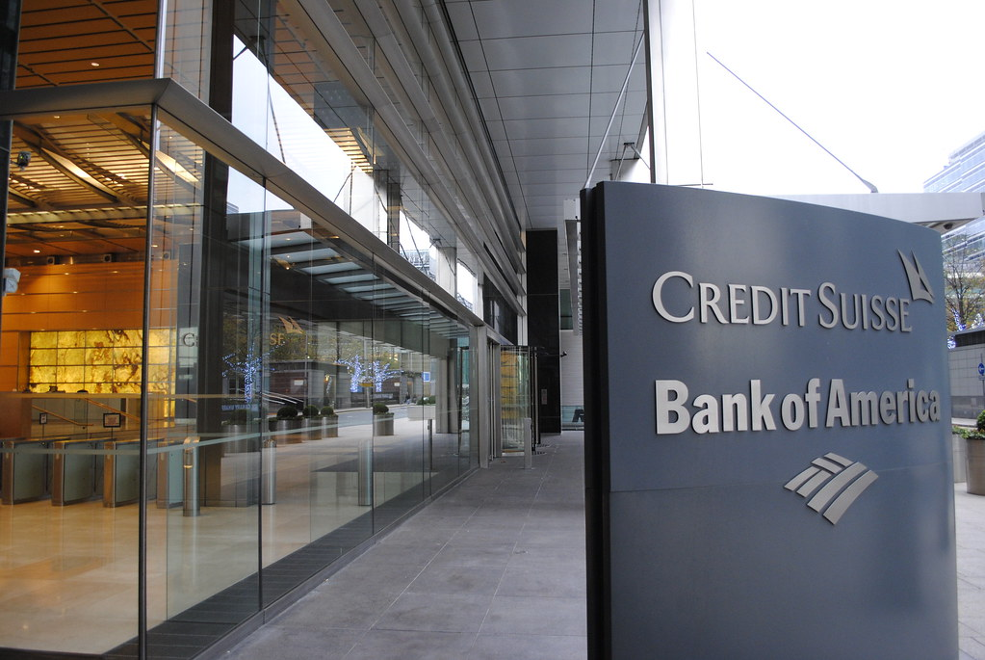
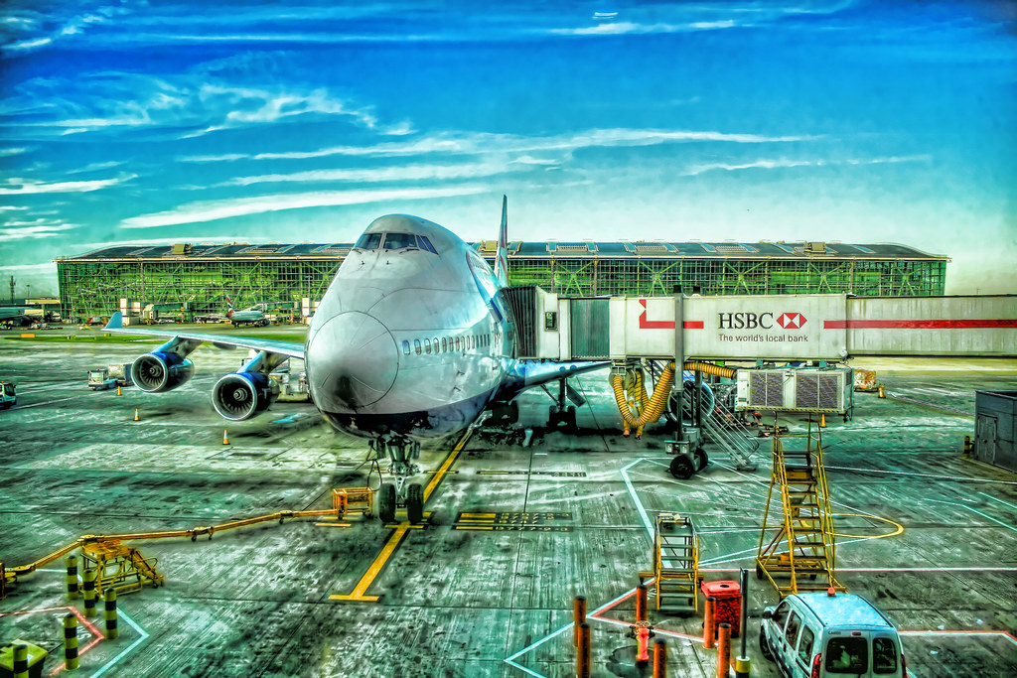
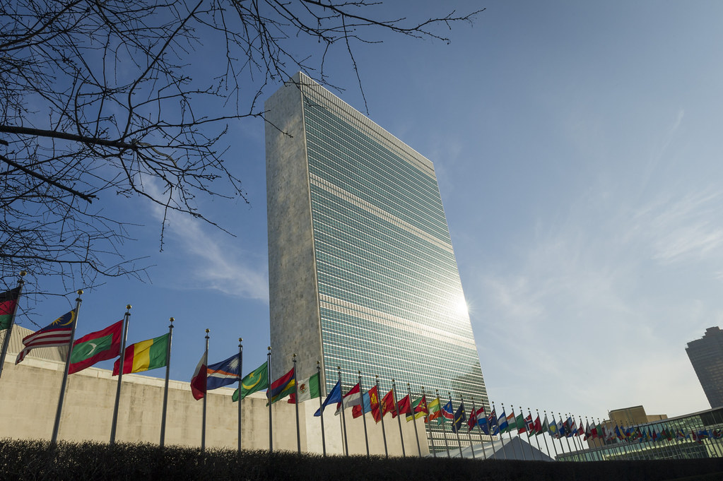
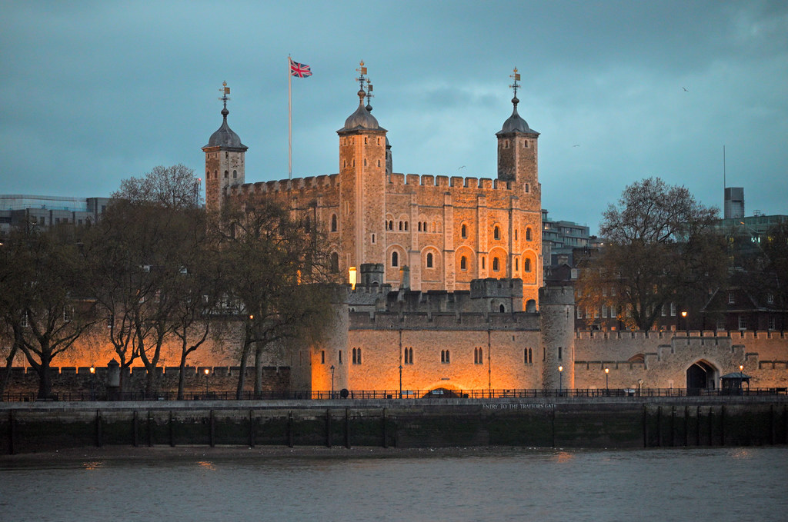
CC BY-NC-ND 2.0
CC BY 2.0
CC BY-NC-ND 2.0
CC BY-NC-ND 2.0
CC BY-NC-ND 2.0
Each of these images identify a characteristic that a global city will have. Explain what they are and why they are important for a city to be classified as a global city.
Notes:
The learners could work in groups each having one of these images and state the case for their characteristic. Learners should understand that global cities should have all or most of these to qualify.

Slide 6
Frayer Model
Definition:
Characteristics:
Term:
Examples:
Non examples
Use this framework to develop a meaningful definition of a global city.
Notes:
You can give the different frames to learners to fill in after discussion of characteristics to build up the Frayer model for a global city. Share with the class

Slide 7
Frayer Model
Definition: A global city, also known as a world city, is a significant urban centre that exerts a substantial influence on global affairs through its economic power, political influence, cultural significance, and connectivity. These cities act as key nodes in the global economic system.
Characteristics:
Economic Influence: Headquarters for multinational corporations, major financial institutions, and significant stock exchanges.
Cultural Hub: Centres for arts, entertainment, fashion, and media that shape global culture and trends.
Connectivity: Extensive transportation networks, including major airports and seaports, and advanced telecommunications infrastructure.
Political Influence: Hosts important international organizations, diplomatic missions, and global policy-making forums.
Term:
Global City.
Examples:
New York City: Major financial center with Wall Street, UN headquarters, cultural landmarks like Broadway.
London: Financial hub with the London Stock Exchange, rich cultural heritage, and global connectivity.
Tokyo: Economic powerhouse with major corporations, advanced technology, and significant cultural influence.
Paris: Renowned for its fashion, art, and international organizations like UNESCO.
Non examples:
Small Town: Limited economic impact and global influence, primarily local connectivity and cultural presence.
Regional City: Important within its country but lacks the global reach and influence of a global city.
Isolated City: Limited transportation links and connectivity, minimal impact on global affairs.
Industrial City: Focused on manufacturing or specific industries without significant global economic or cultural influence.
Notes:
Here is a possible model answer learners can judge and if needed add to their model of what a global city is . This can also be adapted as a sorting activity.

