Slide 1


GeogShots
CC BY-NC-ND 4.0

Slide 2
GeogShot.
A 10-minute solution focused “shot” of geography to help guide your learners to more successful responses in the exam.
They are designed so you can fit these resources into your existing lesson plan or adapt as you want.
Each builds on identified actions from examiners reports.
They could be part of your intervention strategy to support and challenge your learners in class.
They are designed to allow you to insert a relevant question to work on from any aspect within the specification.

Slide 3

It is important your learners know and understand the demands of the questions in NEA and are prepared to apply their experience to support their response.
How can this be included in your lesson?
CC BY-SA 3.0
Notes:
Ideas on how to use these slides in your lesson is included in the notes these are just suggestions and the idea is this is flexible for you to edit and use as you would want to.

Slide 4
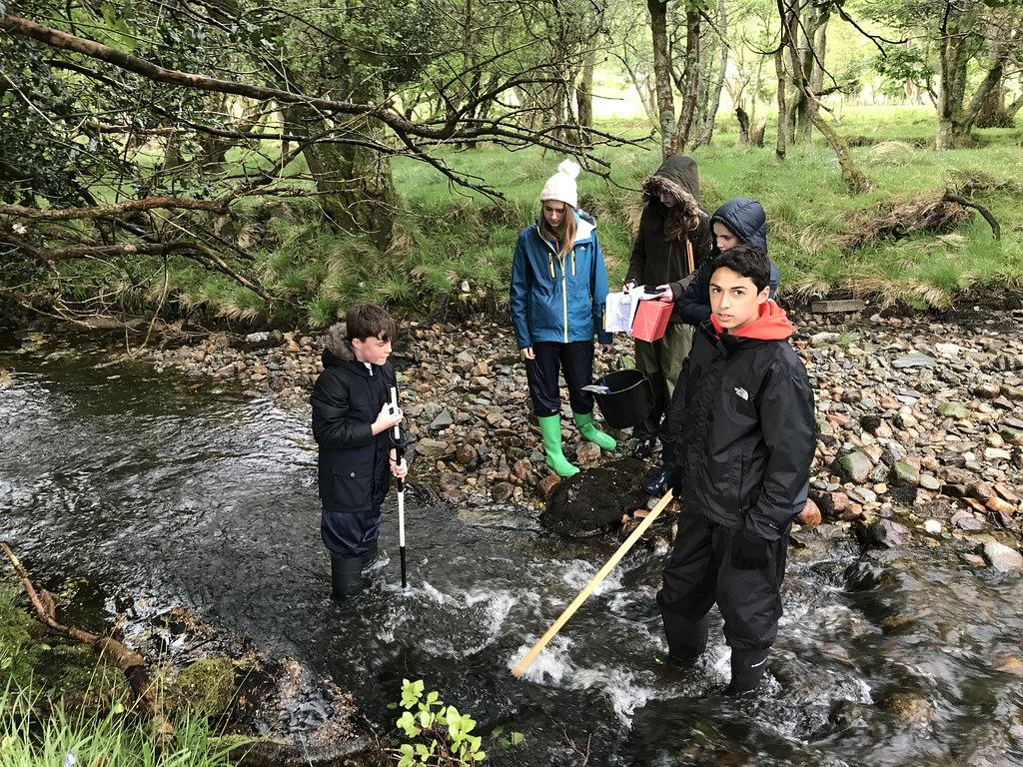
Task taking
There are two phases of task taking.
Phase 1 Creation of a fieldwork portfolio: a limited level of control is specified. Phase 2 Report writing: a high level of control is specified.
Once your phase 1 is complete you need to use your portfolio to help you answer the questions for phase 2 report writing.
Notes:
Image CC BY 2.0 The learners need to understand how to effectively use the information from their portfolio to inform and authenticate their understanding of field work enquiry.

Slide 5
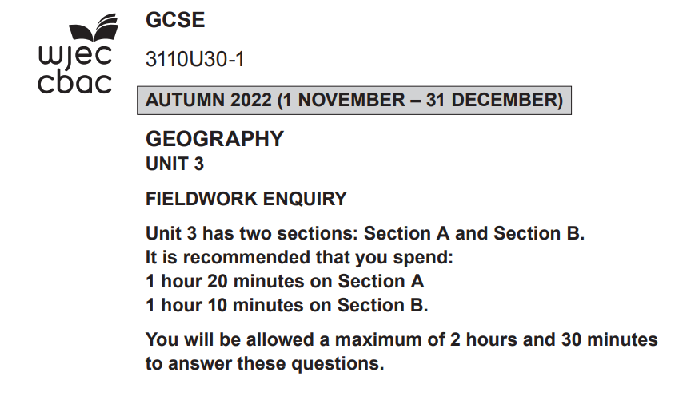

Remember Section A will refer to the methodology set for the year you will qualify
Section B will refer to the concept.
In 2023 the methodology was TRANSECTS
The concept was INEQUALITY.
Notes:
It is important that the learners understand where their focus was for these concepts and methodologies when they undertook their field work. This example is based on series 2023 for illustration.

Slide 6
You will need to approach the questions as you would for Unit 1 and 2 exam papers.
De bug the question
AO1.2 Demonstrate understanding of places, environments and processes at a variety of scales.
Select one sampling technique you used along a transect. Explain why you chose this technique. [4]
One sampling technique
along a transect
Explain why
Command word
Explain why: Give reasons why something happens; set out the purposes for something.
You need to show your understanding of the relevance of the sampling technique and link to what you did in the field.
You need to give reasons why these techniques were effective when used on a transect and reference your experience to illustrate your reasons..
Notes:
Use this slide to take the learners through how to debug an AO1.2 question, this can be modelled to the whole class possibly using question and answer session, employ white boards to identify the parts of the question.

Slide 7
Consider what the mark scheme is going to reward AO1.2 responses require explanation and so often have banded mark schemes.
Band Marks Descriptor
Band 2 3-4 marks
The response provides a
clear and specific
explanation linked to
transects.
Band 1 1-2 marks
A basic and general
explanation.
Band 0 mark
Award 0 marks if the
answer is incorrect or
wholly irrelevant.
You need to be:
clear,
specific and
refer to transects/methodology you carried out.

Slide 8
Clear | specific | Transects/methodology
In the case of a transect across a river meander, the systematic sampling technique would be highly suitable. | This involves taking samples at regular intervals along the transect line, for instance, every 1 or 2 meters across the river meander from one side to the other. | River meanders have gradual changes in features such as water depth, vegetation, and soil characteristics from the inside bank (deposition zone) to the outside bank (erosion zone). In our fieldwork question we were focusing on water depth across the meander on the Afon Gwyfrai. Systematic sampling ensures that these changes are captured evenly along the transect, providing a good understanding of the river's gradient and landscape changes.
Use this table to organise your response to this type of question using your own fieldwork example in your answer.
Notes:
You can use other banded mark schemes to develop similar organizing tables to help learners structure their answers. ALWAYS make sure they reference their own experiences of fieldwork.

