Slide 1
The Intellectual Property Office is the official government body for intellectual property rights within the UK.
Copyright, patents, designs and trade marks are all types of intellectual property (IP) protection.
IP helps you to gain value from ideas - turning inspiration into sustainable business success and boosting the economy.

Slide 2
Why do we need to learn about intellectual property?
Click to Play Video in Internet Browser

Slide 3
What is intellectual property?
Intellectual Property is the collective term for creations of the mind and the fixed formats in which they can be protected:
Patents
Trade marks
Registered Designs
Copyright
Unregistered Design right
Confidentiality
Trade secrets

Slide 4
Copyright

Slide 5
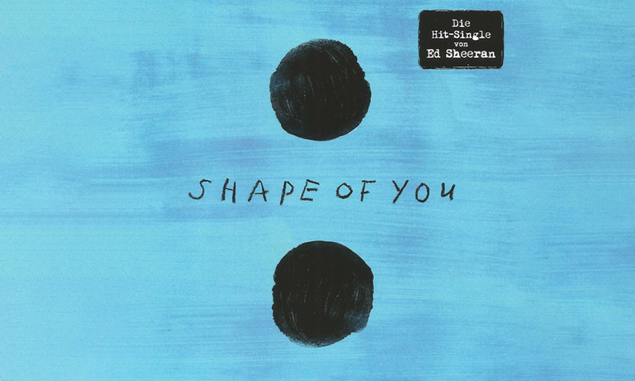
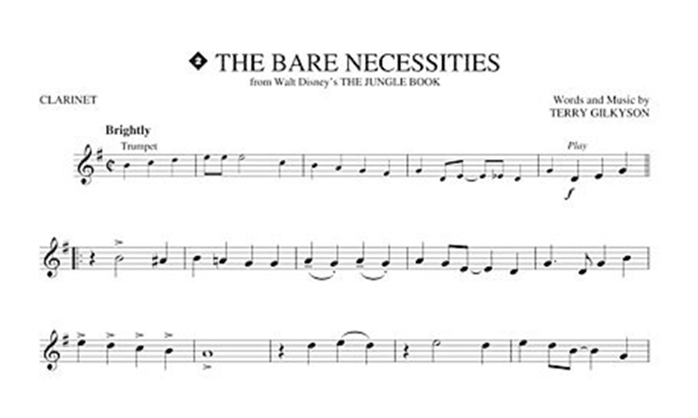
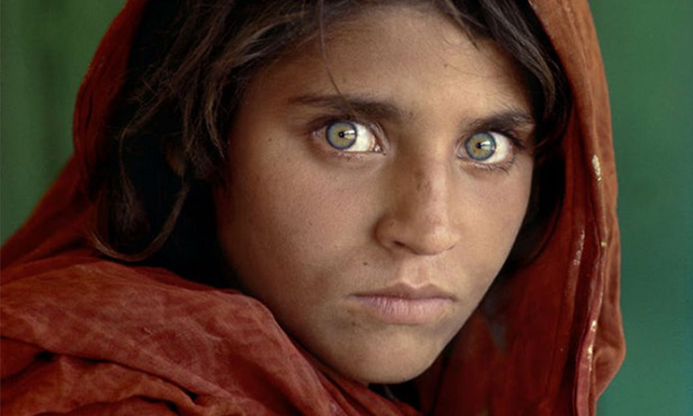
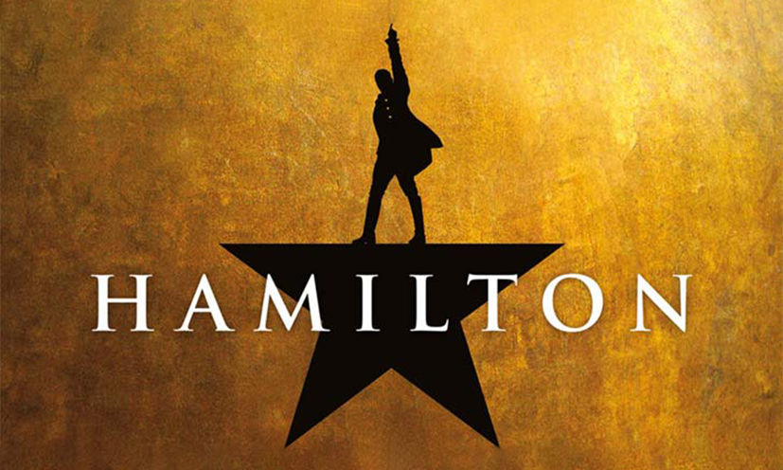
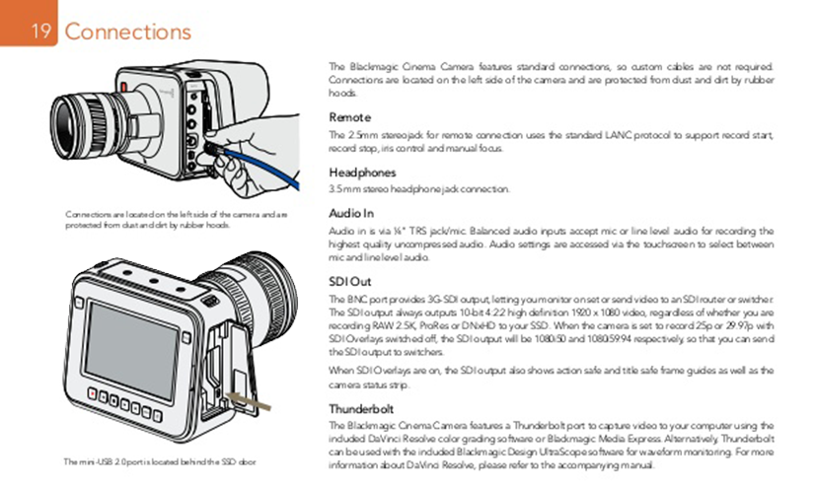
Copyright
©/blog.flipsnack.com/harry-potter-book-covers-all-around-the-world/
©/wallpapersafari.com
Copyright protects literary, dramatic, musical and artistic works such as :
Books
Music
Photographs
Paintings
Manuals
Dance or a mime
Copyright also protects sound recordings, films, databases and broadcasts.
©/www.discogs.com
©/Terry Gilkyson Disney
©/Steve McCurry
©/David Hockney
©/Spotco
©/Blackmagic Design
Notes:
Copyright protects your work and stops others from using it without your permission. You get copyright protection automatically - you don't have to apply or pay a fee. There isn't a register of copyright works in the UK. ... original literary, dramatic, musical and artistic work, including illustration and photography.
Images – Harry Potter (1997-2007) – JK Rowling, Avatar(2009)film – James Cameron, Shape of You(2017) – Ed Sheeran, Bare Necessities(1967) – Terry Gilkyson Disney, The Afghan Girl (1985) -Steve McCurry , Garden(2015) – David Hockney, Hamilton(2015) - Lin-Manuel Miranda, Instruction Manual – Black Magic camera.
*Copyright covers a wide variety of works and we are likely producing copyright material regularly within our daily roles*.

Slide 6
Copyright
Copyright is automatic in the UK, and most other countries
Berne convention (Berne Convention for the Protection of Literary and Artistic Works)
Protects original works as soon as they are fixed or recorded in a material form
It is advisable to keep a record of any work, should you need to prove when it was created
Notes:
The Berne Convention, is an international agreement governing copyright, which was first accepted in Berne, Switzerland, in 1886 it introduced the concept that a copyright exists the moment a work is "fixed", rather than requiring registration. It also is the most universal of rights requiring that countries recognize copyrights held by the citizens of all other parties to the convention.

Slide 7
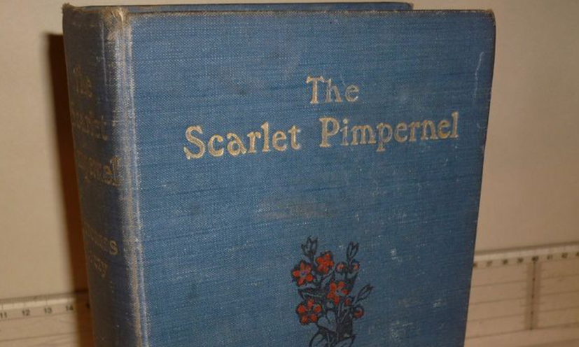
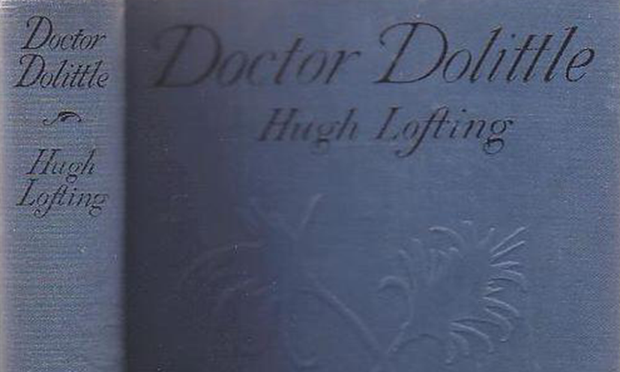
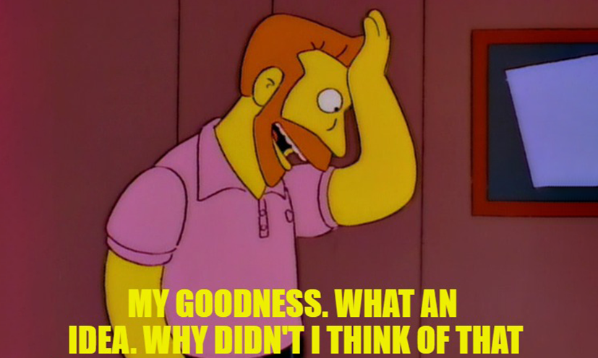
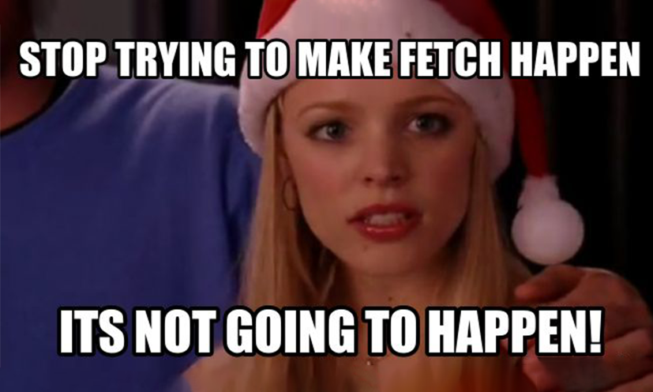
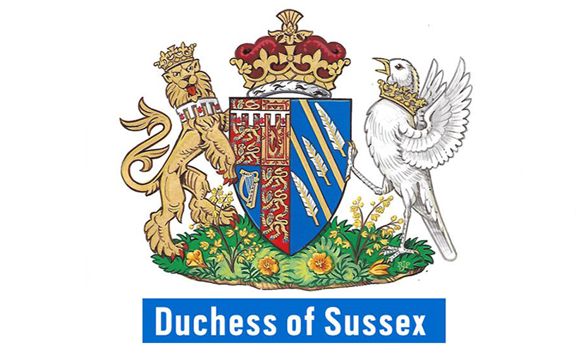
Copyright
Does not protect
Works in the public domain
when copyright has expired
Ideas
copyright protects the expression of an idea not the idea itself
Single words
Titles
Facts
©/www.ebay.co.uk
©/www.abebooks.co.uk
©/knowyourmeme.com
©/knowyourmeme.com
©/metro.co.uk
©/bbc.co.uk
Notes:
Copyright expiry and works in the public domain can very from country to country – so works that have expired in the US may not have expired in the UK.
Exceptions: The following exceptions are known as ‘fair dealing exceptions’ meaning the use must also be ‘fair’ for these exceptions to apply: non-commercial research or private study, criticism or review, reporting current events, illustration for instruction, quotation, or parody, caricature or pastiche
The list of fair dealing exceptions is set in law, which means that it would be irrelevant if the use of an artistic work is fair but for a purpose that is not listed as a ‘fair dealing’ exception in the law. In this way the law provides more certainty.
Hugh Lofting – Doctor Dolittle 1886 (death 1947)
Emma Orczy – Scarlet Pimpernel 1865 (death 1947)
You can’t protect an idea – only the execution or expression of that idea. The only way to protect an idea is to keep it secret.
(I’ve had an idea for a box that travels through time) – If they say DrWho you say Bill and Ted or vice versa.
Single words can’t be subject to copyright but they can be trade marked.
Titles like Sir, Madam, Duchess of Sussex
Facts are not artistic, there's no creativity involved

Slide 8
How long does copyright last?
Notes:
*For clarification of the duration of crown copyright (which, we’ll touch on shortly)…
For crown copyright works that have been published – duration is 50 years after publication;
or
for works that haven’t been published – duration is 125 years after creation.
These limits on crown copyright are defined under section 163 of the Copyright, Designs and Patents Act 1988 – (For crown copyright works created prior to August 1989 there may be slightly different limits – good idea to refer to The National Archives for further clarification)
Additionally,
Copyright can also come into Crown ownership by means of assignment or transfer of the copyright from the legal owner of the copyright to the Crown. Copyright in a work which has been assigned to the Crown lasts 70 years after the death of the person who created it.
Crown copyright covers material created by civil servants, ministers and government departments and agencies. This includes legislation, government codes of practice, Ordnance Survey mapping, government reports, official press releases, academic articles and many public records.*

Slide 9
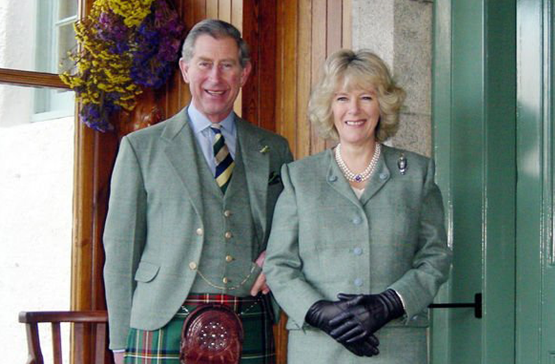
Who first owns copyright?
Usually the first creator(s) or author
An employer will usually own the work if it was produced in the ordinary course of employment
A contractor may retain ownership of works created, although this can depend on their contract
Moral rights are still retained even if the creator sells their copy right
©/Carolyn Robb
Notes:
As we’ve mentioned earlier, Copyright covers a wide variety of works and we are likely producing copyright material regularly within our daily roles.
Copyright works, when created by an employee within their official duties, will fall under the ownership of the employer – for those working in the civil service, copyright works created by individuals will fall under the ownership of the crown.
ROYAL PHOTO
Carolyn Robb employed as an organic chef was asked by an aide to take a snapshot of Prince Charles and Camilla. She asked why it was being taken and was told the couple wanted a photograph of themselves dressed in their new green tweeds on their way to church. It ended up being used as the official engagement photograph of the couple and was later made into stamps. Because she was employed as a chef and not a photographer she would retain the copyright. Ms Robb was rumoured to have received a four-figure settlement over the use of the image.

Slide 10
Copyright exceptions and permitted acts
Non-exhaustive list includes;
Private study
Education
Libraries
Research
Incidental inclusion
Disability
Criticism/Review
News reporting
Parody
Time shifting of broadcasts
Some official reports
Notes:
Fair dealing is a framework for determining exceptions to United Kingdom copyright law which allows for the use of copyrighted works without licensing or permission in certain circumstances.
Not to be confused with Fair Use that they use in the US as their meaning and scope are defined by different legal systems
The difference is commercial purposes. If you’re using someone else’s IP to make money without their permission– it’s unlikely to be covered by an exception and it’s theft (This is wrong – it’s infringement)

Slide 11
Copyright
Record your work
Keep proof
Use contracts
Licensing opportunities
There are no official registers
There are unofficial registers you can register with and upload your work for third party proof
Registration does not prove ownership, only that the work existed at the point it was uploaded
Notes:
Best practice when managing copyright in your work:
Ways to keep proof – post something to yourself and keep it sealed with the post mark. Get things signed and dated and independently witnessed. Keep rough drafts, sketches, chains of emails and agreements. Keep high resolution files, keep negatives or other digital and raw files if you’re dealing with photos. Keep rough drawings and plans for sculptures or early tests of things. It‘s all to build a picture for a judge in court who must decide who’s actually put their artistic craftmanship into a piece of work if you get challenged or infringed.

Slide 12
Registered designs

Slide 13
Registered Designs
A Registered Design protects the overall visual appearance of a product:
Physical shape
Configuration
How different parts are arranged together
Decoration
Such as a pattern on a fabric

Slide 14
Registered designs

Slide 15
Registered designs don’t protect
How a product functions
What material it is made from
How it’s manufactured
A form dictated by it’s function or where there is no design freedom
Must fit or must match like a key or universal/standard attachments

Slide 16
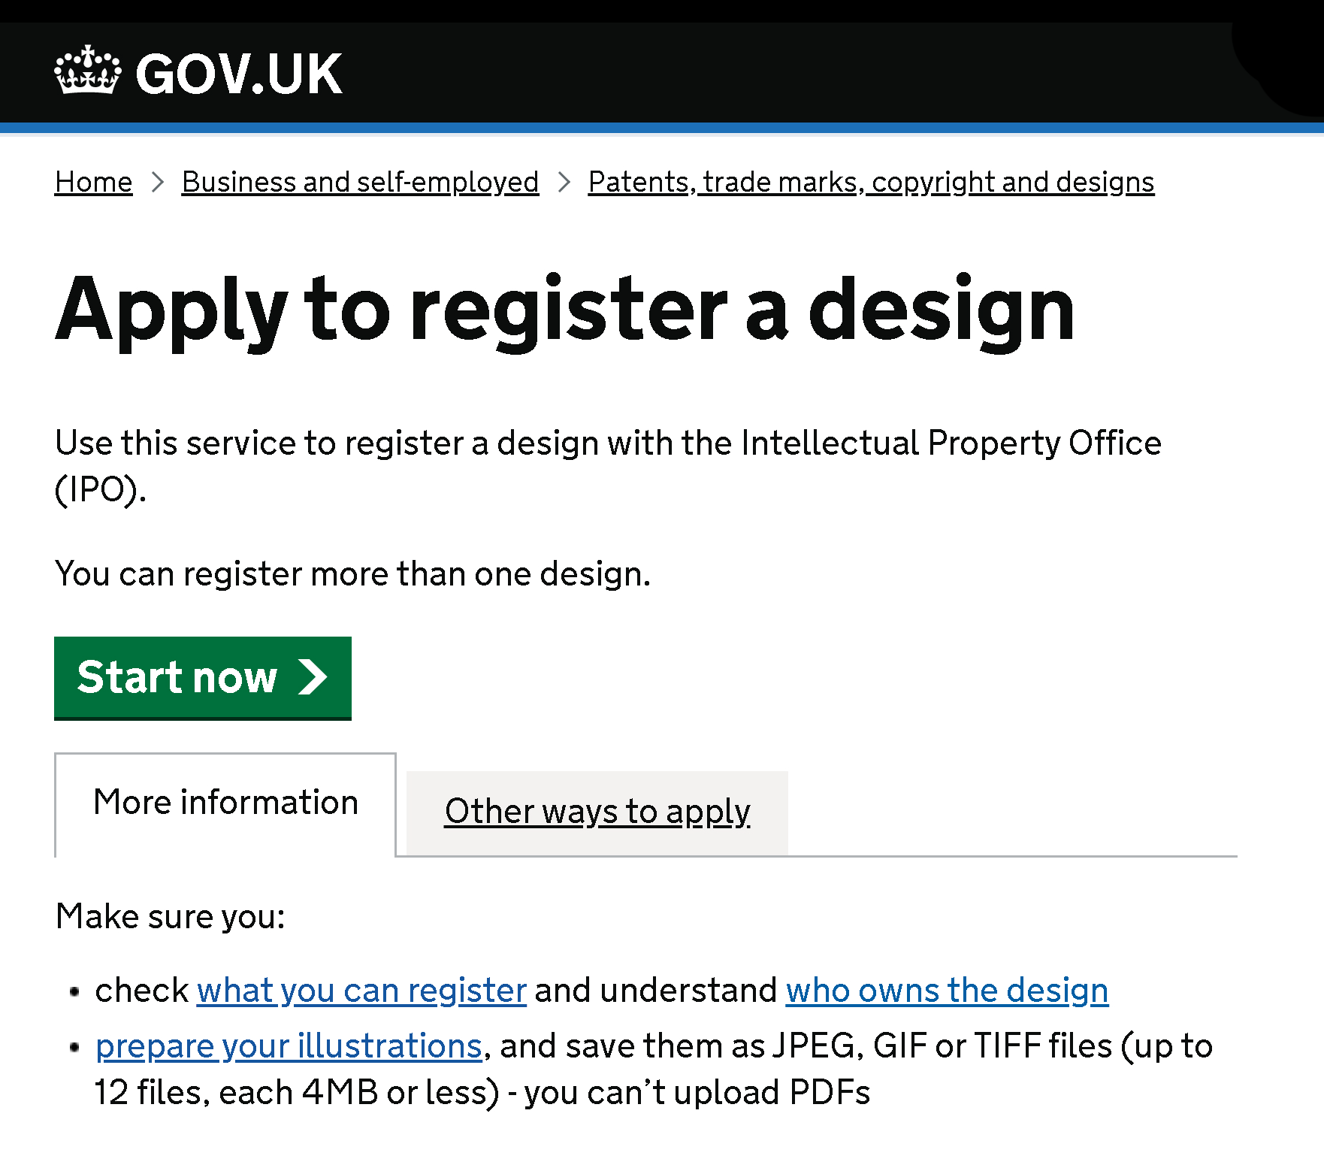
Registered design costs
£60 for 1 design (paper application)
£50 for 1 design (online application)
£60 for first and £40 for each additional design in the same application
£70 for up to 10 designs in the same application
Additional £20 up to and including every further set of 10 designs in the same application
Designs do not have to be related to each other, just filed at the same time

Slide 17
Patents

Slide 18
Patents
Patents protect
New inventions
How products work
Technical function
What they do
How they do it
Notes:
*Innovation within the public sector can generate significant benefits; and government organisations are often at the forefront of scientific and technological advancements – involving patents.
Managing these forms of IP effectively within the public sector can unlock it’s potential; and, support and enhance innovation within the UK; and generate spill over benefits - helping deliver the best results for our public services, economy and society*

Slide 19
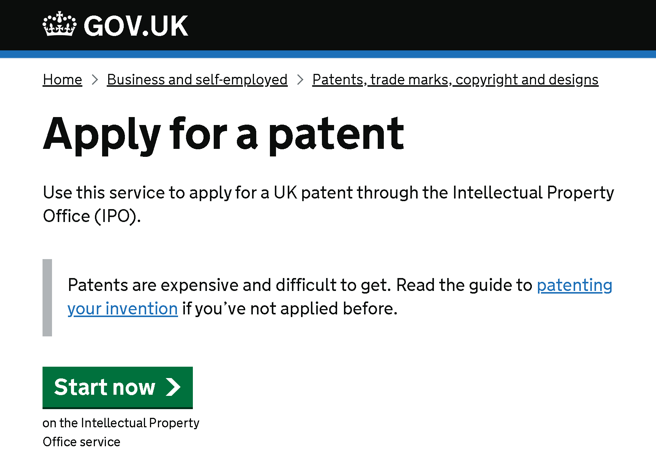
Patent fees in the UK
Applications contain separate parts:
Application fee
£90 paper
£60 online
Search fee
£180 paper
£150 online
Examination fee
£130 paper
£100 online
Renewals
start in year 5 and end in year 20

Slide 20
How long does the patent process take?

Slide 21
Patents – Due Diligence
Keep your inventions confidential
Use Non-disclosure and confidentiality agreements
Search for existing and similar inventions
Seek help from a patent attorney to draft your application
Notes:
*Government organisations play a big role in Scientific and technological advancements (MOD, NHS), and as such, they generate spill overs which contribute greatly to economy and wider society in the UK – patents hold significant value and this form of IP represents another type of knowledge asset which require careful attention in order to exploit and reap the rewards of its development.
Due Diligence is key*

Slide 22
Trade marks

Slide 23
Trade marks
Any sign which is capable of distinguishing the goods or services of one undertaking from another
A badge of origin
If in use can be renewed indefinitely
®
Notes:
Trade marks are badges of origin. They distinguish the goods or services of one trader from another. Trademarks are registered for specific goods or services within 45 individual subjects, of goods and services known as classes. It is possible for others to register identical or similar marks as long as it is in a different, unconnected class.
Example Polo car, polo mint, polo shirt, polo fragrance. It’s all about if you as a consumer would get confused and walk into a shop to buy a packet of polo mints and come out with a car because you’ve confused the brands. If something is distinctive in it’s field then you could potentially trade mark it.
*Trade marks are intrinsically linked to reputation. That could be the reputation of a company, brand, product, service etc… As an asset, a trade mark can be extremely valuable; and that value is often, largely dependant on building and protecting that reputation.*

Slide 24
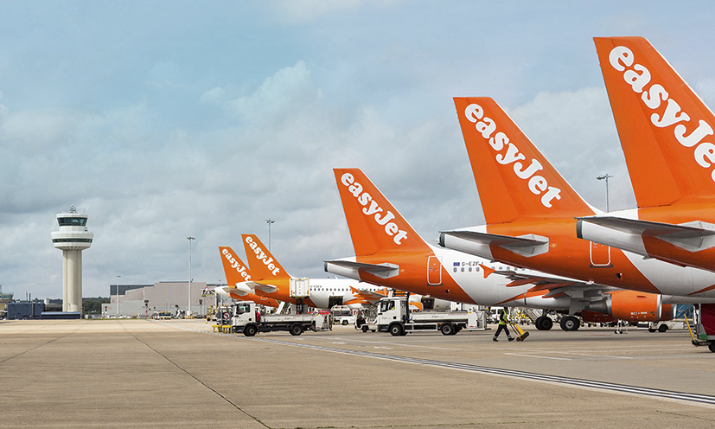
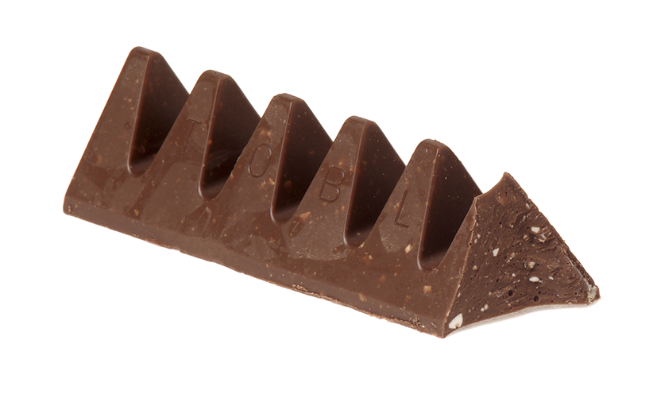
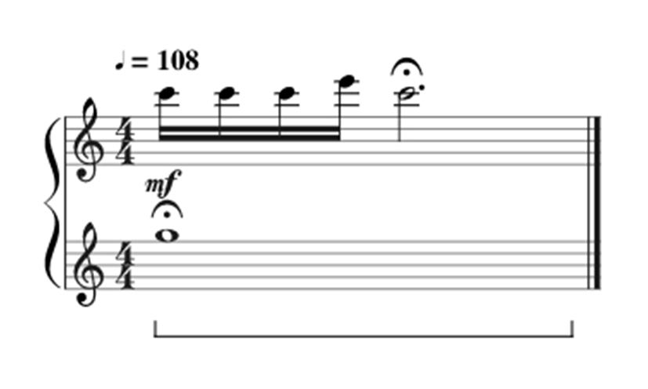
What can be registered?
Name
Logo
Domain name
Slogan
Colour theme
Shape theme
Action
Sound / Jingle
The mark must be distinctive for the goods and services you provide.
Notes:
Chanel name, Nike logo, B&Q domain name, Carlsberg slogan, easy jet colour theme, Toblerone chocolate shape, ASDA pocket tap, T-Mobile jingle

Slide 25
What can’t be registered?
Your trade mark cannot
Be offensive
Be descriptive
Use “laudatory terminology” or words/shapes in common usage in the class of goods in question.
Be non-distinctive
“We lead the way”
Use protected emblems
Notes:
You need to think of your trade mark as a brand or a mark of origin. It needs to be distinctive and unlikely to be confused. The point of a trade mark is so consumers can identify clearly who is providing the goods or services they’re purchasing.
Chanel name, Nike logo, B&Q domain name, Carlsberg slogan, easy jet colour theme, Toblerone chocolate shape, ASDA pocket tap, T-Mobile jingle Apples for computers but not for green grocers. Couldn’t use a 3d egg shape for selling eggs but you could use it for credit cards.
Protected emblems like red cross or Olympic rings etc can’t be registered.
Can’t use “organic” if your products aren’t organic for example.
*The use of Protected emblems is important to note; this includes Heraldic symbols, Armorial bearings/insignias, Coats of Arms, the logo of the royal crown (all public sector type examples), but also protected international emblems like the red cross or Olympic rings etc can’t be registered.*

Slide 26
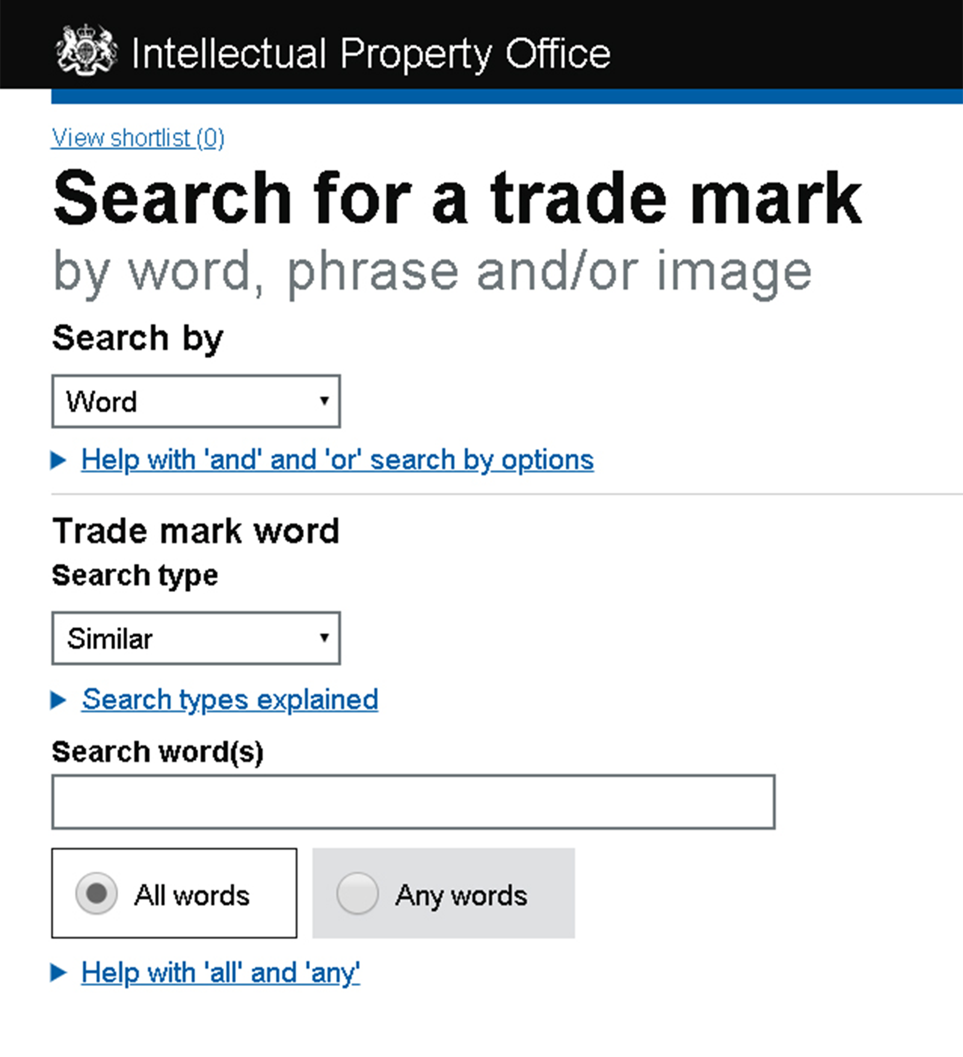
Trade marks
Why search before you register?
Avoid expensive mistakes
Become aware of competing marks
Early resolution of potential problems
Free!

Slide 27
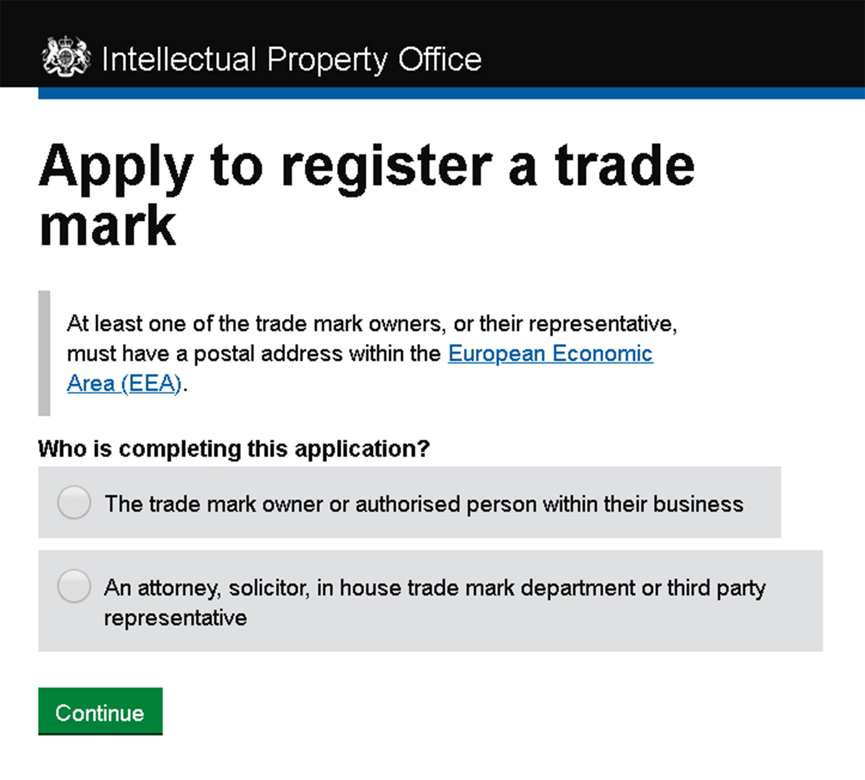
Trade mark costs
UK (Intellectual Property Office)
£170 application fee (1 class included)
EUIPO (European Intellectual Property Office
€850 application fee (up to 3 classes)
WIPO (World Intellectual Property Office)
Madrid protocol (fee calculator available online)
Need professional legal advice?
CITMA - Citma.org.uk (Chartered Institute of Trade mark Attorneys)

Slide 28
IP Abroad

Slide 29
Key messages on IP
1. Know before you go: IP rules and regimes around the world vary significantly
2. IP is territorial: IP rights granted in one jurisdiction usually only provide cover within that same jurisdiction
3. It’s a first to file system across the world: Act fast or miss out!
1. Know before you go: IP rules and regimes around the world vary significantly
2. IP is territorial: IP rights granted in one jurisdiction usually only provide cover within that same jurisdiction
3. It’s a first to file system across the world: Act early or miss out!
Crown Copyright 2022. All Rights Reserved

Slide 30
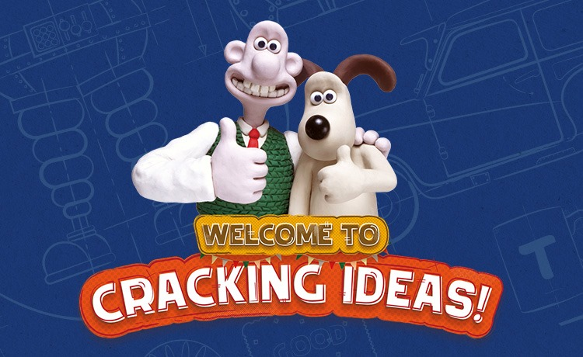
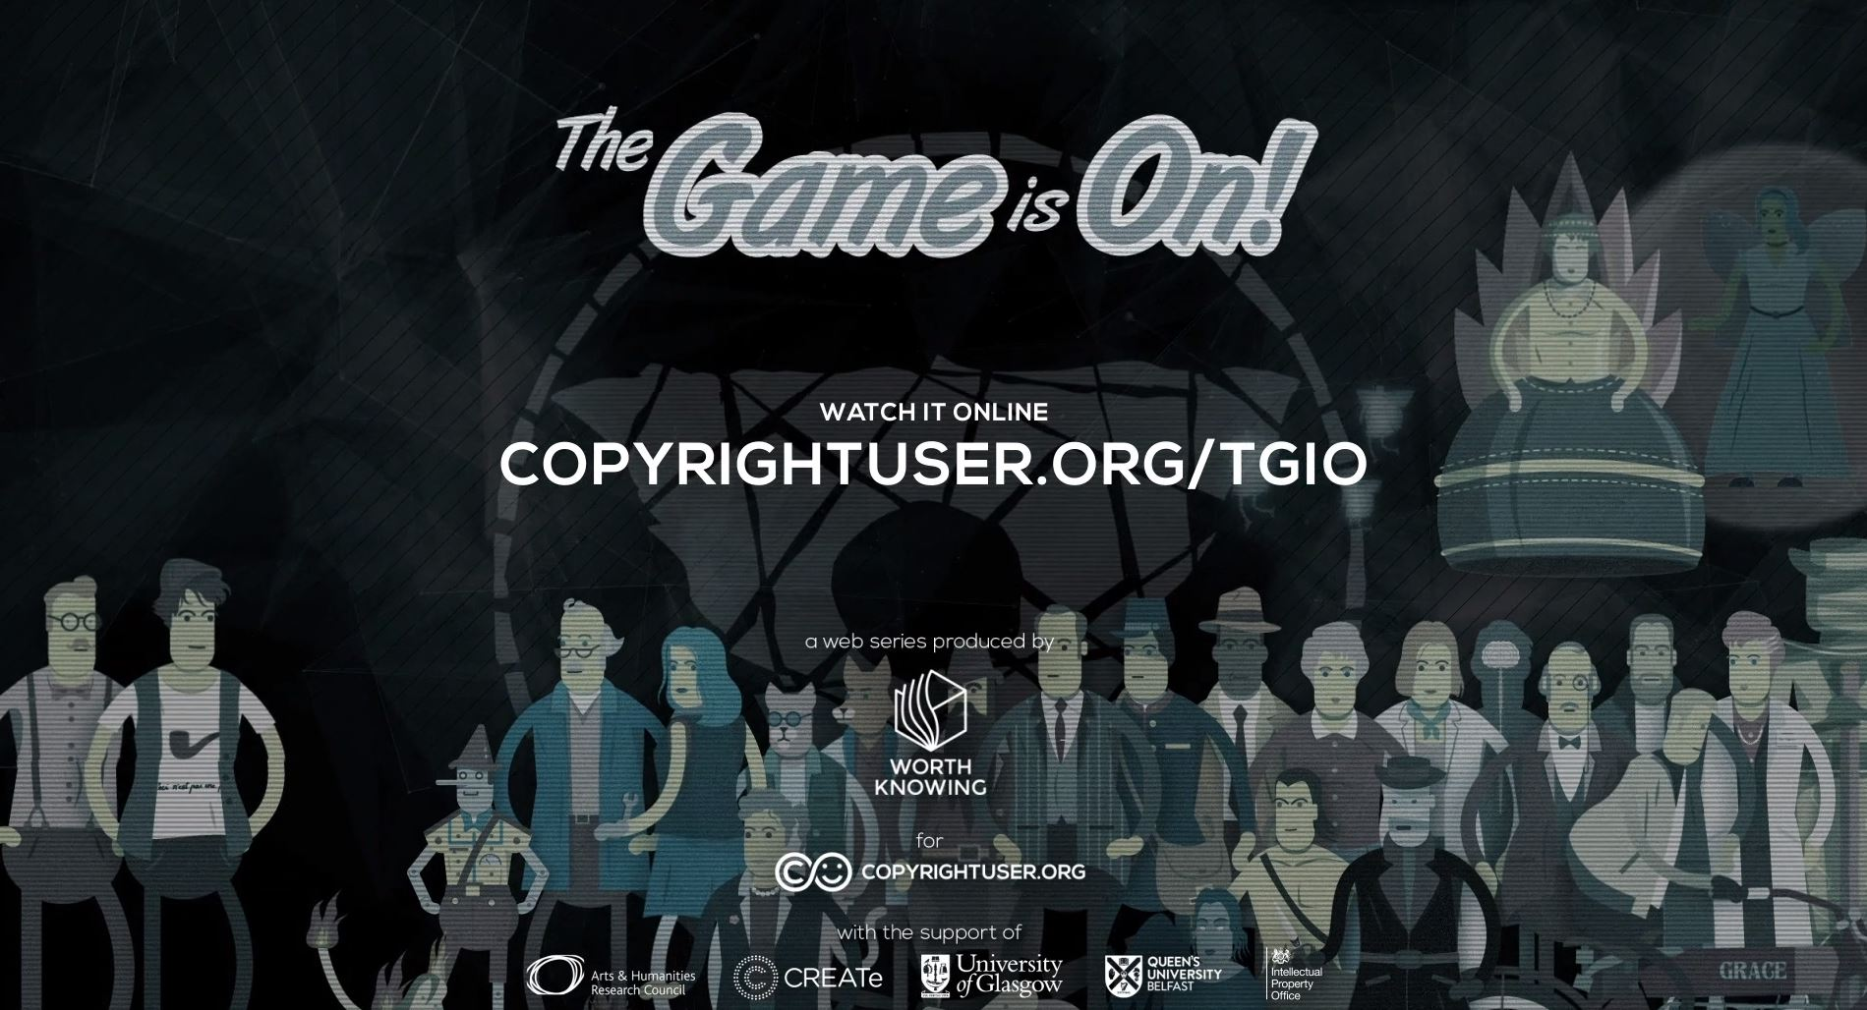
IPO & FURTHER SUPPORT
CRACKING IDEAS
FREE EDUCATIONAL RESOURCES
CrackingIdeas@ipo.gov.uk
IPO ONLINE SUPPORT TOOLS
Notes:
Cracking Ideas, brought to you by the Intellectual Property Office UK, is dedicated to nurturing creativity and innovation in the younger generation. With complimentary classroom kits, riveting competitions, and engaging games, our goal is to infuse classrooms with the spirit of inventive thinking and open up dynamic discussions around creative concepts. Visit www.CrackingIdeas.com to access our range of educational resources. The IPO’s online support tools have been designed to help you:
Understand how IP works and what can be protected using patents, copyright, trade marks and designs
Understand how to manage and use IP
Consider IP within business planning
Best leverage IP to protect investments and products
The tools are designed for businesses, business advisors, students, lecturers, civil and crown servants although they will be helpful for anyone learning how to manage or use IP.

