Slide 1


WJEC Design and Technology
Product Design
CPD Assessment : 2019 – AS
2019 – ALevel

Slide 2
Audio Recording
The presenter is required to make an audio recording of this event. This is a control designed to ensure that WJEC is able to demonstrate compliance with regulatory Conditions of Recognition; specifically Conditions relating to the confidentiality of assessment materials.
The recording will be made available to the qualifications regulator if required, but it will not be shared with any other third parties. The recording will be stored securely by WJEC for a period of three years and then permanently destroyed.
Please note that delegates are NOT PERMITTED to make an audio or video recording of any aspect of this event.

Slide 3
Preliminary Entries
What?
Preliminary Entries are collected for the June series for GCE, GCSE, Entry Level, Vocational Awards/Certificates, and Applied Certificates/Diplomas
Where?
Must be submitted online via WJEC's secure website www.wjecservices.co.uk
Why?
Preliminary entries are an important source of information for WJEC, and are used to calculate the despatch of examination stationery, pre-release materials and early exam papers to centres. It is therefore important that they are submitted as accurately as possible and by the published deadline.
When?
The deadline for submission of preliminary entries is 10th October.

Slide 4
DFE Guidelines
GCE AS and A Level subject content
The AS and A level subject content sets out the knowledge, understanding and skills common to all AS and A level specifications in design and technology.
It provides the framework within which awarding organisations create the detail of the subject specification. AS and A Level specifications in design and technology must reflect the subject aims and objectives.

Slide 5
Course Structure
Design and technology must specify that students engage in both practical and theoretical study in design and technology.
Specifications must require students to cover design and technology skills, knowledge and understanding.
These have been separated into:
• technical principles
• designing and making principles

Slide 6
Course Structure
Specification titles
Design and technology specifications may offer one or more of the endorsed titles listed below. The endorsed title should prepare students for tertiary education and/or work-based study and training in the design, creative, engineering and/or manufacturing industries:
• design and technology (product design)
• design and technology (fashion and textiles)
• design and technology (engineering design)
The subject content has been arranged to define a core content of knowledge and understanding applicable to all AS and A level specifications with additional content for each endorsed title.

Slide 7
Course Structure
AS two units
20 % examination 20% coursework
A level two units (Plus AS units) - Two year course
30 % examination 30% coursework
The focus of this presentation will be the AS and AL Level Examination Papers 2019
Useful links
http://www.wjec.co.uk/qualifications/design-and-technology/r-design-and-technology-gce-2017/
Resources
http://resources.wjec.co.uk/Pages/ResourceByArgs.aspx?subId=8&lvlId=1

Slide 8

General Points – Command Verbs
Candidates need to read and understand the command verb.

Slide 9
General Points – Command Verbs
Give State Name Place | 1 + mark | These questions are designed to ease the learner into the question. They need a simple statement, a short phrase, tick, underline……… Low tariff questions that rely on recall. Will only be used in early questions at GCE.
Describe Outline Explain Justify | 2 + marks | These questions ask the learner to describe something in detail. The answer will be in sentences and/or in a list. There is a need for detail in the answer with elaboration of the answer. Sometimes the question will ask the learner to use notes and sketches; this means that a clearly labelled sketch or diagram will of course gain the marks. Higher tariff questions, more challenging and meant to test knowledge and understanding.

Slide 10
General Points – Command Verbs
Evaluate Analyse | Extended answers | Evaluate could imply / involve assessing or appraising a situation or product or material giving reasons to support their answers. Analyse means examining and dissecting a situation or product giving thoughtful appropriate reasons to support the answer. It could include logical chains of reasoning. These high tariff questions are designed to test, stretch and challenge the more able learner. These questions require the learner to make a well-balanced argument involving both advantages and disadvantages. A paragraph or a number of sentences of extended writing will be required.

Slide 11
General Points- Overview Unit 1
The format of the paper was well received by candidates and centres.
Small improvement in student achievement in Questions 1-5.
Lower attainment in Question 6.
In general a number of candidate’s responses were disappointing not demonstrating the depth of technical knowledge and detailed understanding anticipated at this level.
Candidate’s responses at the higher marks demonstrated improved technical knowledge and understanding
As the content of the specification and the structure of the questions become more familiar to centres it is assumed that the responses of the candidates will access the higher marks.
The format of this paper was consistent with the sample assessment material and the 2018 paper. Available on the WJEC website; however, centres would be advised that this can change in future.
Many centres reacted to the advice delivered during CPDs addressing the need for candidates to show more in-depth subject knowledge in the 8 mark questions this was evident in many response.

Slide 12
General Points – Item Level Data 2018 - 2019
Item Level Data
GCE Unit 1 Summer 2018
All Candidates performance across questions
Question Title | N | Mean | S D | Max Mark | F F | Attempt %
1 | 873 | 4.0 | 1.7 | 8 | 50.4 | 100.0
2 | 873 | 4.4 | 1.7 | 8 | 54.9 | 100.0
3 | 873 | 3.5 | 1.9 | 8 | 44.1 | 100.0
4 | 873 | 4.2 | 1.7 | 8 | 52.5 | 100.0
5 | 871 | 2.7 | 1.7 | 8 | 33.3 | 99.8
6 | 873 | 24.0 | 5.7 | 40 | 60.1 | 100.0
GCE Unit 1 Summer 2019
All Candidates performance across questions
Question Title | N | Mean | S D | Max Mark | F F | Attempt %
1 | 1055 | 4.5 | 2.2 | 8 | 56.4 | 99.9
2 | 1054 | 3.9 | 2.5 | 8 | 48.6 | 99.8
3 | 1056 | 4.1 | 2.1 | 8 | 50.8 | 100.0
4 | 1055 | 4.7 | 1.7 | 8 | 58.3 | 99.9
5 | 1041 | 2.6 | 2.0 | 8 | 32.8 | 98.6
6 | 1054 | 20.0 | 5.7 | 40 | 49.9 | 99.8

Slide 13
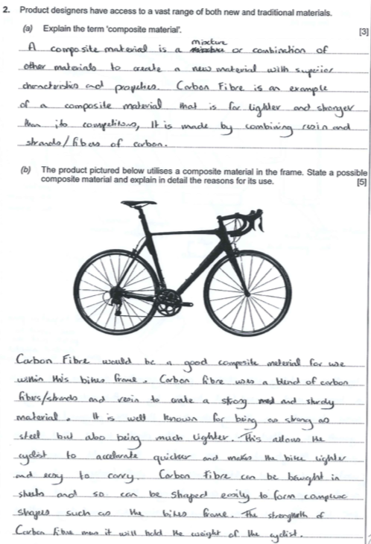

Question 2
Comments
Q2. Question asks candidates to demonstrate their knowledge of materials.
(a). Candidate has explained in detail the key factors that define a composite material. Please note that the question does not want a material to be named.
(3 Marks)
(b) Candidate has stated and justified the selection of a suitable composite material relevant to the bicycle.
Some candidates stated Fibre Glass as a material and were credited.
A significant number of candidates stated aluminium as a composite material and were not credited.
(5 Marks)

Slide 14
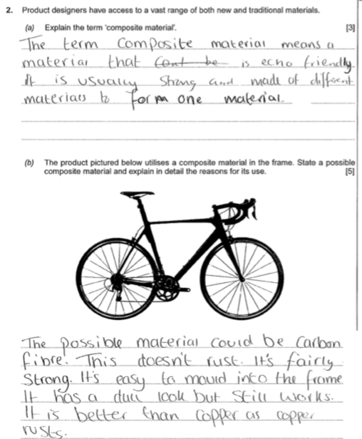
Question 2
Comments
Q2. Question asks candidates to demonstrate their knowledge of materials.
Simplistic explanation. No detail amplifying the candidates response. (1 Mark)
Suitable material stated, vague explanation of its suitable properties.
(2 Marks )

Slide 15
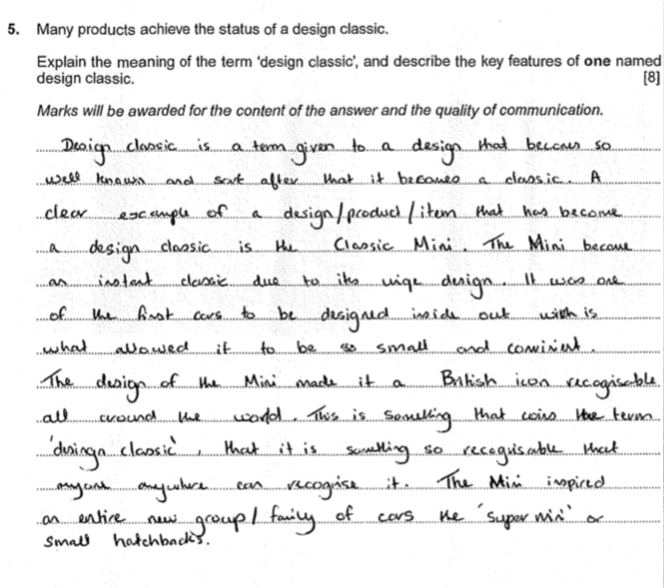
Question 5
Comments
Q5. Candidates are required to explain their understanding of the term ‘Design Classic’ with reference to an identified product.
Level 2 response:
Some technical language has been employed.
Has identified a unique element in the design
Has identified the desirability over time of the Mini.
Has identified its impact on similar products
(4 Marks)

Slide 16
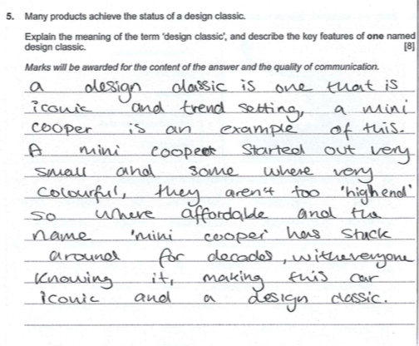
Question 5
Comments
Q5. Candidates are required to explain their understanding of the term ‘Design Classic’ with reference to an identified product.
Level 1 response:
Little/no use of technical language.
Simple explanation of the term ‘design classic’
Has identified timeless appeal of a ‘design classic’ in the Mini.
Weak Grammar, punctuation and spelling.
(2 Marks)

Slide 17
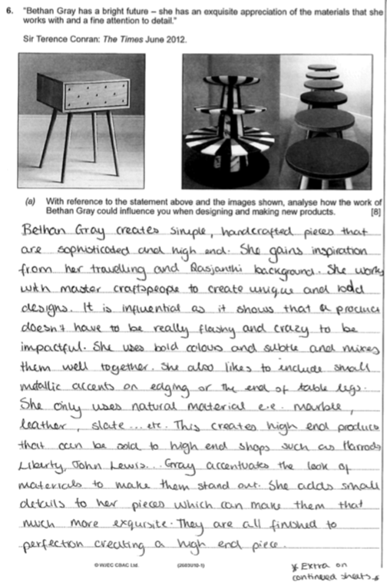
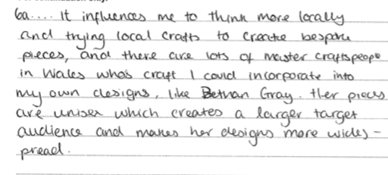
Question 6
Comments
Q6. (a) Candidates are required to analyse a small range of product images showing the work of Bethan Gray.
Response displays a sound understanding of the work of Bethan Gary and is not biographical in nature.
Response highlights many key elements of the work of Bethan Gray i.e details, materials use of skilled persons.
Response refers to the finish of many products and the designers desire to target products at the higher price range.
Links made to the influence that Bethan Grays work could have on the proposed task.
( 6 Marks)

Slide 18
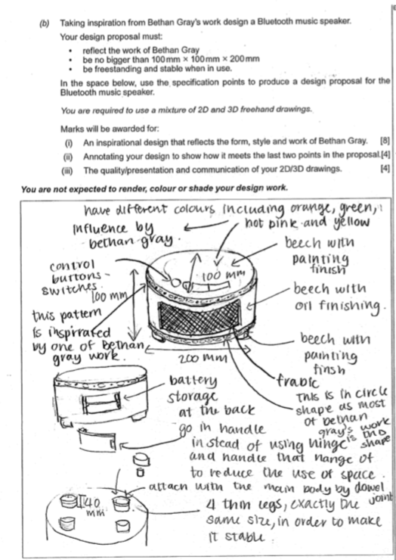
Question 6
Comments
(b) Design task. Candidates expected to design/ draw and annotate a product.
2D/3D illustrations clearly displaying a potential idea.
Good supporting annotation highlighting key points of the design, user interface, links to the work of Bethan Gray.
details, materials and potential finishes identified.
(7 Marks)
Clear identification of specification points for size and stability. 3 key dimensions or size identified. Candidate has stated the feet need to be the same size.
(4 Marks)
Simple and clear drawings. Clear explanation/ statements supporting the drawings. Lacking some details
(3 Marks)

Slide 19
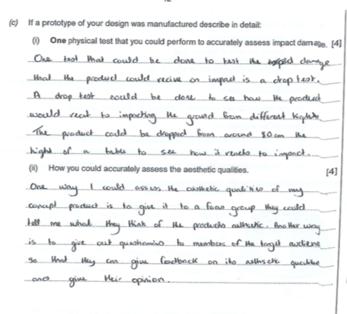
Question 6
Comments
If a prototype of your design was manufactured describe in detail:
(i) One physical test you could perform to accurately assess impact damage.
The response has clearly stated a type of test ‘Drop Test”.
The response has defined some of the parameters for this test ,however, lacks a few key elements of the test i.e. No mention of guide rails.
(3 Marks)
(ii) How you could accurately assess the aesthetic qualities.
The response states two methods of assessing the aesthetic qualities, focus group and open questionnaires.
The response states that opinions would be provide by the Target audience.
( 2 Marks)

Slide 20
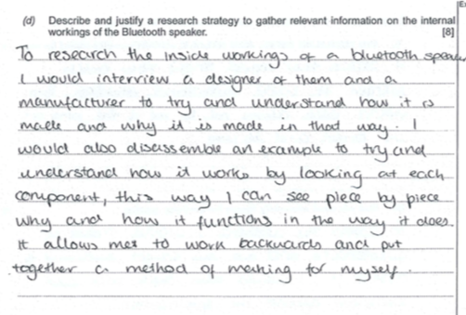
Question 6
Comments
(d) Describe and justify a research strategy to gather relevant information on the internal workings of the blue tooth speaker.
The response clearly identifies two potential methods of finding detail information.
Interviews/ questionnaires with experts in the form of manufacturers/ designers.
Detailed description of the disassembly of an existing product and its advantages.
(5 Marks)

Slide 21
General Points- Overview Unit 3
The paper was well received by candidates and most of candidates answered all questions on the paper. Considering this was the first A-Level paper for this new qualification candidates clearly developed their knowledge and understanding from the AS unit 1 paper.
There is a clear indication that the longer style responses generally require more structure and planning, as many candidates failed to clearly cover all requirements of the questions to gain the higher banding marks. Where candidates successfully applied their knowledge and understanding to the given context, they were able to access the higher mark bands within questions.
Many candidates are able to link key terms; however some continue to use key terms throughout the paper without applying these to the specific question.
In all, candidates made good attempt to answer all questions in the time allocated.
Some candidates made good use of planning notes to structure their responses and this is something that should be encouraged by centres during delivery of the course.
Centres should continue to advise candidates to use the mark allocation indicated at the end of each question to guide the depth of response required.

Slide 22

UNIT 3 – Item Level Data

Slide 23

Question 4
Comments
The best responses provided clear understanding of galvanising as a protective process. Many responses identified zinc being a main material in the process however, many did not explain the process of adding heat to galvanise the steel chassis to be able to gain the full marks.
3

Slide 24
Question 4
3
Comments
The answer needed to be expanded to explain that the injection moulding process doesn't need a finish to the polymer as the process is self finishing. Too many answers didn’t relate to the actual finish of the material.
Total 6/12

Slide 25
Question 8
4
Comments
Responses invariably did not differentiate between the two areas in that Quality Assurance ensures quality in the process and Quality Control identifies defects in products before release. The better responses were able to provide some differences between the two and identified the use of standards such as BSI within their response to enable high quality products.

Slide 26
Question 8
5
Comments
On occasions, candidates merely repeated themselves from part (a), where the higher mark responses made good reference to both the consumer and manufacturer. The main responses included the safety concerns for the consumer along with the brand reputation for the manufacturer.
Total 9/12

Slide 27
Question 9
Comments
It was clear to see that if the candidate didn’t understand market segmentation, they were not able to gain the higher marks as they just discussed target markets. The higher responses made good use of examples where candidates linked their answer to a product and making good reference to traits such as age, gender, religion and target market interests.
Total 7/8

Slide 28
Summary Unit 1 and 3
Candidates should be advised to read the question carefully in order to ensure that all elements are understood and are also included in their response.
Candidates should be advised to identify key instructions/ command words in each question and construct an appropriate response.
There were a number of instances where the responses were correct but not detailed enough to gain the higher level of marks.
Well-planned and structured responses score well. These responses contain clear, and specific details relating to the question. They also show accuracy in terms of spelling, punctuation and grammar. An increasing number of candidates require more structure and planning in order to organise information clearly and coherently.
Generic terms, particularly in naming materials (together with their characteristics or properties) are still used by candidates and are therefore not given credit. For example: wood, plastic, metal, as opposed to oak, MDF, ABS and stainless steel.

Slide 29
Summary Unit 1 and 3
In Unit 1, question 5 responses varied considerably; responses generally require greater structure and planning, whilst ensuring that ALL elements of the question are covered. Majority of candidates were able to reword the term ‘Design Classic’, few were able to define the term and relate it appropriately to a product.
Centres should continue to advise candidates to use the mark allocation indicated at the end of each question to guide the depth of response required and manage time effectively.
Centres should also be advised to remind candidates that answers could be amplified with detailed labelled sketches and/or diagrams where appropriate; many of the answers were unfortunately brief with a few words and simple sketches not allowing the candidate to fully explain the response. Quality of the sketches needs to be worked on by centres.
Planning for each question is encouraged.

Slide 30

Cwestiynau? | Any Questions?
Cysylltwch â’n Swyddogion Pwnc arbenigol a thîm cefnogaeth weinyddol eich pwnc os oes gennych unrhyw gwestiynau.
steve.howells@wjec.co.uk
designandtechnology@wjec.co.uk
029 2240 4303
cbac.co.uk
wjec.co.uk
Contact our specialist Subject Officers and administrative support team for your subject with any queries.

Slide 31


Slide 32
EXAMINING FOR WJEC-EDUQAS
We value the contribution you as experienced teachers and lecturers make in assessing students’ work, ensuring that candidates are given a fair result which accurately reflects their ability
We appoint examiners to mark externally assessed work and moderators to review the original marking of teachers for internally assessed components or units
We provide face-to-face training for examiners and moderators (appointees) prior to assessment work commencing
Our senior examiners and subject officers provide support and advice during the assessment period

Slide 33
Application process
Complete an application using the on-line application system available on the Appointees page of the WJEC website
Once you have completed the initial registration, please make sure that you validate your email account so that you can complete the application process
When you have completed your application, remember to click ‘submit’ on the homepage, to complete the process
Remember to inform your referee of your application, as sometimes delays occur due to referees not completing the reference section
On rare occasions, applicants may not be accepted due to a lack of relevant teaching experience
Applicants may re-apply once they have gained sufficient experience
Some applicants will be approved, but may have to wait on the reserve list until a suitable vacancy arises

Slide 34
