Slide 1
WJEC
INNOVATION AWARDS
Product Design @ Cardiff Metropolitan
David Jarvis
cardiffproductdesign
csadproductdesign
csadproduct

Slide 2
WJEC INNOVATION AWARDS
IDENTIFYING OPPORTUNITIES FOR INNOVATION

Slide 3
IDENTIFYING OPPORTUNITIES FOR INNOVATION
What is Innovation?
A Framework for Innovation – Discover, Define, Develop, Deliver
Asking the correct Questions
Empathy

Slide 4
Design isn’t for Mam & Dad.
Hands up, any students that have designed a project that is form any of the following: Parents or Guardians
Brothers or Sisters
Grandmother/Grandfather
Friends
Students
Your own hobbies
Notes:
Hands up, those that have designed for one of the following…..
Designing for these groups leaves less space for innovation and allows us to stay in our comfort zone. Ultimately, there is less opportunity for us show how creative we are and reduced the real impact that we can have on the world as Designers. Today we are going to discuss some techniques that begin to breakdown our assumptions and how we can elevate our work beyond our friends and families needs.

Slide 5
IDENTIFYING OPPORTUNITIES FOR INNOVATION
What is Innovation?
A Framework for Innovation – Discover, Define, Develop, Deliver
Asking the correct Questions
Empathy

Slide 6
WHAT IS INNOVATION?

Slide 7
WHAT IS INNOVATION?
Definition: “The creating and use of new ideas or methods”
In a Design context, innovation is the ability to conceive, develop, deliver, and scale new products, services, processes, and business models for customers

Slide 8
IDENTIFYING OPPORTUNITIES FOR INNOVATION
What is Innovation?
A Framework for Innovation – Discover, Define, Develop, Deliver
Asking the correct Questions
Empathy

Slide 9
THE FRAMEWORK 4 INNOVATION

Slide 10
THE FRAMEWORK 4 INNOVATION
Discover.
The first diamond helps people understand, rather than simply assume, what the problem is. It involves speaking to and spending time with people who are affected by the issues.
Define.
The insight gathered from the discovery phase can help you to define the challenge in a different way.
Develop.
The second diamond encourages people to give different answers to the clearly defined problem, seeking inspiration from elsewhere and co-designing with a range of different people.
Deliver.
Delivery involves testing out different solutions at small-scale, rejecting those that will not work and improving the ones that will.

Slide 11
KEY DESIGN PRINCIPLES
Put people first.
Communicate visually and inclusively.
Collaborate and co-create.
Notes:
The framework for innovation outlines four core principles for problem-solvers to adopt so that they can work as effectively as possible.
Put people first. Start with an understanding of the people using a service, their needs, strengths and aspirations.
Communicate visually and inclusively. Help people gain a shared understanding of the problem and ideas.
Collaborate and co-create. Work together and get inspired by what others are doing.

Slide 12
IDENTIFYING OPPORTUNITIES FOR INNOVATION
What is Innovation?
A Framework for Innovation – Discover, Define, Develop, Deliver
Asking the correct Questions
Empathy

Slide 13
ASKING QUESTION ZERO
Question Zero is a creative process of asking a sequence of “Whys” and “Whats” to access the core of the problem.
Here are some ways to reframe a problem.
Step back from the obvious solution.
Alter your point of focus
Uncover the real issue
Look for ways to bypass resistance or mental blocks.
Think in opposites.
Notes:
Solving a problem is not easy. Sometimes, it seems like there are no real solutions whatsoever; even after trying out all the tested methods.
The flaw here is that we haven’t identified the source of the problem. We’re also not likely to find it until we change our approach. The key is to find the root cause and fix it instead of tackling the immediate problem.
There is an easy way to get past this type of creative block, it’s called ‘Question Zero’. *Read Slide*

Slide 14
ASKING QUESTION ZERO
Design Challenge: Create a new drill that appeals to the next generation of DIY enthusiasts.
Question Zero: People don’t want to buy a 10mm drill bit, they want a 10mm hole.
Ask the Correct Questions to enable Innovation

Slide 15
IDENTIFYING OPPORTUNITIES FOR INNOVATION
What is Innovation?
A Framework for Innovation – Discover, Define, Develop, Deliver
Asking the correct Questions
Empathy

Slide 16
WHAT IS EMPATHY?
“The ability to understand and share the feelings of another.”
(Oxford Dictionary)
Empathy = Design Research= Understanding our Users
Notes:
So what is Empathy?
We create more great ideas when we understand our users and their feelings
Empathy means challenging your preconceived ideas and setting aside your sense of what you think is true in order to learn what is actually true.
How?
We speak to people, observe people, interview people as they engage with their products, environment and services

Slide 17
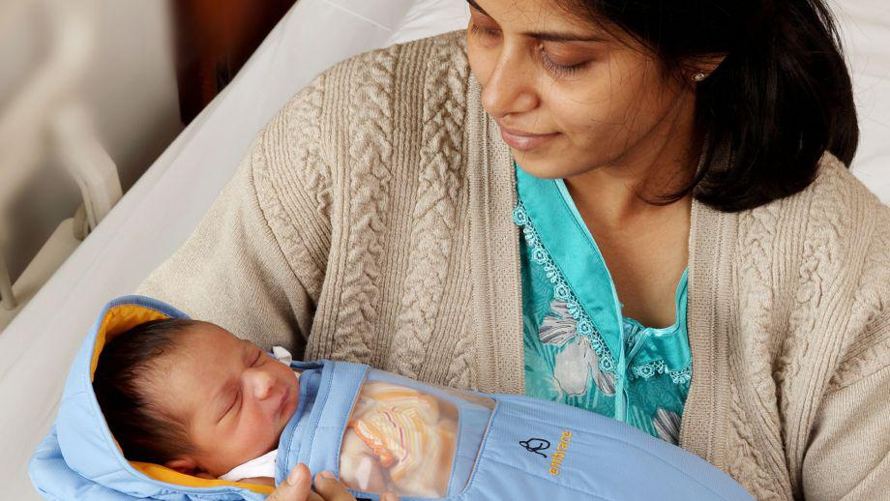
The Embrace Portable Incubator
Notes:
This is the Embrace portable incubator, this is a perfect example of how design teams asked the correct questions at the start of their project, listened and observed their users, to create a design that has saved over 200,000 lives.
The core technology of the Embrace incubator is a wax like substance, which when melted, can maintain a constant temperature of 98 degrees for up to eight hours. This wax pouch can be reheated thousands of times. It is then placed into a sleeping bag, where it creates a warm micro-environment for the baby.

Slide 18
THE DESIGN CHALLENGE
The project began as “Redesign for extremely affordability” targeted at Incubator's in developing nations.
Every 10 seconds the world loses a newborn
Six babies die every minute
Three million of those babies die in the first 28 days of their life
Millions more grow up with debilitating health issues
Issues with incubators are that they are technically complex, expensive and require a stable supply of electricity - making them prohibitive in remote parts of the world
The obvious solution, a cheap simple to use self-sustaining incubator, research done, right?

Slide 19
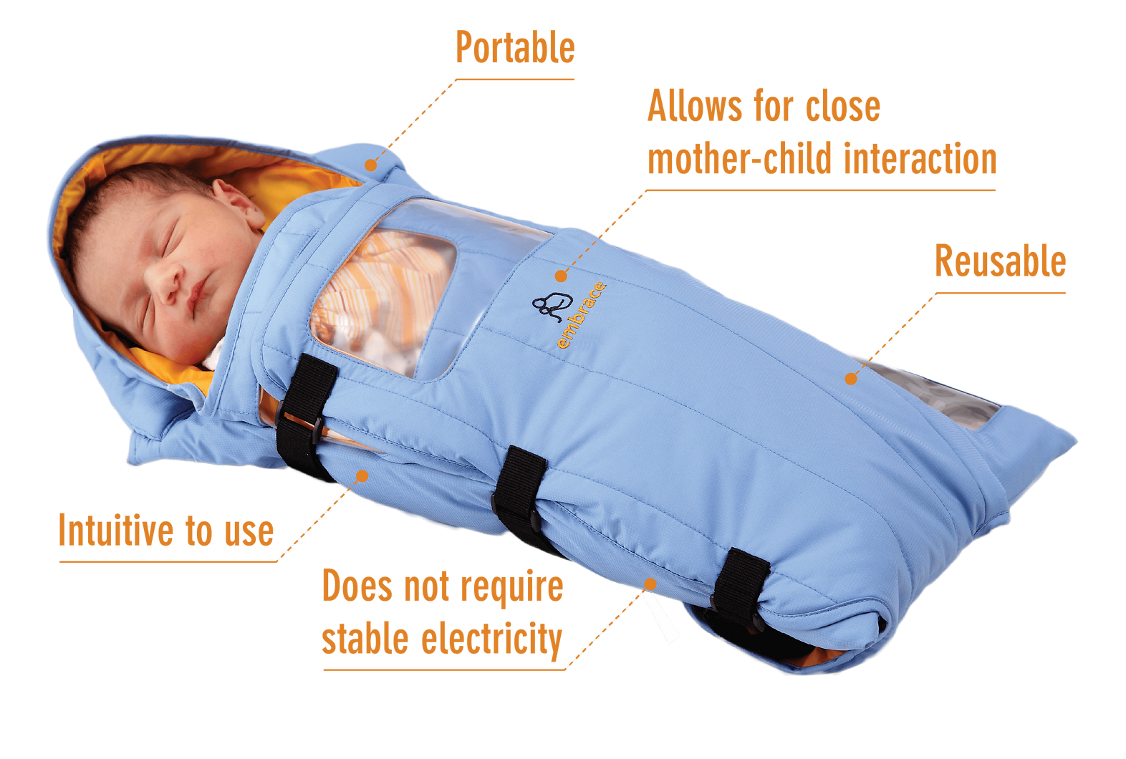
THE EMBRACE INCUBATOR
After spending several days observing, the neonatal unit of a Nepal hospital, the team asked to be taken outside the city to see how premature infants were cared for in rural areas.
They learned alarming things:
Most of all premature Nepalese infants were born in these rural areas.
most of these infants would never make it to a hospital.
They realized that no matter how good their design for a new incubator was, it would never help these babies if it stayed in a hospital.
Notes:
The team decided that they needed to action some primary research and headed to Nepal to observe the hospitals where these statistics were the highest and found two alarming things…..the incubators were all empty.
They came to the realisation that Most of all premature Nepalese infants were born in these rural areas and most of these infants would never make it to a hospital. They realized that no matter how good their design for a new incubator was, it would never help these babies if it stayed in a hospital.
So as design insights:
1. Regardless of parameters such as cost or intuitive design features life and death battles were being fought at the mothers home, rather than at the hospital
Mothers and babies were up to thirty miles away in neighbouring villages.
2. Even if families has the opportunity to travel to hospital and maintain skin to skin contact (something that is crucial to maintaining the life of a premature baby), cultural tendencies meant that families would travel home after 5 or 6 days even if the baby should remain in incubators.
The project therefore evolved into “How might we create a device that helps parents in remote villages give dying infants a chance to survive”

Slide 20
THE EMBRACE INCUBATOR
Notes:
These insights were then developed into innovation.
Through 6 rounds of prototyping & development the team created a solution that uses a paraffin puch that can maintain heat for up to four hours when heated.
When testing prototype 6 with families in rural villages, further challenges began to emerge. At this stage the prototype has a built-in temperature gauge.
When mothers were informed that the heating pouch should be heated to 37 degrees, the response was surprising and further unsettled the project.
In certain communities there are assumptions that western medicine is too strong and would often under dose in relation to doctors instructions.
Traditionally this would have been described as ‘user error’, although due to the HCD nature of the project the temperature gauge was replaced by a binary system to avoid families underheating and risking life.

Slide 21
KEY TAKEAWAYS.
Design Research = Empathy = Understanding our Users = Innovation.
Asking the correct questions at the beginning of a project creates more opportunities for creativity and innovative practices.
Utilizing our User/Target Market throughout our projects ensures that we create solutions that innovative and fit for purpose.
Have some Fun!

Slide 22
UCAS CODE BA : W240 | BSC : W2H1
ENTRY REQUIREMENTS: Min. Tariff 120 Points
cardiffproductdesign
csadproductdesign
csadproduct

