Slide 1


GeogShots
CC BY-NC-ND 4.0

Slide 2
GeogShot.
A 10-minute solution focused “shot” of geography to help guide your learners to more successful responses in the exam.
They are designed so you can fit these resources into your existing lesson plan or adapt as you want.
Each builds on identified actions from examiners reports.
They could be part of your intervention strategy to support and challenge your learners in class.
They are designed to allow you to insert a relevant question to work on from any aspect within the specification.

Slide 3

It is important your learners know the demands of the different assessment objectives and how to recognize the requirements they have to demonstrate in their response to exam questions.
How can this be included in your lesson?
CC BY-SA 3.0
Notes:
Ideas on how to use these slides in your lesson is included in the notes these are just suggestions and the idea is this is flexible for you to edit and use as you would want to.

Slide 4
AO3 (25%)
AO3 (25%) Skills and techniques in the investigation of questions and issues
AO3 (25%)
Skills and techniques in the investigation of questions and issues
Candidates will be asked to: Select
  Adapt Use
… mathematical/statistical skills and techniques in a range of geographical contexts Communicate findings
Command words can include:
Describe, Give, Tick,
Draw, Compare
These questions are often low tariff 1-4 marks
Notes:
Build into your lessons the understanding of the demands of AO3 the learners need familiarity with the skills in appendix A.

Slide 5
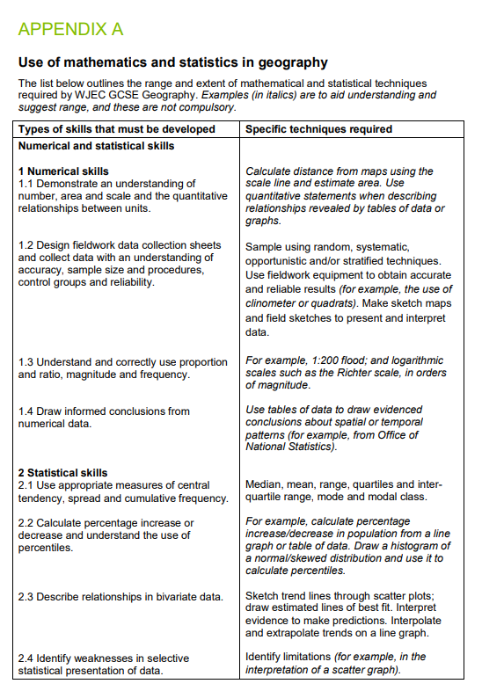
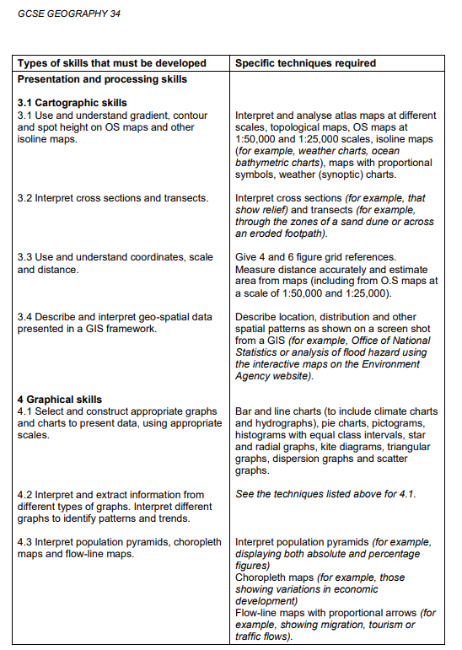
You need to be familiar with all these techniques.
Resource WJEC Educational Resources Website
Notes:
Make sure the candidates have a good understanding of all of these techniques. AO3 is examined in all units. Use the exercises on the link to the digital resources to help candidates become successful in attaining these low tariff marks.

Slide 6
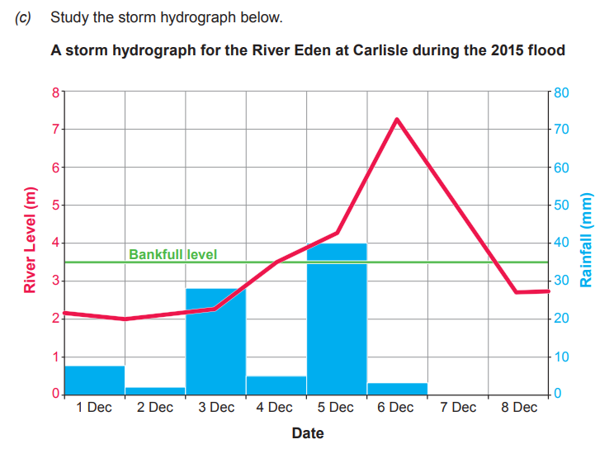

What will these type of questions look like?
Time lag between max rainfall and peak flow
river remains in flood after rain stops
Describe the relationship between rainfall and river level from 1st to 8th December. [3] 2019.
Award one mark for each valid point.
River level increases as rainfall increases – or converse
Notes:
CC0 1.0 Public Domain
You could use this slide as a class discussion understanding that the question asks for a relationship so just identifying where the discharge increases will not address the question.
.2 Interpret and extract information from different types of graphs. Interpret different graphs to identify patterns and trends from appendix A

Slide 7
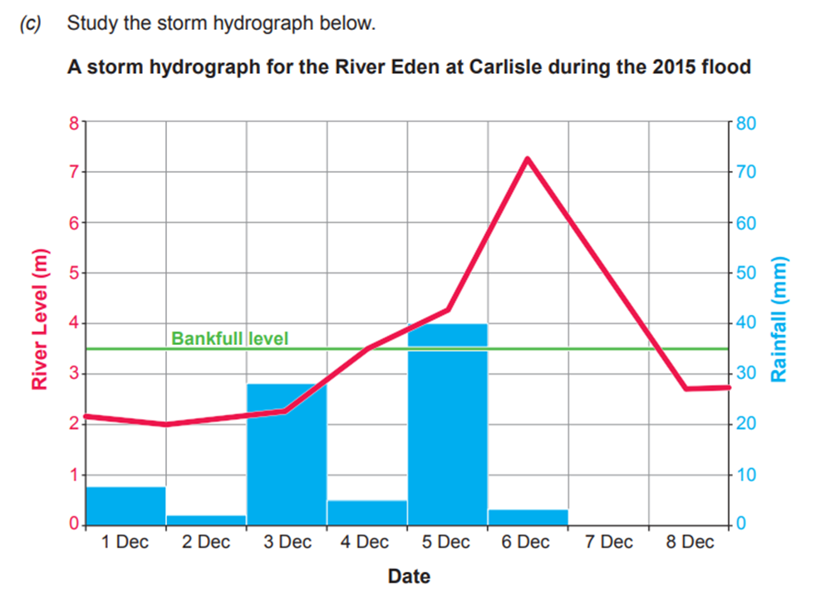
Graph exercise:
Describe the relationship between rainfall and river level from 1st to 8th December. [3] 2019.
Description | Letter
River level increases as rainfall increases – or converse
Time lag between max rainfall and peak flow
river remains in flood after rain stops
A
C
B
Notes:
This is another way to introduce where relationships exist. Always ask candidates to justify choice in their response to develop deeper understanding and develop resilience in the exam room.
This question addresses .2 Interpret and extract information from different types of graphs. Interpret different graphs to identify patterns and trends from appendix A

Slide 8
Numerical and statistical skills
Table 2.1 Number of people commuting out of Wrexham County 2010-2019.
2010 | 2011 | 2012 | 2013 | 2014 | 2015 | 2016 | 2017 | 2018 | 2019
16600 | 17700 | 18000 | 17900 | 14900 | 15700 | 15900 | 17300 | 19400 | 16800
Use appropriate measures of central tendency, spread and cumulative frequency.
Calculate the range in this dataset. [2] Show your working in the space below.
Range .......................................
The range is a measure of dispersion. State one way in which the interquartile range may be a more appropriate measure of dispersion. [1]
Practice | Using maths in geography (wjec.co.uk)
Notes:
EDUQAS A 2022.
Use this data to calculate the interquartile range discuss/demonstrate the reliability of interquartile V range in the data set.

Slide 9
2010 | 2011 | 2012 | 2013 | 2014 | 2015 | 2016 | 2017 | 2018 | 2019
16600 | 17700 | 18000 | 17900 | 14900 | 15700 | 15900 | 17300 | 19400 | 16800
Calculate the interquartile range
Re
order data from highest to lowest
19400
18000
17900
17700
17300
16800
16600
15900
15700
14900
17300+16800= 34100
÷ 2= 17050
Median is 17050
Upper quartile 17900
Find the median in this case the average of the two middle data points in the list.
Lower quartile
15900
Interquartile range Upper quartile- lower quartile
17900 – 15900 = 2000
IQR is 2000 people commuting.
Notes:
Use the animation to take the pupils through the calculations.

Slide 10
Table 2.1 Number of people commuting out of Wrexham County 2010-2019.
2010 | 2011 | 2012 | 2013 | 2014 | 2015 | 2016 | 2017 | 2018 | 2019
16600 | 17700 | 18000 | 17900 | 14900 | 15700 | 15900 | 17300 | 19400 | 16800
What is the significance?
This is a more accurate perspective of the range of people commuting over a period of time. The difference/range between top value and bottom is 4500.Yet when investigated the IQR is less at a figure of 2000, which is a more realistic figure when the whole data range is considered.
Inter quartile range (IQR)
Is 2000 people commuting out of Wrexham.
Notes:
Go back to the question:
The range is a measure of dispersion. State one way in which the interquartile range may be a more appropriate measure of dispersion. [1]
And reinforce understanding of the significance of the value IQR.

