Slide 1



Assessing WJEC Eduqas GCSE Sociology

Slide 2
Assessing evidence
Please read the qualification overview PowerPoint first.
This PowerPoint focuses on applying the marking criteria in GCSE Sociology component 2
You will also need access to the following documents:
  relevant marking schemes
  exemplar materials.
  GCSE syllabus

Slide 3
Assessing evidence
Assessment Objectives
Here are the assessment objectives for this specification. Learners must:​
AO1 Demonstrate knowledge and understanding of sociological theories, concepts, evidence and methods.
AO2 Apply knowledge and understanding of sociological theories, concepts, evidence and methods.
AO3 Analyse and evaluate sociological theories, concepts, evidence and methods in order to construct arguments, make judgements and draw conclusions.

Slide 4
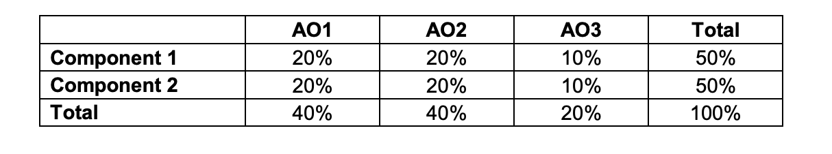
Assessing evidence
Assessment Objectives
The table below shows the weighting of each assessment objective for each component and for the qualification as a whole.
In each examination series, a minimum of 15% of the available marks will be awarded for learners' knowledge and understanding in relation to Research Methods.

Slide 5
Component 2 Content
Part 1 – Q 3,4 and 5 Social Stratification and Differentiation – 49 marks total. – Suggested time 1 hour
Part 2 - Q1 – Knowledge and Understanding – 4 marks
Q2 and 7 = Applied Research Methods – 17 marks
Q6 – Crime and Deviance – 30 marks – 51 marks total. - Suggested time 1 hour

Slide 6
Assessing evidence
Social Stratification and Differentiation
Questions from within the three questions 3,4 and 5 which form this part of the component are assessed out of 2,4 and 9 marks.
Questions assessed which offer 2 or 4 do not contain marks for AO3. They assess either AO1 or AO2.

Slide 7
Assessing evidence
Social Stratification and Differentiation
Knowledge and Understanding AO1
An example of this would be below.
Describe what is meant by moral panic. [2]
Award one mark for a basic explanation suggesting that it is when the media put a lot of attention on an issue and exaggerate it.
Award one further mark for a more developed explanation or development.
The mark scheme suggests possible indicative content, but generally developed explanations are required to achieve full marks.

Slide 8
Assessing evidence
Social Stratification and Differentiation
Application of Knowledge and Understanding AO2
An example of this would be below.
Explain two reasons why some people experience poverty in the UK today. [4]
2 marks available for each reason explained and applied to the question. If more than two reasons are given, the best two should be assessed.
Award one mark for each reason identified and a further mark for development or examples.

Slide 9
Assessing evidence
Social Stratification and Differentiation
9 mark questions award 3 marks for each of AO1, AO2 and AO3
Assess Marxist views of social class. [9]
In your answer you are advised to consider different sociological ideas and theories to support your judgement.
Many answers may present accurate and detailed knowledge, but fail to meet criteria for AO2 and more often AO3. It is important to recognise that this is GCSE and candidates should be given recognition for attempts at analysis and evaluation, whilst accepting that this may not be lengthy.

Slide 10
Assessing evidence
Question 1 is a knowledge based matching exercise worth 4 marks.
Question 2 is a research methods question using knowledge of how to interpret data. 6 marks for AO1.
Crime and Deviance
There are questions worth 2 and 5 marks which are awarded for AO1.
8 mark questions are 4 marks for AO1 and 4 for AO2.
15 mark questions award 4 marks for AO1, 3 for AO2 and 8 for AO3
Applied Research Methods
These questions are worth 11 in total which may include questions worth 1,2 and 4 marks awarded for AO2 and therefore require accurate application of knowledge and understanding.
The debate question is worth 6 marks which are divided equally between AO2 and AO3.

Slide 11
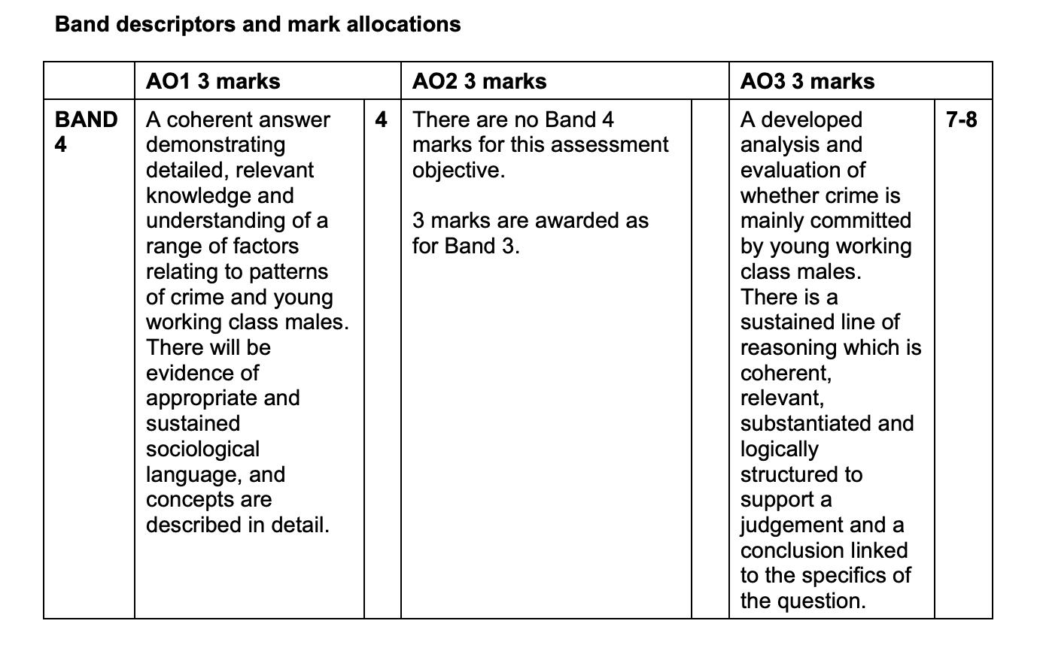
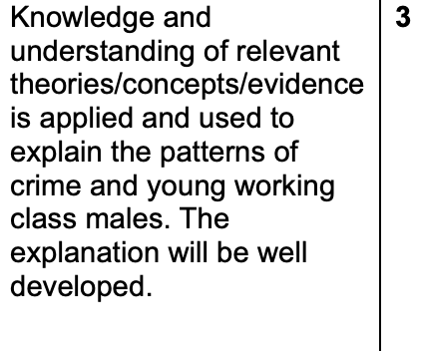
Assessing evidence
Assessment Criteria
Amend this slide to fit your subject
Amplification of band qualifiers in all bands with examples
E.g. what does sound mean in practice? Or what is clear analysis as opposed to some analysis?
These are top band descriptors for a 15 mark question which shows the high levels needed to achieve this band. It is possible that candidates may reach higher bands for AO1 and AO2, but not for AO3.

Slide 12
Assessing evidence
Characteristics of a successful response
AO1 Knowledge and Understanding – Candidates should show detailed and accurate knowledge of sociological theories, concepts and/or evidence. There should be consistent use of subject language throughout the answer.
AO2 Application of Knowledge and Understanding – Candidates should refer to the question regularly and include phrase such as
“This shows that”, “This supports the view that”, “Functionalists/ New Right/Marxists would argue that”. Stronger answers will also illustrate or support their argument with examples from the news or case studies.

Slide 13
Assessing evidence
Characteristics of a successful response
AO3 Analysis and Evaluation – Candidates should attempt to offer evaluative comments and note the strengths and weaknesses of different arguments. They should also compare other viewpoints or interpretations.
Useful phrases which may aid evaluation include connectives to balance their judgement.
However​ On the other hand​ More importantly
Nonetheless​ Furthermore​ Moreover​
Additionally But​ Finally​
What this demonstrates/highlights is…​ An example to demonstrate this is…​

Slide 14
Assessing evidence
Characteristics of a successful response
AO3 Analysis and Evaluation – Band 1 is characterised by limited, Band 2 by partial and band 3 by developed analysis and evaluation.
In the case of a 15 mark question on crime, there is a further differentiation with Band 3 requiring good analysis and evaluation.
Marking in general
Choosing the correct band is the first stage in marking the questions with higher marks. In particular, this will help in awarding marks for 15 mark questions. Once the band has been decided then the specific mark can be decided for each Assessment Objective.

Slide 15
Exemplar material
Read the script below for commentary on these answers from 2019.
2. Look at the following information and answer the questions that follow. A guide to the Minimum Wage in the UK, 2018
Adapted from livingwage.org.uk
What age group? | The Minimum Wage (per hour)
Under 18 | £4.20
18 to 20 | £5.90
21 and above | £7.38
25 and above | £7.83
(c) Describe two patterns or trends shown in the table supporting your answer with reference to the statistics in the table. [4]
Notes:
SCRIPT:
The two most common patterns identified were
The minimum wage is higher for older people.
The rise becomes less as you get older ..
If these patterns are spotted, two marks would be awarded, one for each . Further marks would be gained by using the detail in the table to show understanding. Eg. The rise becomes less as you get older .
The jump at 25 years is only 45p an hour, which isn’t much compared to the jump of £1.48 at 21 years. You would have to wait another 4 years.
You would need to do the same for the other pattern spotted.
The next slide is a student’s work.

Slide 16
Exemplar material
c) Describe two patterns or trends shown in the table supporting your answer with reference to the statistics in the table. [4]
Student answer
One pattern shown by the data is that there is an increase in wages as you get older. Under 18’s have a minimum wage of £4.20 while over 25’s have minimum wage of £7.83.
Another pattern is shown that as you go up every age group the increase in minimum wage decreases. Under 18’s to 18-20 have a difference of £1.70 whereas 21 and above to 25 and above, have a minimum wage difference of 45p. So the amount of the increase in wage is less with every step up the age group.
Notes:
This answer sets itself out clearly in 2 paragraphs for each pattern shown. It backs up the patterns with data from the source in both cases. This answer is not perfectly written, but clearly meets the criteria to nail all 4 marks. Notice the way that their first sentence in both paragraphs points the examiner clearly to what their main points are.

Slide 17
Exemplar material
Question 3 – Social differentiation and stratification
3. (c) Discuss reasons why some age groups may face discrimination in the UK. [9]
Student answer – 2nd paragraph
The elderly may face discrimination due to ideas that are preconceived. As the elderly are seen as feeble and incompetent with technology, they are discriminated against when it comes to finding work. This is because they are seen as unskilled with technology. However, some companies intentionally hire older people to give employment chances, such as Barclays scheme to assist older people with returning to work and even offers apprenticeships.
Notes:
Question 3 c required candidates to show all 3 skills and there are equal marks for each.
AO1 - K+U 3 marks, AO2 Application of knowledge 3marks, AO3 Evaluation/Analysis 3 marks.
This is just the second paragraph of this candidates answer. They also had a first paragraph which dealt with similar ideas about preconceived notions about youth. This paragraph could have used more subject terminology but still stands up very well as it explains the reasons for discrimination and uses examples to apply their knowledge. The highlighted paragraph rather wonderfully showcases all three skills. It shows their K+ U, applies this and offers an evaluation which balances against their first paragraph. The paragraph is littered with application of examples.

Slide 18
Exemplar material
Question 3 – Social differentiation and stratification
3. (c) Discuss reasons why some age groups may face discrimination in the UK. [9]
Student answer – 3rd paragraph
The elderly have to pay more expensive life insurance than younger people or my not be offered it. They also face discrimination at work as they are seen as more prone to illness. Lack of life insurance may limit their ability to take part in certain activities, making them socially excluded. This is made worse by employers who do not want to employ them in case they take a lot of time off sick which costs the employer money. This makes them discriminated as consumers and workers.
Notes:
Question 3 c required candidates to show all 3 skills and there are equal marks for each.
AO1 - K+U 3 marks, AO2 Application of knowledge 3marks, AO3 Evaluation/Analysis 3 marks.
This is the third paragraph of the same candidate’s answer. They had more than one idea here but did enough to gain more credit. The answer contained a good understanding of the reasons for discrimination, but again could have included more terminology.
This candidate wrote far more than the average and covered at least one and a half sides. The average for the 9-mark questions is a full side.
The candidate did well and gained 3+3 +2 marks making 8 out of 9. Lots of application and K+U, not so much evaluation which is why it didn’t gain all 9 marks.
Smart use of terminology could have helped here, and they might have written slightly less and been more concise. However, this was a strong answer to this question.

Slide 19
Exemplar material
Question 6 – Crime and Deviance
(b) Describe how social control works in society. [5]
Student answer
Social control is a process by which norms and values are enforced. Informal social control is performed by the family and education as they give sanctions ( rewards or punishments) to reinforce society norms and values, to ensure that they are a law abiding citizen. However, when informal social control fails formal social control is implicated. This refers to government institutions such as prison which is used to reiterate and ensure one is reformed and act according to norms.
Notes:
The 5 marks offered are for Skill AO1 K and U.
Obviously for 5 marks these answers require a much greater level of detail and development required for higher marks. A developed answer would use subject terminology and probably distinguish between informal and formal social control. It would also describe what the process of social control works.
This answer gained 4 out of the 5 marks available and as highlighted you can see that it included some relevant terminology. To have gained the extra mark they might have expanded on formal social control. A more advanced answer might also refer to theories and Marxist ideas that the ruling class control the workers or feminist ideas that men control women. However, this candidate was strong and had a firm grasp of the concept.

Slide 20
Exemplar material
Question 6 – Crime and Deviance
(d) ‘Crime is mainly committed by young working-class males.’ Do you agree with this view? [15] In your answer you are advised to refer to sociological arguments and ideas to support your judgement.
Notes:
Question 6d is the giant question which many students find intimidating. It is designed to be challenging, mainly because of the large number of marks for AO3.
AO1 - K+U 4 marks, AO2 Application of knowledge 3 marks, AO3 Evaluation/Analysis 8 marks.
However, every student should be able to respond and make some points about the debate. These questions are always debate questions and are usually looking to see at least two arguments. If a response only features one argument marks will be limited for AO1 and AO2 which are the easier marks to pick up.
Many students try to gain the AO3 evaluation marks at the end by tacking a conclusion on to the end. This is better than not having any evaluation, but stronger answer will keep an evaluative edge throughout.
Another feature we see is that candidates present two arguments and then make up their mind right at the end. Again better than not coming to any evaluative conclusion. Stronger answers will make it clear what they are arguing from the very start . This does not mean that they do not give both sides of the argument a fair hearing. However, there are a limited number of debates at GCSE Sociology. It is a good idea to have an idea what their views are on on different aspects of crime, family, education and methods.
Things to bear in mind are the need to make sure that age, class and gender are featured in the answer. The question links neatly to the earlier questions on the ‘typical offender’. In many ways this is a common sense view that young working class males are the typical offender. These views could be challenged in the answer.
Separating responses into paragraphs will help show the student’s main ideas. Opening sentences should be the topic sentence and refer back to the question. Eg The view that crime is committed by young , working class males is supported by the prison statistics. All of these groups are represented more in the prison population. There are more working class, more males and there is an age crime curve. This shows that young people commit crime and grow less likely to as they grow older.
Students should sure come up with a balanced judgement.
The next slide features some excerpts from real answers.

Slide 21
Exemplar material
Question 6 – Crime and Deviance
(d) ‘Crime is mainly committed by young working class males.’ Do you agree with this view? [15] In your answer you are advised to refer to sociological arguments and ideas to support your judgement.
Student answer –Opening argument
Crime statistics show that crime is usually committed by young working class males.
This is affirmed by Merton’s strain theory. This suggests that crime is committed by the working class because of the strain between one’s goals and how they achieve it. This leads to them adopting a strain to anomie by which they do whatever allows them to achieve their goal, for example crime. This explains why working class commit crime.
Notes:
A lovely opening argument that supports the idea that the statement is correct as far as working class are concerned. Sometimes the words are not always completely clear but they show a good understanding of the theory of Merton and apply this well. On the next slide you will see how they begin to evaluate straight away.

Slide 22
Exemplar material
Question 6 – Crime and Deviance
(d) ‘Crime is mainly committed by young working class males.’ Do you agree with this view? [15] In your answer you are advised to refer to sociological arguments and ideas to support your judgement.
Student answer – evaluative edge
However, Slapper and Tombs identified two forms of crime, white collar and corporate crime. They suggested that corporate crime was less likely to be detected due to the power of the company. This is illustrated by the expenses scandal in the UK. This shows that crime is committed by people of other classes as well as the working class.
Notes:
This is the second paragraph and the answer smartly offers a counterargument to the previous argument that suggests crime is likely to be committed by working class people. It explains why crime committed by higher social classes may not be detected and relates this back to the question.
The example of the expenses scandal is relevant showing application of knowledge. It is slightly misplaced as it is technically and example of white collar rather than corporate crime. However, overall this is a smart paragraph or two.
The answer offered two more paragraphs showing detailed knowledge about class and crime in the first. The final paragraph used the ideas of Heidensohn to link gender into the answer.
It didn’t really address the age part of the question and ran out of time on gender.
Overall, the answer gained 11 of the 15. 3 for AO1 , 2 for AO2 and 6 for AO3. The lack of a wider range of arguments ad the overemphasis on social class resulted in missing the top band for AO1 and AO2. The evaluation was impressive in places but didn’t provide the sustained line of reasoning for the top band.

Slide 23
Assessing evidence
Characteristics of a less successful response
No use of sociological terminology
Failure to address the actual question​
Repetition of points​
Inaccuracies​
Irrelevant information ​
Not using paragraphs for essays and even 4 mark questions
Failure to address the skills of analysis and evaluation ​

Slide 24
Assessing evidence
Potential problem areas / what not to reward
POTENTIAL PROBLEM AREAS / WHAT NOT TO REWARD​
Question 2 expects candidates to spot patterns or trends in the data, but does not require or award marks for their interpretation of possible meanings of this, however sociological they may be.
Question 6 - There are a lot of marks on the Crime 15 mark questions for AO3. ​Candidates need to do very well to get into Band 3 and 4 offering an evaluative edge through the essay. However, candidates should receive some award in Band 1 or 2 for some attempt at evaluation, even if they are not highly skilled. Many candidates attempt no evaluation at all.
Question 7 is an Applied Research Methods question. Suggestions of research methods to be used by candidates should be logical to gain credit. Some candidates will make inappropriate choices, but still may be awarded some credit for attempting to apply reasons to follow up questions. Candidates should be specific about the exact method they suggest using, e.g. structured interview rather than just interview to gain a mark.

Slide 25
If you have any questions, contact our specialist subject officers and administrative support team for your subject with any queries.
GCSESociology@eduqas.co.uk

