Slide 1
TESTING AND EVALUATING ‘EFFECTIVE’ INNOVATION
Philip Harfield - Senior Lecturer in Design Thinking & Innovation
University of South Wales (USW)
Notes:
PHIL –USW – MA Design Innovation programme -
Cardiff Met - Focus 1 – IDENTIFYING OPPORTUNITIES FOR INNOVATIVE DESIGN –
UWTSD Focus 2 – USER CENTRED DESIGN –
Uni S Wales Focus 3 – TESTING AND EVALUATING FOR EFFECTIVE INNOVATION –the iterative cycle is not well applied in centres, and some centres / teachers / candidates think some evidence of modelling is sufficient. There needs to be a drive towards ‘think, test, analyse, repeat’ and this is not well appreciated at the moment. Also linking to 1, the specification should be the framework used to check that success criteria are present, but again this does not happen.

Slide 2
What does effective innovation look like?
How might we test effective innovation ?
Notes:
TWO BIG KEY QUESTIONS:
EFFECTIVE - depends on your perspective, i.e., commercial oriented innovation sees users as consumers/customers.
to simply be in favour of innovation for innovations sake i.e. innovations which are are not responsible or sustainable. 'Pesticides kill parasites but also pollute food chains’.
TEST - our hypothesis is testable when it can be shown true (validated) or false (invalidated), based on evidence (and guided by experience).

Slide 3
Design Innovation Framework
CHALLENGES
INTERVENTIONS
Notes:
MADI - Design (purposeful) Innovation Framework
@USW - Non-linear ‘process’ so you are constantly TESTING which becomes how we progress or CONVERGE towards delivering a intervention (product service or business model)

Slide 4
WHAT DOES EFFECTIVE (GOOD) INNOVATION LOOK LIKE:
What are our criteria for good?
Notes:
The FIRST or DRIVING force for any innovation, is the definition of good. You CRITERIA for success!
AGAIN...
Effective will depend on your perspective i.e., commercial 'value' business in a competitive marketplace 'effective' might be ' cost reducing ,value adding profit making.
Values-base perspective where benefit to society (healthcare)
EASIER TO EXPERIENCE BAD innovation or NOT innovation has a basis in what is overlooked or UNCHECKED..

Slide 5
THE RISKS OF UNCHECKED ASSUMPTIONS:
An assumption is:
Something ‘believed’ to be generally true without evidence
Something ‘taken for granted’, accepted as true without being tested
Notes:
Assumptions made based on our mental shortcuts (Cognitive Biases) to reach solutions
Confirmation bias - the tendency to interpret information in a way that confirms our own preconceptions. i.e., teams to default to white, male, and able-bodied users.
‘cognitive biases where we create false dichotomies of choices and then think we have answered a question. In reality, we’ve made a choice between a limited set of options’¹
The danger is we only seek answers for our own questions not the questions posed by other perspectives.

Slide 6
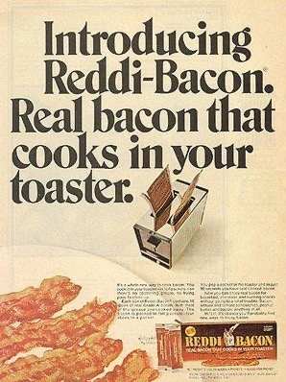
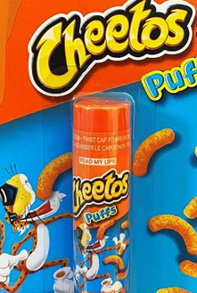
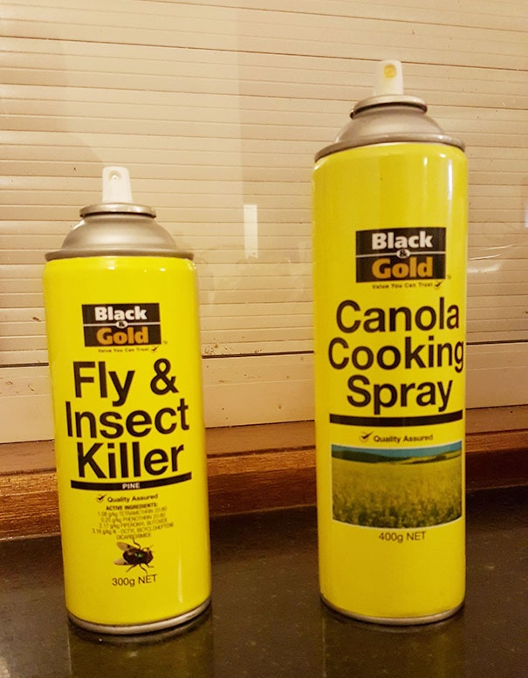
Assumptions about desirability
Because BRAND CONSISTENCY is more important than user safety!
TOASTER BACON - Because it is going to be so much easier to do the washing up!
CHEETOS LIP BALM - Because everybody likes to kiss someone who tastes of Cheetos!

Slide 7
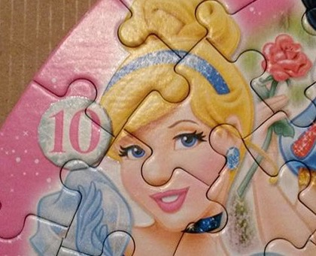
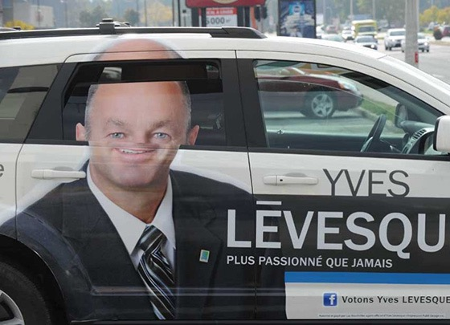
Assumptions about feasibility
Design & manufacturing teams are communicating!
Our execution considers the context of use and delivery.
Images source: https://www.braineet.com/blog/innovation-failures
Source: Jeff Wysaski [online] 24 Examples of Extremely Crappy Design. Available at: https://www.reddit.com/r/CrappyDesign/
Notes:
Our business teams communicate

Slide 8
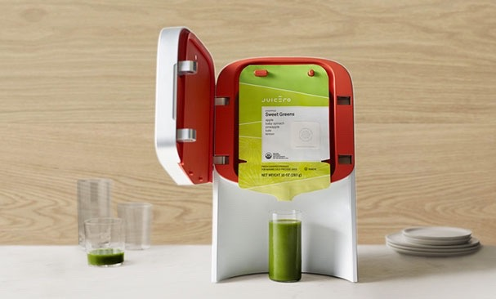
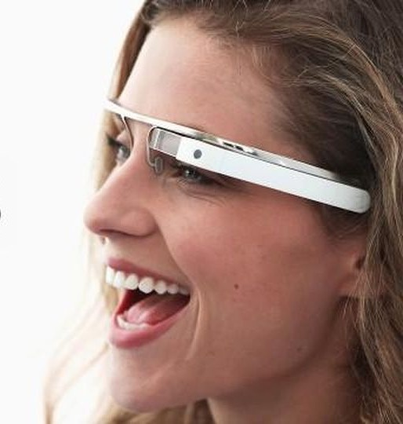
Assumptions about viability
Juicero – users will love the slick design of the ‘gourmet juice system’ and not just but the juice sachets.
Google Glass – consumers are willing to pay £1000 for augmented reality glasses
Images source: https://www.braineet.com/blog/innovation-failures
Notes:
The system had a lot of support from investors, who poured in over $134 million US. Unfortunately, as soon became apparent, customers could simply order the juice packets and squeeze them into a glass, making the whole expensive contraption completely redundant.
was likely its high price point. Asking customers to pay $1,500

Slide 9
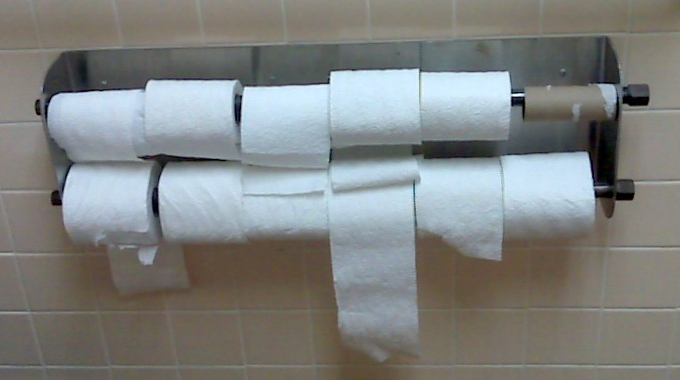
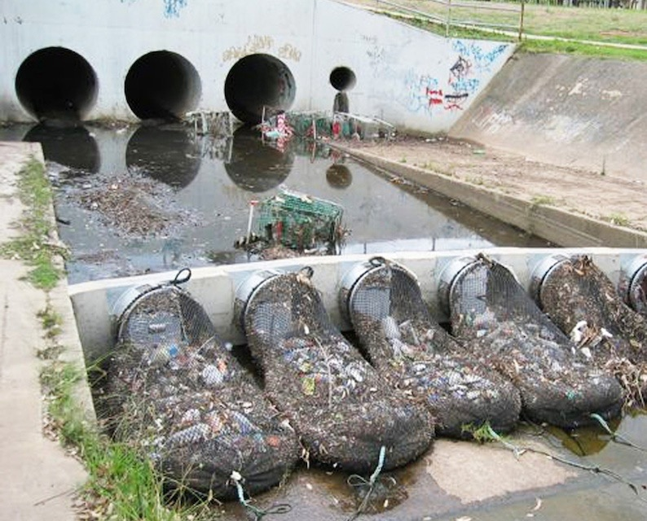
Assumptions about sustainability
It is more efficient to do it like this!
It is recyclable, so people will recycle it.
Image - https://www.infragistics.com/community/blogs/b/ux/posts/remote-usability-testing-preparing-for-the-worst-case-scenario
Image: https://stormwatersystems.com/wp-content/uploads/2012/01/stormx_nets.jpg

Slide 10
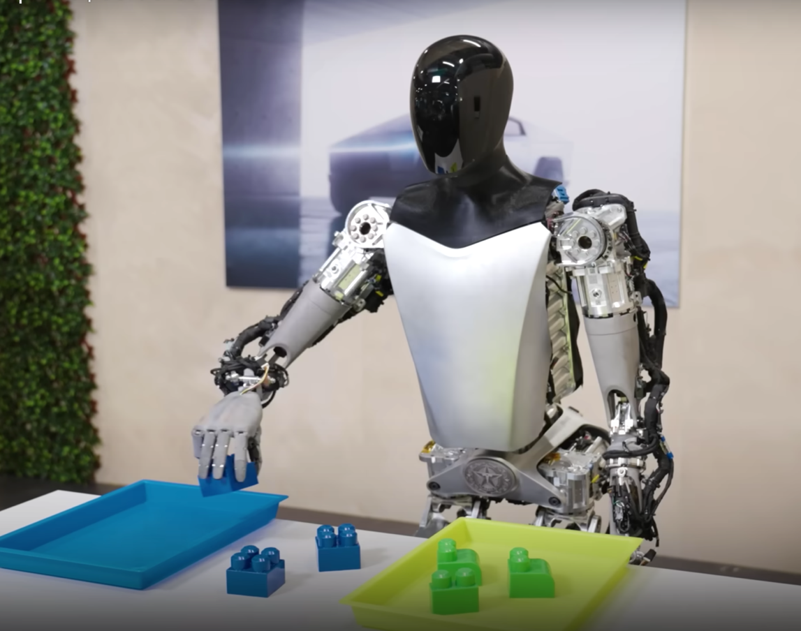
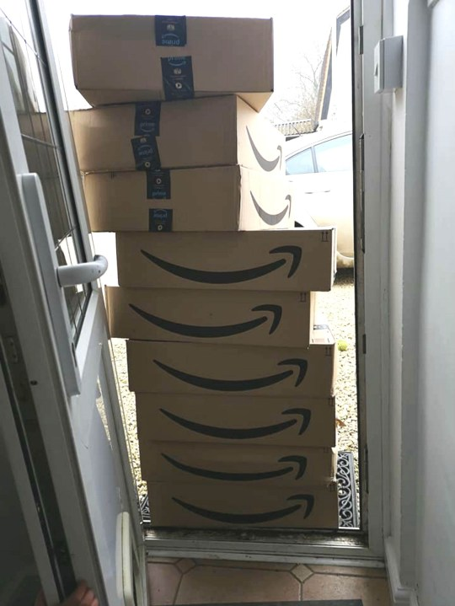
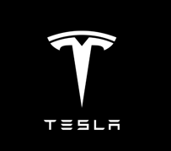
Assumptions about responsibility
Tesla’s Optimus Robot – Artificial Intelligence (AI) and automation will enable human benefit
Amazon - the cost of returned goods is our primary challenge
Image : Inside Evs article [online]. Available at: https://insideevs.com/news/688289/tesla-optimus-robot-sorts-objects-stretches-video/
Notes:
TESLA (Elon Musk) robot
emerging technologies such as AI ..and not travel back in time to meet their maker!!
The fourth is a general problem of anything future-oriented: the incumbents who may stand to lose most from an innovation are likely to be well-organised and powerful, while potential future beneficiaries may be powerless and lack a voice.

Slide 11
Design Innovation Framework
CHALLENGES
Responsible & Sustainable
INTERVENTIONS
Desirable
This becomes our criteria for effective innovation!
Feasible
Viable
Notes:
Framework for purposeful innovation - our criteria for good?
Define your assumptions
Through RESEARCH you gain INSIGHT to test assumptions about how others see this. Do they NEED WANT this?
Through developing CONCEPTS, you reflect on if INTENT is sustainable and responsible. Are there unintended consequences, externalities HIDDEN COSTS to People or Planet??
Through MODELLING you test the viability of your IDEAS. Can this innovation survive in the real world.
Everything has to go through TESTS you ensure where we converge on a FEASIBLE DELIVERY
This is ITERATIVE

Slide 12
HOW MIGHT WE TEST EFFECTIVE INNOVATION?
INTERVENTIONS
What are the unchecked assumptions and biases?
Notes:
To ensure the effects are as intended we –need to research assumptions around - Desirability – feasibility – viability – sustainability & responsibility (HUMAN-CETRED indicators for success!)

Slide 13
RESEARCH
INSIGHT
OBSERVATION
Do people behave like us?
Is this desirable in their world?
Observational insights are like:
The first time to visit someone's house and realise ‘that’s why they are do that!
How will they use it?
Photo by Mick Haupt on Unsplash
Notes:
Seek insight through research ETHNOGRAPHIC
People behave like us
This is desirable in their world?
They will use it like this?

Slide 14
RESEARCH
INSIGHT
CONVERSATION
Do people think & feel like us?
They are willing to pay that?
Conversational insights are like: The first time you talk to someone’s parents and go ‘that explains everything’
Photo by Daniel Cheung on Unsplash
Notes:
Or meet their parents --- Oh that explains it!
Insights at their best are those
epiphany, an "aha" moment or a "eureka' feeling
That explains everything!
ALSO they need to be crafted , from the hidden
Assumptions around Desirability Feasibility, Viability and Integrity have been identified and checked (where risk is high)

Slide 15
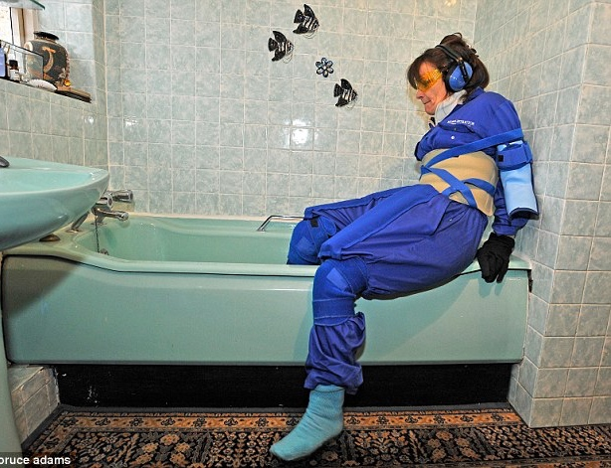
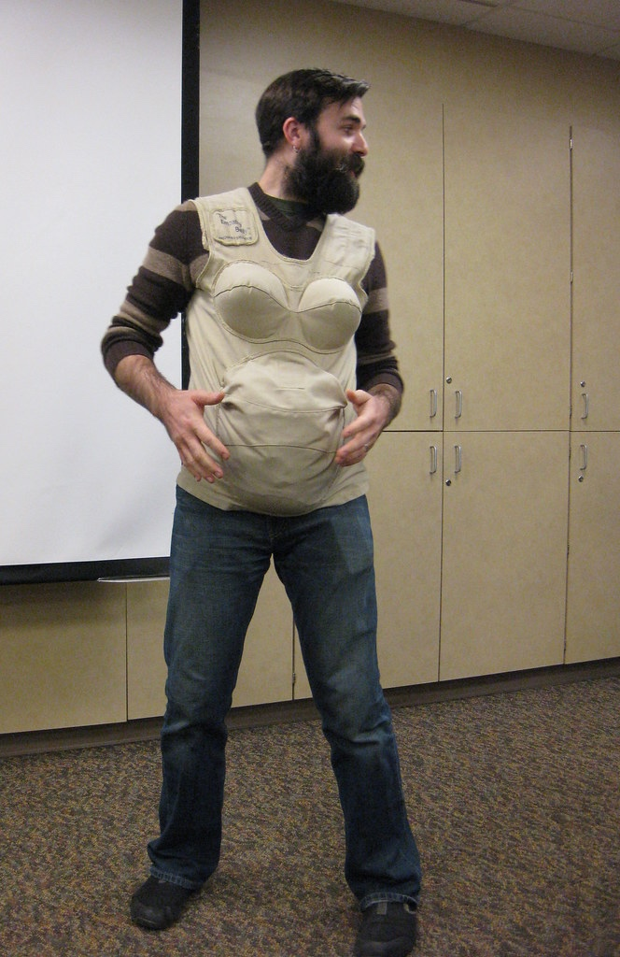
RESEARCH
INSIGHT
IMMERSION
Do people see and experience the world like us?
Does this meet their needs?
Immersive insights are like – when you empathise through simulating their experience.
Notes:
Can we SIMULATE And therefore experience

Slide 16
What might your test (experiment) be?
HYPOTHESIS
An educated guess about what you expect your innovation to offer
(that is measurable)
ASSUMPTION
Notes:
Can be anything which checks an assumption, a norm, an untested belief…
a cause and effect).
MUST be measurable.

Slide 17
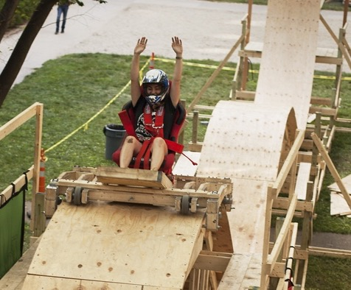
Our approach is accessible
TEST: SIMULATION
Develop evidence for context driven behaviour, by putting humans in the loop
TEST: CO-DESIGN
Iterate your design based on diverse
(inc. extreme) user feedback
Image sources: https://mitadmissions.org/blogs/entry/roller-coasters-and-dance-parties/ https://en.wikipedia.org/wiki/Flight_simulator#/media/File:980310-N-7355H-003_Simulator_Training.jpg
Notes:
Test user experience: through a low tech simulation

Slide 18
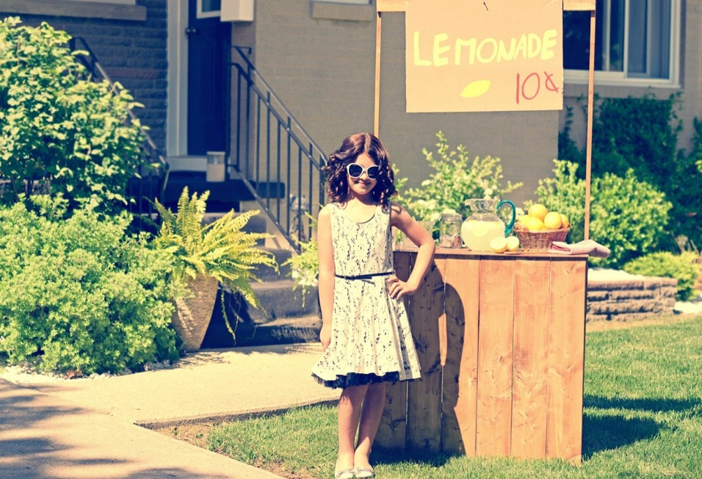
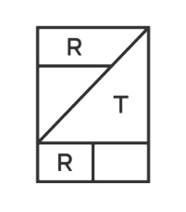
Customers see the value?
TEST = CONCIERGE
Pilot your service as a gateway experiment to understand customer perception, such trust online!
TEST = MVP
Create a Minimum Viable Product (MVP) to check value perceptions.
Images: https://www.renttherunway.com/
https://medium.com/boosterstage/the-purpose-of-business-is-to-create-and-keep-a-customer-e466d9d1b487
Notes:
TEST in person service with college students ‘try before you rent’ (As a better experience than renting ‘cold’ online If this test failed then there was little hope for online model!

Slide 19
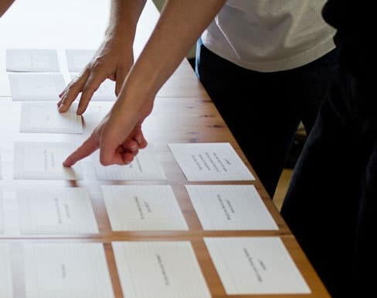
We respond to customer needs
TEST : IMPOSTER JUDO
Mock-up a ‘live’ user choice experiment
to test the attractiveness of your product, service.
TEST: CARD SORTING
Ask users to prioritise features which they value, not those we think they need.
Board of Innovation. 2020. Validation Guide. Available at: https://www.boardofinnovation.com/guides/validation-guide/
Notes:
Dutch startup 3D Hubs initially served their customers by finding owners of 3D printers in Amsterdam willing to take paid printing jobs

Slide 20
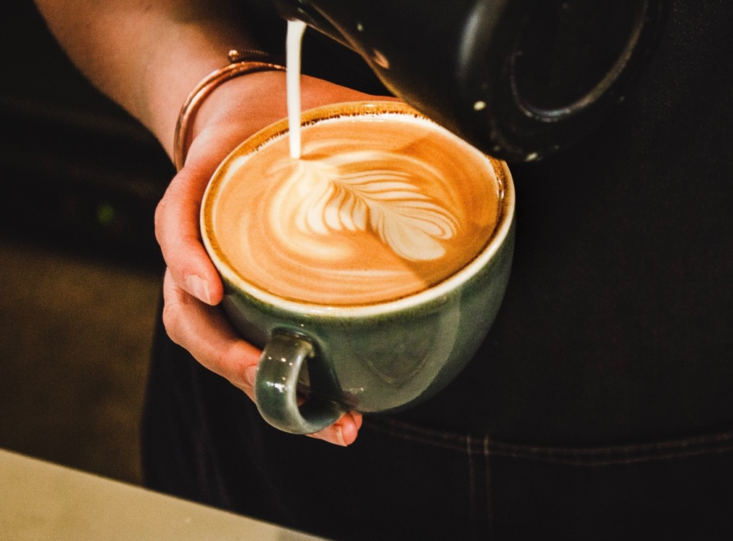
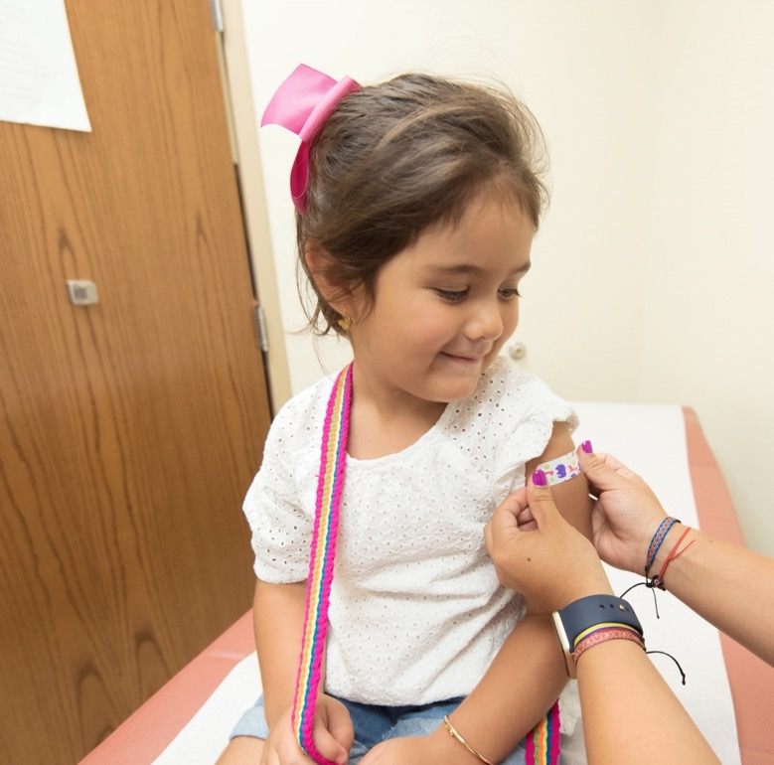
This is a new problem
TEST: ANALOGY
Ask if analogous experiences might show us how similar problems have already been ‘solved’ outside our industry.
Photo by Louis Hansel @shotsoflouis on Unsplash
Photo by CDC on Unsplash
Notes:
Where customers emotions are served

Slide 21
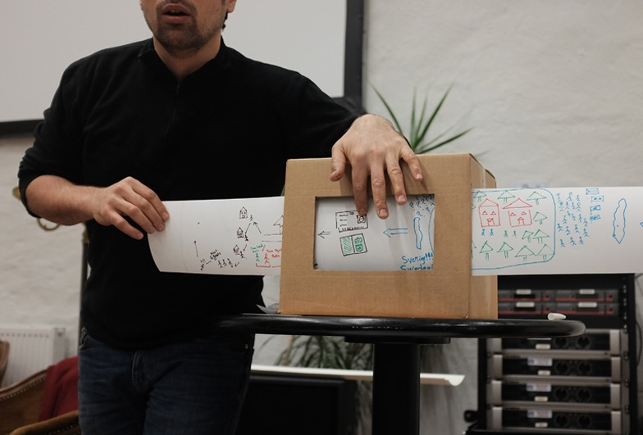
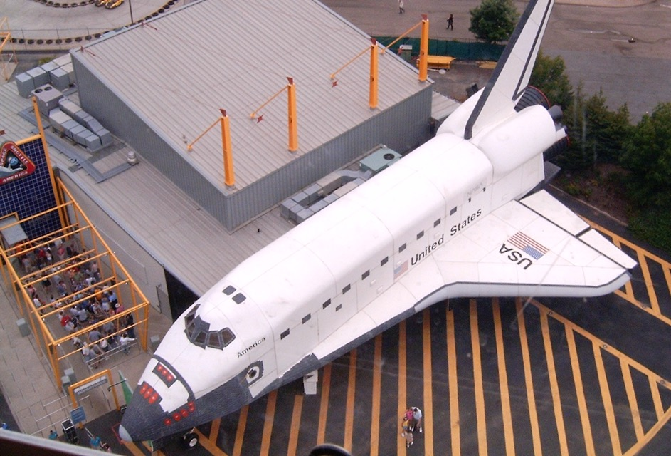
Users don’t need to experience this
TEST: PROTOTYPING
Check ideas through models; low fidelity prototypes such as sketches, story boards, role-play, wireframes etc. Prototypes should be the cheapest and easiest way to test a given assumption, however risk of failure might mean we need high resolution models!
Image: https://en.wikipedia.org/wiki/Mockup
Notes:
TESTING ideas through models low fidelity prototypes could consist of simple sketches, story boards, role-play with artefacts,, websites, renders, product models
Prototypes should be the cheapest and easiest way to test a given assumption.
Risk of failure might mean we need high resolution models

Slide 22
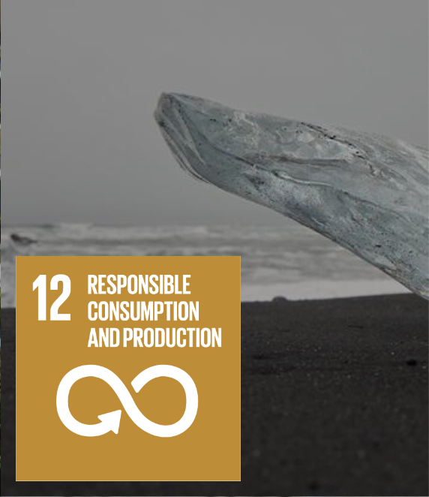
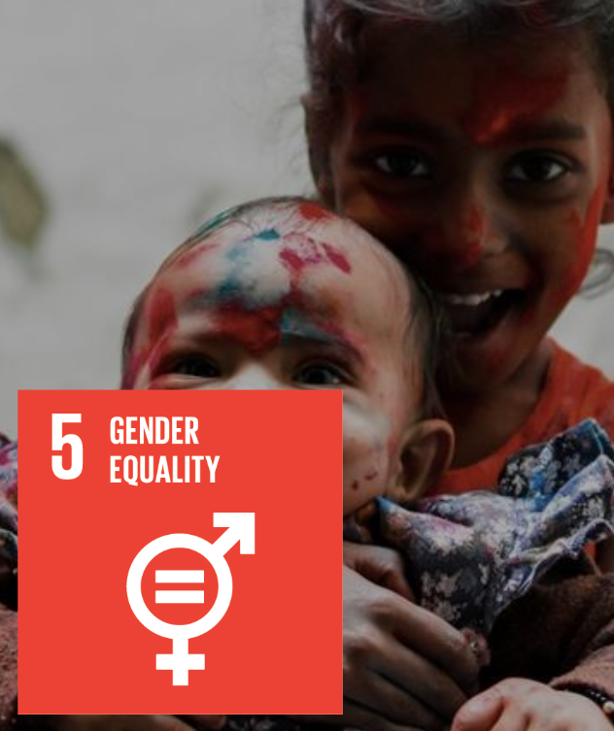
Our impact
is Responsible & Sustainable
Image: UN Sustainable Development Goals. Available at https://sdgs.un.org/goals
TEST: CIRCULARITY
Check responsible consumption through test to explore lifecycle impact, including environmental, social and economic factors.
TEST: GENDER BIAS
Check you empower and act on equality through tests on equity in innovation ecosystems such as in the manufacture of products.
Notes:
Apart from these perhaps cliched examples there is a conflict with many every day goods. If we consider the sdg (UN)
Total cost of ownership
Externalities

Slide 23
Philip Harfield
Course Leader, MA Design Innovation
Senior Lecturer in Design Thinking and Innovation | Uwch Ddarlithydd mewn Arloesi a Meddylfryd Dylunio
Website | Gwefan: www.southwales.ac.uk/courses/ma-design-innovation
E-Mail | E-Bost: philip.harfield@southwales.ac.uk
Thanks to - Board of Innovation. 2020. Validation Guide. Available at: https://www.boardofinnovation.com/guides/validation-guide/

