Slide 1


GeogShots
CC BY-NC-ND 4.0

Slide 2
GeogShot.
A 10-minute solution focused “shot” of geography to help guide your learners to more successful responses in the exam.
They are designed so you can fit these resources into your existing lesson plan or adapt as you want.
Each builds on identified actions from examiners reports.
They could be part of your intervention strategy to support and challenge your learners in class.
They are designed to allow you to insert a relevant question to work on from any aspect within the specification.

Slide 3

It is important your learners can define with understanding geographical concepts.
How can this be included in your lesson?
CC BY-SA 3.0
Notes:
Ideas on how to use these slides in your lesson is included in the notes these are just suggestions and the idea is this is flexible for you to edit and use as you would want to.

Slide 4

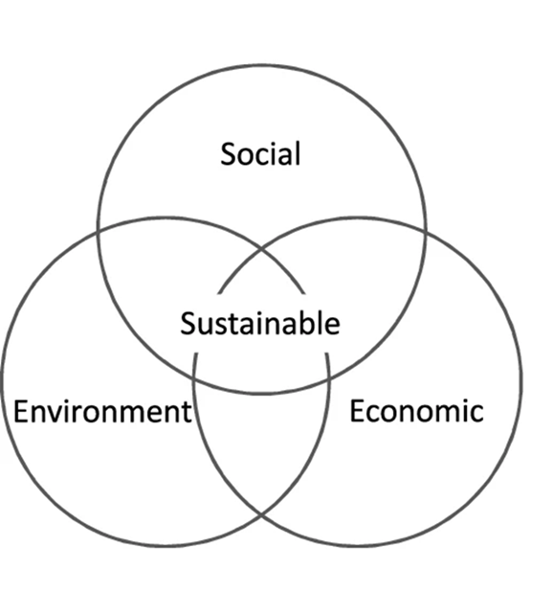
Promoting fair access to resources and opportunities, improving quality of life, and fostering inclusive communities.
What does this image tell you about sustainability?
Ensuring economic practices are financially sustainable and can continue over the long term.
Preserving natural habitats, reducing pollution, and promoting biodiversity.
Include all 3 pillars in your written definition of sustainability.
Notes:
Discuss the meaning of the three areas/pillars of sustainability.

Slide 5
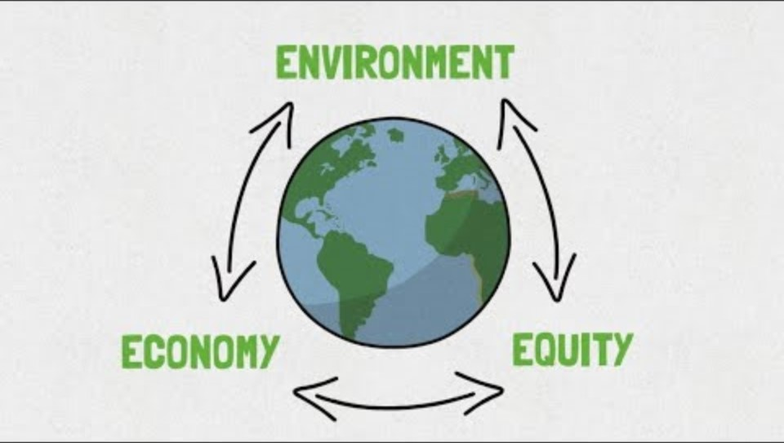
Notes:
A useful video that identifies well the main characteristics of sustainability: ensure learners recognizes equity is the same as social which geography refers to. What is Sustainability (youtube.com)

Slide 6
Frayer Model
Definition:
Characteristics:
Term:
Examples:
Non examples
Use this framework to develop a meaningful definition of sustainability from the information in the video.
Notes:
You can give the different frames to learners to fill in while they watch the video to build up the frayer model for sustainability. Share with the class

Slide 7
Frayer Model
Definition: Sustainability refers to the ability to maintain or support processes, systems, or practices over the long term without depleting resources or causing harm to the environment, society, or economy. It involves meeting the needs of the present without compromising the ability of future generations to meet their own needs.
Characteristics:
Resource Efficiency: Using resources in a way that maximizes their value and minimizes waste.
Environmental Protection: Preserving natural habitats, reducing pollution, and promoting biodiversity.
Economic Viability: Ensuring economic practices are financially sustainable and can continue over the long term.
Social Equity: Promoting fair access to resources and opportunities, improving quality of life, and fostering inclusive communities.
Term:
Sustainability.
Examples:
Renewable Energy: Using solar, wind, or hydro power instead of fossil fuels.
Sustainable Agriculture: Practicing crop rotation, organic farming, and water conservation.
Green Building: Designing buildings to be energy-efficient and use sustainable materials.
Circular Economy: Implementing systems where products are reused, refurbished, or recycled instead of discarded.
Non examples:
Deforestation: Clearing forests for short-term gain without replanting.
Overfishing: Depleting fish populations faster than they can reproduce.
Pollution: Releasing harmful substances into air, water, and soil.
Single-Use Plastics: Producing and using plastics that are discarded after one use, contributing to waste
Notes:
Here is a possible model answer learners can judge and if needed add to their model of sustainability. This can also be adapted as a sorting activity.

