Slide 1


GeogShots
CC BY-NC-ND 4.0

Slide 2
GeogShot.
A 10-minute solution focused “shot” of geography to help guide your learners to more successful responses in the exam.
They are designed so you can fit these resources into your existing lesson plan or adapt as you want.
Each builds on identified actions from examiners reports.
They could be part of your intervention strategy to support and challenge your learners in class.
They are designed to allow you to insert a relevant question to work on from any aspect within the specification.

Slide 3

Where candidates are asked to evaluate/say to what extent they agree and then to decide and justify. In these questions there must be some element of discussion to access the higher bands. For example, if a candidate is asked to choose a factor, candidates need to consider all factors and then reason why they chose the one they have.
https://creativecommons.org/licenses/by-sa/3.0/
How can this be included in your lesson?

Slide 4
How to evaluate.
How to measure? Explain strengths/weaknesses, positives/negatives balance this information in your response.
Substantiated means you must include and discuss evidence to support the point you are making, data, photographs, text and named examples. If you are given resource material use this and your own studies.
To evaluate you must measure the value/success of a strategy/issue/development and ultimately come to a substantiated judgement/conclusion.
Recognising that there are counter-arguments is essential in your response for evaluation. You need to be clear what your judgement is whilst recognising there is not an unequivocal/absolute response.
Notes:
Break down a definition of evaluation this can then be used as a scaffold to help learners create a written answer in the exam.

Slide 5
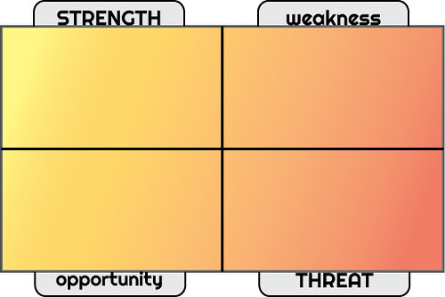
What is SWOT analysis?
SWOT analysis is a balanced technique that looks at both internal and external factors that could positively and negatively impact whatever it is that's being analysed.
Strengths: a resource or capability that will help to achieve sustainability.
Weaknesses: a barrier that will hinder the chance of achieving sustainability
Opportunities: something, usually external, that could provide you with an opportunity to become more sustainable.
Threats: potential obstacles that your ability to be sustainable could be affected by.
Notes:
CC BY-SA 2.0 This is an excellent way to get learners to begin to evaluate a named example/case study. It needs to be modelled in class.

Slide 6
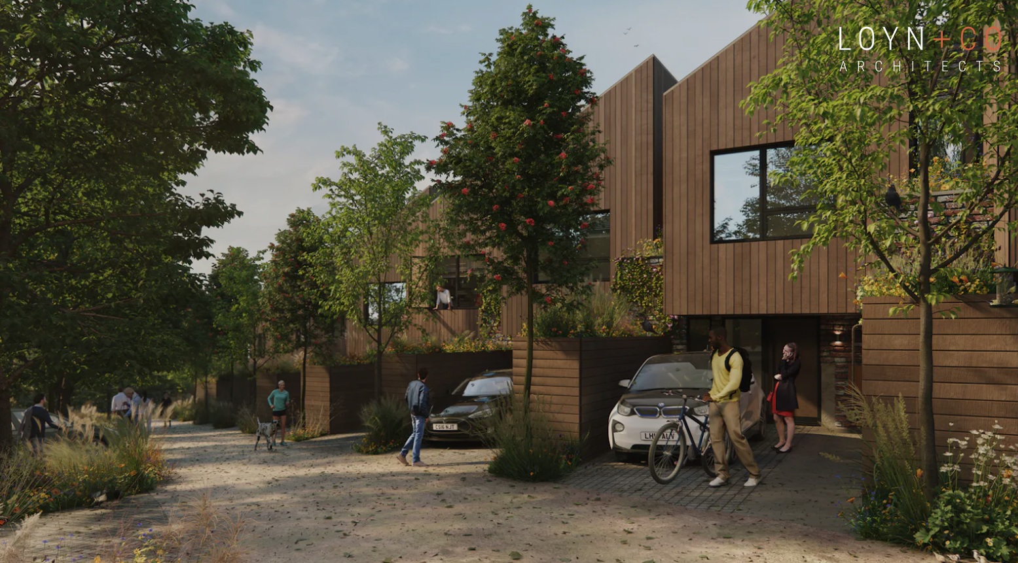
Case study: Parc Hadau in Pontardawe, South Wales.
Billed as one of the world’s first true ‘net zero carbon in operation’ neighbourhoods, the 35 homes are due for completion in 2021. The £8+million development from Cardiff-based Sero Homes (https://www.serohomes.com) uses very low energy building design to reduce the energy demands of the homes and their residents. This will be combined with a mix of renewable energy technologies, including thermal and electrical storage, on-site
photovoltaic (solar) panels and ground source heat pumps, electric vehicle rapid charging points, together with ventilation systems and smart energy management systems.
Parc Hadau is expected to be the first scheme that will meet the full extent of the UK Green Building Council’s definition of net zero carbon. It will track real-time ‘in-use’ carbon emissions.
The zero carbon neighbourhood planning application was submitted to Neath Port Talbot Borough Council October 2019 and planning permission was granted December 2019. Completion date is summer 2021. In 2019 the scheme secured a £2million grant from Welsh Government Innovation Housing Programme Fund towards the zero carbon and ecological features
ACTIVITY:
Use this case study to create a SWOT analysis to answer Evaluate the success of Parc Hadau as a sustainable housing development.
Notes:
Parc Hadau | Loyn + Co Architects The estate of eco-homes with underground heat pumps and solar panels set to be built in Pontardawe - Wales Online
It may be that before this is used in class a reading homework is set to read the case study/named example of Parc Hadau

Slide 7
Evaluate the success of Parc Hadau as a sustainable housing development.
What facts/knowledge do I need to include?
Conclusion
Command words what do they mean?
Evaluate means I will look at the strength’s, weaknesses, threats and opportunities the scheme has.
What does the question want me to do?
The question is asking me to show understanding of what sustainable is.
I will need to make a decision/judgement on how Parc Hadau is social, economic and environmentally sustainable.
I will need to explain the problems and the strengths and use facts to illustrate the points I make.
How to structure the answer.
Notes:
This is a framework that learners can use to help develop a structure to the answer, partially completed so you can model the possible answer to help successful responses for this command word.

