Slide 1
Innovation 2023
A Celebration of Welsh Design & Technology at
Advanced Level and GCSE
Arloesedd 2023
Dathlu Dylunio a Thechnoleg Safon Uwch a TGAU Cymru

Slide 2
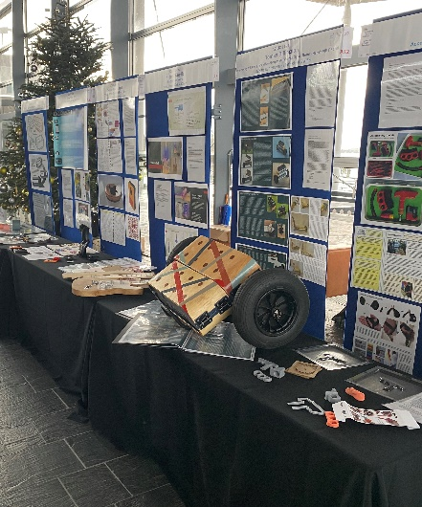
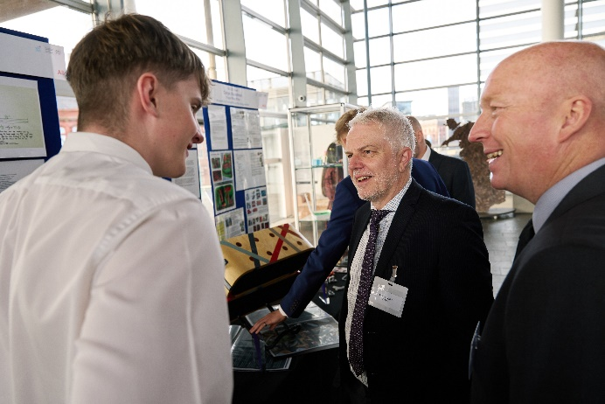
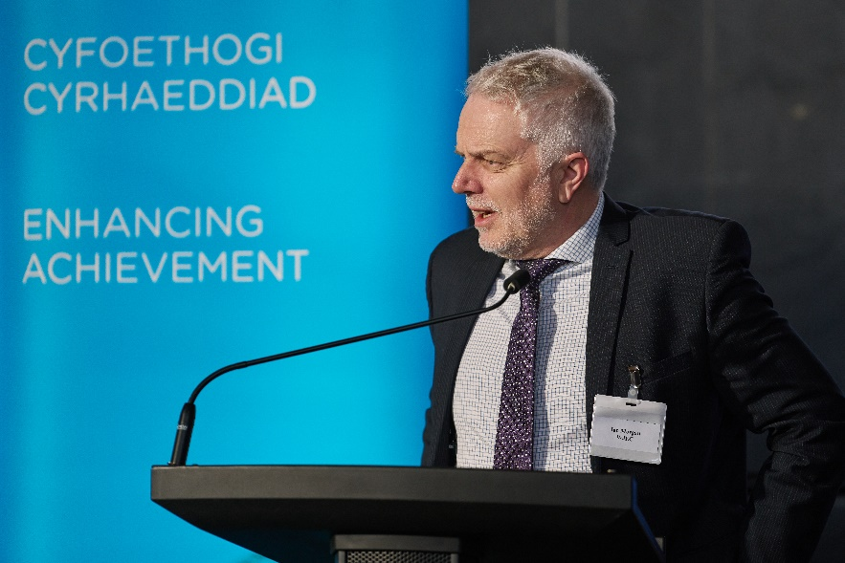
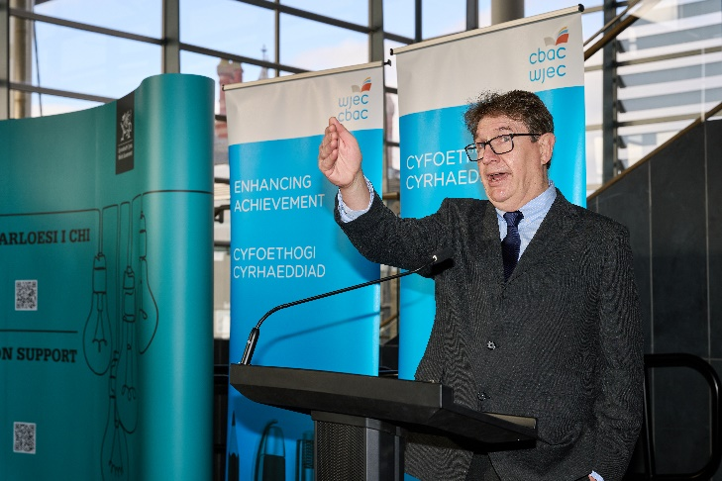
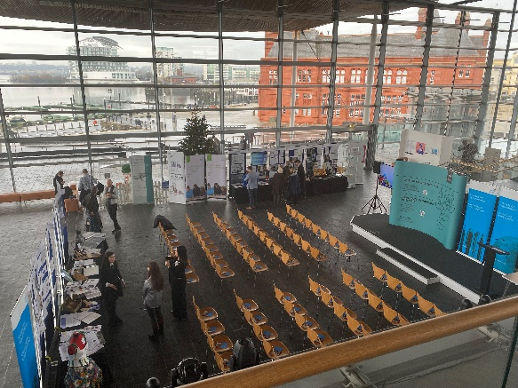
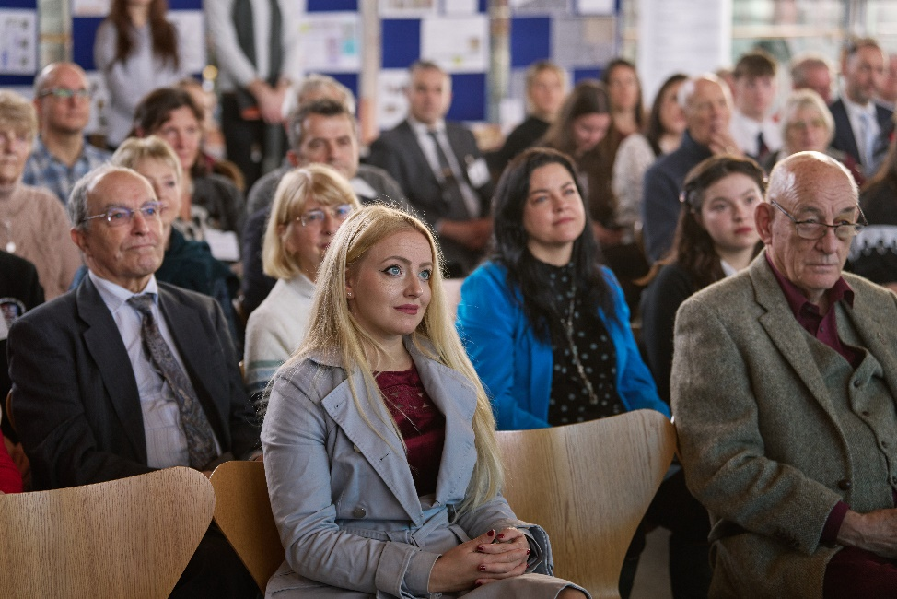
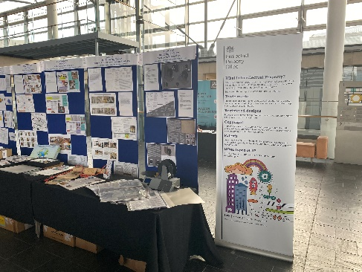
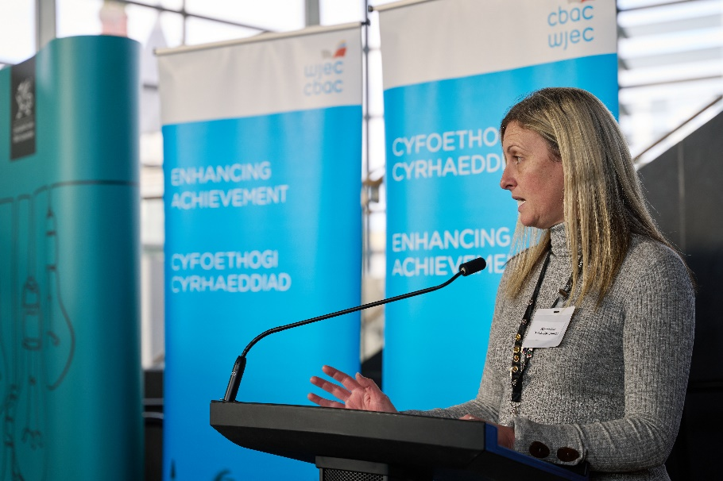
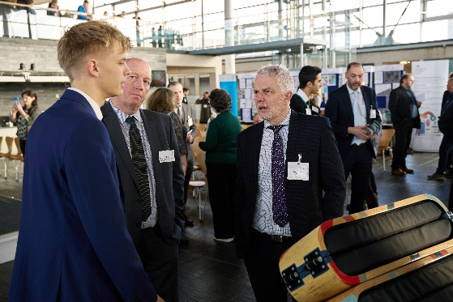

Slide 3
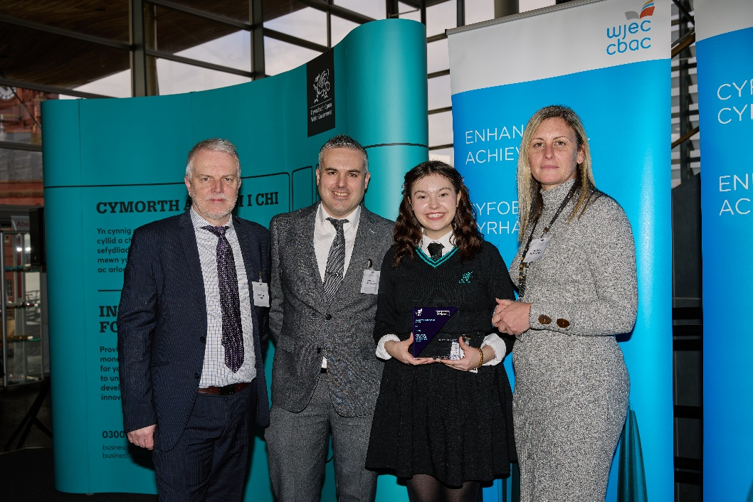
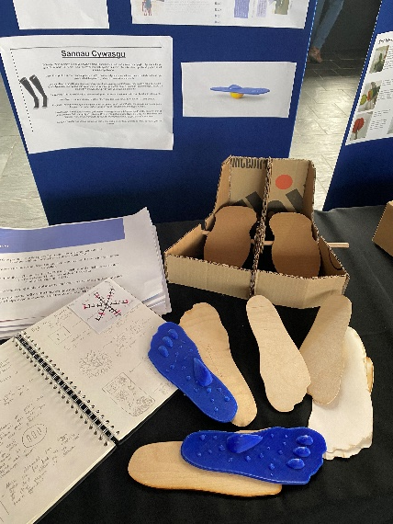
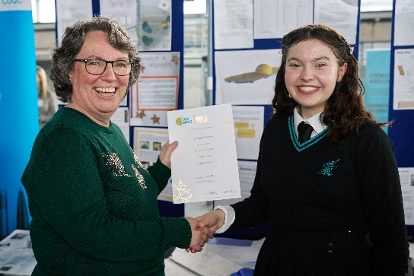
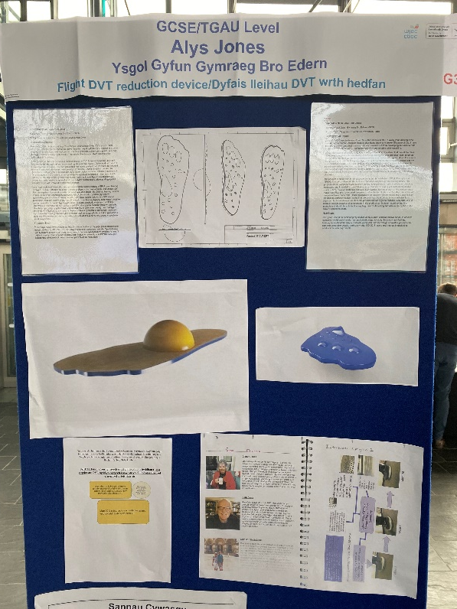
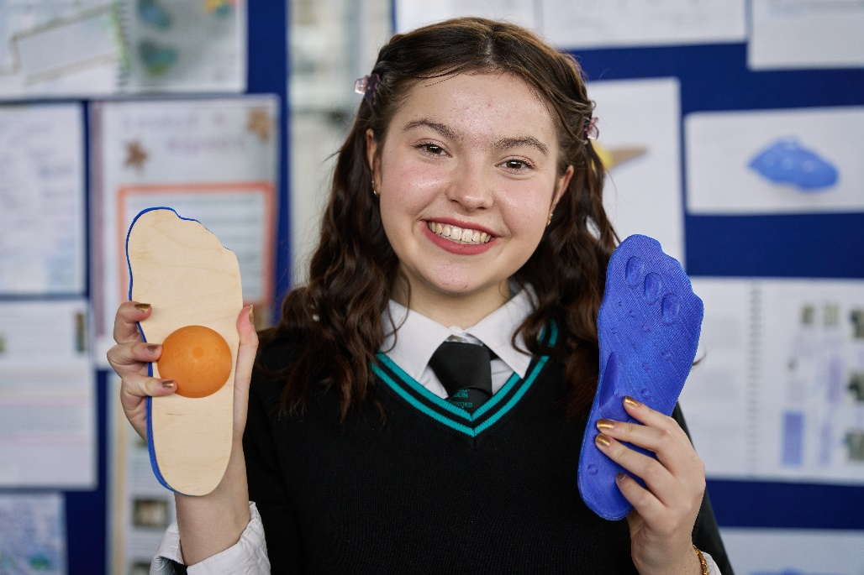
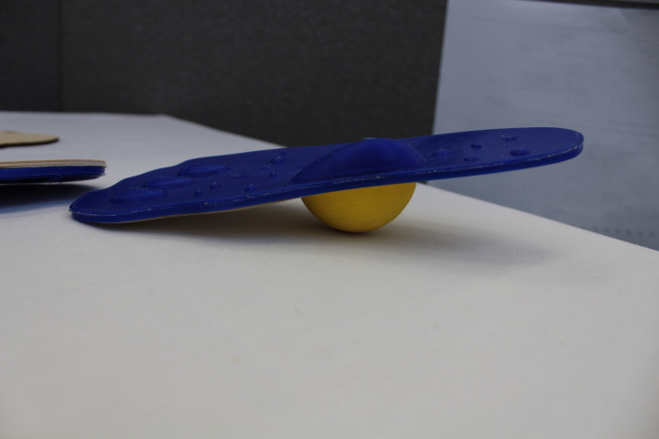
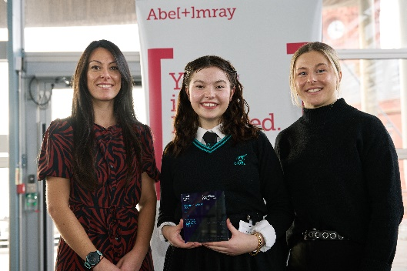
GCSE 1st Prize
TGAU Gwobr 1af
Alys Jones
Ysgol Gyfun Gymraeg Bro Edern
Flight DVT reduction device
Dyfais lleihau DVT wrth hedfan

Slide 4
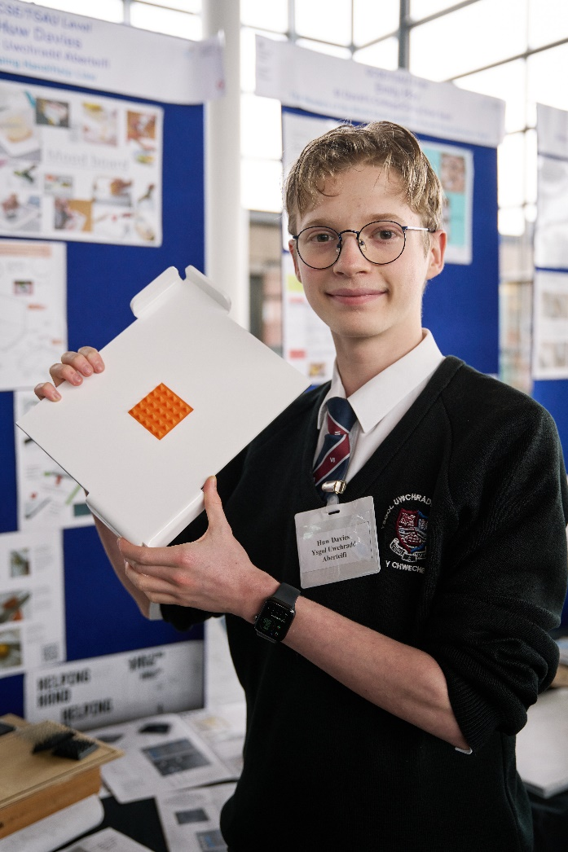
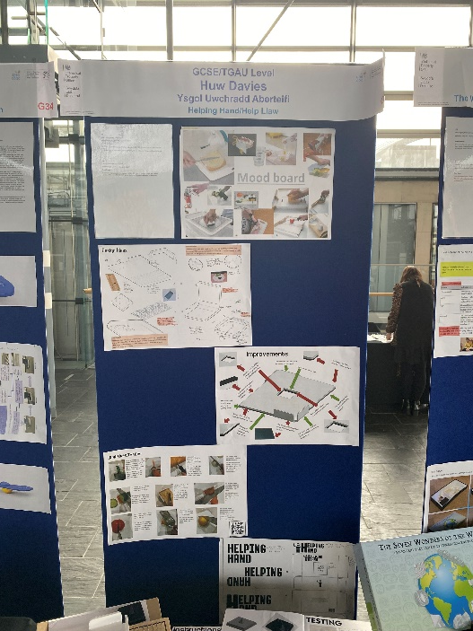
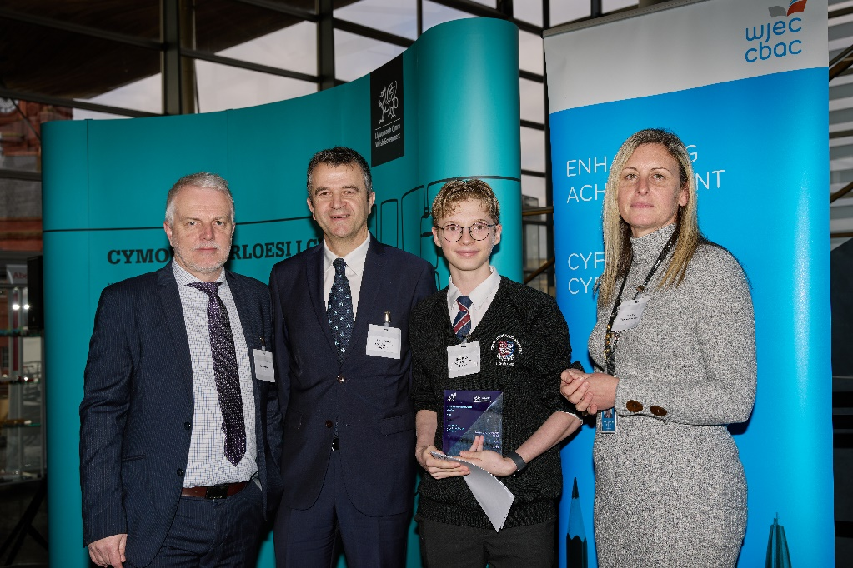
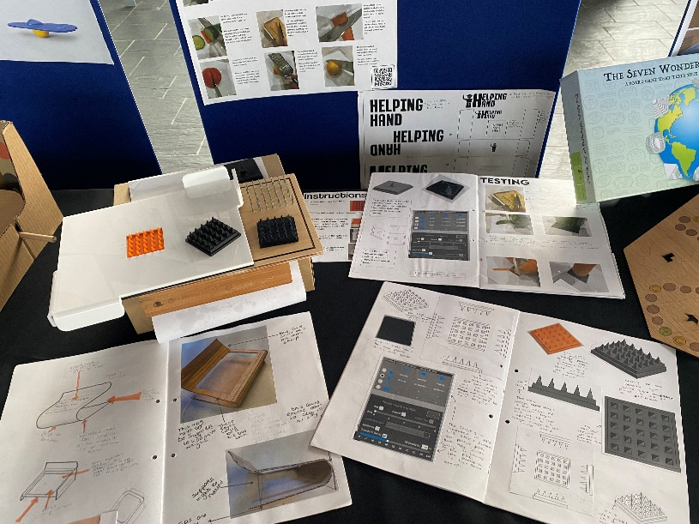
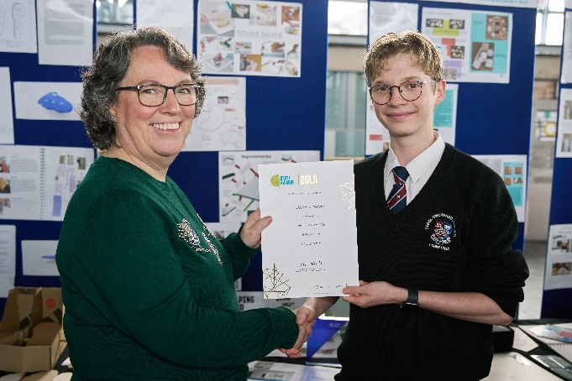
GCSE 2nd Prize
TGAU 2il Wobr
Huw Davies
Ysgol Uwchradd Aberteifi
Helping Hand
Help Llaw

Slide 5
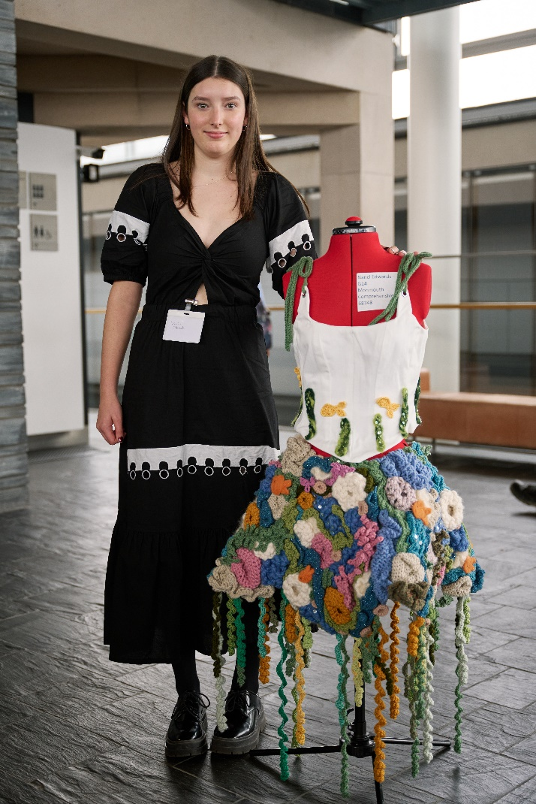
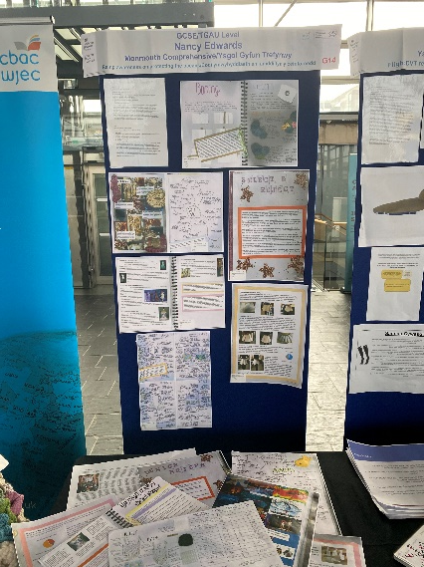
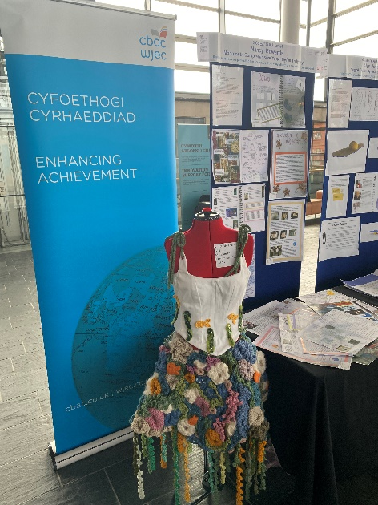
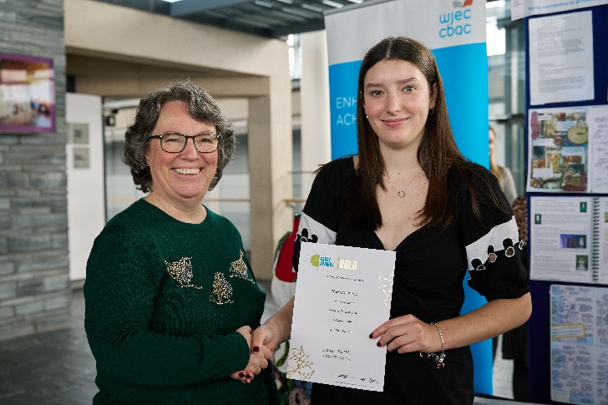
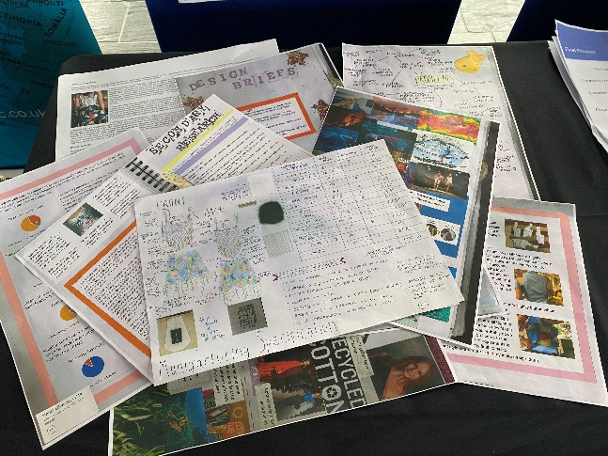
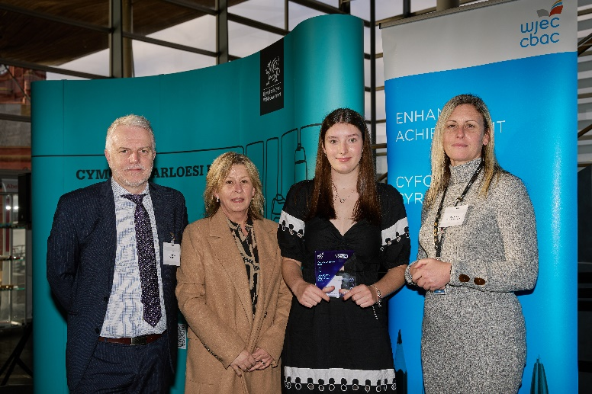
GCSE 3rd Prize
TGAU 3ydd Wobr
Nanci Edwards
Monmouth Comprehensive
Raising awareness on protecting the oceans
Codi ymwybyddiaeth am amddiffyn y cefnforoedd

Slide 6
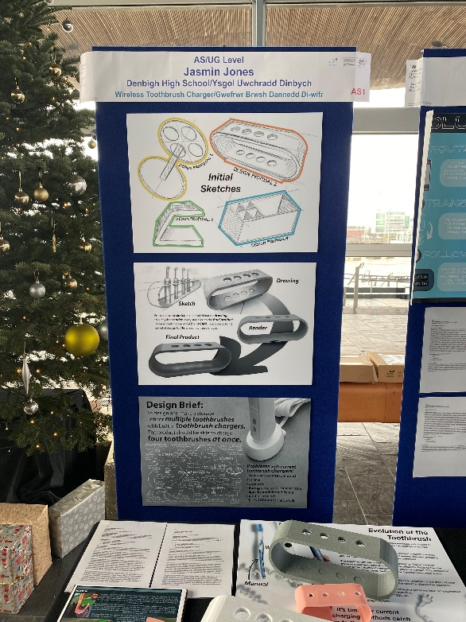
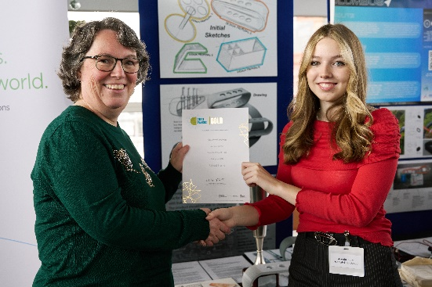
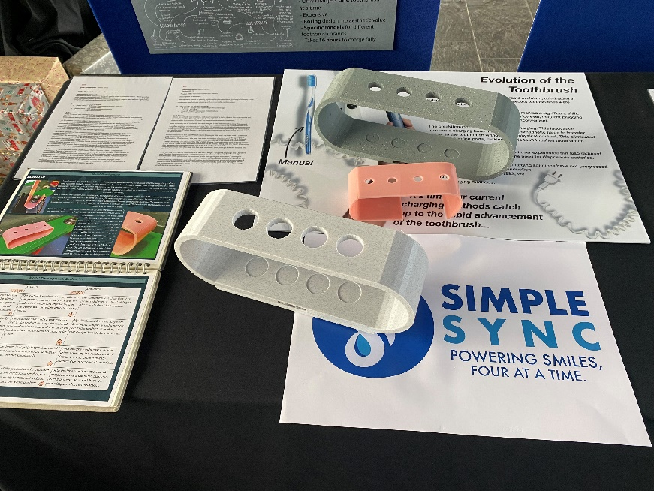
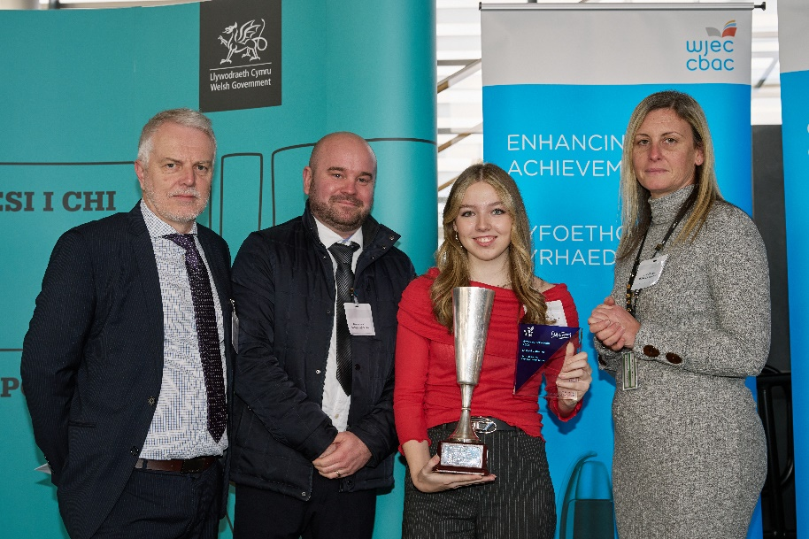
AS 1st Prize
Overall Winner
UG Gwobr 1af
Prif Enillydd
Jasmin Jones
Denbigh High School
Wireless Toothbrush Charger
Gwefrwr Brwsh Dannedd Di-wifr

Slide 7
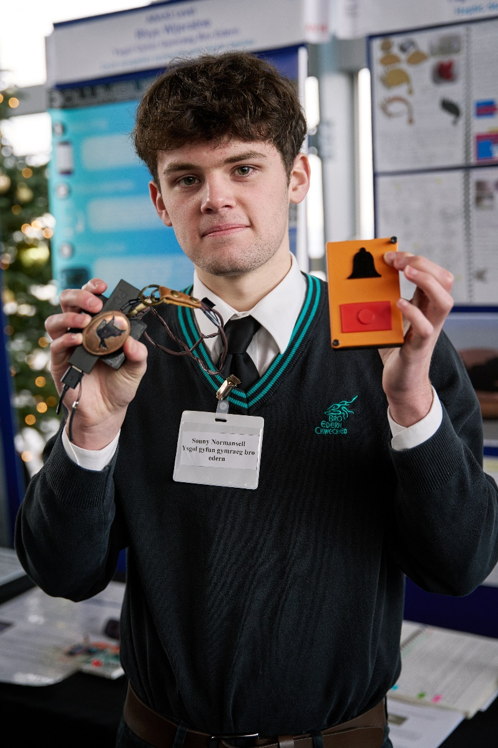
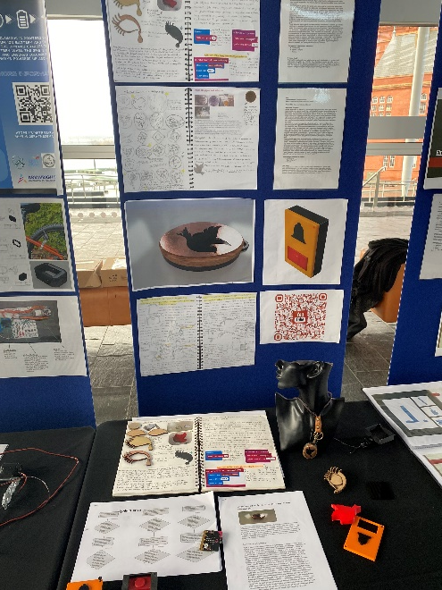
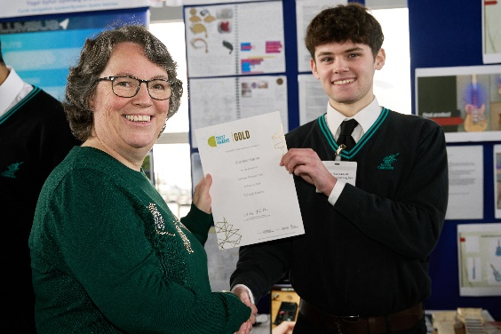
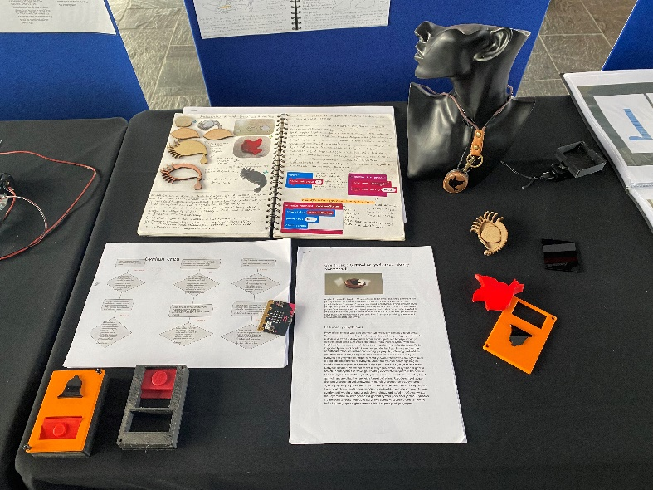
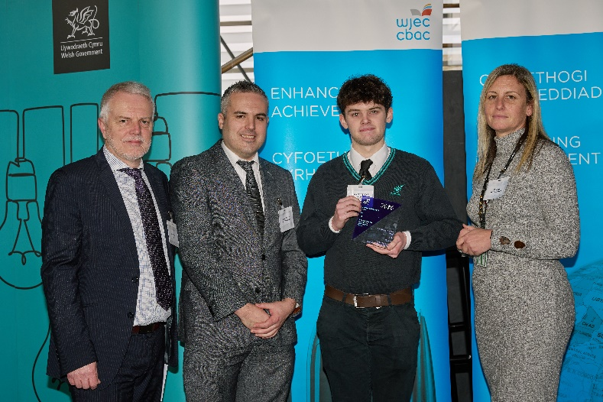
AS 2nd Prize
UG 2il Wobr
Sonny Normansel
Ysgol Gyfun Gymraeg Bro Edern
Haptic doorbell
Cloch drws haptig

Slide 8
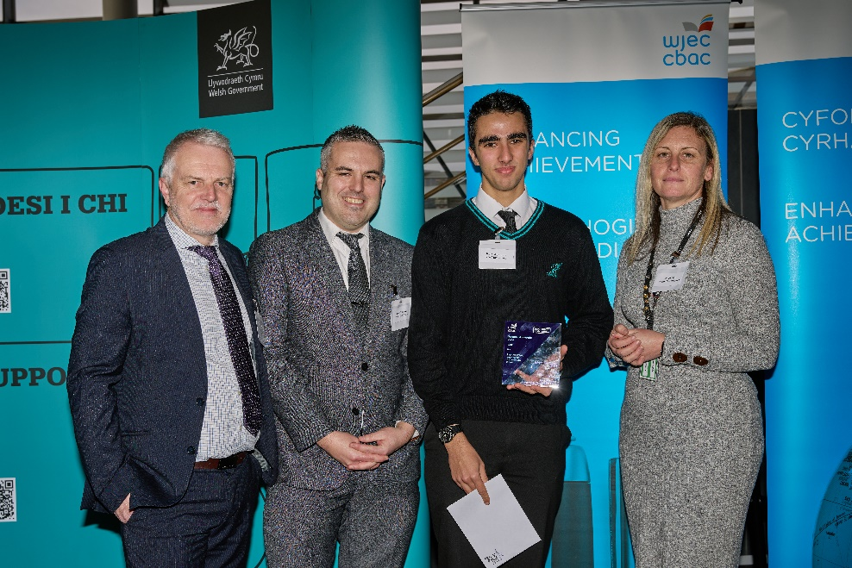
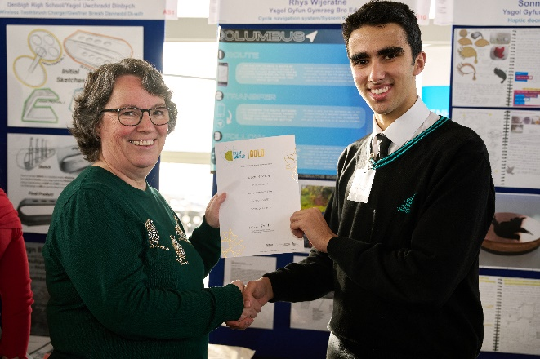
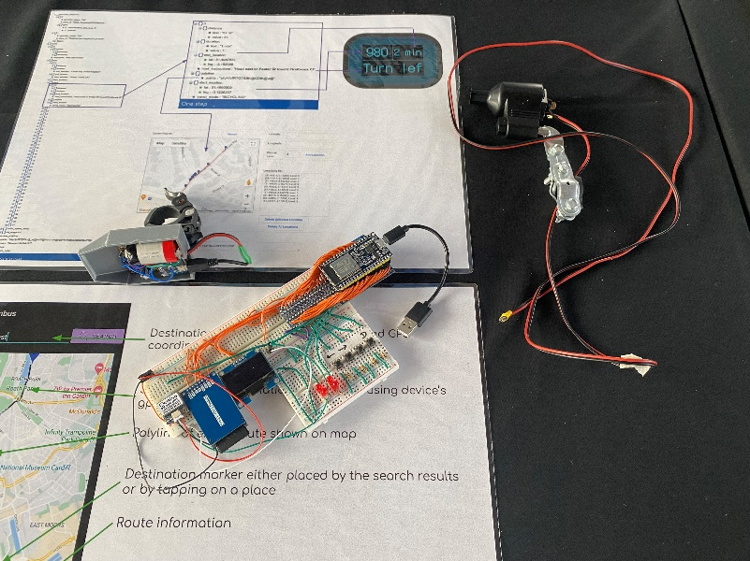
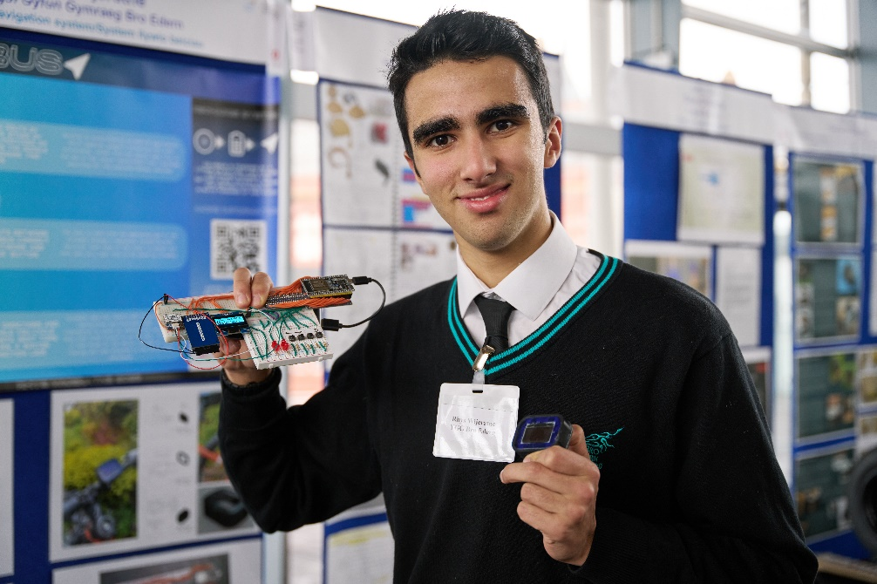
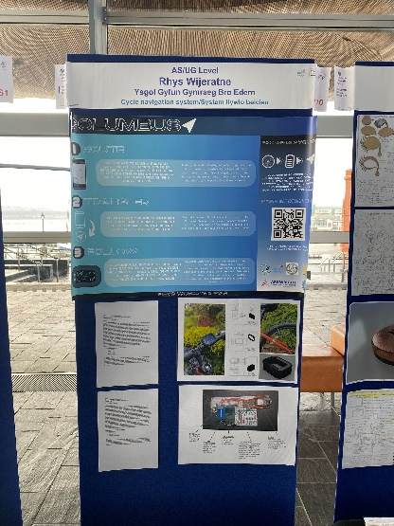
AS 3rd Prize
UG 3ydd Wobr
Rhys Wijeratne
Ysgol Gyfun Gymraeg Bro Edern
Cycle navigation system
System llywio beiciau

Slide 9
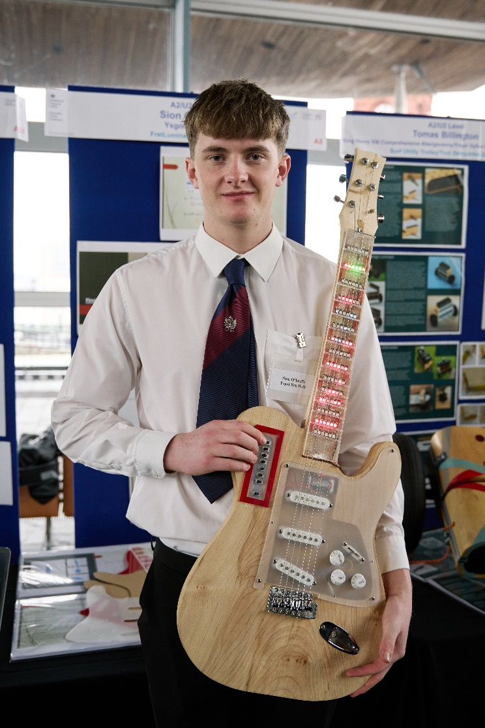
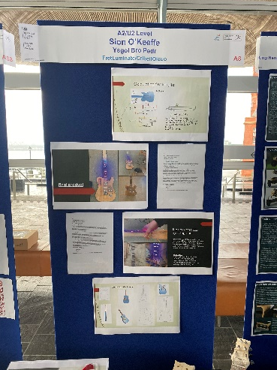
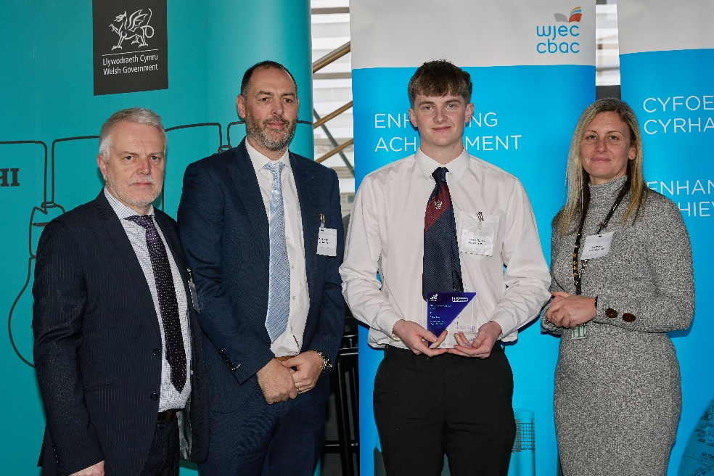
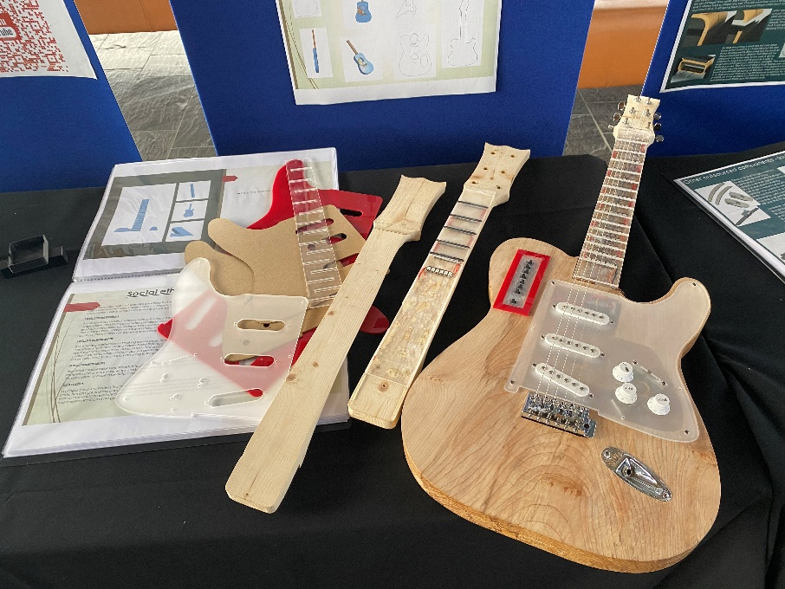
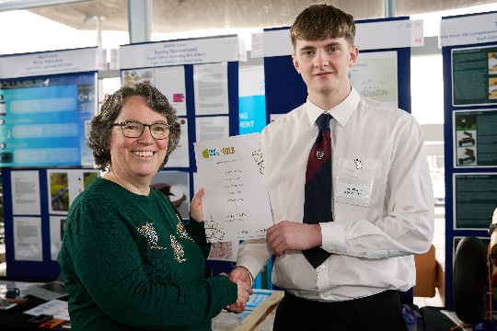
A Level 1st Prize
Safon Uwch Gwobr 1af
Sion O’Keeffe
Ysgol Bro Pedr
FretLuminate
CribellOleuo

Slide 10
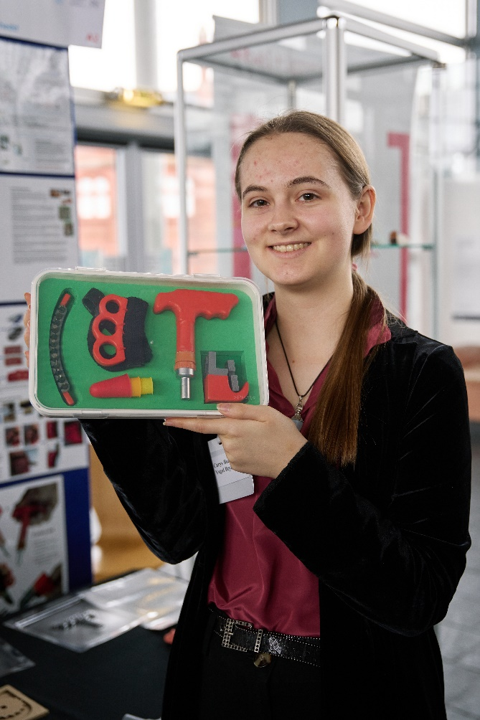
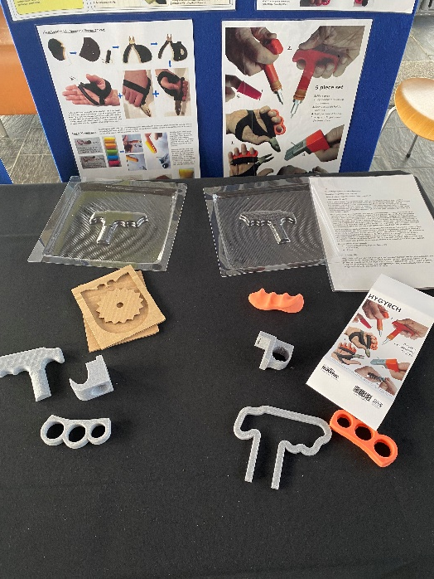
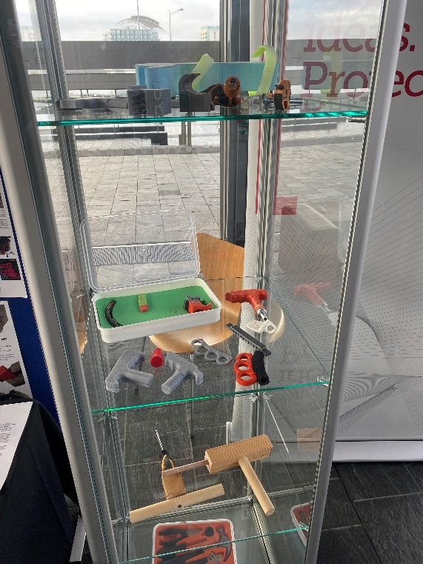
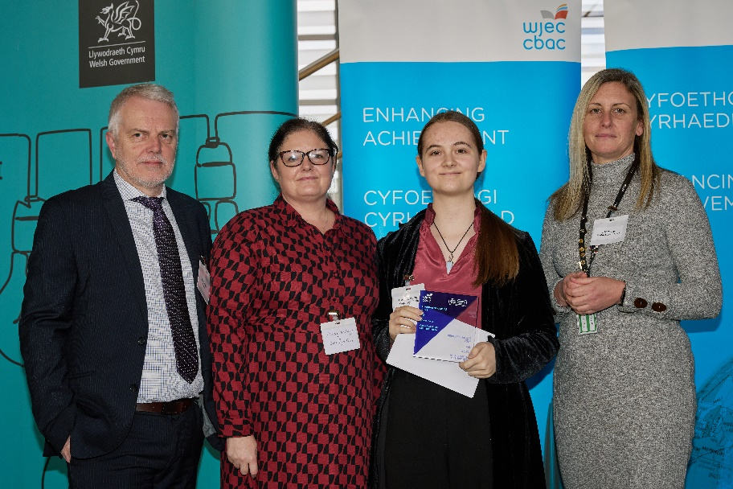
A Level 2nd Prize
Safon Uwch 2il Wobr
Carys Boardman
Ysgol Bryn Elian
Accesibility Toolkit
Pecyn Offer Hygyrchedd

Slide 11
A Level 3rd Prize
Safon Uwch 3ydd Wobr
Tomas Billington
King Henry VIII Comprehensive Abergavenny
Surf Utility Trolley
Troli Defnyddiol Syrffio

Slide 12
Creativity Prize Winner
Enillydd Gwobr Greadigrwydd
Emily Hay
St David's College
The Wonders of the World board game
Gêm fwrdd Rhyfeddodau'r Byd

Slide 13
IP Prize Winner
Enillydd Wobr IP
Finn Channing Davies
Brecon High School
Climbing Hang board
Bwrdd Hongian Dringo

Slide 14
Science Prize Winner
Enillydd Gwobr Gwyddoniaeth
Jacob Taylor Chow
Ysgol Uwchradd Glan Clwyd
Plastic bottle re-former
Ailffurfydd Poteli Plastig

